Slide 1
11-1
This work is licensed under a Creative Commons Attribution-Sharealike 4.0 International License.
Please add this statement to all the videos you create.
English Bible quotes are from the World English Bible US, which is in the public domain.
Notes:
checked

Slide 2
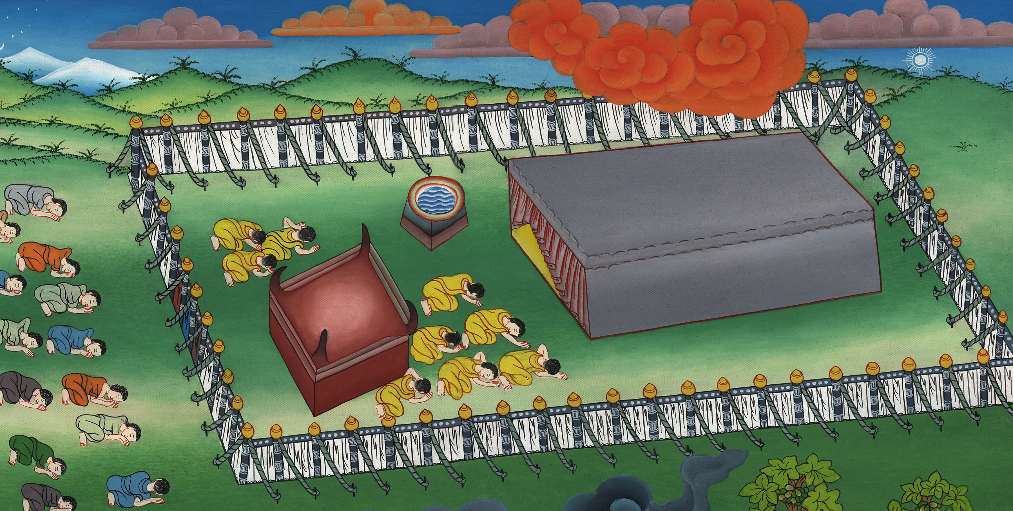
Tabernacle – Exodus 35 – 40

Slide 3
1 Samuel
1) Tabernacle – Exodus 35 – 40
Notes:
11 The Exodus – Part 2
1) Tabernacle – Ex 35 – 40 (Top)
2) Complaining and unbelief – Numbers 10:11 – 14:45 (Right 2nd)
3) Revolt of Korah – Num 16:1-50 (Right Bottom)
4) The Bronze Serpent – Num 21:1-9 (Left Bottom)
5) Balaam – Num 22:1 – 24:25 (Left Center)
6) Joshua succeeds Moses – Num 27:12-23; Deu 31:14 – 34:12 (Center)

Slide 4
Tabernacle – Exodus 35 – 40

Slide 5
1 Samuel
Moses said to the Israelites35: 10“‘Let every wise-hearted man among you come, and make all that Yahweh has commanded: 11the tabernacle, its outer covering,……

Slide 6
Exodus 35:10,11

Slide 7
1 Samuel
8All the wise-hearted men among those who did the work made the tabernacle with ten curtains of fine twined linen, blue, purple, and scarlet. They made them with cherubim, the work of a skillful workman.

Slide 8
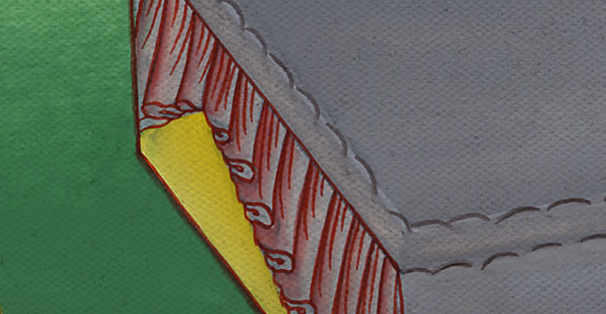
Exodus 36:8

Slide 9
1 Samuel
19He made a covering for the tent of rams’ skins dyed red, and a covering of sea cow hides above.

Slide 10
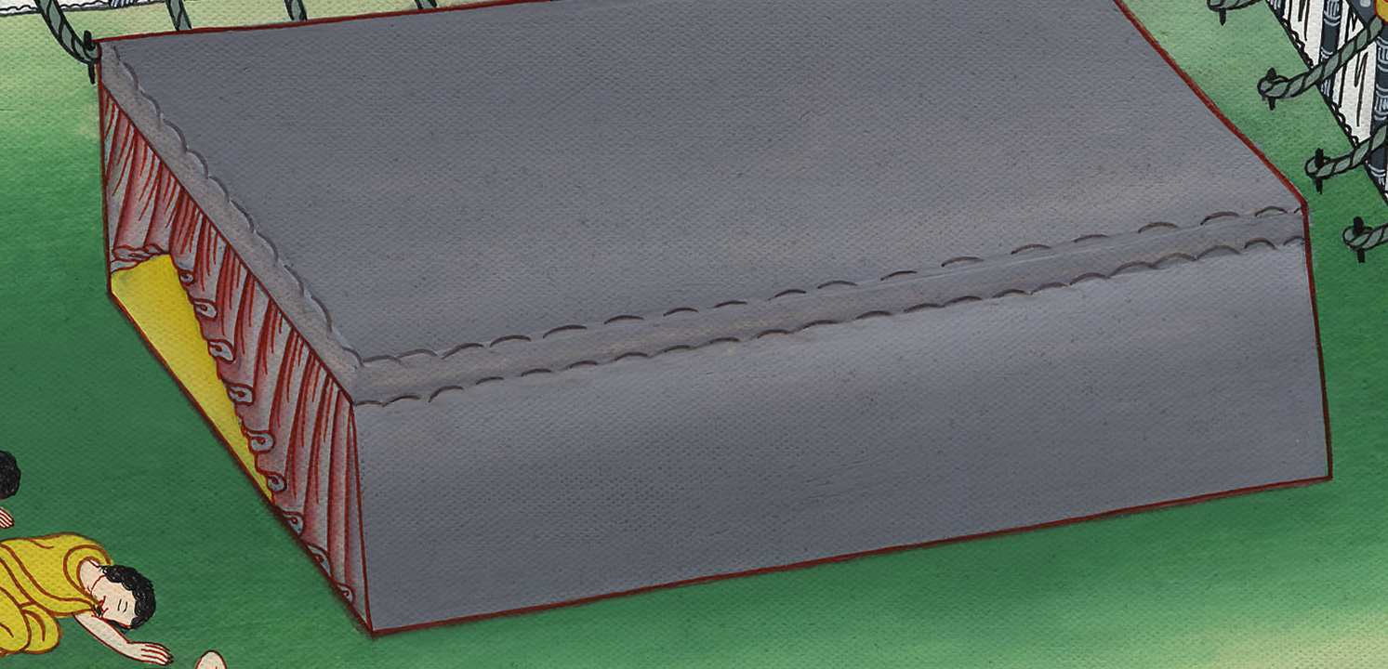
Exodus 36:19

Slide 11
1 Samuel
20He made the boards for the tabernacle of acacia wood,

Slide 12
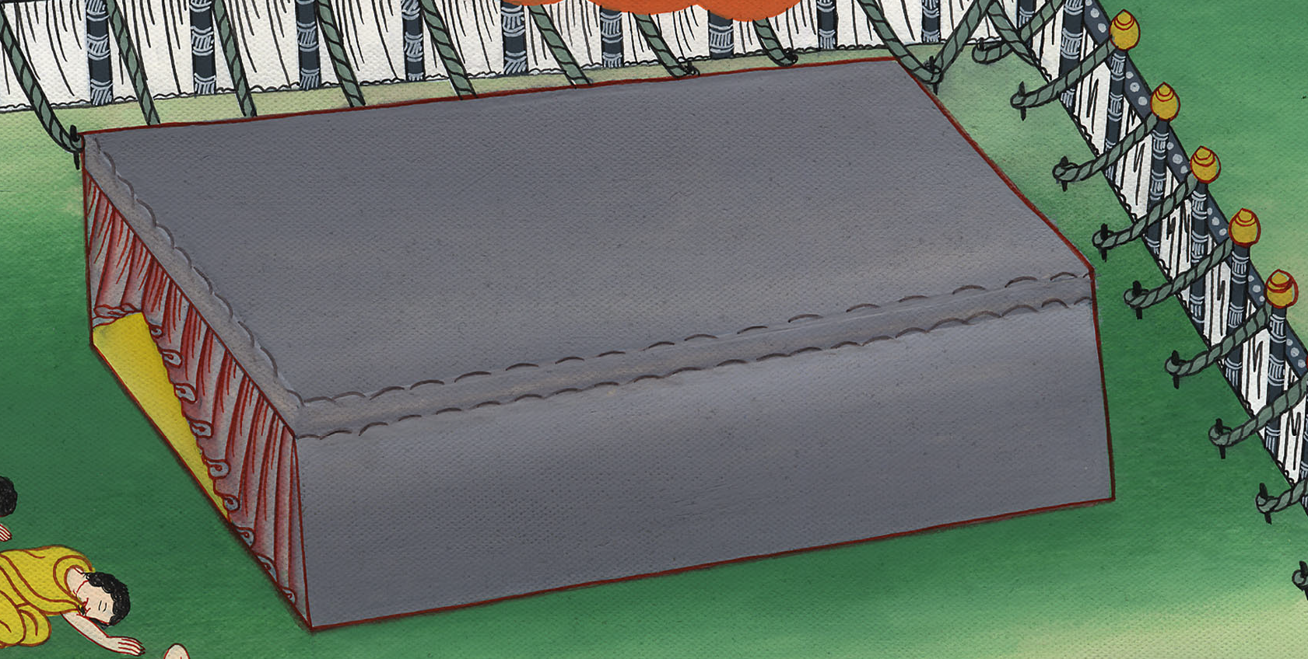
Exodus 36:20

Slide 13
1 Samuel
1Bezalel made the ark of acacia wood. …
2He overlaid it with pure gold inside and outside,. …

Slide 14
Exodus 37:1,2

Slide 15
1 Samuel
4He made poles of acacia wood and overlaid them with gold. 5He put the poles into the rings on the sides of the ark, to bear the ark.

Slide 16
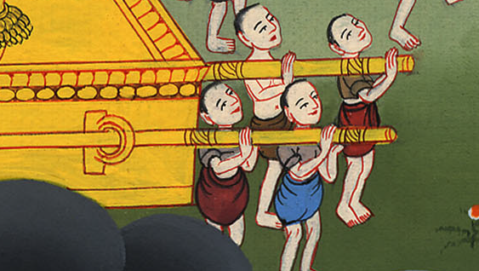
Exodus 37:4,5

Slide 17
1 Samuel
7He made two cherubim of gold. He made them of beaten work, at the two ends of the mercy seat:

Slide 18
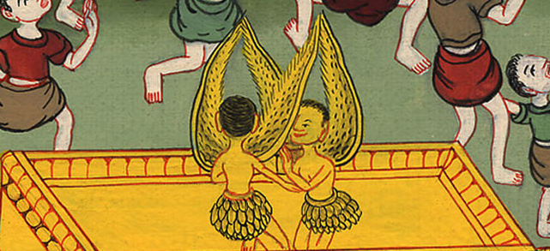
Exodus 37:7

Slide 19
1 Samuel
16He made the vessels which were on the table, its dishes, its spoons, its bowls, and its pitchers with which to pour out, of pure gold.

Slide 20
Exodus 37:16

Slide 21
1 Samuel
17He made the lamp stand of pure gold…

Slide 22
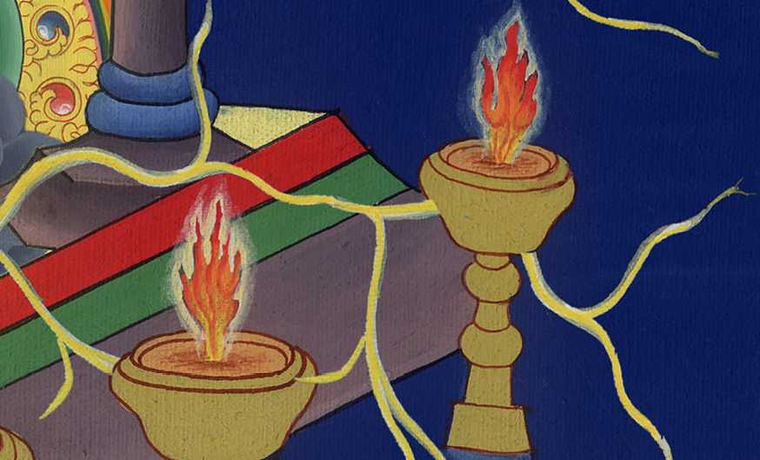
Exodus 37:17

Slide 23
1 Samuel
29He made the holy anointing oil and the pure incense of sweet spices, after the art of the perfumer.

Slide 24
Exodus 37:29

Slide 25
1 Samuel
1Of the blue, purple, and scarlet, they made finely worked garments for ministering in the holy place, and made the holy garments for Aaron,

Slide 26
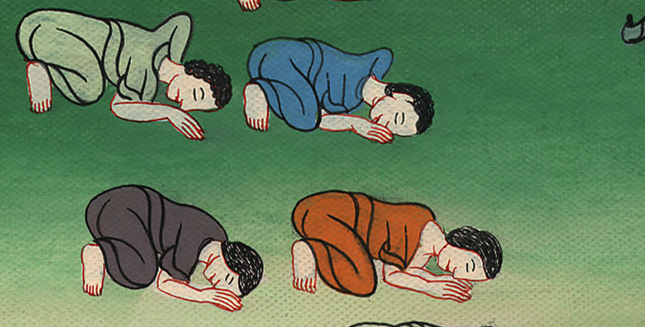
Exodus 39:1

Slide 27
1 Samuel
32Thus all the work of the tabernacle of the Tent of Meeting was finished. The children of Israel did according to all that Yahweh commanded Moses; so they did.

Slide 28
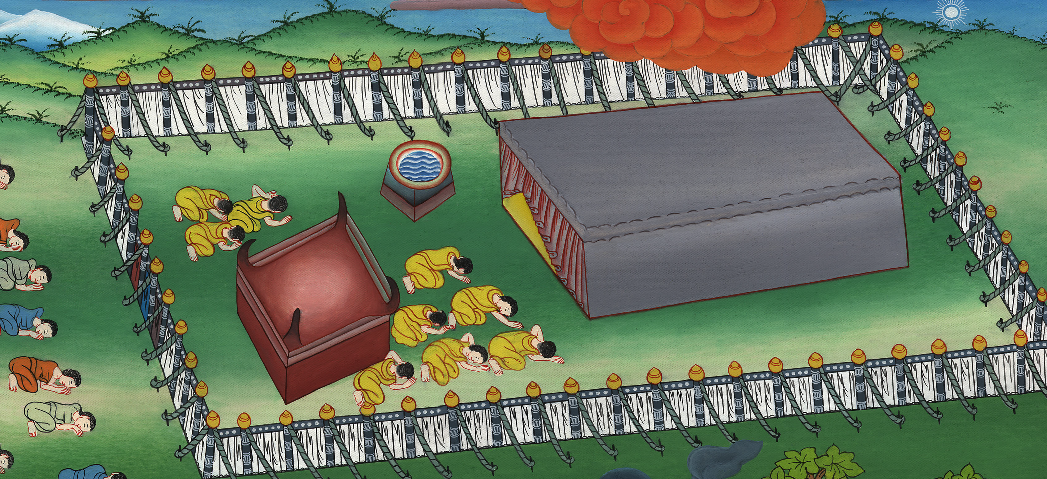
Exodus 39:32

Slide 29
1 Samuel
1Yahweh spoke to Moses, saying, 2“On the first day of the first month you shall raise up the tabernacle of the Tent of Meeting.

Slide 30
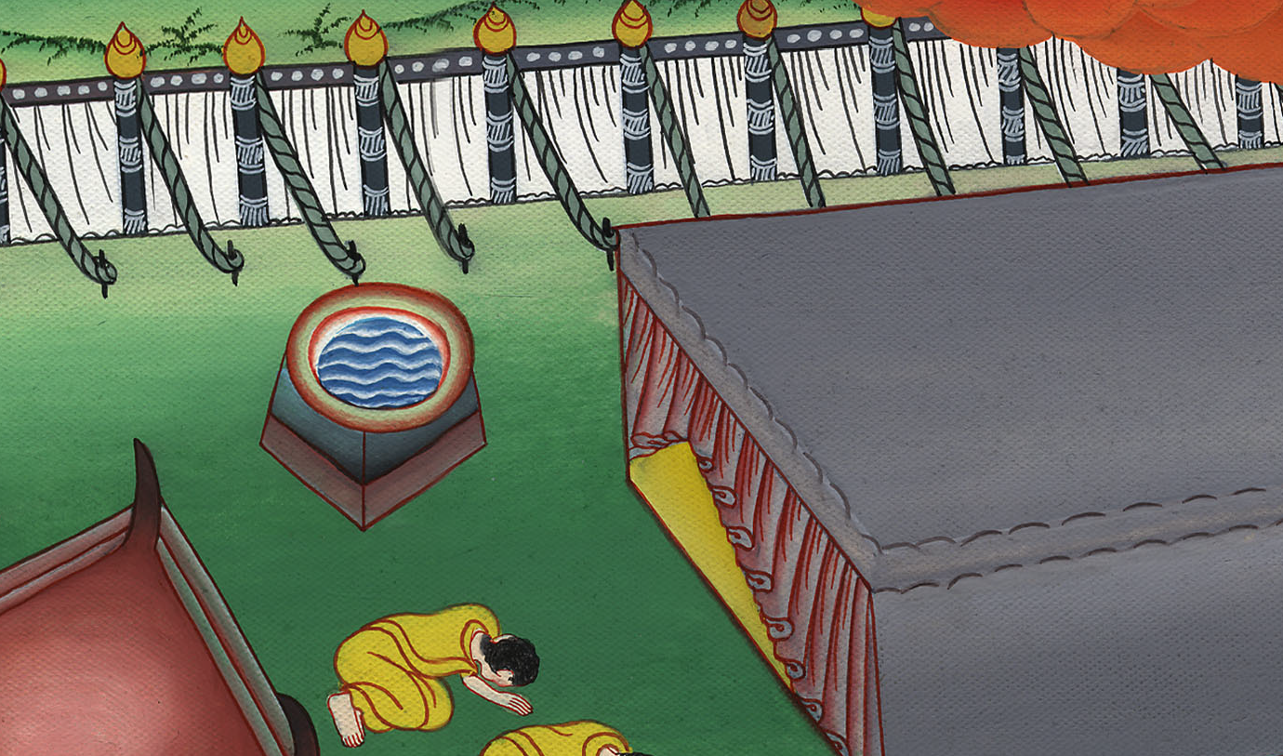
Exodus 40:1,2

Slide 31
1 Samuel
3You shall put the ark of the covenant in it, and you shall screen the ark with the veil.

Slide 32
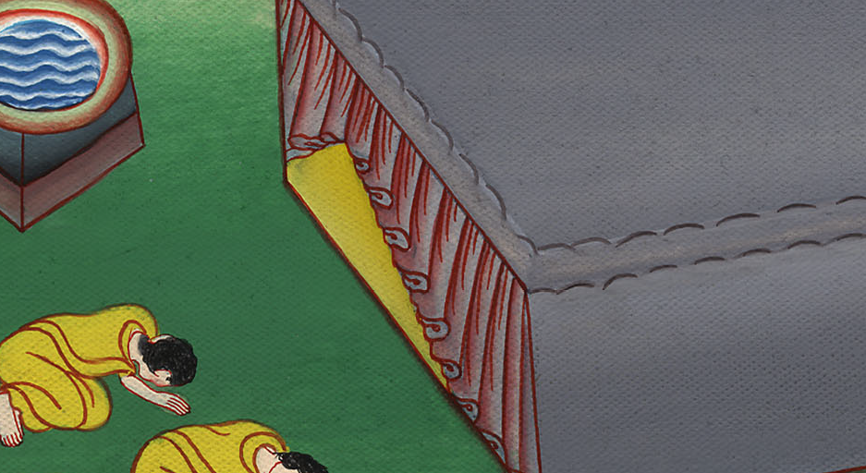
Exodus 40:3

Slide 33
1 Samuel
6“You shall set the altar of burnt offering before the door of the tabernacle of the Tent of Meeting.

Slide 34
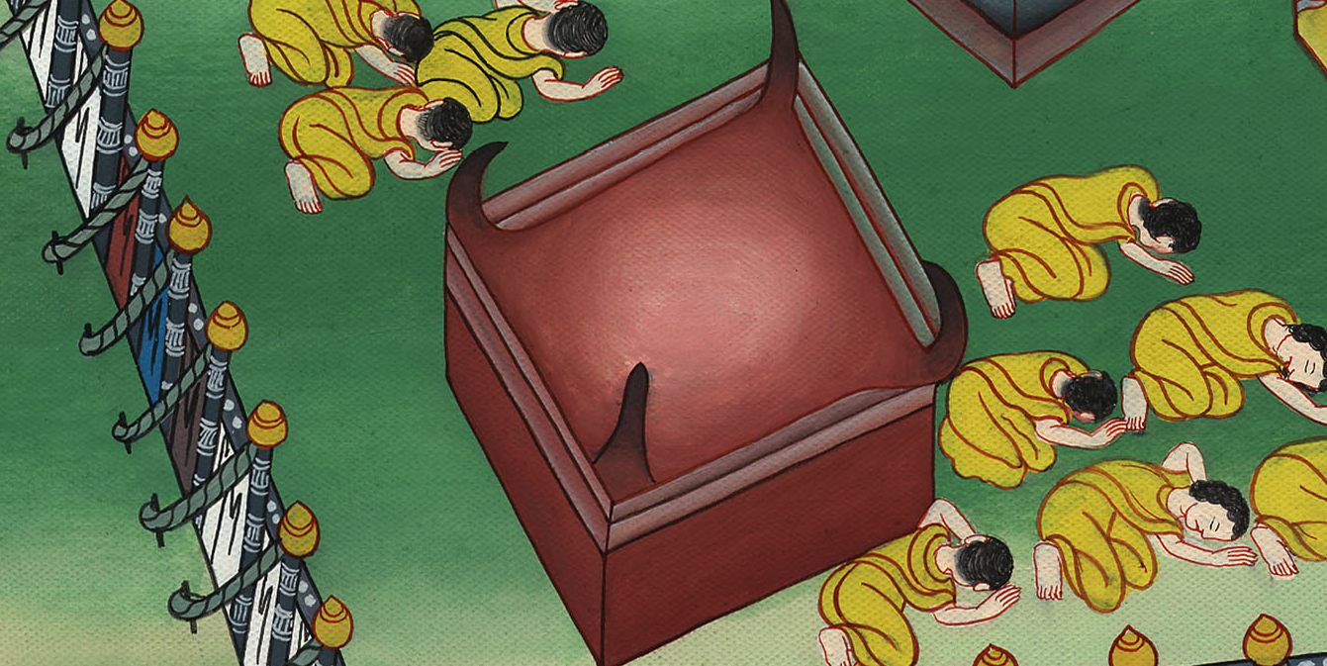
Exodus 40:6

Slide 35
1 Samuel
9“You shall take the anointing oil, and anoint the tabernacle and all that is in it, and shall make it holy, and all its furniture, and it will be holy.

Slide 36
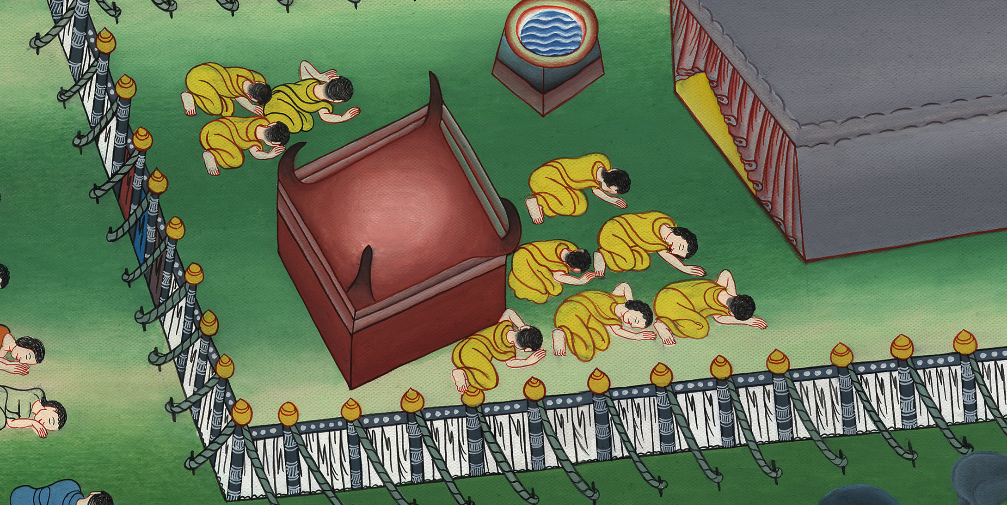
Exodus 40:9

Slide 37
1 Samuel
12“You shall bring Aaron and his sons to the door of the Tent of Meeting, and shall wash them with water. 13You shall put on Aaron the holy garments; and you shall anoint him, and sanctify him, that he may minister to me in the priest’s office.

Slide 38
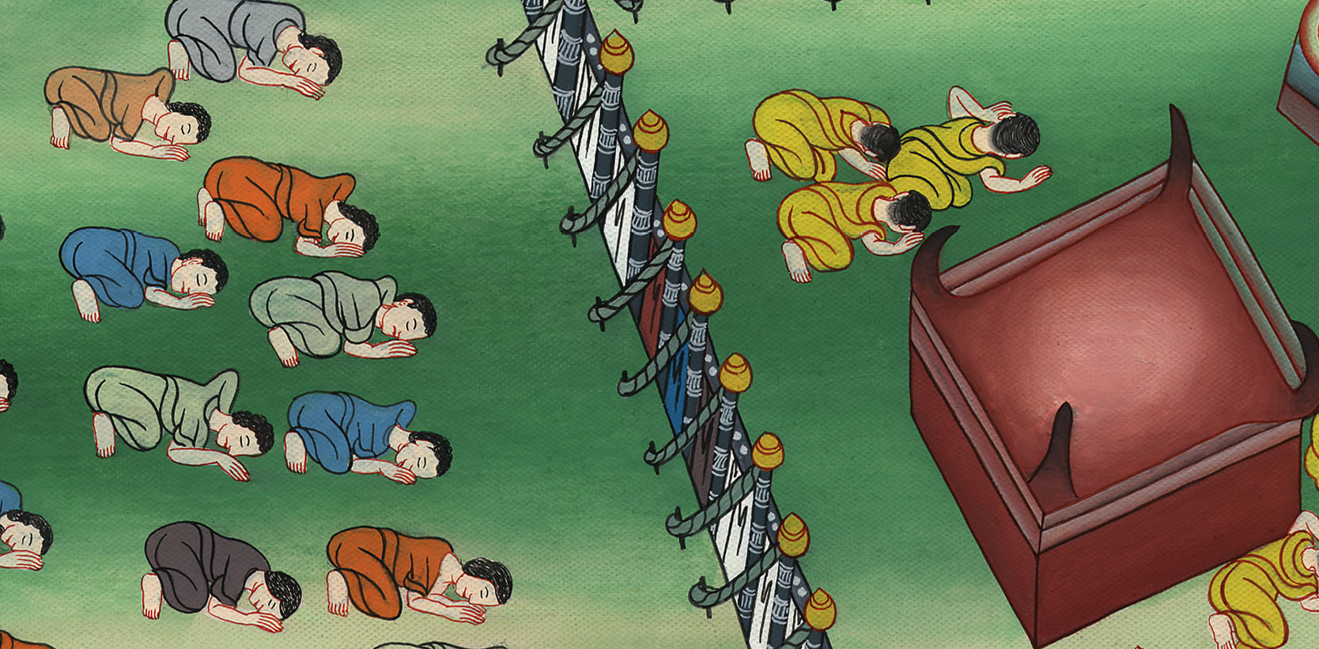
Exodus 40:12,13

Slide 39
1 Samuel
34Then the cloud covered the Tent of Meeting, and Yahweh’s glory filled the tabernacle.

Slide 40
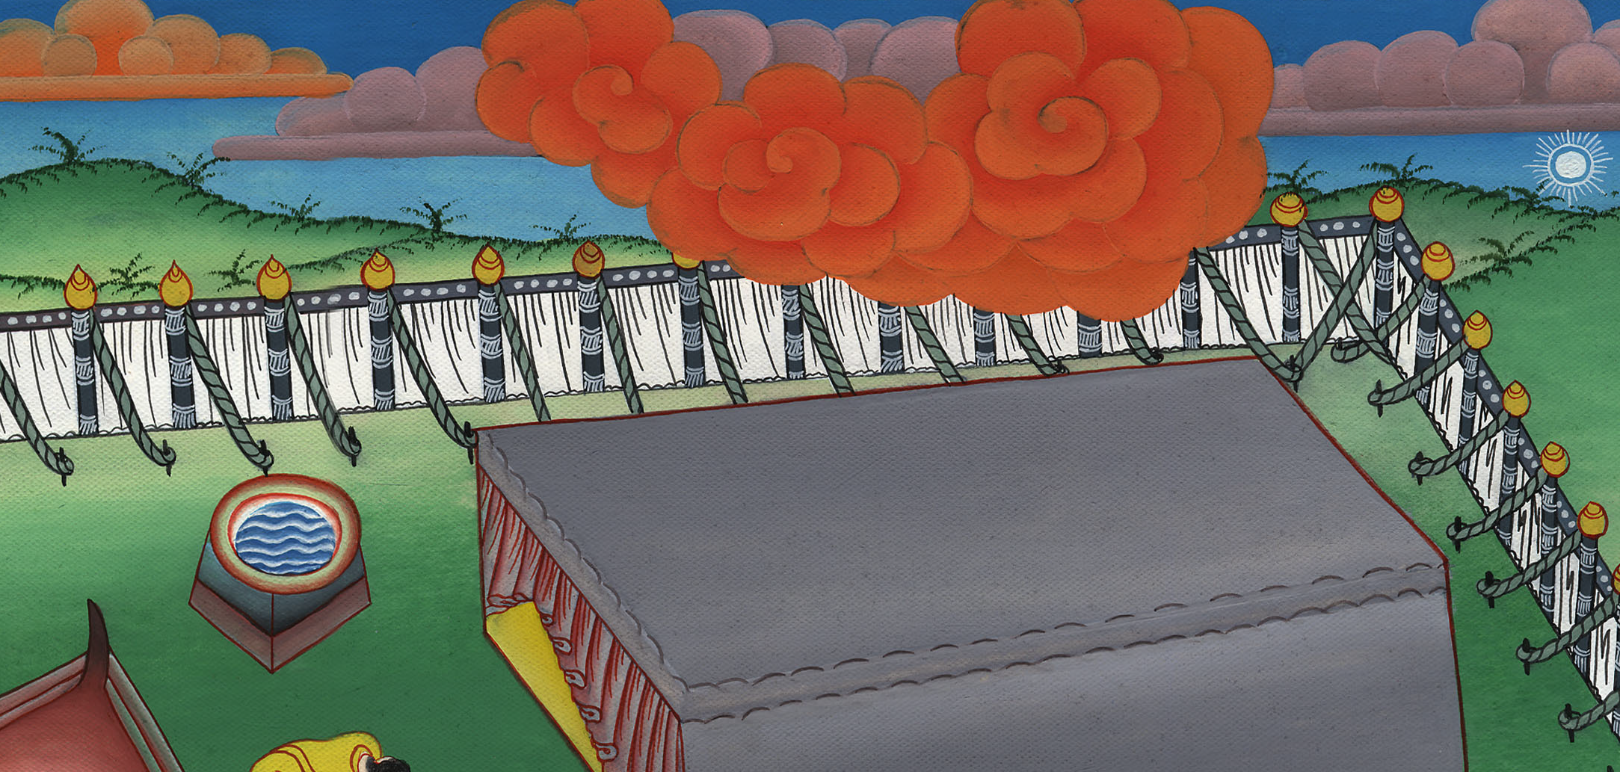
Exodus 40:34

Slide 41
1 Samuel
38For the cloud of Yahweh was on the tabernacle by day, and there was fire in the cloud by night, in the sight of all the house of Israel, throughout all their journeys.

Slide 42
Exodus 40:38

