Slide 1
11-2
This work is licensed under a Creative Commons Attribution-Sharealike 4.0 International License.
Please add this statement to all the videos you create.
English Bible quotes are from the World English Bible US, which is in the public domain.

Slide 2
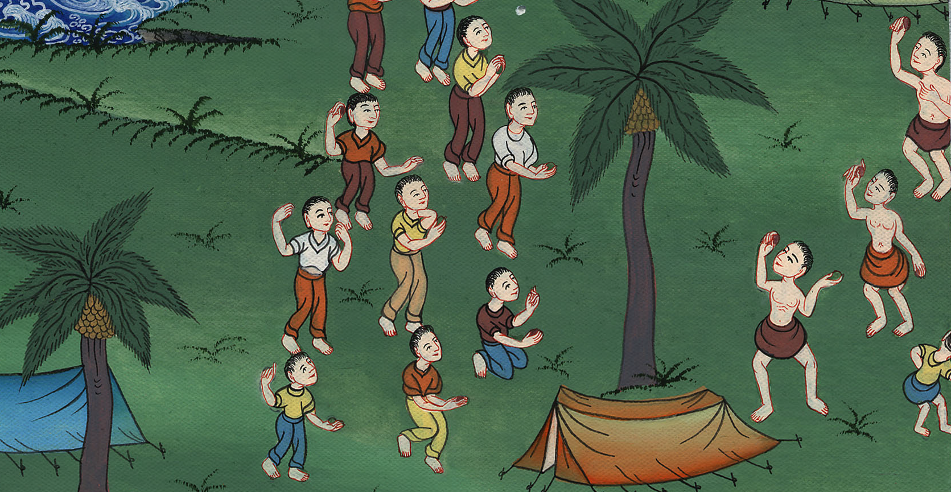
Complaining and unbelief – Numbers 11:1 – 14:45

Slide 3
1 Samuel
Complaining and unbelief – Numbers 11:1 – 14:45

Slide 4
Complaining and unbelief – Numbers 11:1 – 14:45

Slide 5
1 Samuel
Numbers11:1The people were complaining in the ears of Yahweh. …

Slide 6
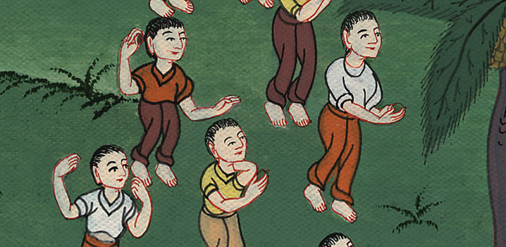
Numbers 11:1

Slide 7
1 Samuel
4The mixed multitude that was among them lusted exceedingly; and the children of Israel also wept again, and said, “Who will give us meat to eat? (The Lord sent them quail. So much that they got sick from eating it)

Slide 8
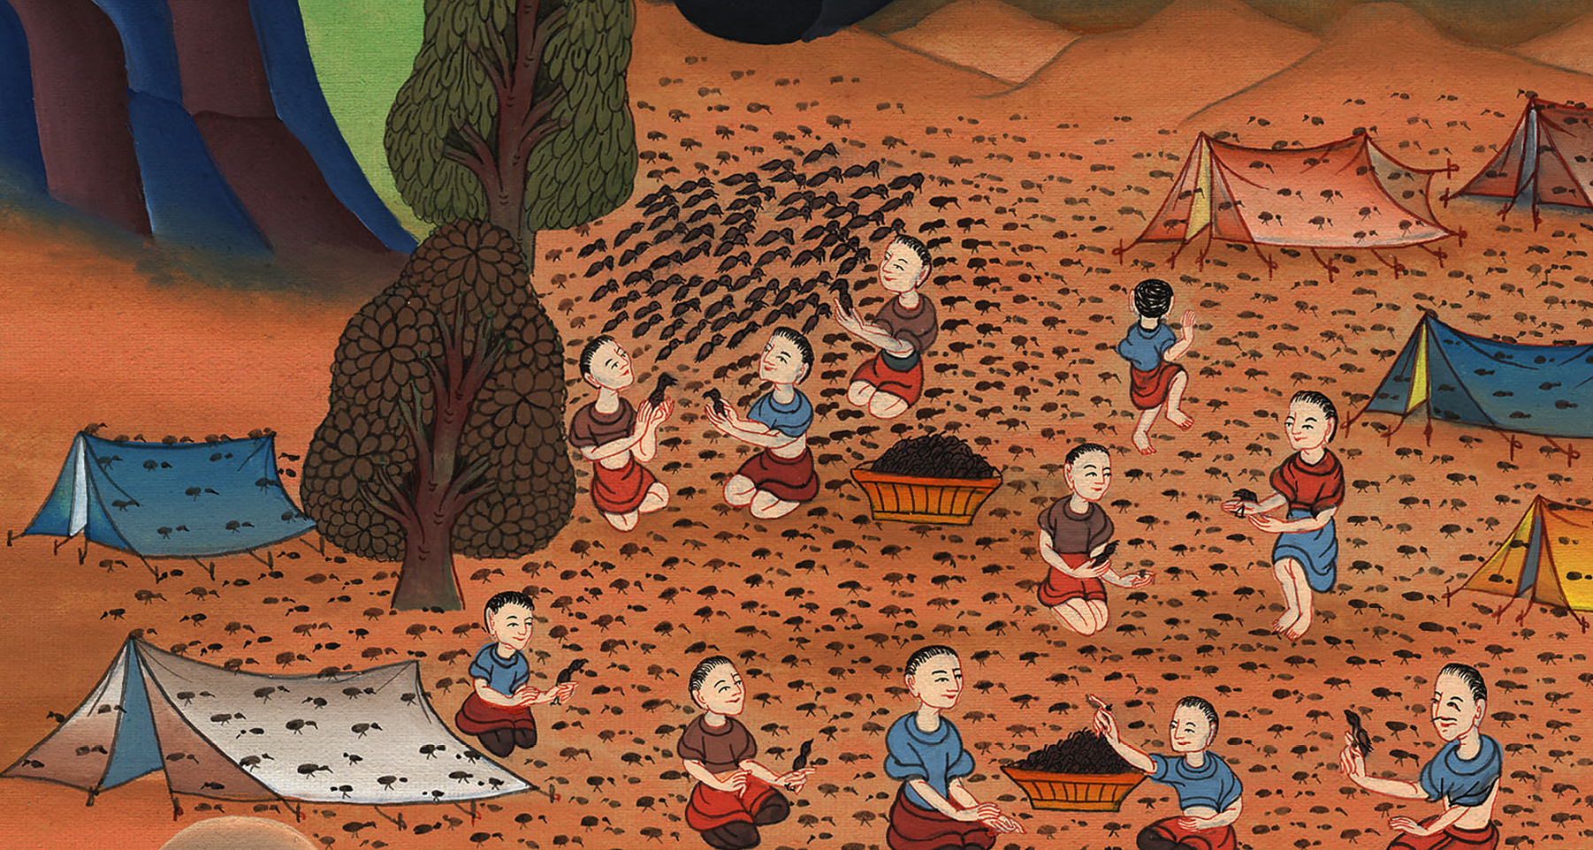
Numbers 11:4

Slide 9
1 Samuel
Numbers13:1Yahweh spoke to Moses, saying, 2“Send men, that they may spy out the land of Canaan, which I give to the children of Israel. Of every tribe of their fathers, you shall send a man, every one a prince among them.”

Slide 10
Numbers 13:1,2

Slide 11
1 Samuel
17Moses sent them to spy out the land of Canaan, and said to them, ….
8See the land, what it is; and the people who dwell therein, whether they are strong or weak, whether they are few or many; 19and what the land is that they dwell in, whether it is good or bad; …

Slide 12
Numbers 13:17-19

Slide 13
1 Samuel
26They went and came (back) ...
27They told him, and said, “We came to the land where you sent us. Surely it flows with milk and honey, and this is its fruit.

Slide 14
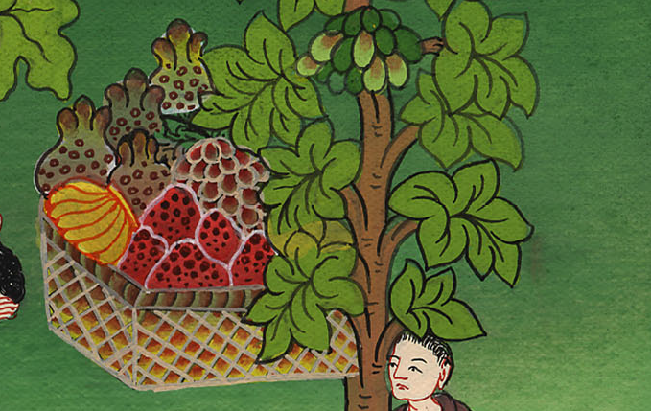
Numbers 13:26,27

Slide 15
1 Samuel
28However, the people who dwell in the land are strong, and the cities are fortified and very large… 31But the men who went up with him said, “We aren’t able to go up against the people; for they are stronger than we.”

Slide 16
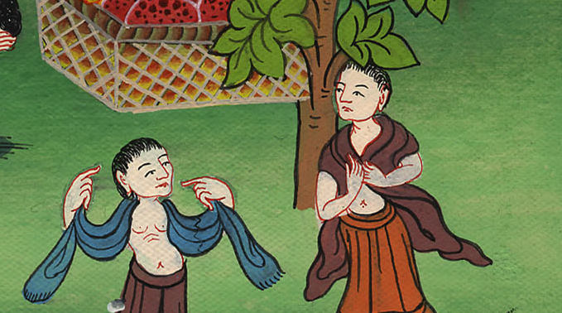
Numbers 13:28,31

Slide 17
1 Samuel
30Caleb stilled the people before Moses, and said, “Let’s go up at once, and possess it; for we are well able to overcome it!” (Joshua and Caleb trusted that God would help them)

Slide 18
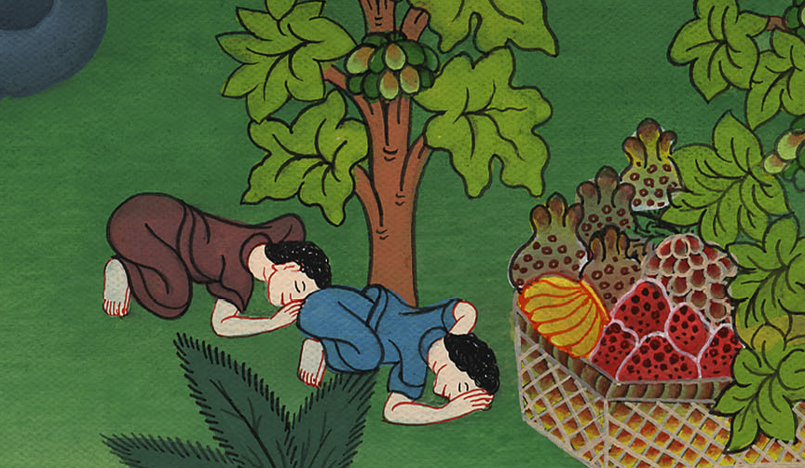
Numbers 13:30

Slide 19
1 Samuel
2All the children of Israel murmured against Moses and against Aaron. The whole congregation said to them, “We wish that we had died in the land of Egypt, or that we had died in this wilderness! 3Why does Yahweh bring us to this land, to fall by the sword? Our wives and our little ones will be captured or killed! Wouldn’t it be better for us to return into Egypt?”

Slide 20
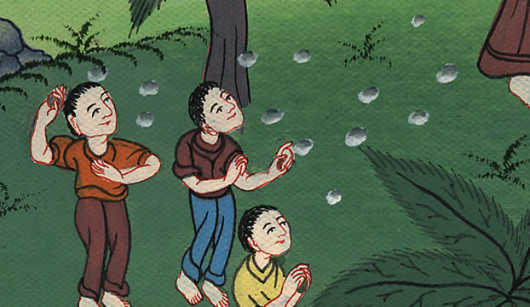
Numbers 4:2,3

Slide 21
1 Samuel
4They said to one another, “Let’s choose a leader, and let’s return into Egypt.”

Slide 22
Numbers 14:4

Slide 23
1 Samuel
The Lord was angry with the people, but when Moses begged God, he forgave them. Then He said:

Slide 24
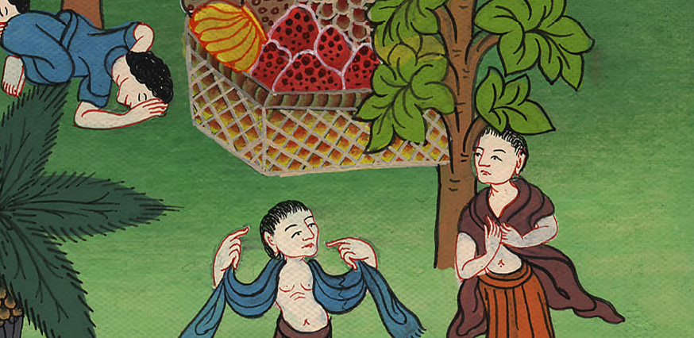

Slide 25
1 Samuel
22because all those men who have seen my glory and my signs, which I worked in Egypt and in the wilderness, yet have tempted me these ten times, and have not listened to my voice; 23surely they shall not see the land which I swore to their fathers, neither shall any of those who despised me see it.

Slide 26
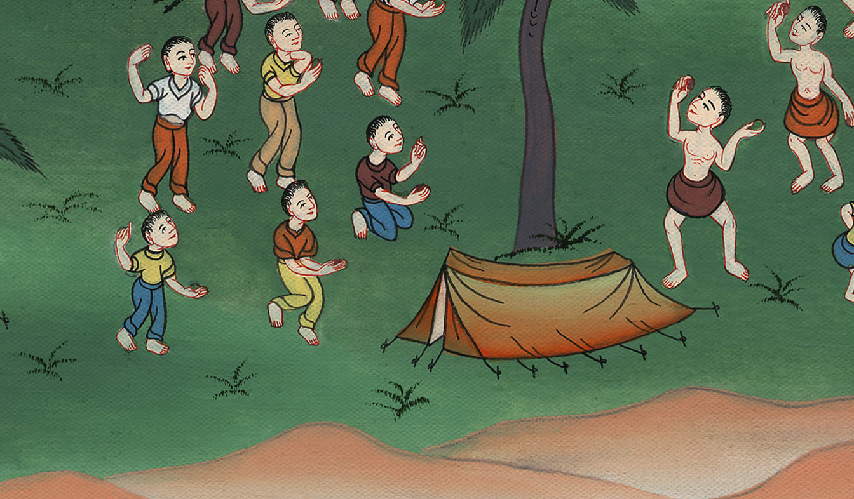
Numbers 14:23

Slide 27
1 Samuel
29Your dead bodies shall fall in this wilderness … 31But I will bring in your little ones that you said should be captured or killed, and they shall know the land which you have rejected. (only Joshua and Caleb will enter the land because they trust me)

Slide 28
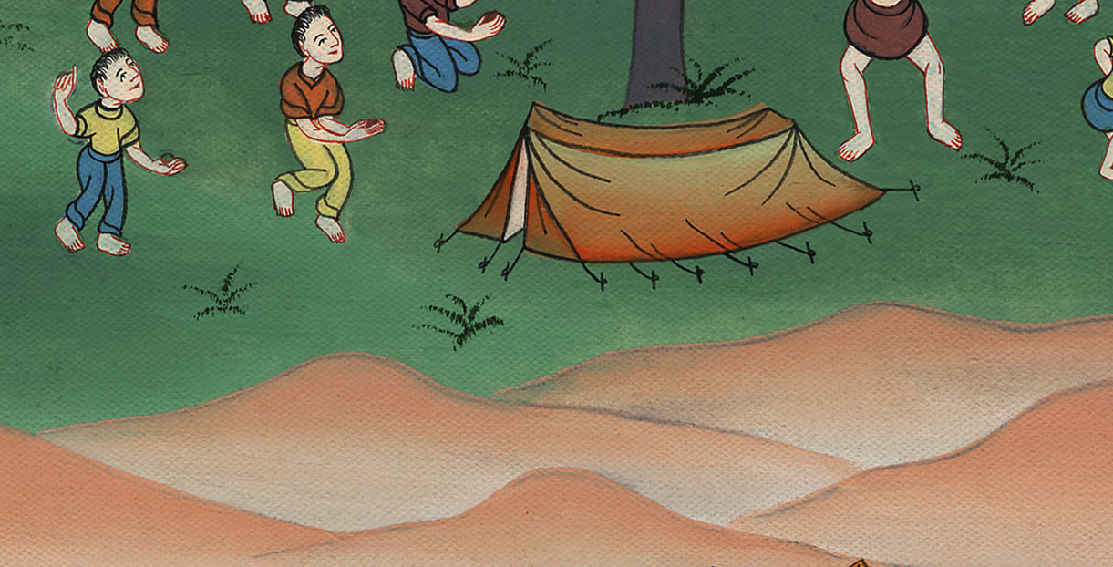
Numbers 14:29,31

Slide 29
1 Samuel
33Your children shall be wanderers in the wilderness forty years, and shall bear your prostitution,…

Slide 30
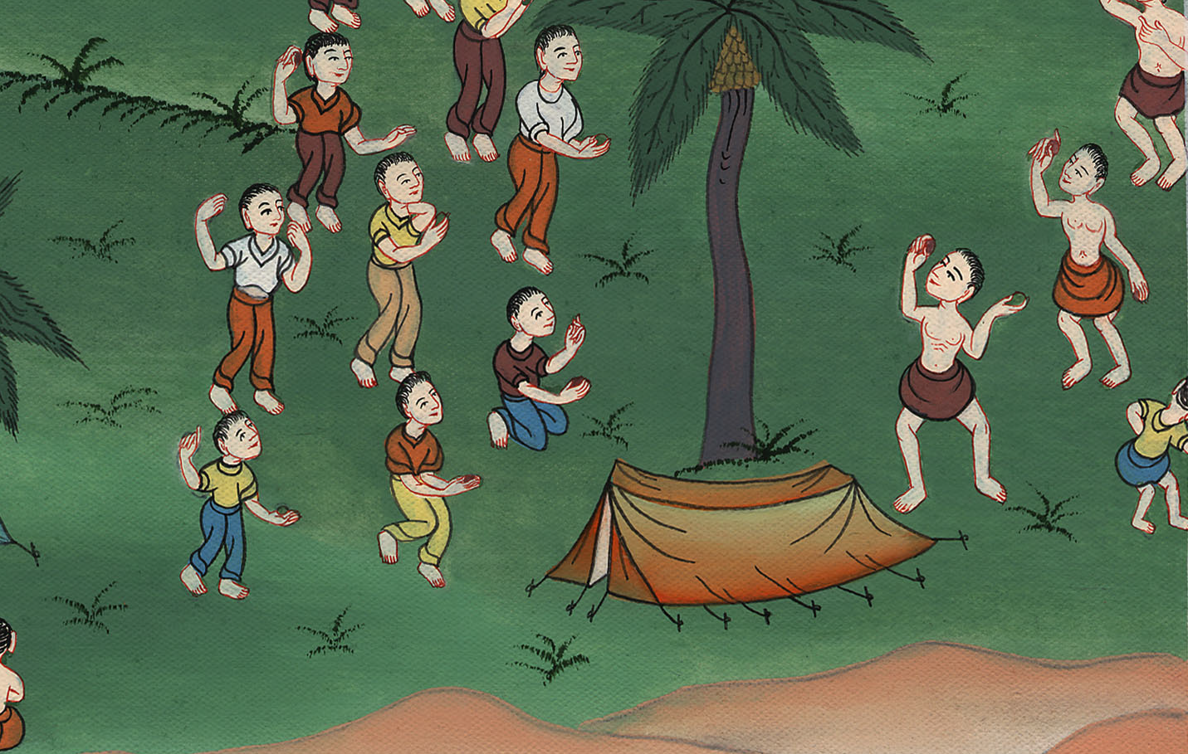
Numbers 14:33

Slide 31
So for 40 years the Israelites wandered in the desert as shepherds because they did not trust in God to care for them or to give them the land of Canaan as he had promised

Slide 32
