Slide 1
11-3
This work is licensed under a Creative Commons Attribution-Sharealike 4.0 International License.
Please add this statement to all the videos you create.
English Bible quotes are from the World English Bible US, which is in the public domain.
Notes:
checked

Slide 2
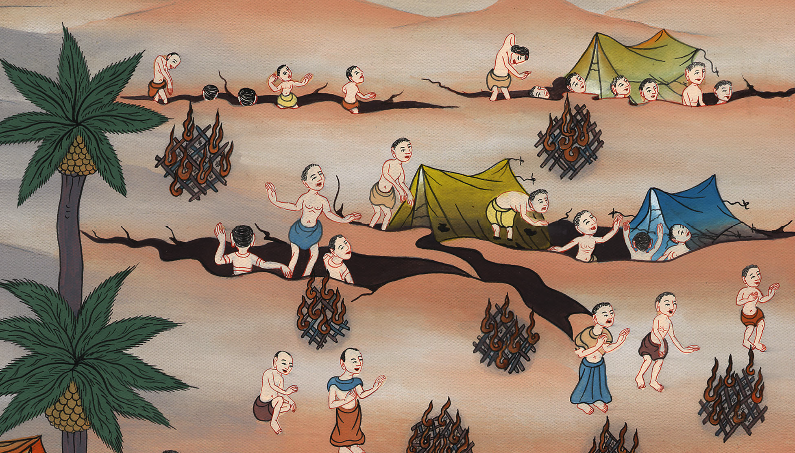
Revolt of Korah – Numbers 16:1-50

Slide 3
3) Revolt of Korah – Numbers 16:1-50 (Right Bottom)
གྲངས་ཀ 16
ཀོ་རཱ་གྱིས་ངོ་ལོག་བྱས་པ།

Slide 4
Revolt of Korah – Numbers 16:1-50

Slide 5
Korah and certain men from the tribe of Reuben turned against Moses.
You don’t have to give all the names, make more simple like I did with the English

Slide 6
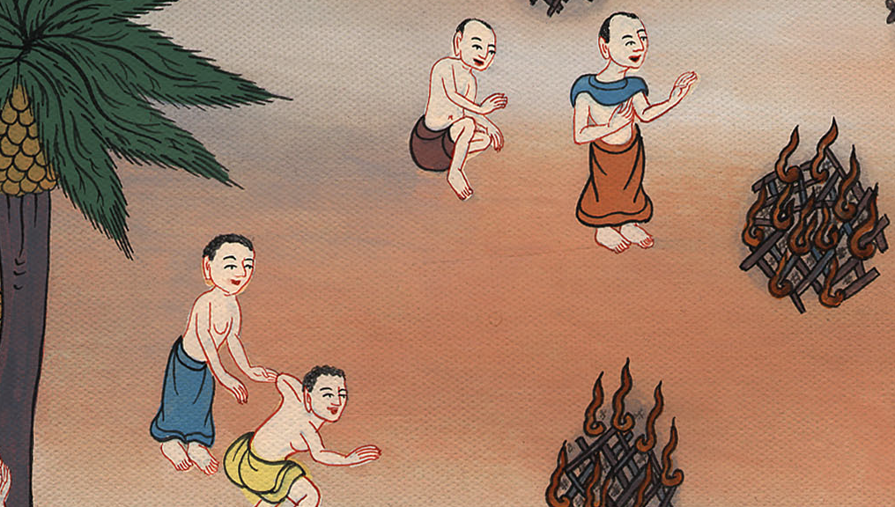

Slide 7
1 Samuel
3They assembled themselves together against Moses and against Aaron, and said to them, “You take too much on yourself, since all the congregation are holy, everyone of them, and Yahweh is among them! Why do you lift yourselves up above Yahweh’s assembly?”

Slide 8
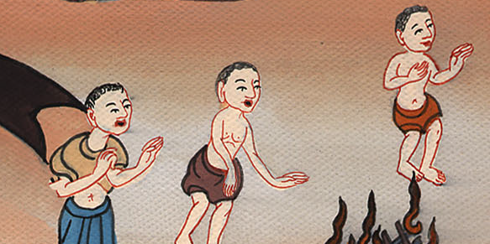
Numbers 16:3

Slide 9
1 Samuel
5He (Moses) said to Korah and to all his company, “In the morning, Yahweh will show who are his, and who is holy,

Slide 10
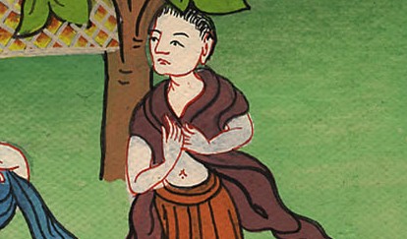
Numbers 16:5

Slide 11
1 Samuel
16Moses said to Korah, “You and all your company go before Yahweh, … tomorrow”

Slide 12
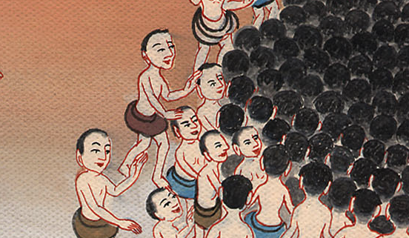
Numbers :16

Slide 13
1 Samuel
17Each man take his censer and put incense on it, and each man bring before Yahweh his censer, two hundred fifty censers; you also, and Aaron, each with his censer.”

Slide 14
Numbers 16:17

Slide 15
1 Samuel
18They each took his censer, and put fire in it, and laid incense on it, and stood at the door of the Tent of Meeting with Moses and Aaron.

Slide 16
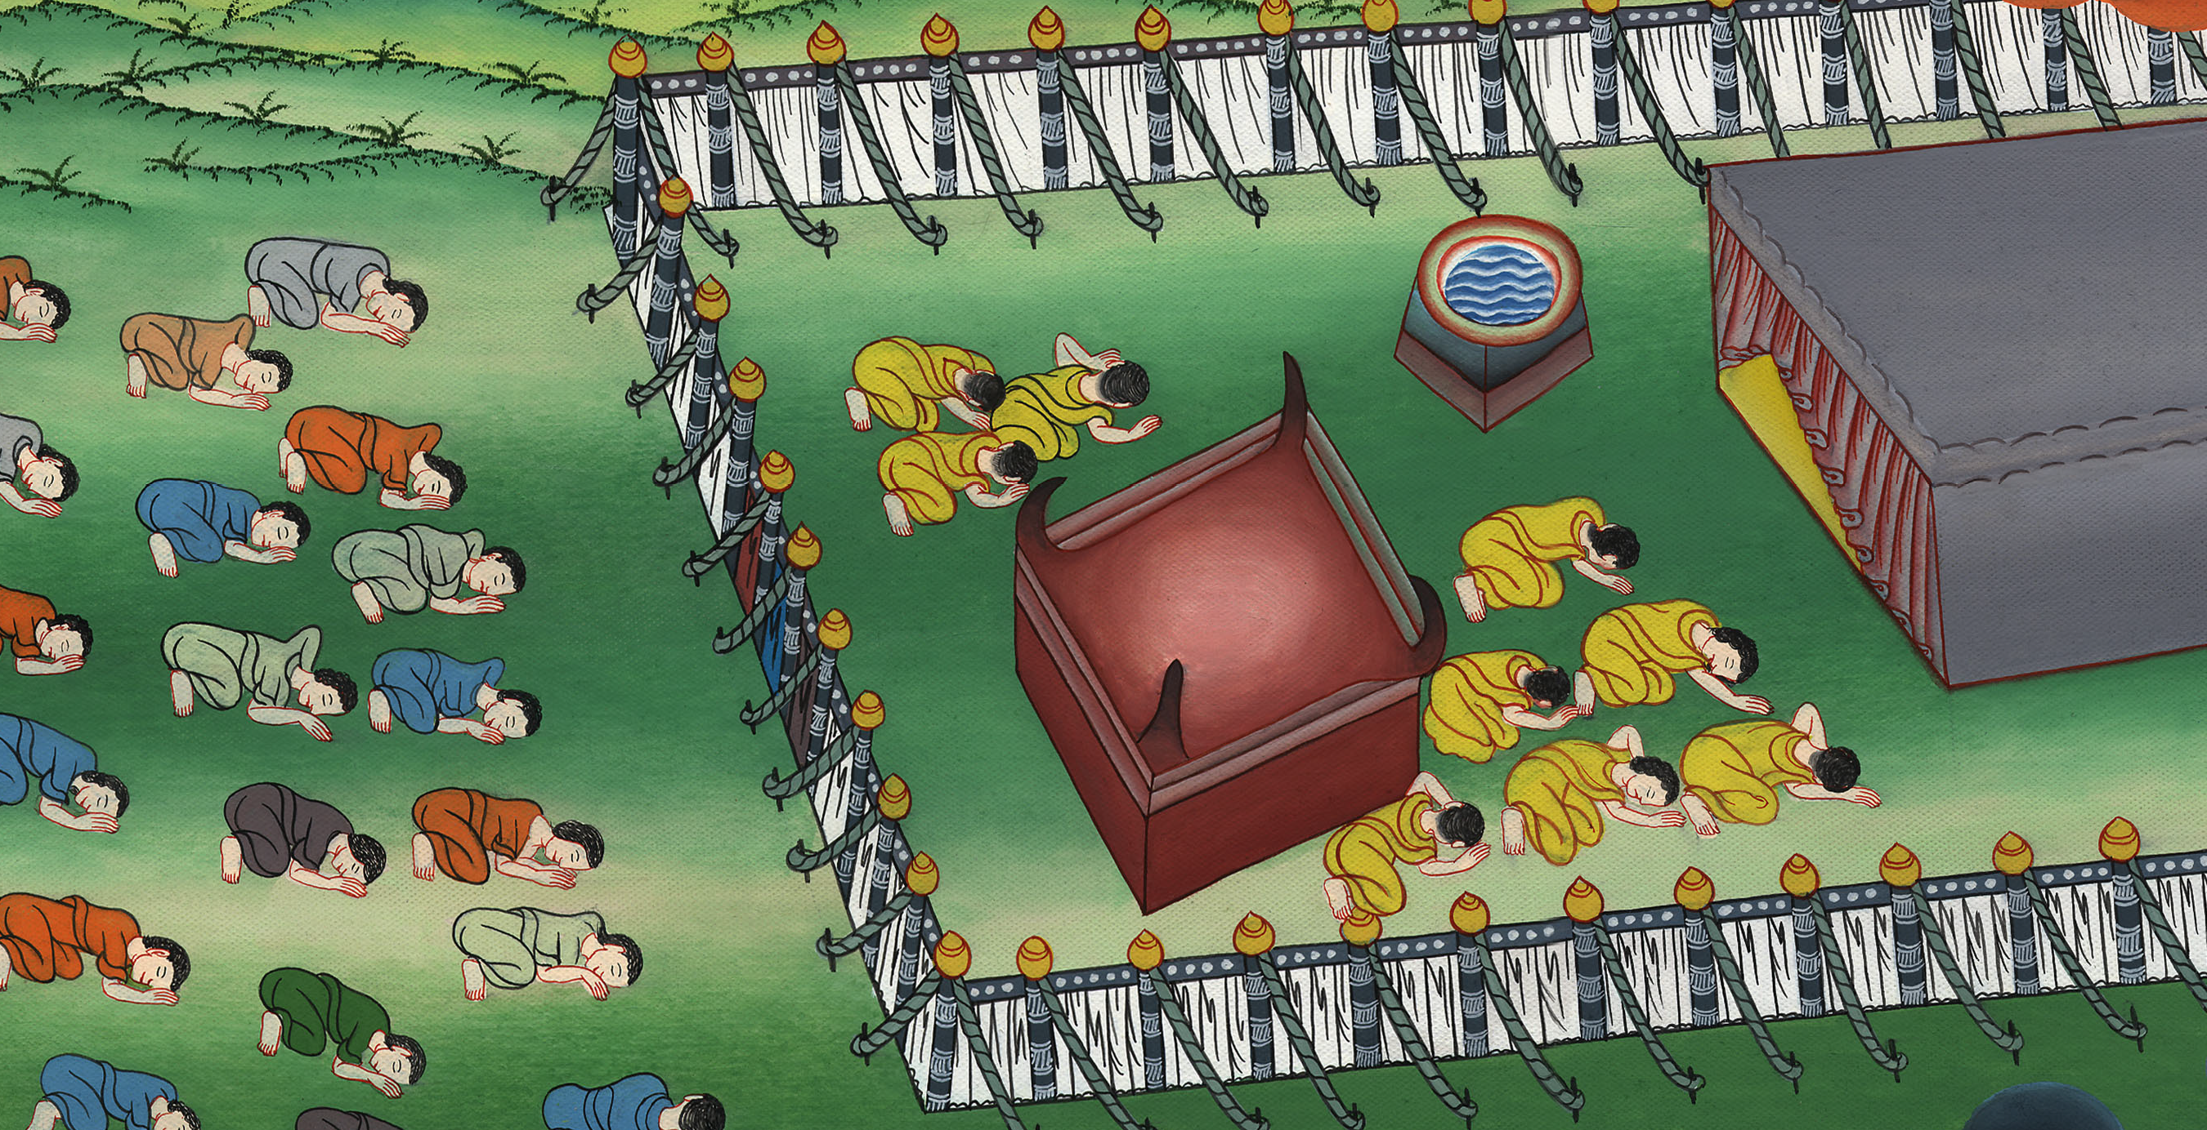
Numbers 16:18

Slide 17
1 Samuel
19… Yahweh’s glory appeared to all the congregation.

Slide 18
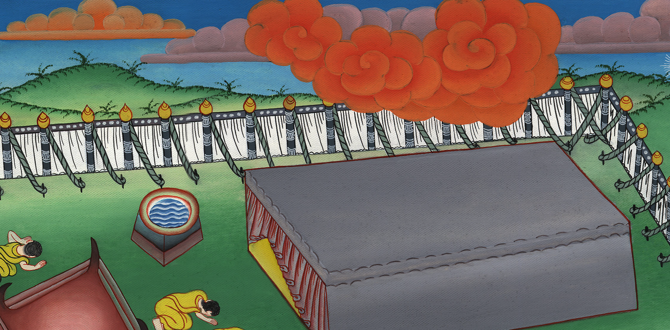
Numbers 16:19

Slide 19
1 Samuel
23Yahweh spoke to Moses, saying, 24“Speak to the congregation, saying, ‘Get away from around the tent of Korah, Dathan, and Abiram!’”

Slide 20
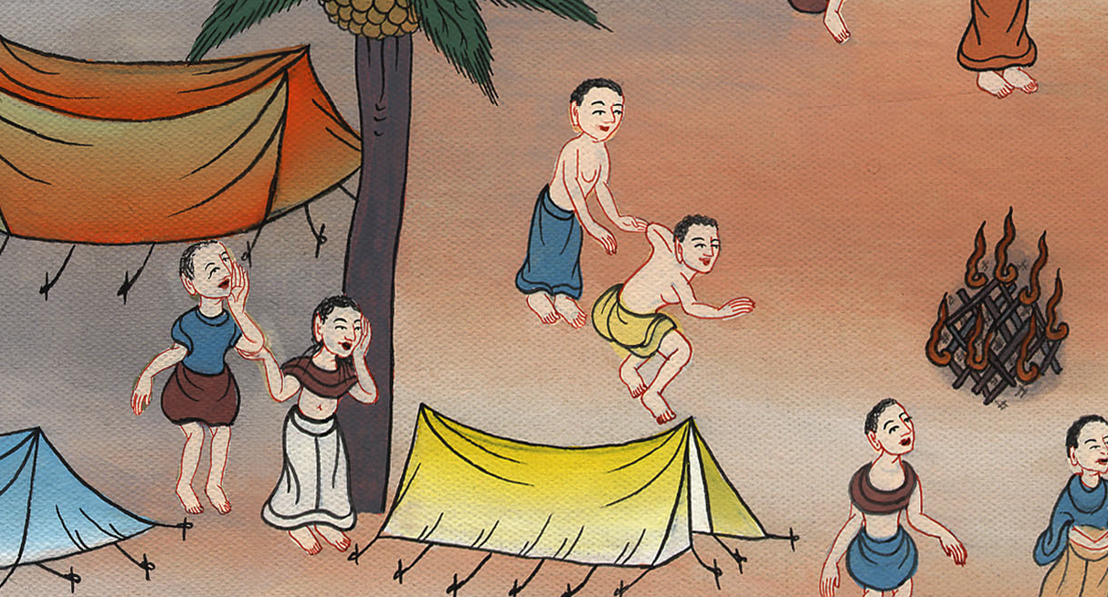
Numbers 16:23

Slide 21
1 Samuel
30But if Yahweh makes a new thing, and the ground opens its mouth, and swallows them up with all that belong to them, and they go down alive into Sheol, then you shall understand that these men have despised Yahweh.”

Slide 22
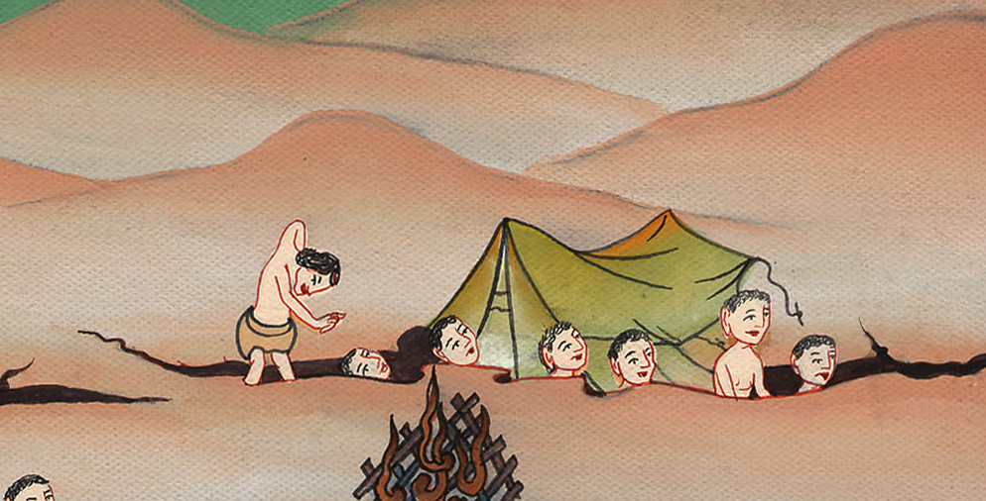
Numbers 16 :30

Slide 23
1 Samuel
31As he finished speaking all these words, the ground that was under them split apart.

Slide 24
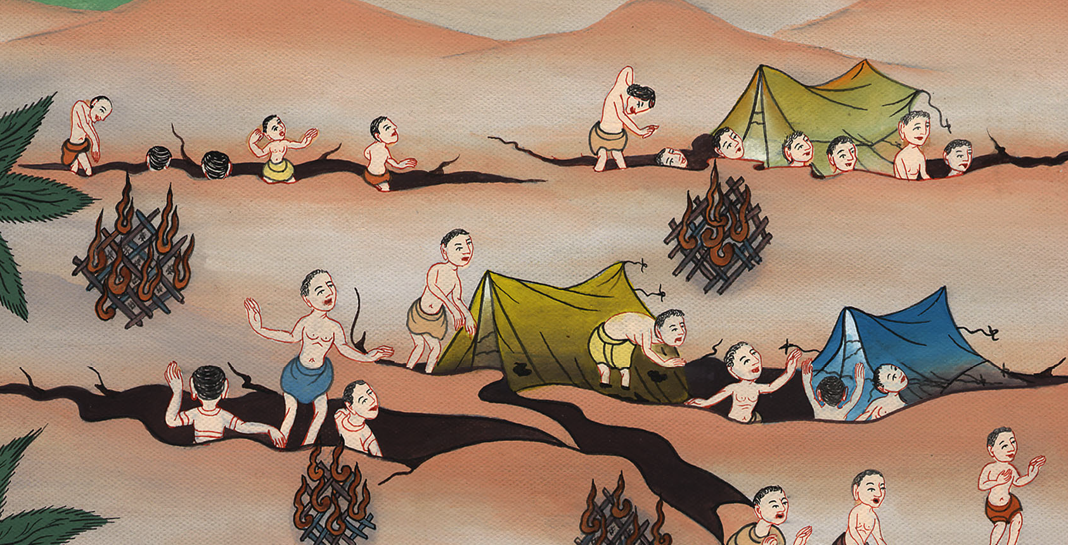
Numbers 16:31

Slide 25
39Eleazar the priest took the bronze censers which those who were burned had offered; and they beat them out for a covering of the altar, 40to be a memorial to the children of Israel, to the end that no stranger who isn’t of the offspring of Aaron, would come near to burn incense before Yahweh, that he not be as Korah and as his company
1 Samuel

Slide 26
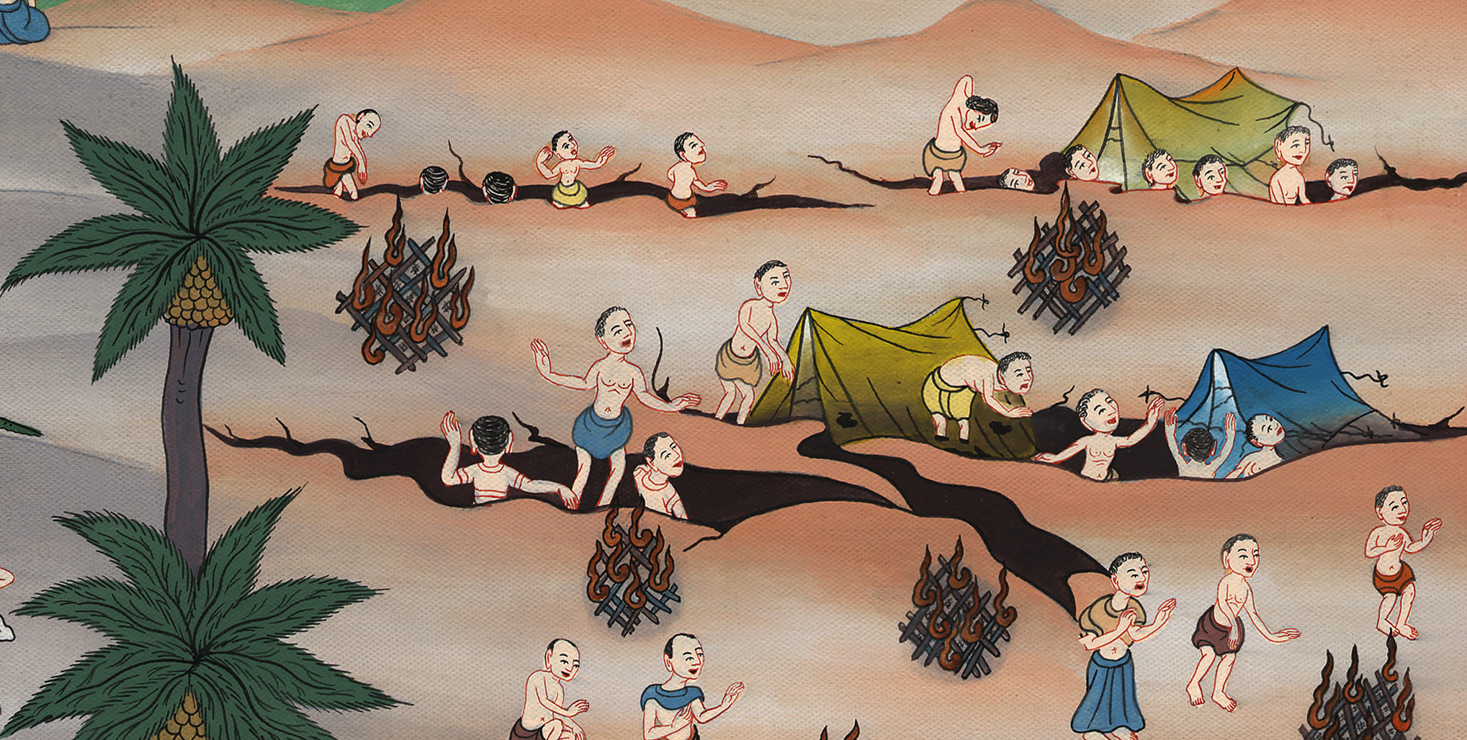
Numbers 16:39,40

