Slide 1
11-4
This work is licensed under a Creative Commons Attribution-Sharealike 4.0 International License.
Please add this statement to all the videos you create.
English Bible quotes are from the World English Bible US, which is in the public domain.
Notes:
checked

Slide 2
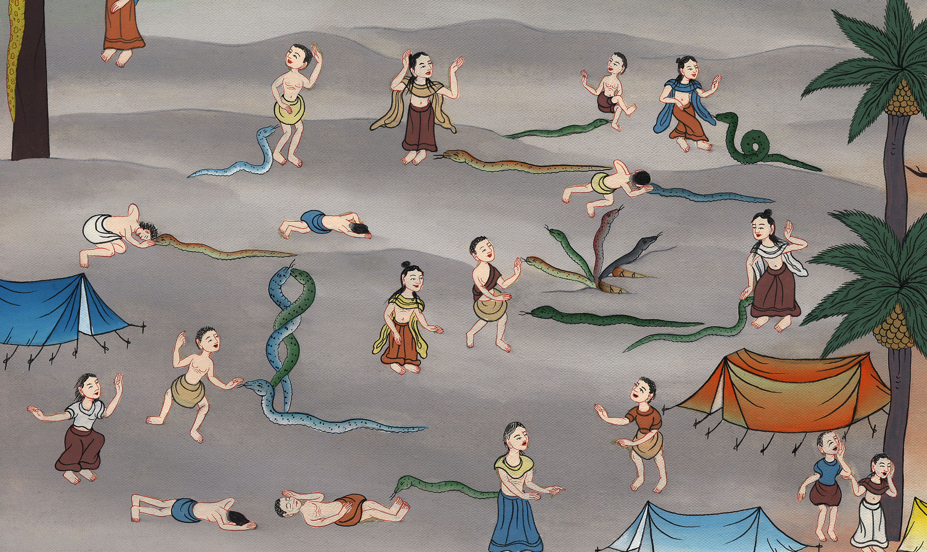
The Bronze Serpent – Numbers 21:1-9

Slide 3
1 Samuel
4) The Bronze Serpent – Numbers 21:1-9 (Left Bottom)

Slide 4
The Bronze Serpent – Numbers 21:1-9

Slide 5
1 Samuel
4They traveled from Mount Hor by the way to the Red Sea, to go around the land of Edom. The soul of the people was very discouraged because of the journey.

Slide 6
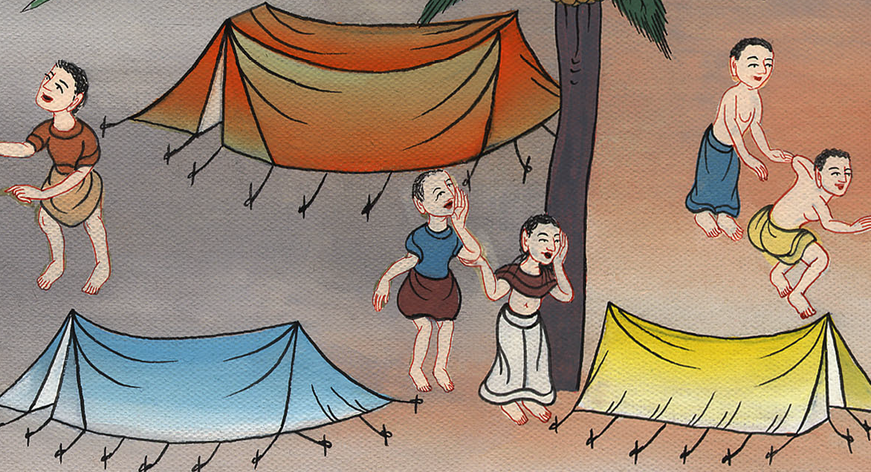
Numbers 21:4

Slide 7
1 Samuel
5The people spoke against God and against Moses: “Why have you brought us up out of Egypt to die in the wilderness? For there is no bread, there is no water, and our soul loathes this disgusting food!”

Slide 8
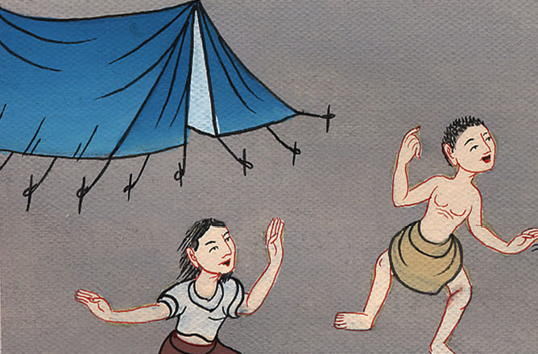
Numbers 21:5

Slide 9
1 Samuel
6Yahweh sent venomous snakes among the people, and they bit the people. Many people of Israel died.

Slide 10
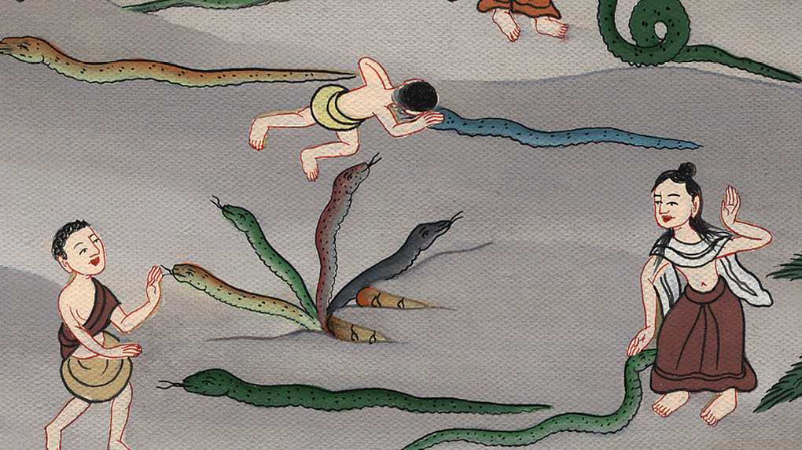
Numbers 21:6

Slide 11
1 Samuel
7The people came to Moses, and said, “We have sinned, because we have spoken against Yahweh and against you. Pray to Yahweh, that he take away the serpents from us.” Moses prayed for the people.

Slide 12
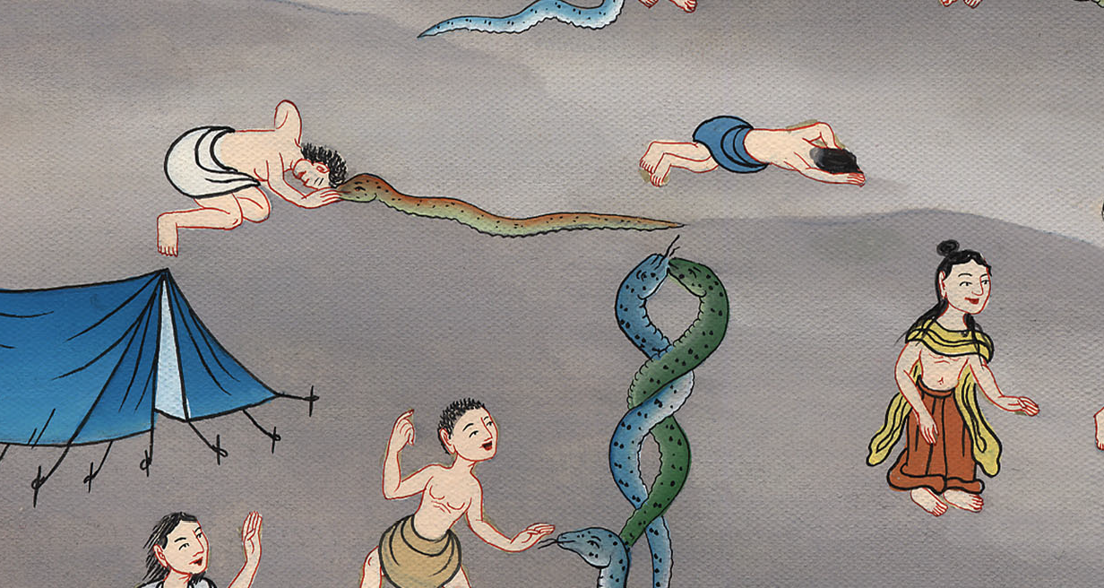
Numbers 21:7

Slide 13
1 Samuel
8Yahweh said to Moses, “Make a venomous snake, and set it on a pole. It shall happen that everyone who is bitten, when he sees it, shall live.”

Slide 14
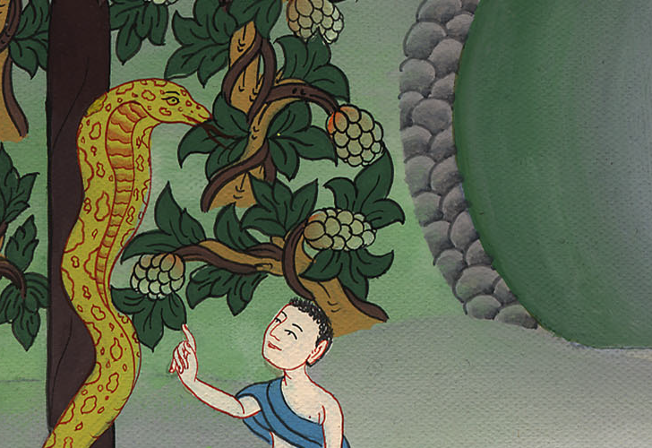
Numbers 21:8

Slide 15
1 Samuel
9Moses made a serpent of bronze, and set it on the pole. If a serpent had bitten any man, when he looked at the serpent of bronze, he lived.

Slide 16
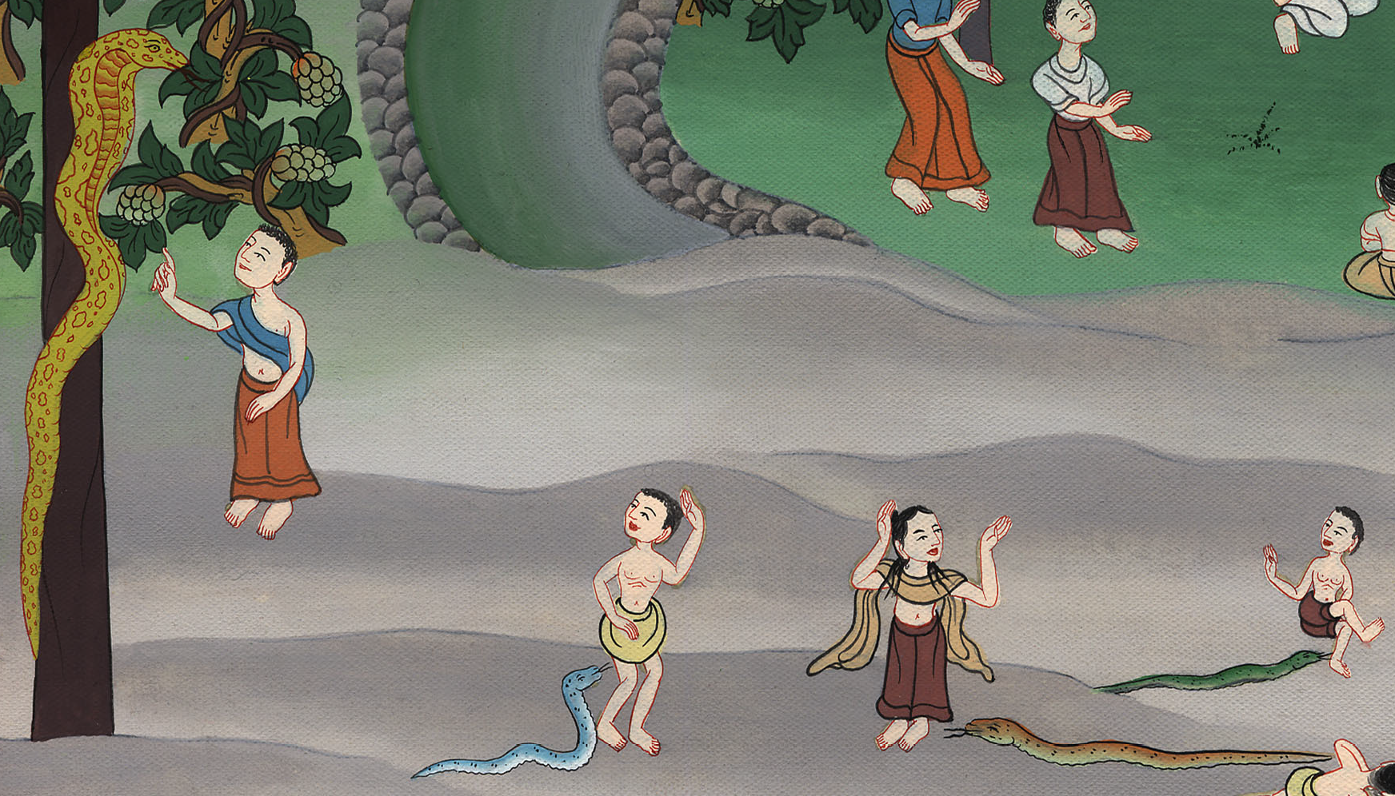
Numbers 21:9

