Slide 1
11-5
This work is licensed under a Creative Commons Attribution-Sharealike 4.0 International License.
Please add this statement to all the videos you create.
English Bible quotes are from the World English Bible US, which is in the public domain.
Notes:
checked

Slide 2
Balaam –
Numbers 22:1 – 24:25

Slide 3
1 Samuel
Balaam – Numbers 22:1 – 24:25 (Left Center)

Slide 4
Balaam –
Numbers 22:1 – 24:25

Slide 5
1 Samuel
Numbers 22:1The children of Israel traveled, and encamped in the plains of Moab beyond the Jordan at Jericho.

Slide 6
Numbers 22:1

Slide 7
1 Samuel
3Moab was very afraid of the people, because they were many. Moab was distressed because of the children of Israel.

Slide 8
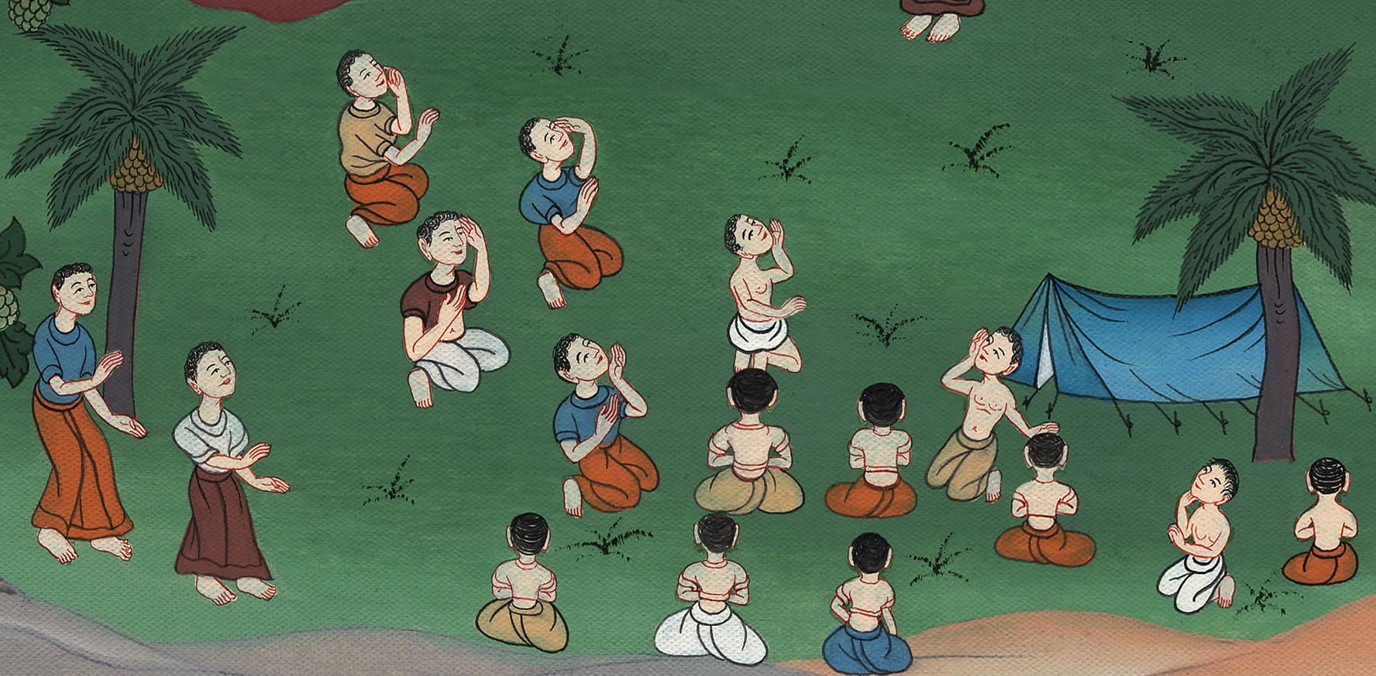
Numbers 22:3

Slide 9
^{4…}
Balak the son of Zippor was king of Moab at that time.
1 Samuel

Slide 10
Numbers 22:4

Slide 11
1 Samuel
5He sent messengers to (the prophet) Balaam. ……... saying, “Behold, there is a people who came out of Egypt. Behold, they cover the surface of the earth, and they are staying opposite me.

Slide 12
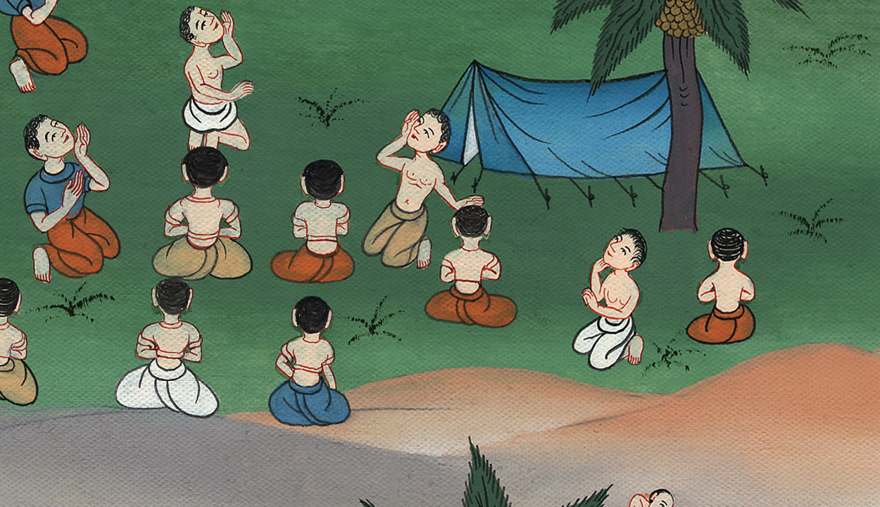
Numbers 22:5

Slide 13
1 Samuel
6Please come now therefore, and curse this people for me; … for I know that he whom you bless is blessed, and he whom you curse is cursed.”

Slide 14
Numbers 22:6

Slide 15
1 Samuel
12God said to Balaam, “You shall not go with them. You shall not curse the people, for they are blessed.”

Slide 16
Numbers 22:12

Slide 17
1 Samuel
15Balak again sent princes, more, and more honorable than they. …

Slide 18
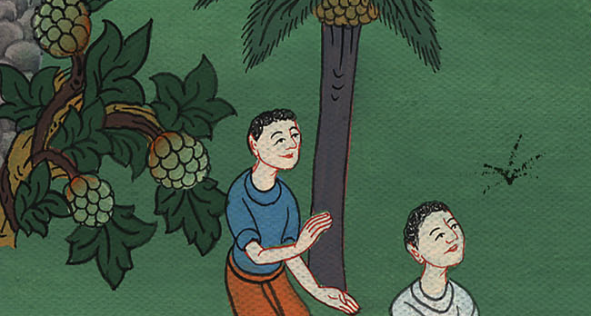
Numbers 22:15

Slide 19
1 Samuel
16They came to Balaam, and said to him, “…17 I will promote you to very great honor, and whatever you say to me I will do. Please come therefore, and curse this people for me.’”

Slide 20
Numbers 22:16,17

Slide 21
1 Samuel
20God came to Balaam at night, and said to him, “If the men have come to call you, rise up, go with them; but only the word which I speak to you, that you shall do.”

Slide 22
Numbers 22:20

Slide 23
1 Samuel
21Balaam rose up in the morning, and saddled his donkey, and went with the princes of Moab.

Slide 24
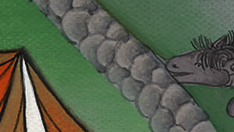
Numbers 22:21

Slide 25
1 Samuel
22God’s anger burned because he went; and Yahweh’s angel placed himself in the way as an adversary against him. Now he was riding on his donkey, …

Slide 26
Numbers 22:22

Slide 27
1 Samuel
23The donkey saw Yahweh’s angel standing in the way, with his sword drawn in his hand; and the donkey turned out of the path, and went into the field. Balaam struck the donkey, to turn her into the path.

Slide 28
Numbers 22:23

Slide 29
1 Samuel
24Then Yahweh’s angel stood in a narrow path between the vineyards, a wall being on this side, and a wall on that side.

Slide 30
Numbers 22:24

Slide 31
1 Samuel
25The donkey saw Yahweh’s angel, and she thrust herself to the wall, and crushed Balaam’s foot against the wall. He struck her again.

Slide 32
Numbers 22:25

Slide 33
1 Samuel
26Yahweh’s angel went further, and stood in a narrow place, where there was no way to turn either to the right hand or to the left.

Slide 34
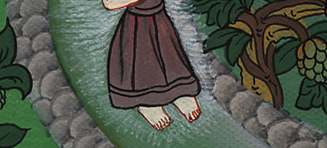
Numbers 22:26

Slide 35
1 Samuel
27The donkey saw Yahweh’s angel, and she lay down under Balaam. Balaam’s anger burned, and he struck the donkey with his staff.

Slide 36
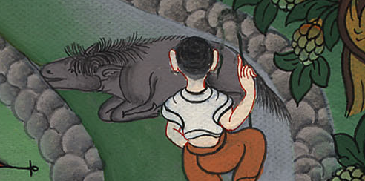
Numbers 22:27

Slide 37
1 Samuel
28Yahweh opened the mouth of the donkey, and she said to Balaam, “What have I done to you, that you have struck me these three times?”

Slide 38
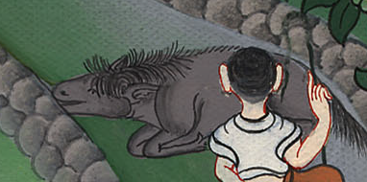
Numbers 22:28

Slide 39
1 Samuel
29Balaam said to the donkey, “Because you have mocked me, I wish there were a sword in my hand, for now I would have killed you.”

Slide 40
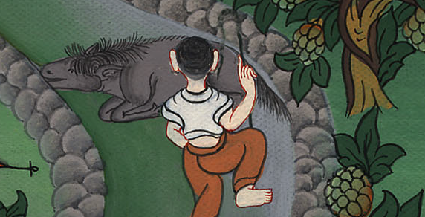
Numbers 22:29

Slide 41
1 Samuel
31Then Yahweh opened the eyes of Balaam, and he saw Yahweh’s angel standing in the way, with his sword drawn in his hand; and he bowed his head, and fell on his face.

Slide 42
Numbers 22:31

Slide 43
1 Samuel
34Balaam said to Yahweh’s angel, “I have sinned; for I didn’t know that you stood in the way against me. Now therefore, if it displeases you, I will go back again.”

Slide 44
Numbers 22:34

Slide 45
1 Samuel
35Yahweh’s angel said to Balaam, “Go with the men; but you shall only speak the word that I shall speak to you.”
So Balaam went with the princes of Balak.

Slide 46
Numbers 22:35

Slide 47
1 Samuel
36When Balak heard that Balaam had come, he went out to meet him. ………..

Slide 48
Numbers 22:36

Slide 49
1 Samuel
37Balak said to Balaam, “Didn’t I earnestly send for you to summon you? Why didn’t you come to me? Am I not able indeed to promote you to honor?”

Slide 50
Numbers 22:37

Slide 51
1 Samuel
38Balaam said to Balak, “Behold, I have come to you. Have I now any power at all to speak anything? I will speak the word that God puts in my mouth.”

Slide 52
Numbers 22:38

Slide 53
1 Samuel
23:18He took up his parable, and said,
“Rise up, Balak, and hear!
Listen to me,
…..

Slide 54
Numbers 23:18

Slide 55
1 Samuel
20Behold, I have received a command to bless.
He has blessed, and I can’t reverse it.

Slide 56
Numbers 23:20

Slide 57
1 Samuel
23Surely there is no enchantment with Jacob;
neither is there any divination with Israel.
Now it shall be said of Jacob and of Israel,
‘What has God done!’

Slide 58
Numbers 23:23

Slide 59
1 Samuel
Numbers24 (Then he spoke many blessings over Israel) 5How goodly are your tents, Jacob,
and your dwellings, Israel!

Slide 60
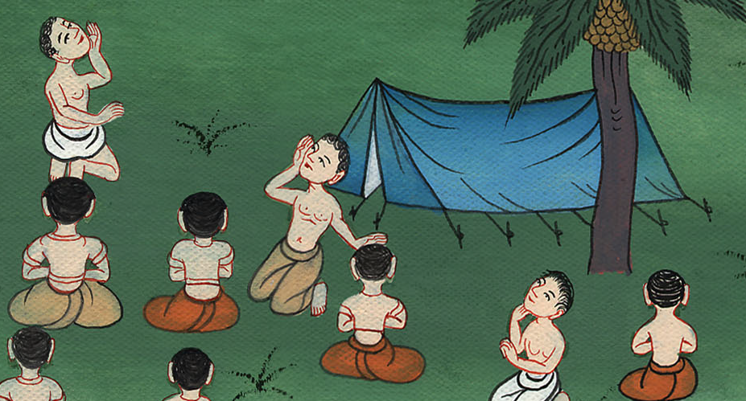
Numbers 24:5

Slide 61
1 Samuel
8God brings him out of Egypt.
He has as it were the strength of the wild ox.
He shall consume the nations his adversaries,

Slide 62
Numbers 24:8

Slide 63
1 Samuel
⁹ …
“Everyone who blesses you is blessed.
Everyone who curses you is cursed.”

Slide 64
Numbers 24:9

Slide 65
1 Samuel
10Balak’s anger burned against Balaam, and he struck his hands together. Balak said to Balaam, “I called you to curse my enemies, and, behold, you have altogether blessed them these three times.

Slide 66
Numbers 24:10

Slide 67
1 Samuel
11Therefore, flee to your place, now! I thought to promote you to great honor; but, behold, Yahweh has kept you back from honor.”

Slide 68
Numbers 24:11

Slide 69
1 Samuel
12Balaam said to Balak, “Didn’t I also tell your messengers whom you sent to me, saying, 13‘If Balak would give me his house full of silver and gold, I can’t go beyond Yahweh’s word, to do either good or bad from my own mind. I will say what Yahweh says’?

Slide 70
Numbers 24:12

Slide 71
1 Samuel
25Balaam rose up, and went and returned to his place; and Balak also went his way.

Slide 72
Numbers 24:25

