Slide 1
11-6
This work is licensed under a Creative Commons Attribution-Sharealike 4.0 International License.
Please add this statement to all the videos you create.
English Bible quotes are from the World English Bible US, which is in the public domain.
Notes:
checked

Slide 2
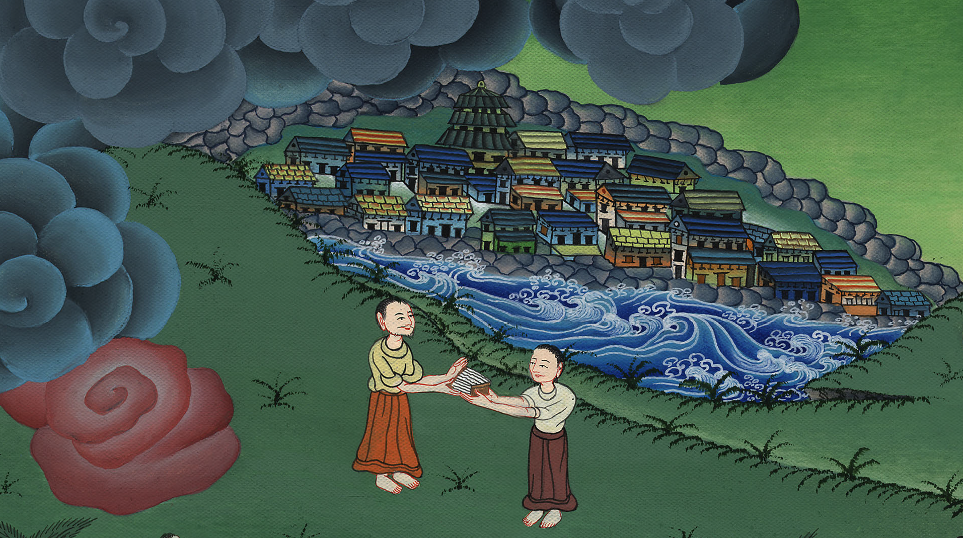
Joshua succeeds Moses –
Numbers 27:12-23; Deuteronomy 31:14 – 34:12

Slide 3
1 Samuel
Joshua succeeds Moses – Numbers 27:12-23; Deuteronomy 31:14 – 34:12 (Center

Slide 4
Joshua succeeds Moses –
Numbers 27:12-23; Deuteronomy 31:14 – 34:12

Slide 5
1 Samuel
The Israelites wandered as nomads in the desert for 40 years.

Slide 6
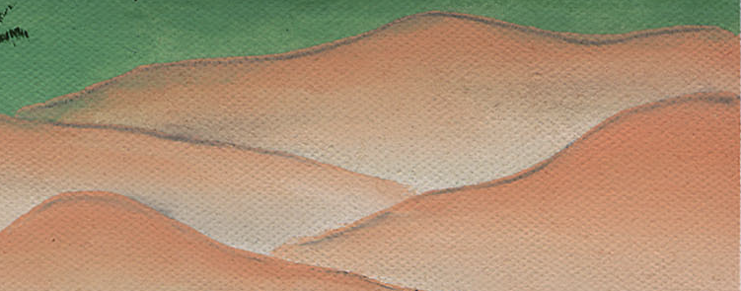

Slide 7
1 Samuel
Numbers27:12Yahweh said to Moses, “Go up into this mountain of Abarim, and see the land which I have given to the children of Israel.

Slide 8
Numbers 27:12

Slide 9
1 Samuel
13When you have seen it, you also shall be gathered to your people, as Aaron your brother was gathered;

Slide 10
Numbers 27:13

Slide 11
1 Samuel
15Moses spoke to Yahweh, saying, 16“Let Yahweh, the God of the spirits of all flesh, appoint a man over the congregation,

Slide 12
Numbers 27:15

Slide 13
1 Samuel
17who may go out before them, and who may come in before them, and who may lead them out, and who may bring them in, that the congregation of Yahweh may not be as sheep which have no shepherd.”

Slide 14
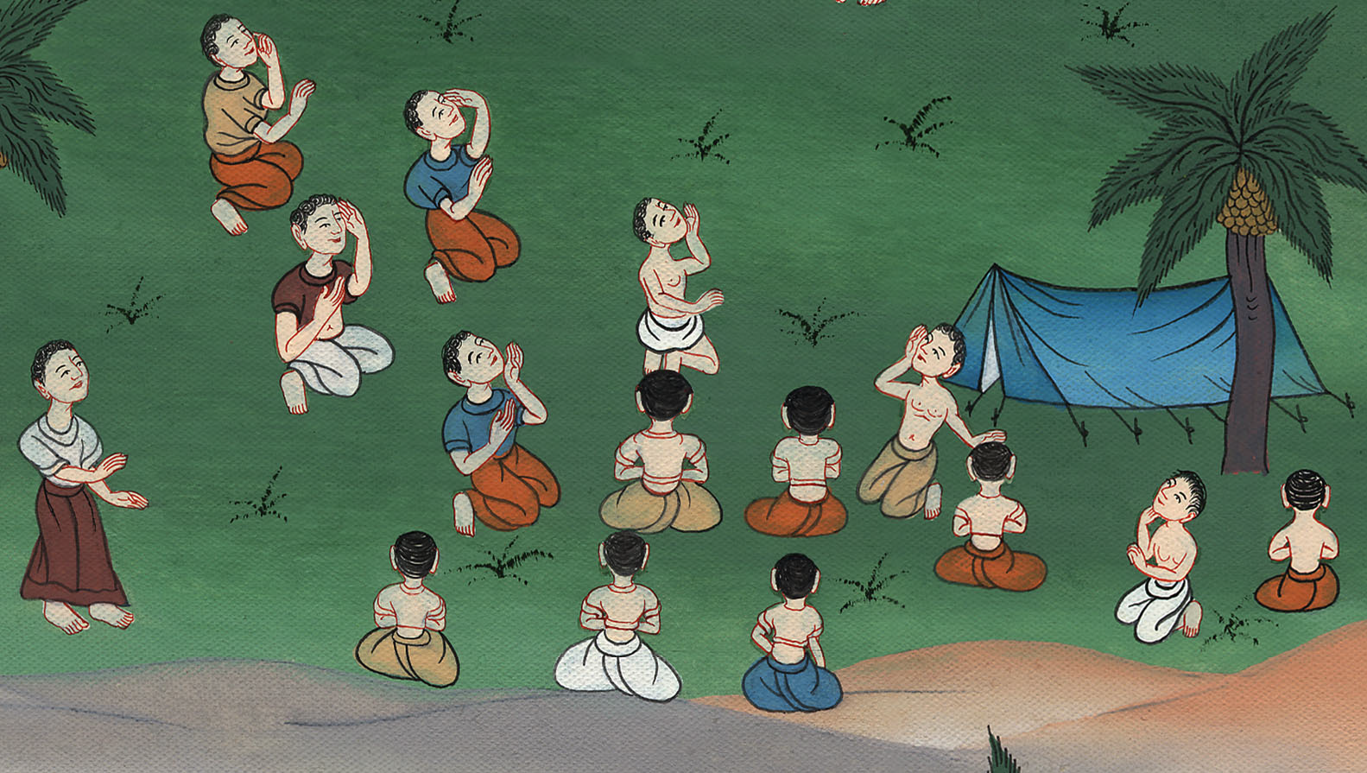
Numbers 27:17

Slide 15
1 Samuel
18Yahweh said to Moses, “Take Joshua the son of Nun, a man in whom is the Spirit, and lay your hand on him.

Slide 16
Numbers 27:18

Slide 17
1 Samuel
19Set him before Eleazar the priest, and before all the congregation; and commission him in their sight.

Slide 18
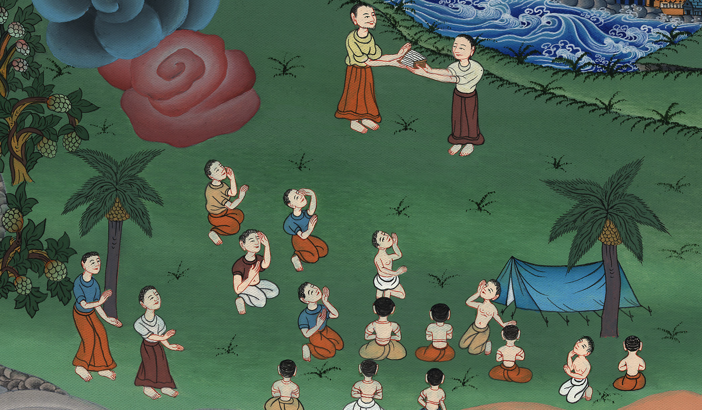
Numbers 27:19

Slide 19
1 Samuel
23He laid his hands on him and commissioned him, as Yahweh spoke by Moses.

Slide 20
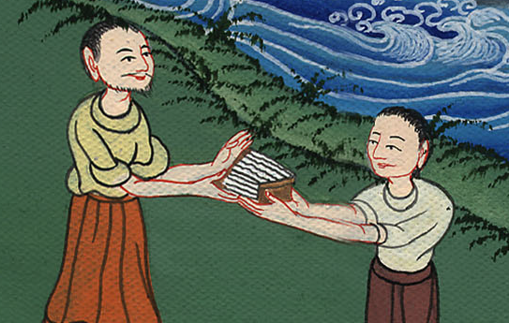
Numbers 27:23

Slide 21
1 Samuel
DEUTERONOMY 31
23He commissioned Joshua the son of Nun, and said, “Be strong and courageous; for you shall bring the children of Israel into the land which I swore to them. I will be with you.”

Slide 22
Deuteronomy 31:23

Slide 23
1 Samuel
5So Moses the servant of Yahweh died there in the land of Moab, according to Yahweh’s word.

Slide 24
Deuteronomy 34:5

Slide 25
1 Samuel
6He buried him in the valley in the land of Moab opposite Beth Peor, but no man knows where his tomb is to this day.

Slide 26
Deuteronomy 34:6

Slide 27
1 Samuel
7Moses was one hundred twenty years old when he died. His eye was not dim, nor his strength gone.

Slide 28
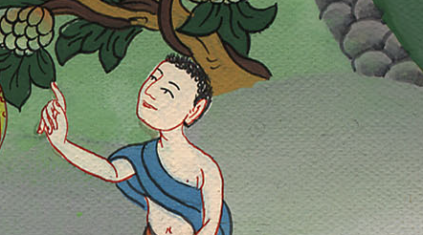
Deuteronomy 34:7

Slide 29
1 Samuel
10Since then, there has not arisen a prophet in Israel like Moses, whom Yahweh knew face to face,

Slide 30
Deuteronomy 34:10

