Slide 1
12-1
This work is licensed under a Creative Commons Attribution-ShareAlike 4.0 International License.
Please add this statement to all the videos you create.
English Bible quotes are from the World English Bible US, which is in the public domain.

Slide 2
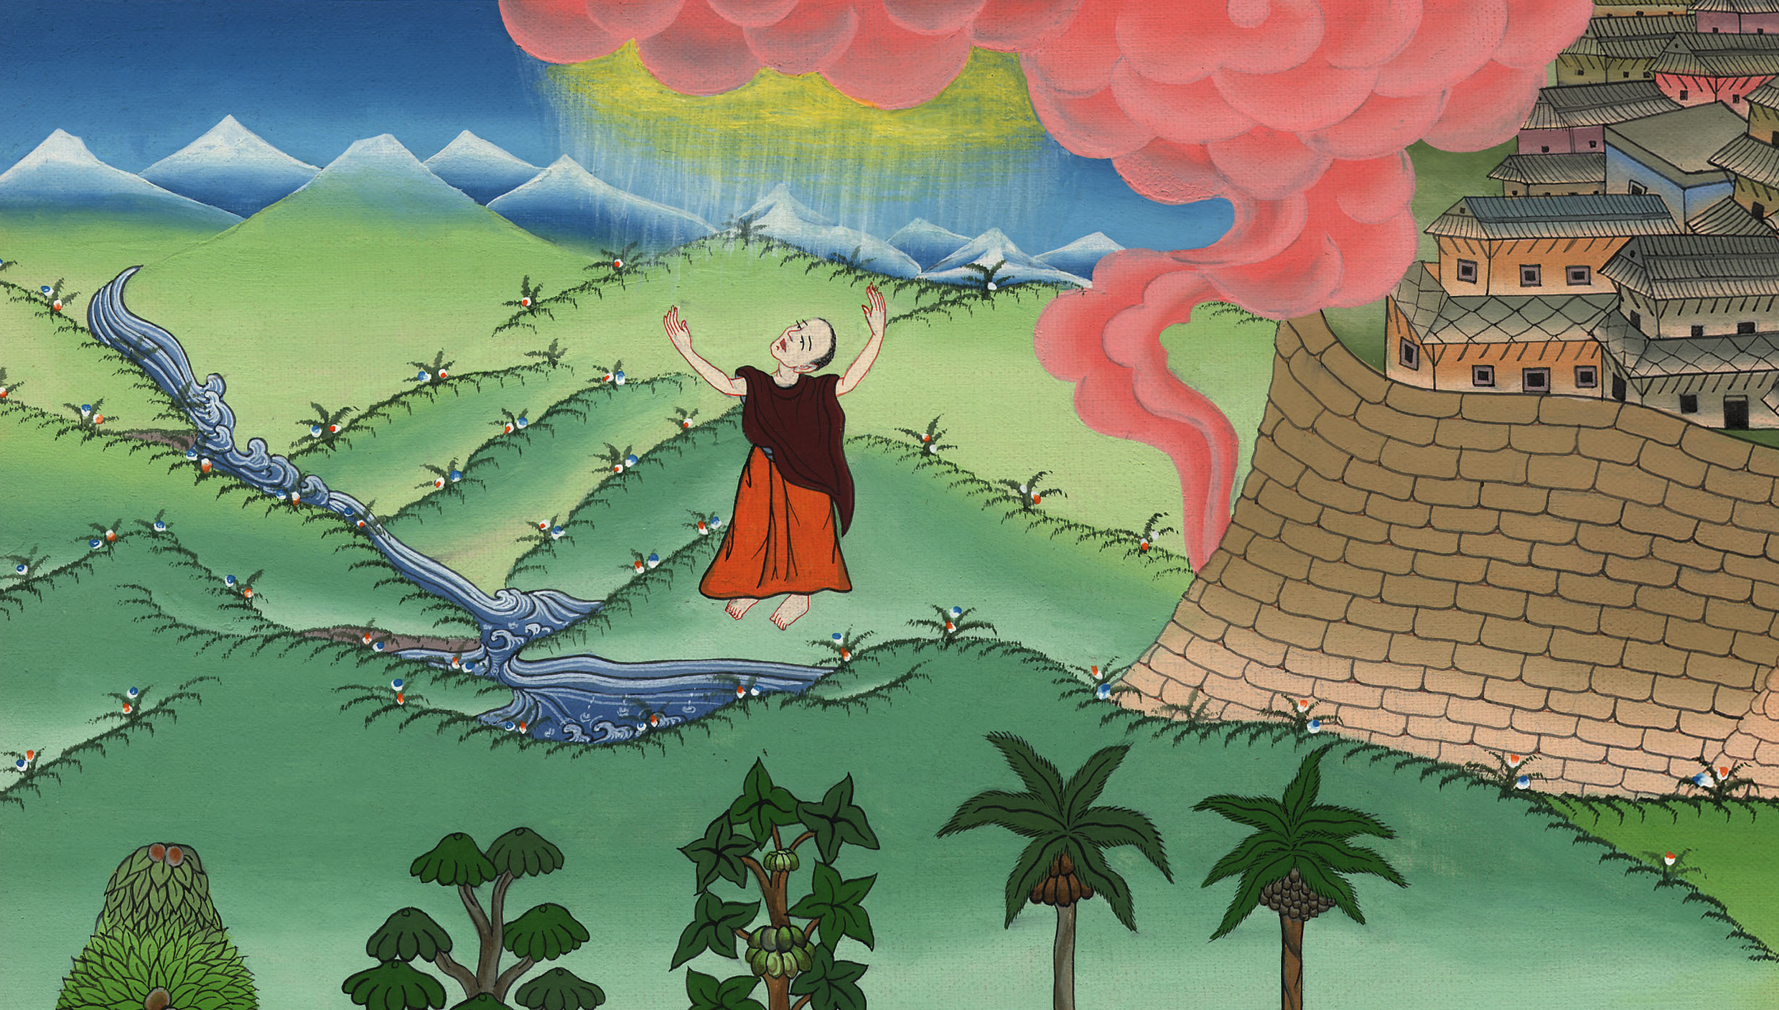
God commissions Joshua –
Joshua 1:1-9

Slide 3
God commissions Joshua - Joshua 1:1-9
Notes:
12 Joshua
2. Spies and Rahab - Joshua 2:1-24 (Right Top)
3. Crossing of the Jordan – Joshua 3:1 – 4:7 (2nd from Top)
4. Capture of Jericho – Joshua 5:13 – 6:25 (3rd from Top)
5. Defeat at Ai - Joshua 7:1-26 (Right Bottom)
6. Sun stands still – Joshua 10:6-14 (Left Bottom)

Slide 4
God commissions Joshua –
Joshua 1:1-9

Slide 5
JOSHUA 1
1Now after the death of Moses the servant of Yahweh, Yahweh spoke to Joshua the son of Nun, Moses’ servant, saying,

Slide 6
Joshua 1:1

Slide 7
2“Moses my servant is dead. Now therefore arise, go across this Jordan, you and all these people, to the land which I am giving to them, even to the children of Israel.

Slide 8
Joshua 1:2

Slide 9
3I have given you every place that the sole of your foot will tread on, as I told Moses.

Slide 10
Joshua 1:3

Slide 11
5No man will be able to stand before you all the days of your life. As I was with Moses, so I will be with you. I will not fail you nor forsake you.

Slide 12
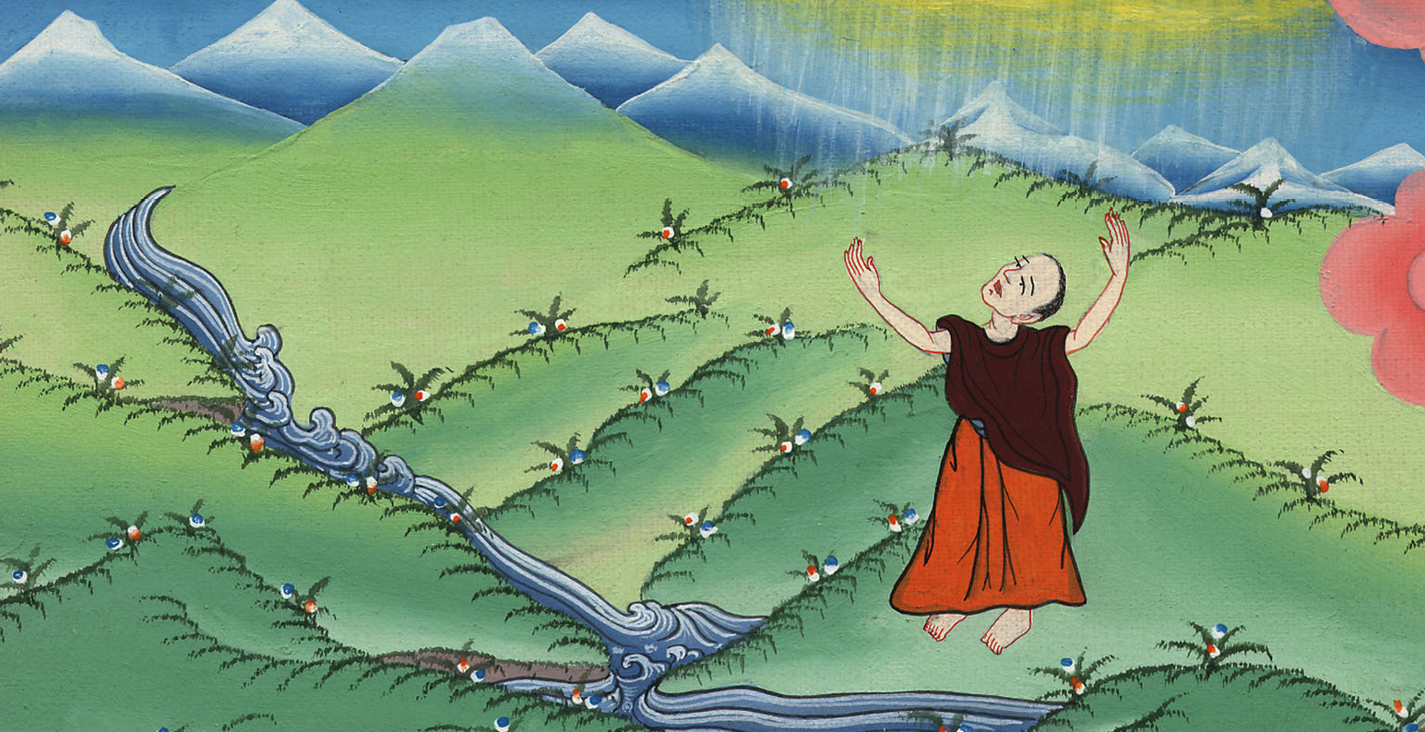
Joshua 1:5

Slide 13
6“Be strong and courageous; for you shall cause this people to inherit the land which I swore to their fathers to give them.

Slide 14
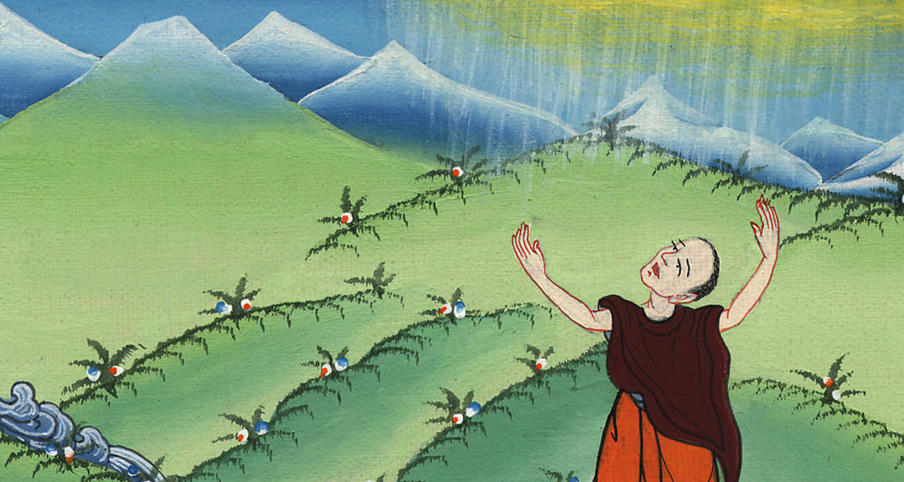
Joshua 1:6

Slide 15
7Only be strong and very courageous. Be careful to observe to do according to all the law which Moses my servant commanded you. Don’t turn from it to the right hand or to the left, that you may have good success wherever you go.

Slide 16
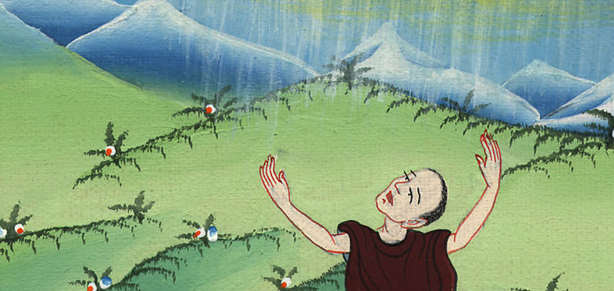
Joshua 1:7

Slide 17
8This book of the law shall not depart from your mouth, but you shall meditate on it day and night, that you may observe to do according to all that is written in it; for then you shall make your way prosperous, and then you shall have good success.

Slide 18
Joshua 1:8

Slide 19
9Haven’t I commanded you? Be strong and courageous. Don’t be afraid. Don’t be dismayed, for Yahweh your God is with you wherever you go.”

Slide 20
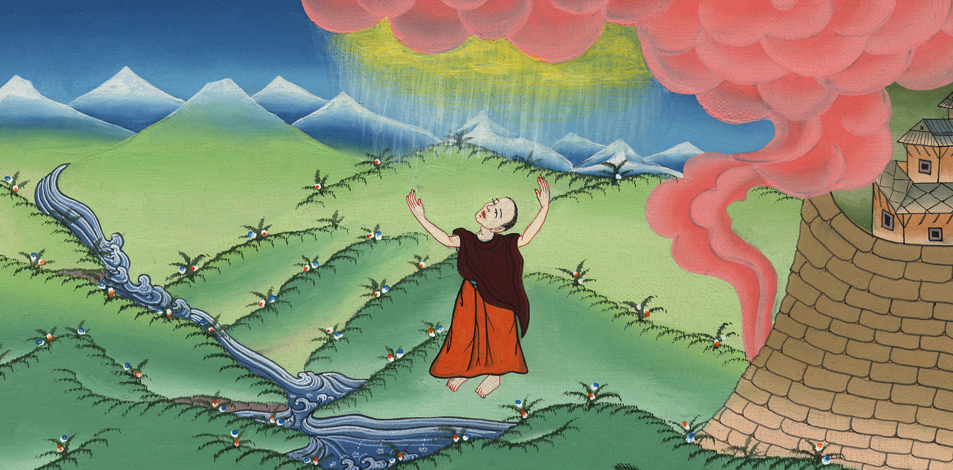
Joshua 1:9

