Slide 1
12-2
This work is licensed under a Creative Commons Attribution-ShareAlike 4.0 International License.
Please add this statement to all the videos you create.
English Bible quotes are from the World English Bible US, which is in the public domain.
Notes:
checked

Slide 2
Spies and Rahab –
Joshua 2:1-24

Slide 3
Spies and Rahab –
Joshua 2:1-24

Slide 4
Spies and Rahab –
Joshua 2:1-24

Slide 5
1Joshua… secretly sent two men… as spies, saying, “Go, view the land, including Jericho.” They went and came into the house of a prostitute whose name was Rahab, and slept there.

Slide 6
Joshua 2:1

Slide 7
2The king of Jericho was told, “Behold, men of the children of Israel came in here tonight to spy out the land.”

Slide 8
Joshua 2:2

Slide 9
3Jericho’s king sent to Rahab, saying, “Bring out the men who have come to you, who have entered into your house; for they have come to spy out all the land.”

Slide 10
Joshua 2:3

Slide 11
4The woman took the two men and hid them. Then she said, “Yes, the men came to me, but I didn’t know where they came from.

Slide 12
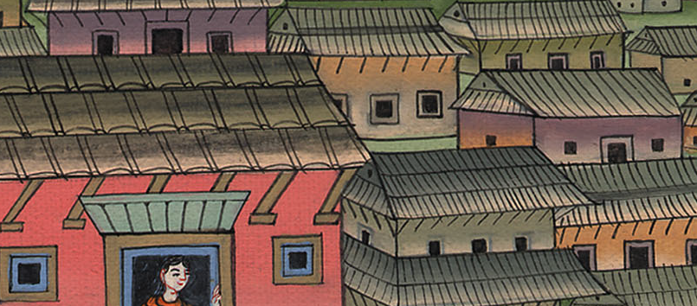
Joshua 2:4

Slide 13
5About the time of the shutting of the gate, when it was dark, the men went out. Where the men went, I don’t know. Pursue them quickly. You may catch up with them.”

Slide 14
Joshua 2:5

Slide 15
6But she had brought them up to the roof, and hidden them under the stalks of flax which she had laid in order on the roof.

Slide 16
Joshua 2:6

Slide 17
9She said to the men, “I know that Yahweh has given you the land, and that the fear of you has fallen upon us, and that all the inhabitants of the land melt away before you.

Slide 18
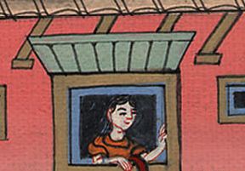
Joshua 2:9

Slide 19
10For we have heard how Yahweh dried up the water of the Red Sea before you, when you came out of Egypt; and what you did to (your enemies), whom you utterly destroyed.

Slide 20
Joshua 2:10

Slide 21
11As soon as we had heard it, our hearts melted, and there wasn’t any more spirit in any man, because of you: for Yahweh your God, he is God in heaven above, and on earth beneath.

Slide 22
Joshua 2:11

Slide 23
12Now therefore, please swear to me by Yahweh, since I have dealt kindly with you, that you also will deal kindly with my father’s house, and give me a true sign; 13and (that you will spare me and my family)

Slide 24
Joshua 2:12

Slide 25
14The men said to her, “Our life for yours, if you don’t talk about this business of ours;

Slide 26
Joshua 2:14

Slide 27
and it shall be, when Yahweh gives us the land, that we will deal kindly and truly with you.”

Slide 28
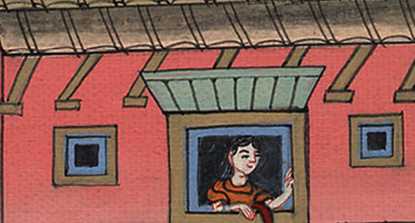
Joshua 2:14

Slide 29
15Then she let them down by a cord through the window; for her house was on the side of the wall, and she lived on the wall.

Slide 30
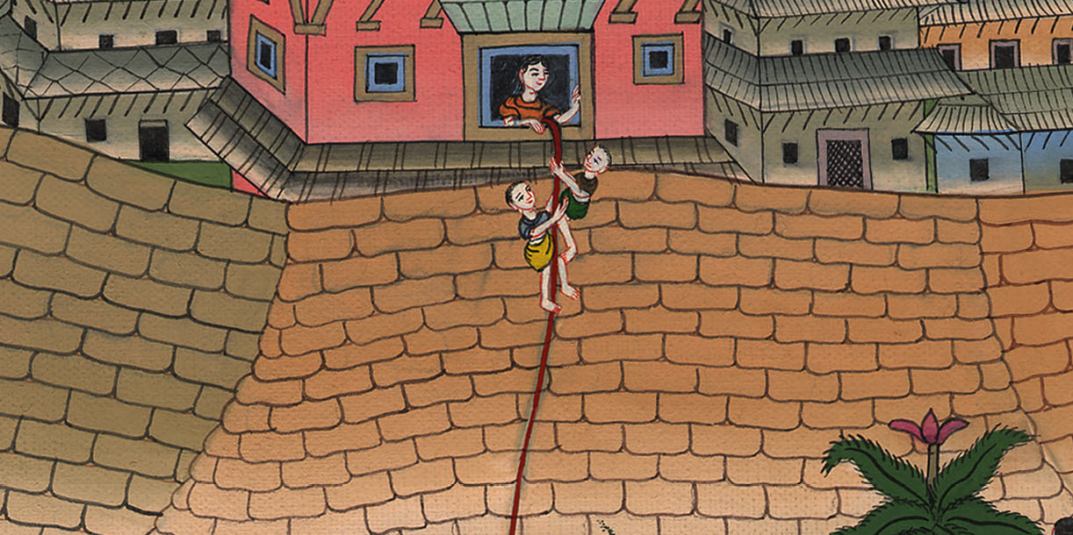
Joshua 2:15

Slide 31
17The men said to her, “We will be guiltless of this your oath which you’ve made us to swear. 18Behold, when we come into the land, tie this line of scarlet thread in the window which you used to let us down. Gather to yourself into the house your father, your mother, your brothers, and all your father’s household.

Slide 32
Joshua 2:18

Slide 33
21She said, “Let it be as you have said.” She sent them away, and they departed. Then she tied the scarlet line in the window.

Slide 34
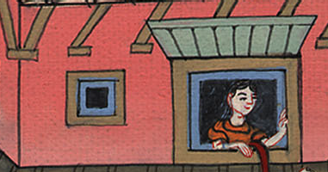
Joshua 2:21

Slide 35
23Then the two men returned, descended from the mountain, crossed the river, and came to Joshua the son of Nun. They told him all that had happened to them.

Slide 36
Joshua 2:23

Slide 37
24They said to Joshua, “Truly Yahweh has delivered all the land into our hands. Moreover, all the inhabitants of the land melt away before us.”

Slide 38
Joshua 2:24

