Slide 1
12-3
This work is licensed under a Creative Commons Attribution-ShareAlike 4.0 International License.
Please add this statement to all the videos you create.
English Bible quotes are from the World English Bible US, which is in the public domain.
Notes:
checked

Slide 2
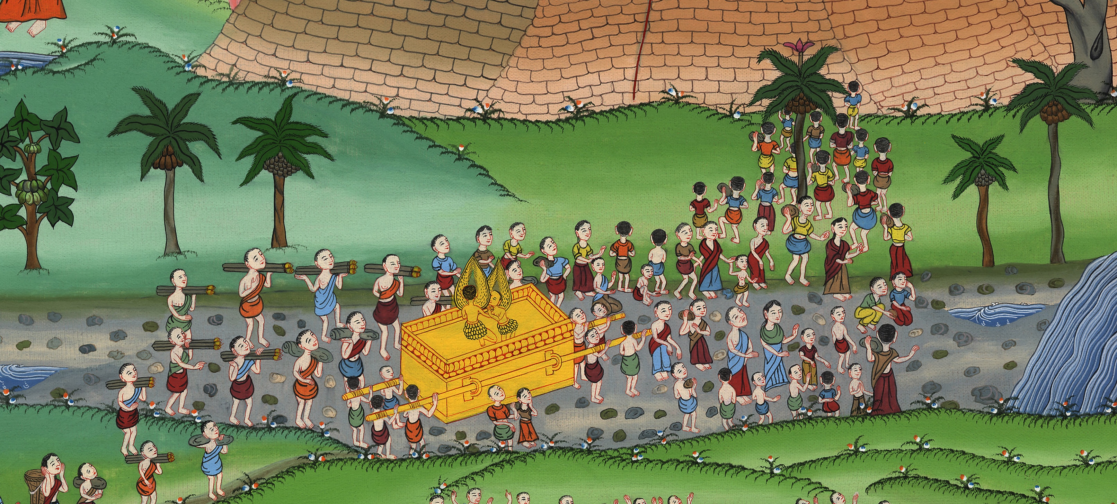
Crossing of the Jordan – Joshua 3:1-4:7

Slide 3
Crossing of the Jordan – Joshua 3:1-4:7

Slide 4
Crossing of the Jordan – Joshua 3:1-4:7

Slide 5
1Joshua got up early in the morning; and they moved from Shittim and came to the Jordan, he and all the children of Israel. They camped there (for three days) before they crossed over.

Slide 6
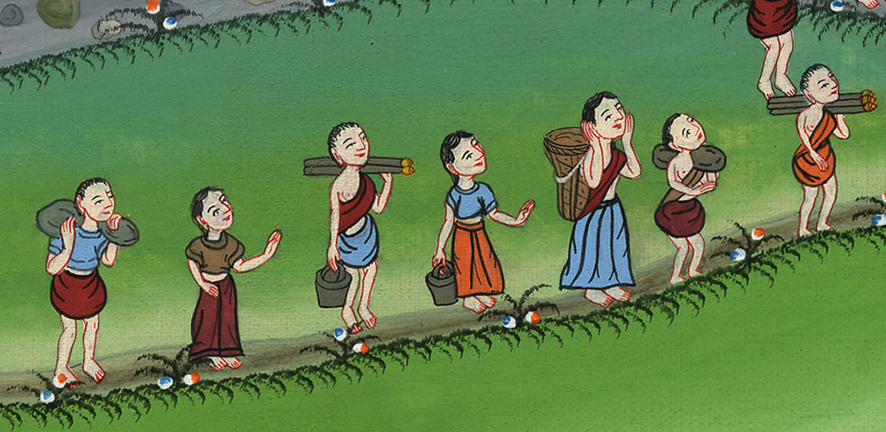
Joshua 3:1

Slide 7
5Joshua said to the people, “Sanctify yourselves; for tomorrow Yahweh will do wonders among you.”

Slide 8
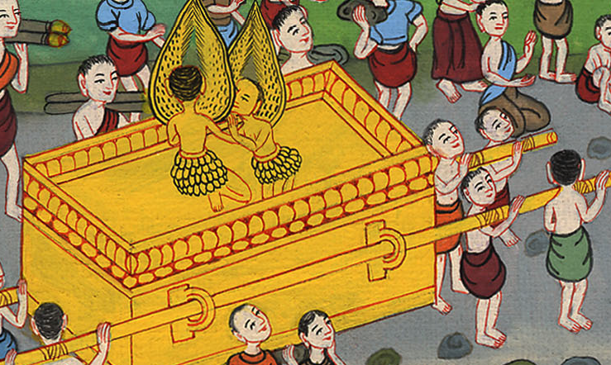
Joshua 3:5

Slide 9
6Joshua spoke to the priests, saying, “Take up the ark of the covenant, and cross over before the people.” They took up the ark of the covenant, and went before the people.

Slide 10
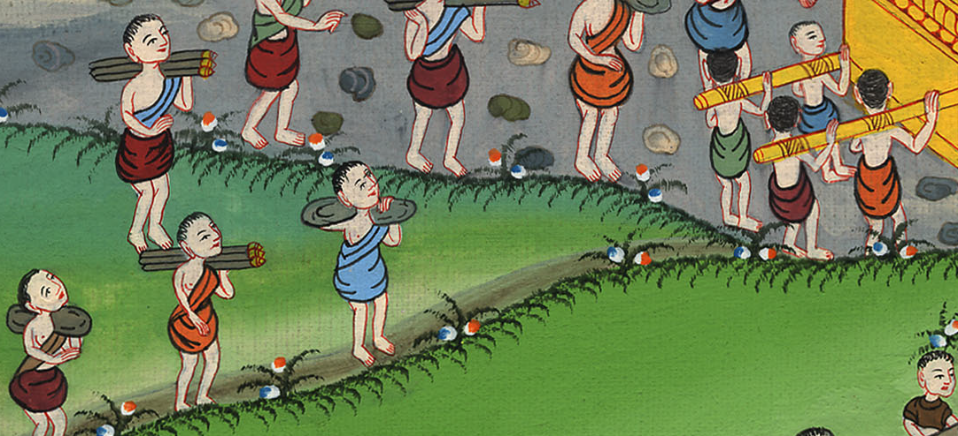
Joshua 3:6

Slide 11
9Joshua said to the children of Israel, “Come here, and hear the words of Yahweh your God.”

Slide 12
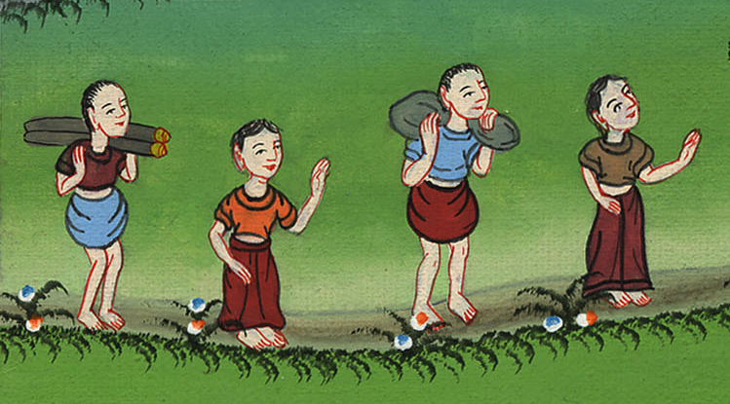
Joshua 3:9

Slide 13
10Joshua said, “By this you shall know that the living God is among you, and that he will without fail drive out (our enemies who now live in this land) from before you.

Slide 14
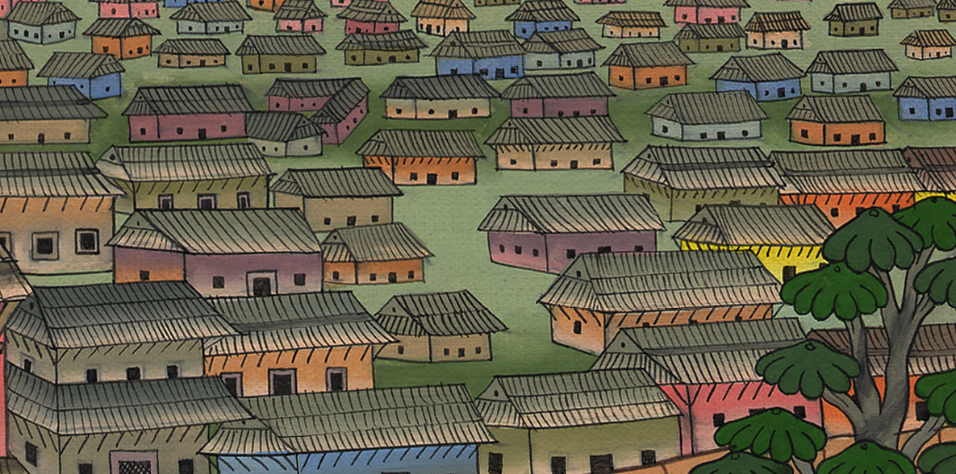
Joshua 3:10

Slide 15
13It shall be that when the soles of the feet of the priests who bear the ark of Yahweh, the Lord of all the earth, rest in the waters of the Jordan, that the waters of the Jordan will be cut off. The waters that come down from above shall stand in one heap.”

Slide 16
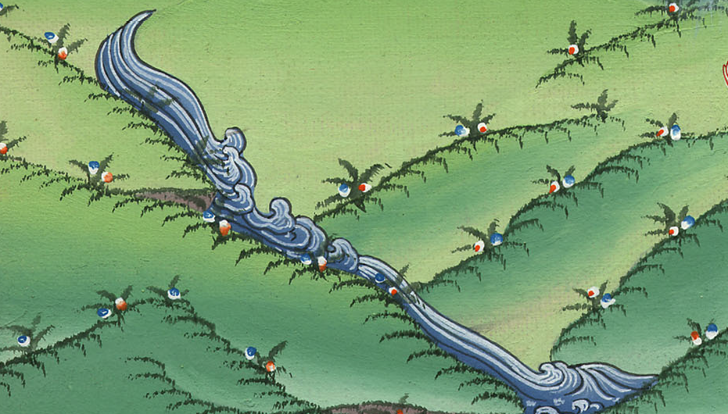
Joshua 3:13

Slide 17
15and when those who bore the ark had come to the Jordan, and the feet of the priests who bore the ark had dipped in the edge of the water (for the Jordan overflows all its banks all the time of harvest),

Slide 18
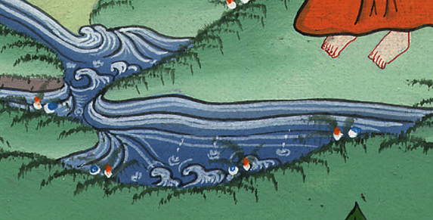
Joshua 3:15

Slide 19
16the waters which came down from above stood, and rose up in one heap a great way off …Then the people passed over near Jericho.

Slide 20
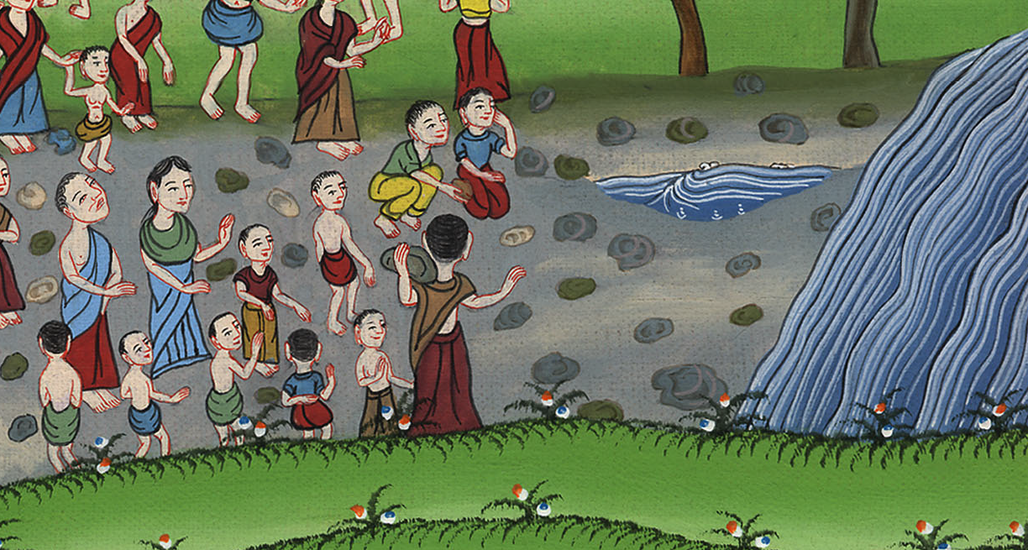
Joshua 3:16

Slide 21
17The priests who bore the ark of Yahweh’s covenant stood firm on dry ground in the middle of the Jordan; and all Israel crossed over on dry ground, until all the nation had passed completely over the Jordan.

Slide 22
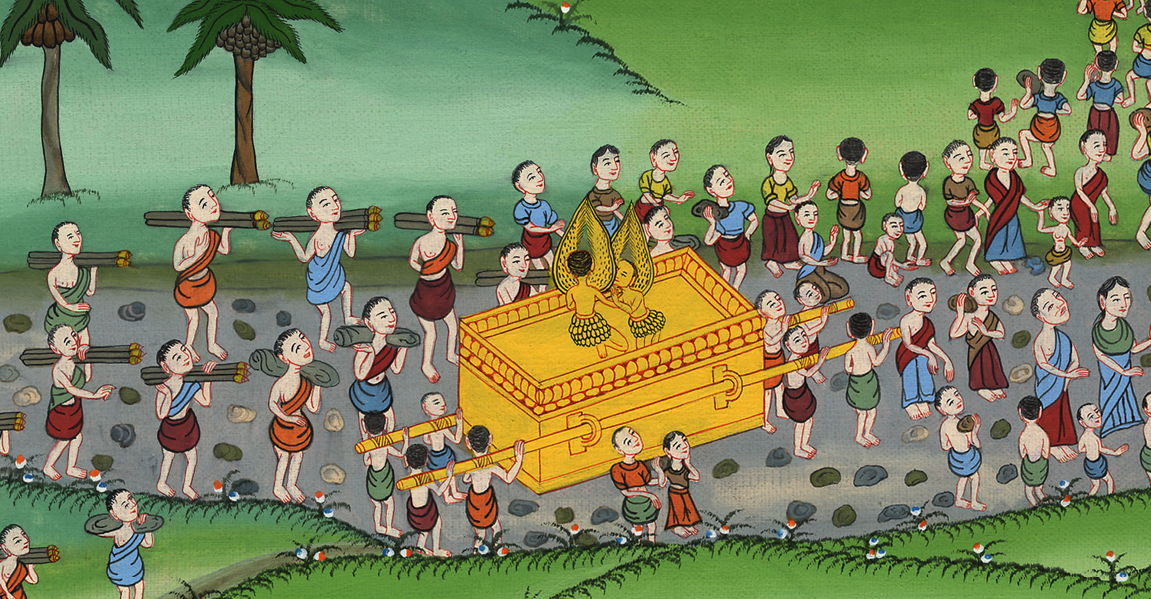
Joshua 3:17

Slide 23
1When all the nation had completely crossed over the Jordan, Yahweh spoke to Joshua, saying, 2“Take twelve men out of the people, a man out of every tribe,

Slide 24
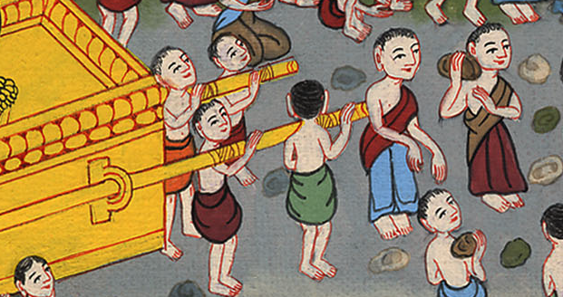
Joshua 4:1

Slide 25
3and command them, saying, ‘Take from out of the middle of the Jordan, out of the place where the priests’ feet stood firm, twelve stones, carry them over with you, and lay them down in the place where you’ll camp tonight.’”

Slide 26
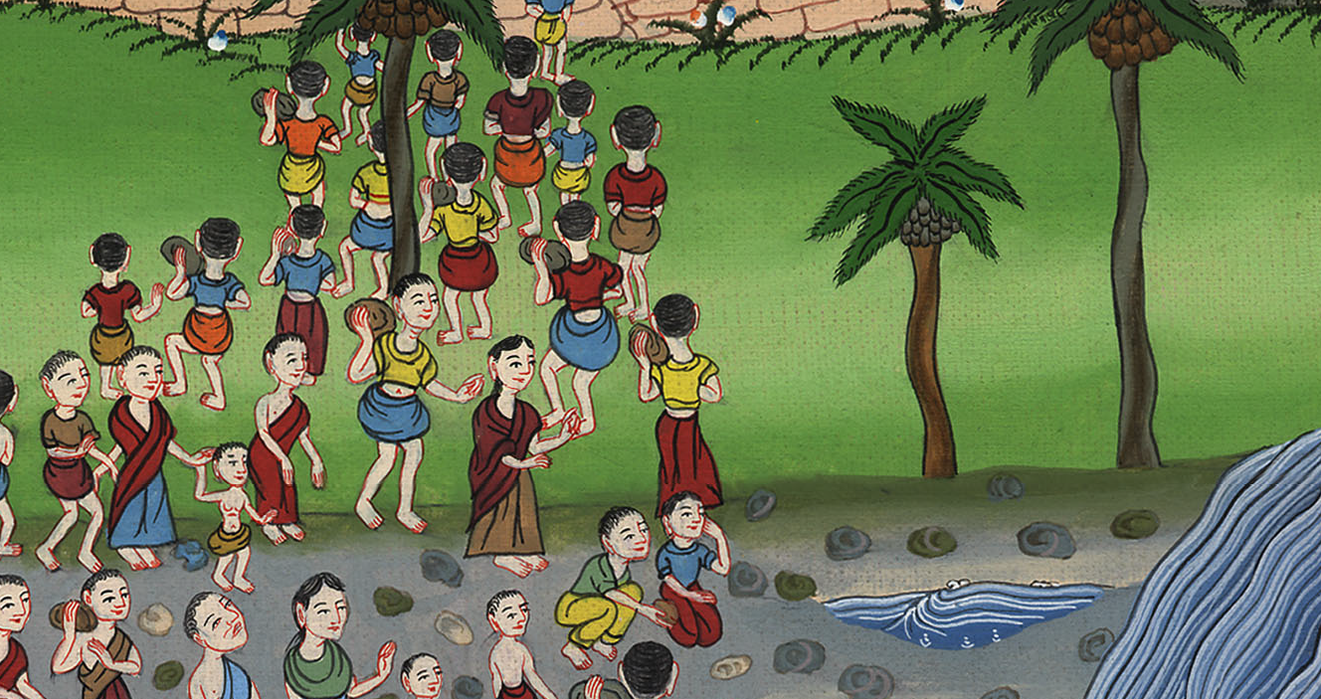
Joshua 4:3

Slide 27
6that this may be a sign among you, that when your children ask in the future, saying, ‘What do you mean by these stones?’

Slide 28
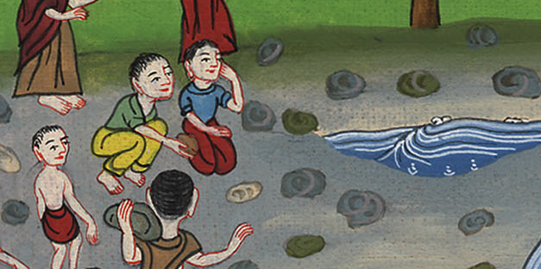
Joshua 4:6

Slide 29
7then you shall tell them, ‘Because the waters of the Jordan were cut off before the ark of Yahweh’s covenant. When it crossed over the Jordan, the waters of the Jordan were cut off. These stones shall be for a memorial to the children of Israel forever.’”

Slide 30
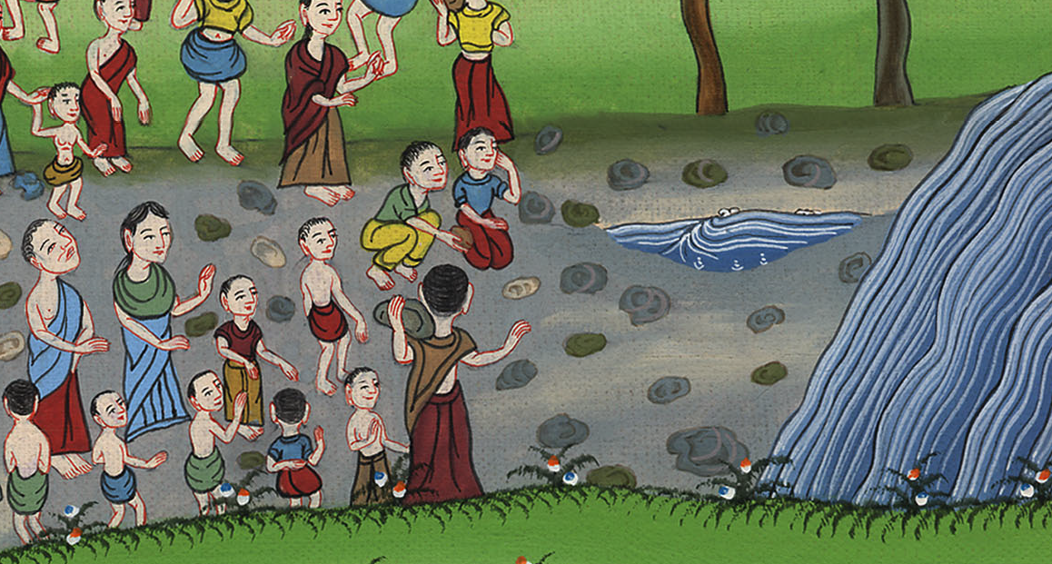
Joshua 4:7

