Slide 1
12-4
This work is licensed under a Creative Commons Attribution-ShareAlike 4.0 International License.
Please add this statement to all the videos you create.
English Bible quotes are from the World English Bible US, which is in the public domain.
Notes:
checked

Slide 2
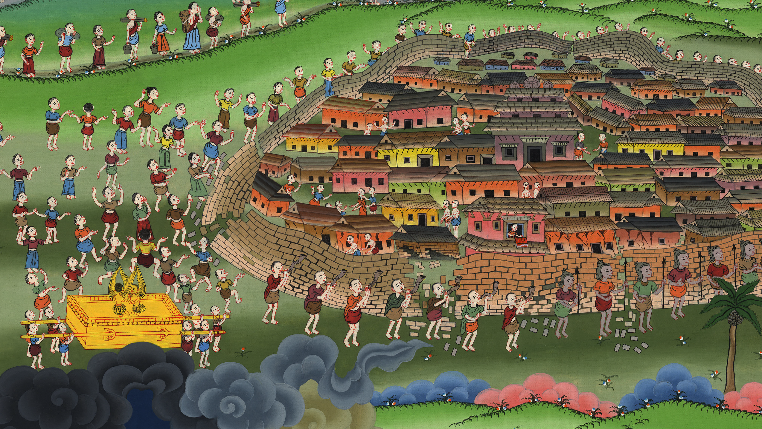
Capture of Jericho – Joshua 6:1-25

Slide 3
Capture of Jericho – Joshua 6:1-25

Slide 4
Capture of Jericho – Joshua 6:1-25

Slide 5
1Now Jericho was tightly shut up because of the children of Israel. No one went out, and no one came in.

Slide 6
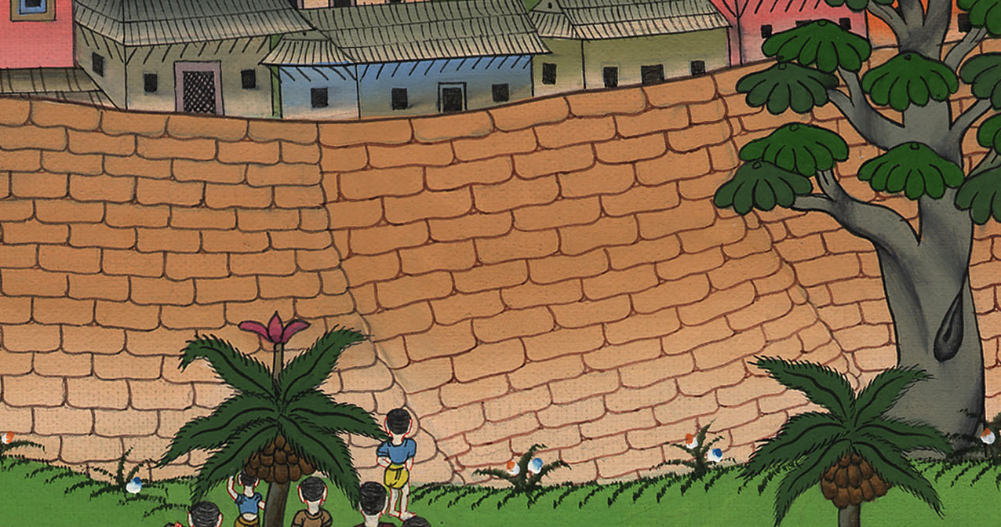
Joshua 6:1

Slide 7
2Yahweh said to Joshua, “Behold, I have given Jericho into your hand, with its king and the mighty men of valor.

Slide 8
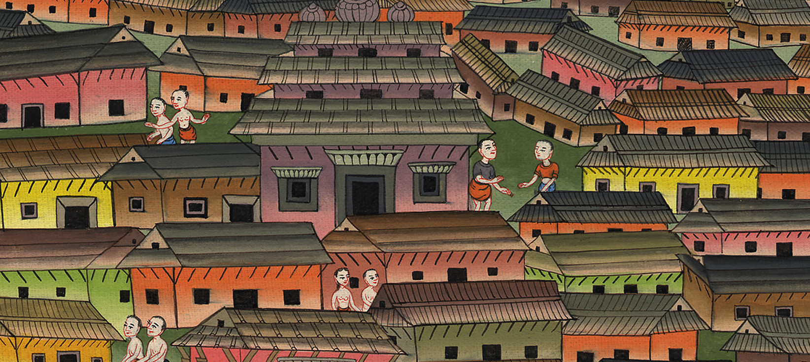
Joshua 6:2

Slide 9
3All of your men of war shall march around the city, going around the city once. You shall do this six days.

Slide 10
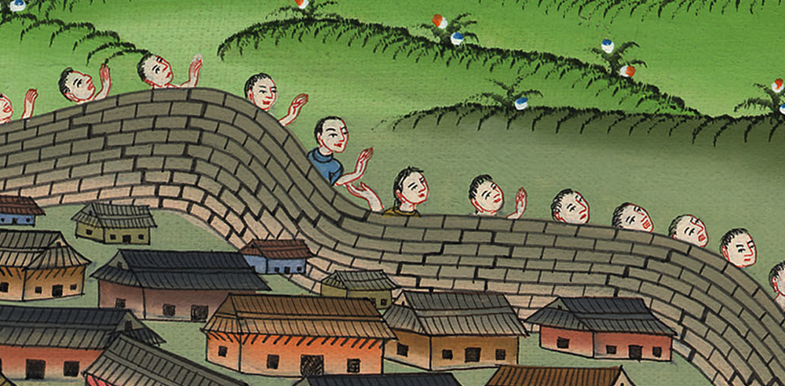
Joshua 6:3

Slide 11
6Joshua the son of Nun called the priests, and said to them, “Take up the ark of the covenant, and let seven priests bear seven trumpets of rams’ horns before Yahweh’s ark.”

Slide 12
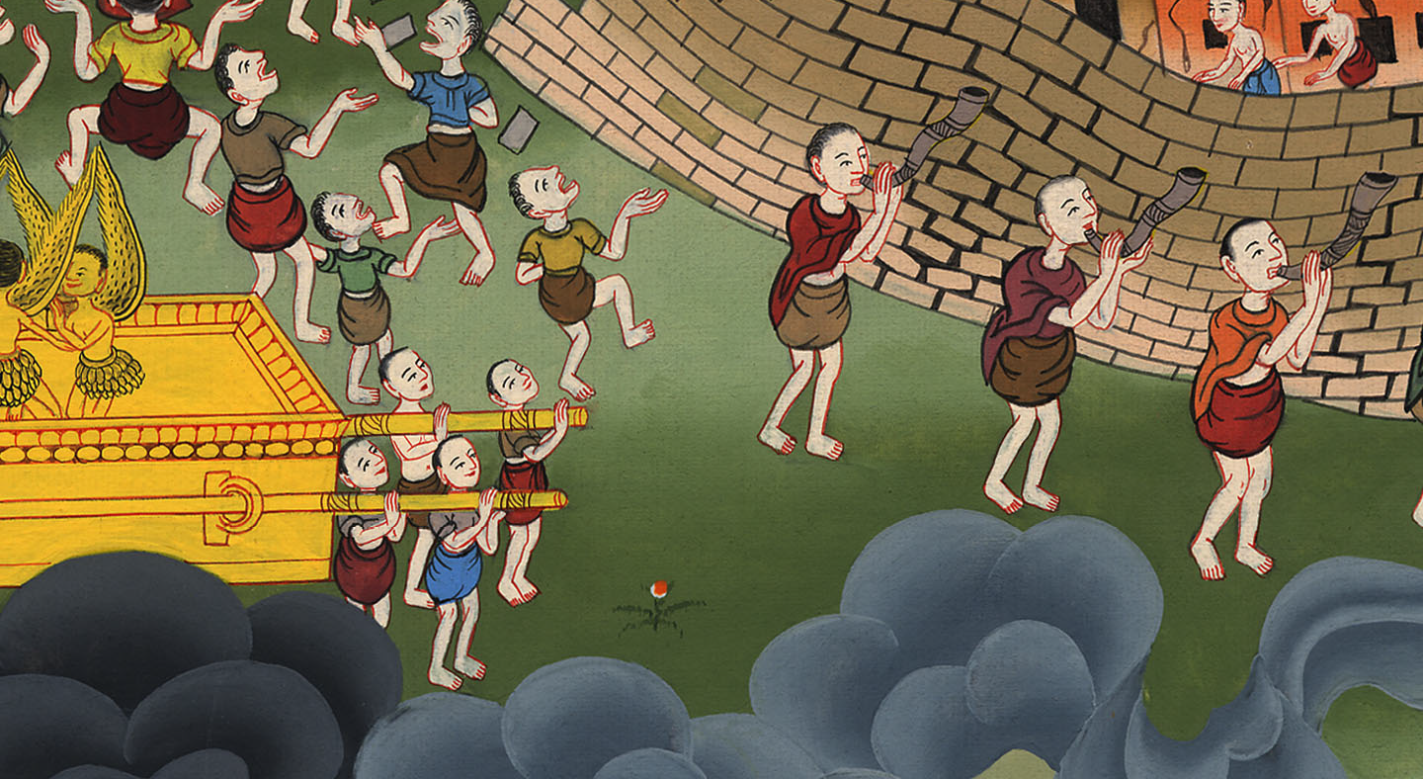
Joshua 6:6

Slide 13
7They said to the people, “Advance! March around the city, …”

Slide 14
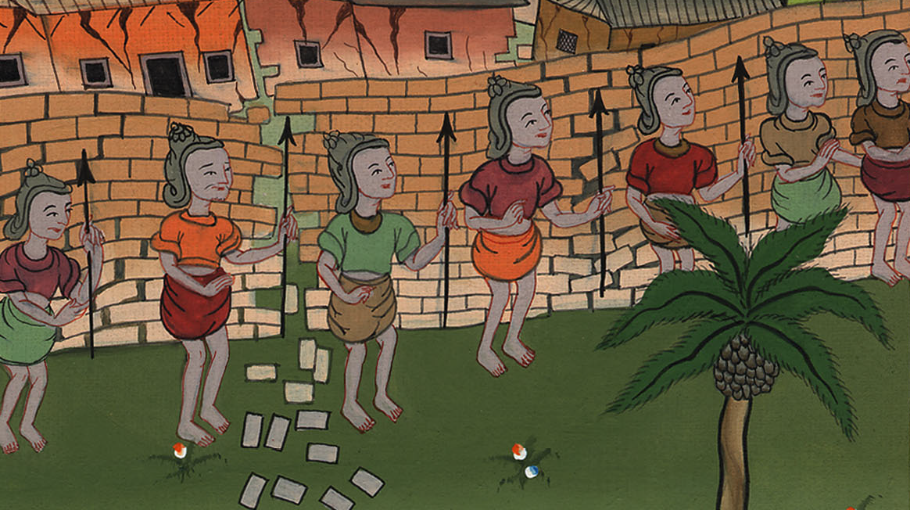
Joshua 6:7

Slide 15
10Joshua commanded the people, saying, “You shall not shout nor let your voice be heard, neither shall any word proceed out of your mouth until the day I tell you to shout. Then you shall shout.”

Slide 16
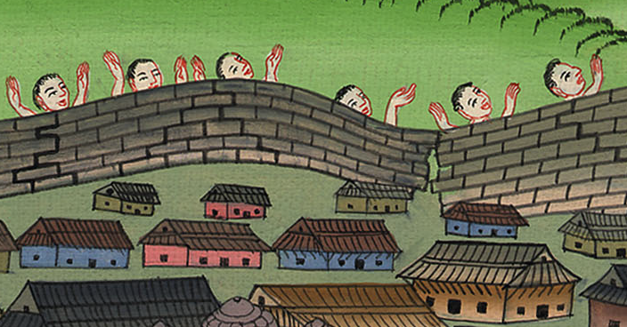
Joshua 6:10

Slide 17
11So he caused Yahweh’s ark to go around the city, circling it once. Then they came into the camp, and stayed in the camp.

Slide 18
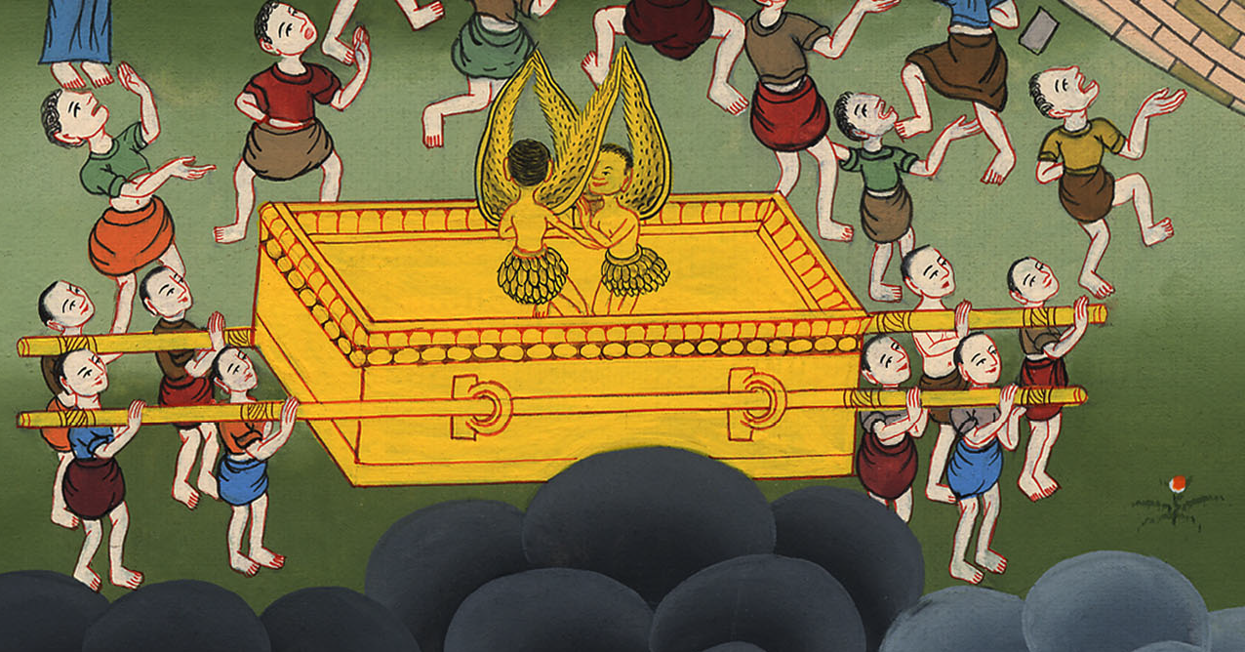
Joshua 6:11

Slide 19
14The second day they marched around the city once, and returned into the camp. They did this six days.

Slide 20
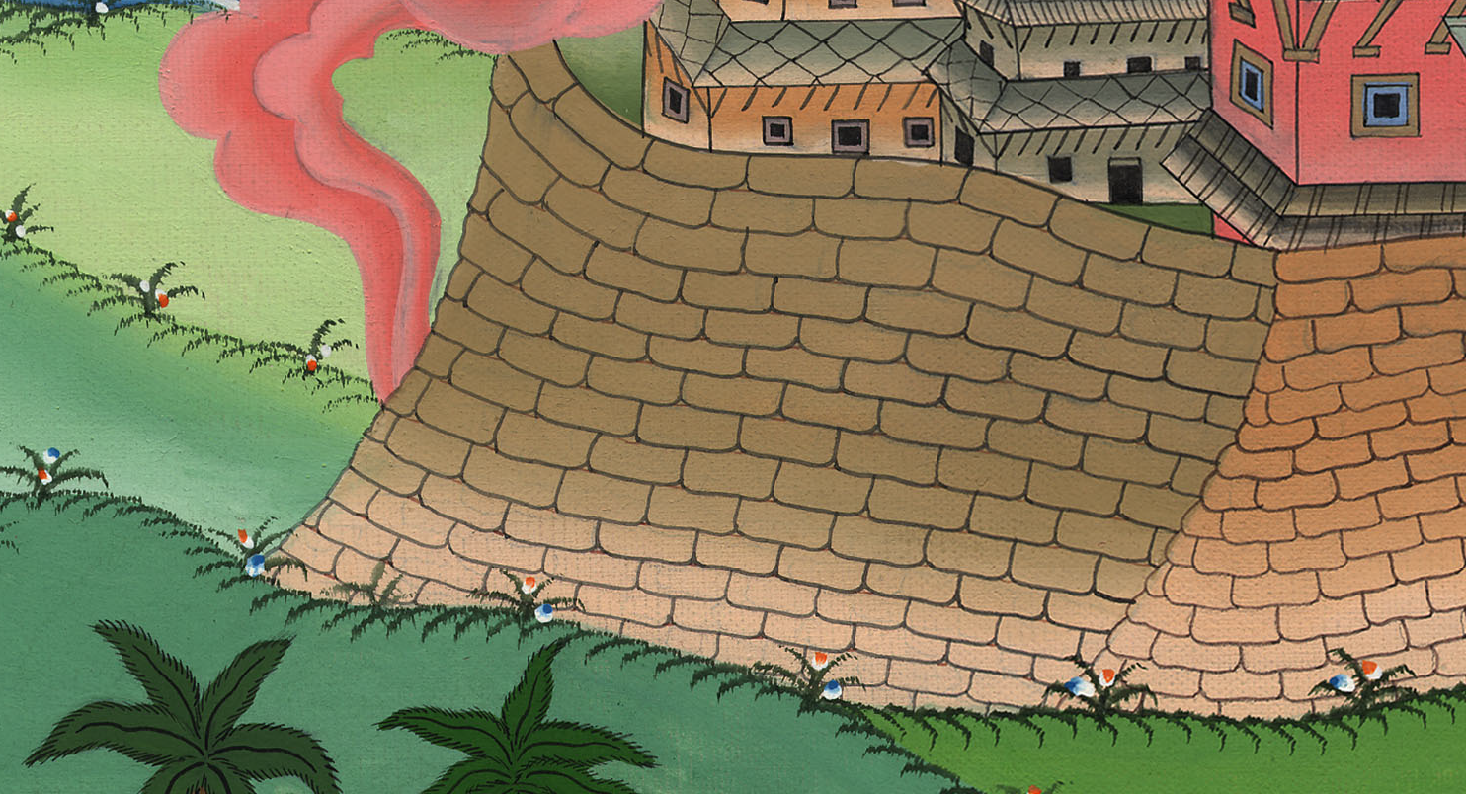
Joshua 6:14

Slide 21
15On the seventh day, they rose early at the dawning of the day, and marched around the city in the same way seven times. On this day only they marched around the city seven times.

Slide 22
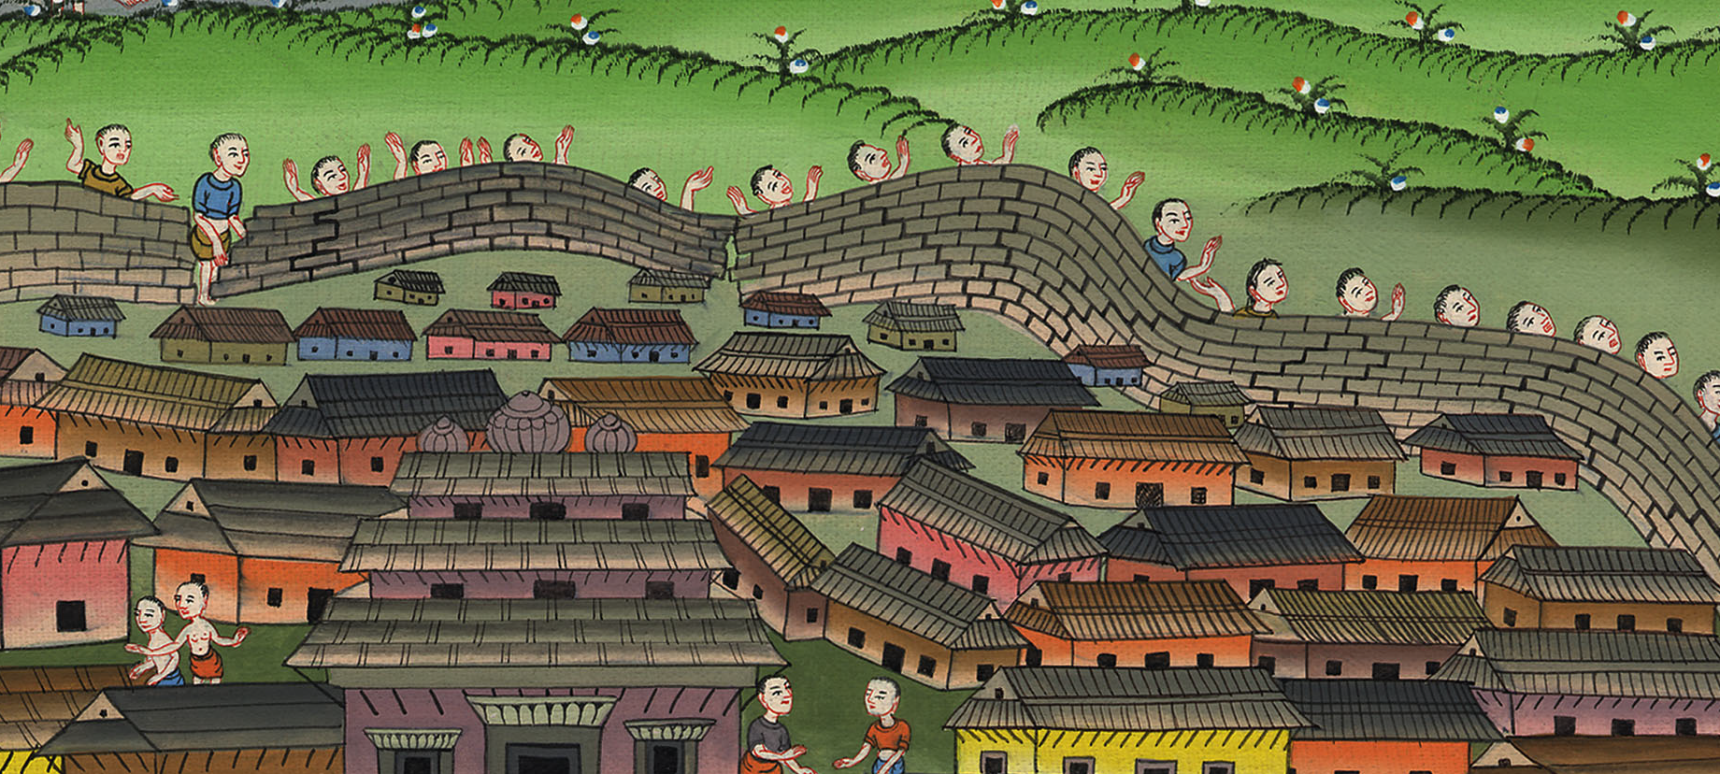
Joshua 6:15

Slide 23
16At the seventh time, when the priests blew the trumpets, Joshua said to the people, “Shout, for Yahweh has given you the city!

Slide 24
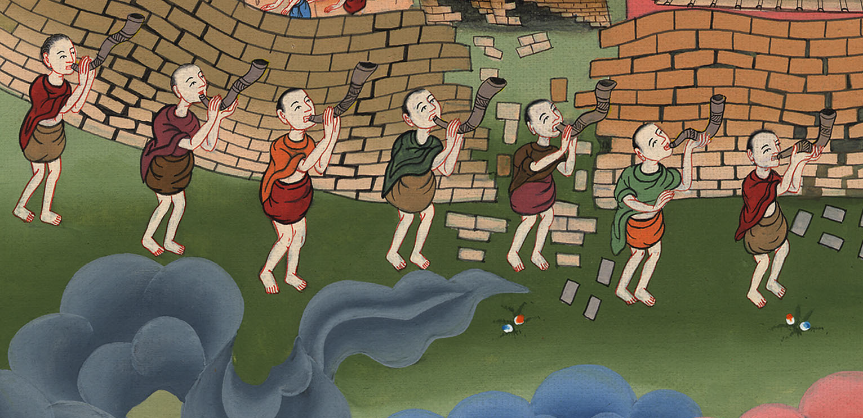
Joshua 6:16

Slide 25
20So the people shouted and the priests blew the trumpets. When the people heard the sound of the trumpet, the people shouted with a great shout, and the wall fell down flat, so that the people went up into the city, every man straight in front of him, and they took the city.

Slide 26
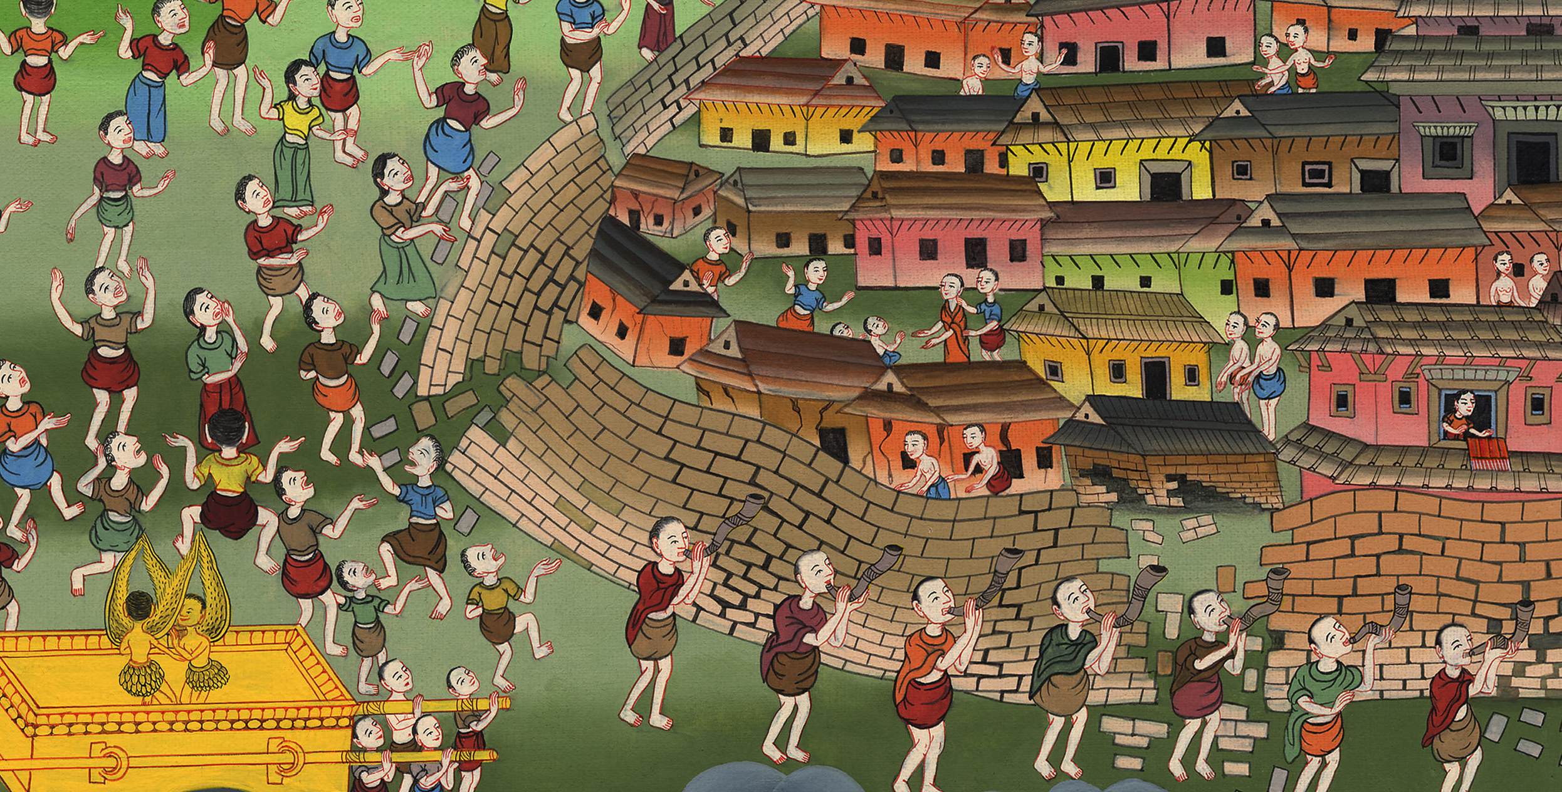
Joshua 6:20

Slide 27
21They utterly destroyed all that was in the city. [They destroyed every living thing in it] with the edge of the sword.

Slide 28
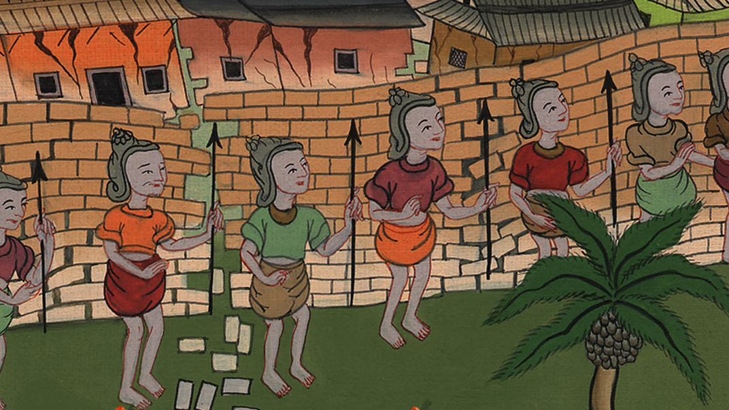
Joshua 6:21

Slide 29
22Joshua said to the two men who had spied out the land, “Go into the prostitute’s house, and bring the woman and all that she has out from there, as you swore to her.”

Slide 30
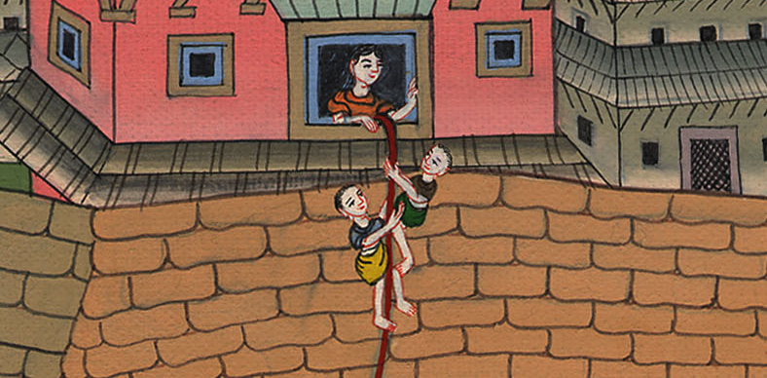
Joshua 6:22

Slide 31
23The young men who were spies went in, and brought out Rahab with her father, her mother, her brothers, and all that she had…

Slide 32
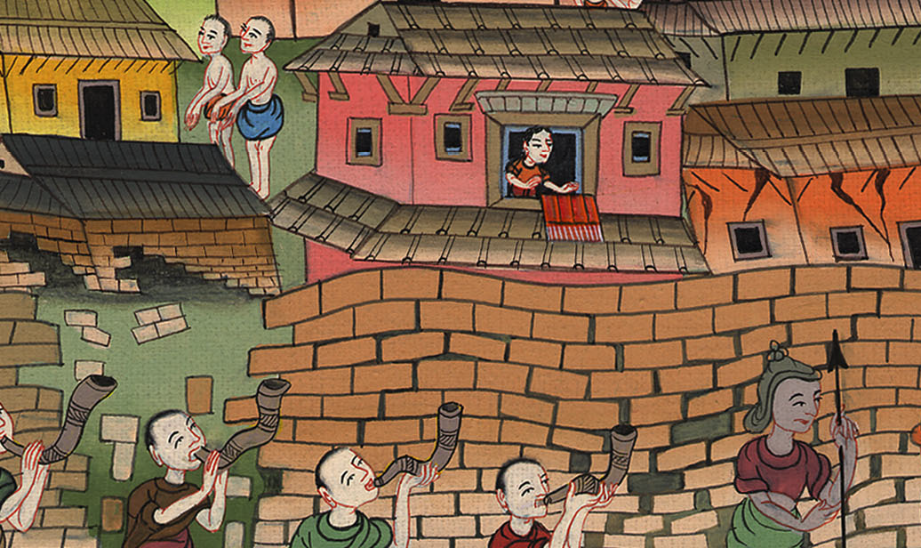
Joshua 6:23

