Slide 1
12-5
This work is licensed under a Creative Commons Attribution-ShareAlike 4.0 International License.
Please add this statement to all the videos you create.
English Bible quotes are from the World English Bible US, which is in the public domain.
Notes:
checked

Slide 2
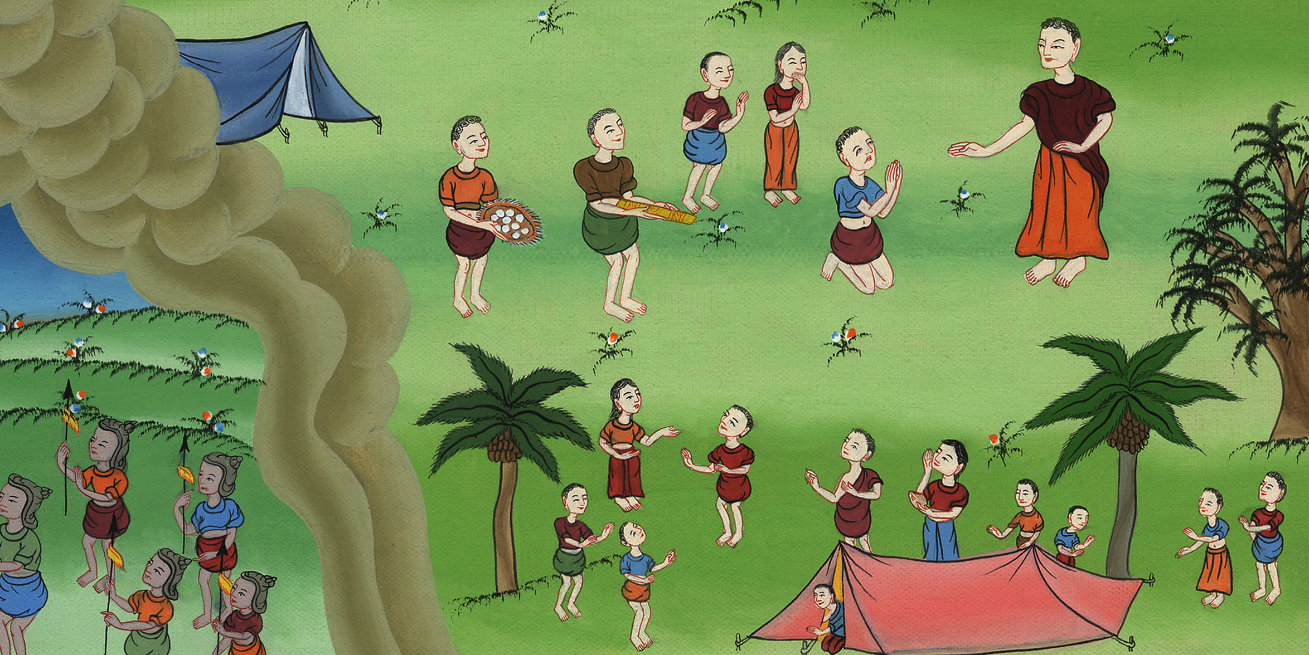
Achan’s sin Joshua 7:1-26

Slide 3
Achan’s sin Joshua 7:1-26

Slide 4
Achan’s sin Joshua 7:1-26

Slide 5
After conquering Jericho, the Israelites wanted to continue fighting. Ai was a small town nearby. They thought It would be easy to win.

Slide 6
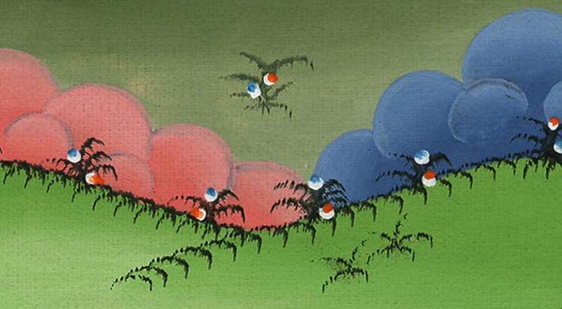

Slide 7
4So about three thousand men of the people went up there, and they fled before the men of Ai.

Slide 8
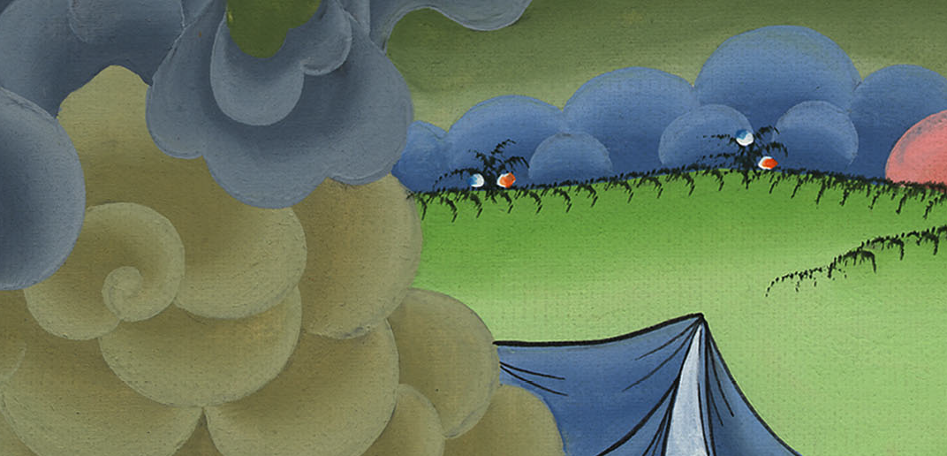
Joshua 7:4

Slide 9
5The men of Ai struck about thirty-six men of them…The hearts of the people melted, and became like water.

Slide 10
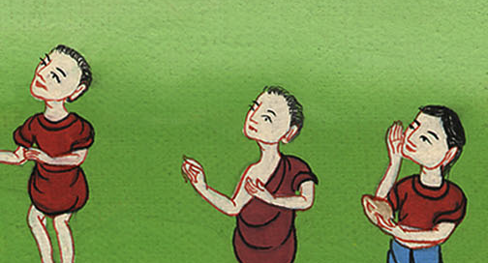
Joshua 7:5

Slide 11
6Joshua tore his clothes, and fell to the earth on his face before Yahweh’s ark until the evening, he and the elders of Israel; and they put dust on their heads.

Slide 12
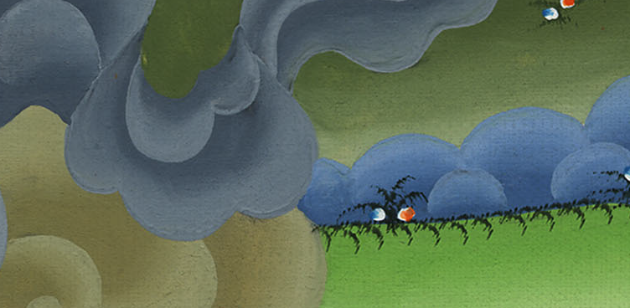
Joshua 7:6

Slide 13
10Yahweh said to Joshua, “Get up! Why have you fallen on your face like that?

Slide 14
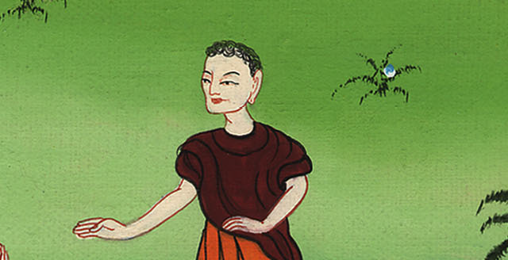
Joshua 7:10

Slide 15
11Israel has sinned. Yes, they have even transgressed my covenant which I commanded them. Yes, they have even taken some of the devoted things, and have also stolen, and also deceived…

Slide 16
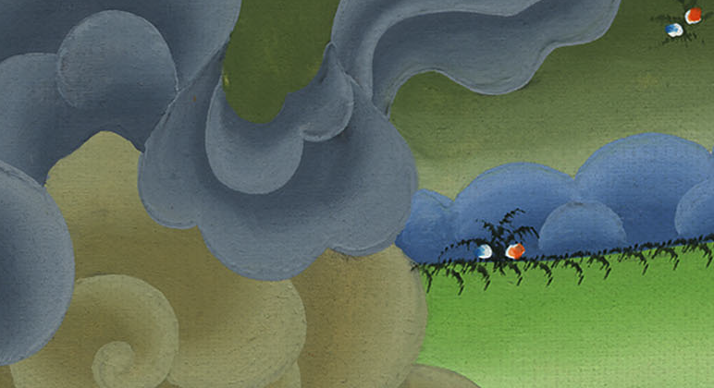
Joshua 7:11

Slide 17
13 … You cannot stand before your enemies until you take away the devoted thing from among you.”

Slide 18
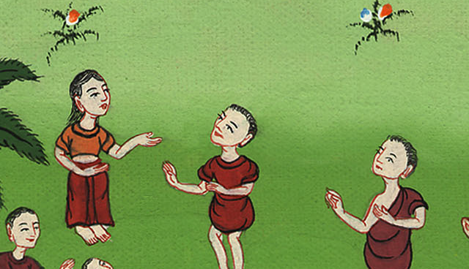
Joshua 7:13

Slide 19
1But the children of Israel committed a trespass in the devoted things; for Achan … took some of the devoted things. Therefore Yahweh’s anger burned against the children of Israel.

Slide 20
Joshua 7:1

Slide 21
16So Joshua rose up early in the morning and brought Israel near by their tribes. The tribe of Judah was selected.

Slide 22
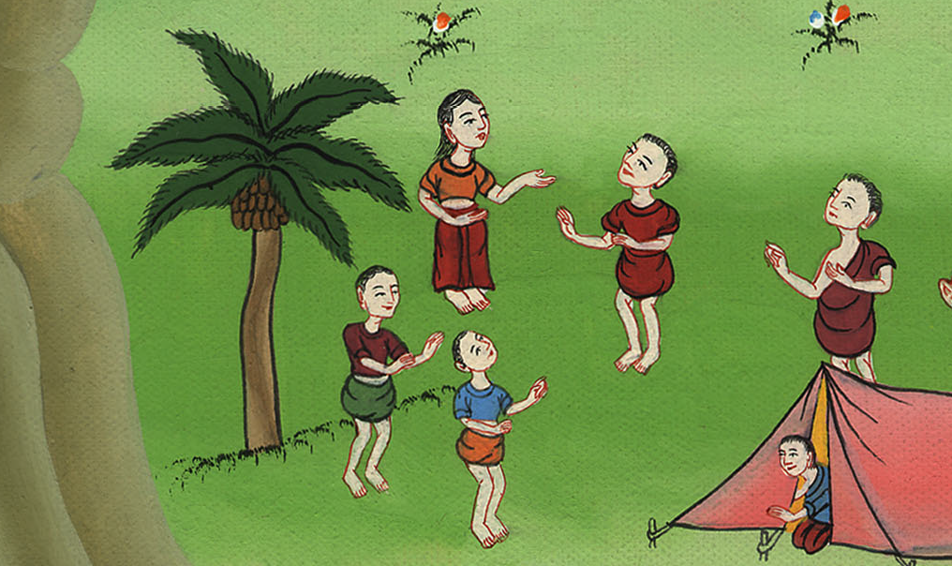
Joshua 7:16

Slide 23
17…he selected the family of the Zerahites. [From the Zeharites the household of] Zabdi was selected… [From this household] Achan… was selected.

Slide 24
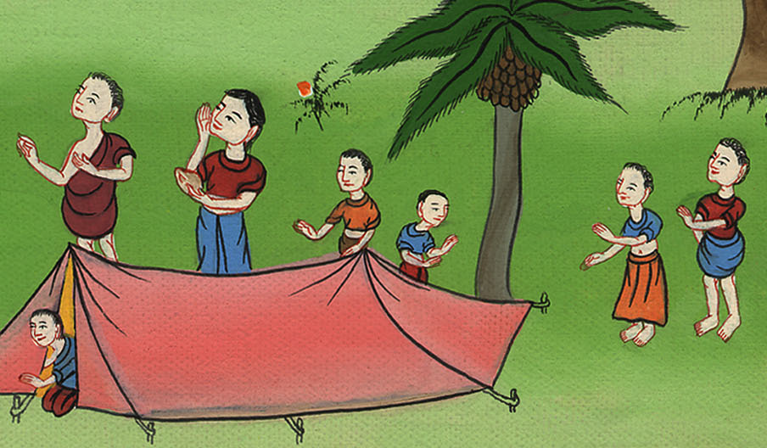
Joshua 7:17

Slide 25
19Joshua said to Achan, “My son, please give glory to Yahweh, the God of Israel, and make confession to him. Tell me now what you have done! Don’t hide it from me!”

Slide 26
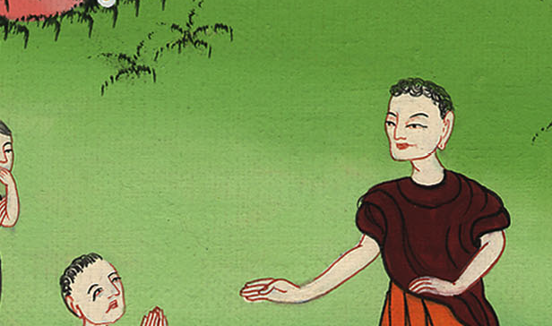
Joshua 7:19

Slide 27
20Achan answered Joshua, and said, “I have truly sinned against Yahweh, the God of Israel, and this is what I have done.

Slide 28
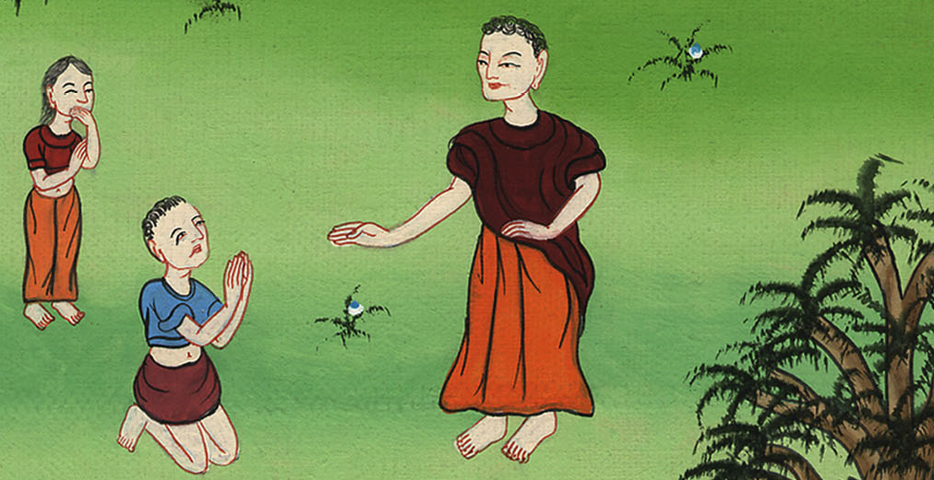
Joshua 7:20

Slide 29
21When I saw among the plunder a beautiful Babylonian robe, two hundred shekels of silver, and a wedge of gold… then I coveted them and took them. Behold, they are hidden in the ground in the middle of my tent, with the silver under it.”

Slide 30
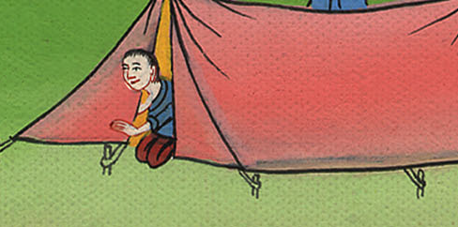
Joshua 7:21

Slide 31
22So Joshua sent messengers, and they ran to the tent. Behold, it was hidden in his tent, with the silver under it.

Slide 32
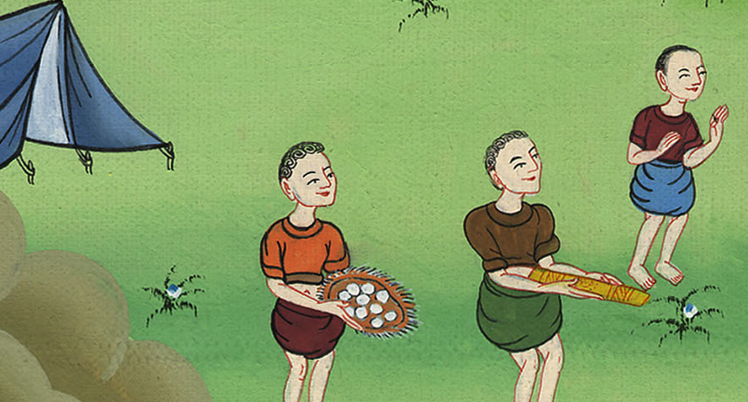
Joshua 7:22

Slide 33
25Joshua said, “Why have you troubled us? Yahweh will trouble you today.” All Israel stoned him with stones, and they burned them with fire and stoned them with stones… Yahweh turned from the fierceness of his anger.

Slide 34
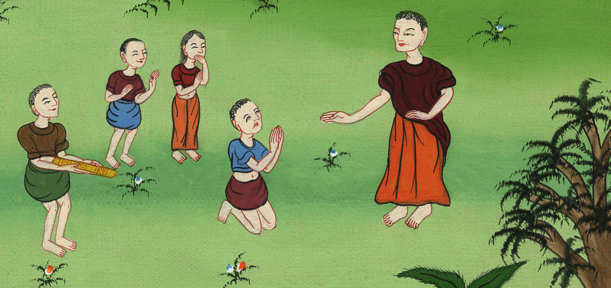
Joshua 7:25

Slide 35
1Yahweh said to Joshua, “Don’t be afraid, and don’t be dismayed. Take all the warriors with you, and arise, go up to Ai. Behold, I have given into your hand the king of Ai, with his people, his city, and his land.

Slide 36
Joshua 8:1

