Slide 1
12-6
This work is licensed under a Creative Commons Attribution-ShareAlike 4.0 International License.
Please add this statement to all the videos you create.
English Bible quotes are from the World English Bible US, which is in the public domain.
Notes:
6. Sun stands still – Joshua 10:6-14 (Left Bottom)
checked

Slide 2
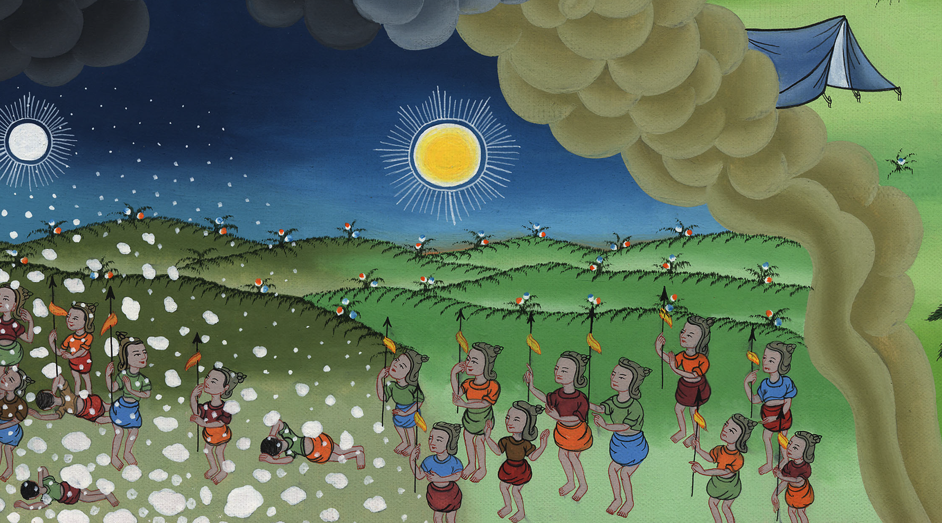
Sun stands still – Joshua 10:6-14

Slide 3
Sun stands still – Joshua 10:6-14

Slide 4
Sun stands still – Joshua 10:6-14

Slide 5
1Now when Adoni-Zedek king of Jerusalem heard how Joshua had taken Ai, and had utterly destroyed it; as he had done to Jericho and her king, so he had done to Ai and her king; and how the inhabitants of Gibeon had made peace with Israel, and were among them,

Slide 6
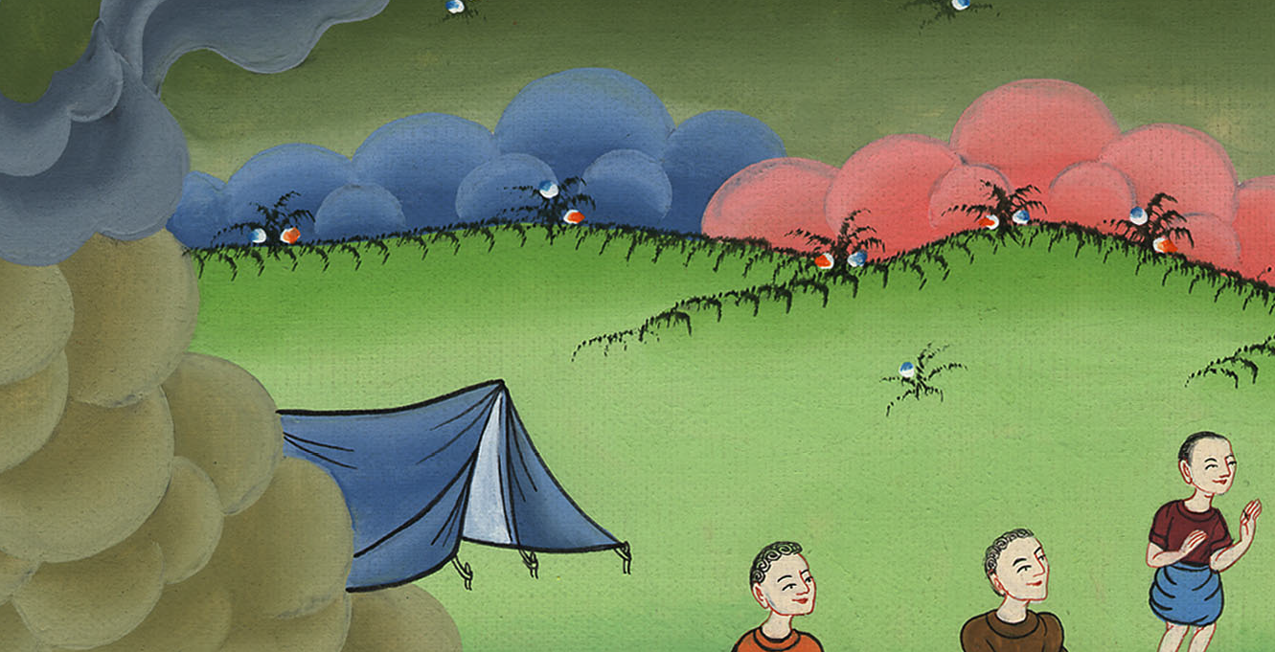
Joshua 10:1

Slide 7
[Because Gibeon was an important city, he asked the kings of four other cities:]
4“Come up to me and help me. Let’s strike Gibeon; for they have made peace with Joshua and with the children of Israel.”

Slide 8
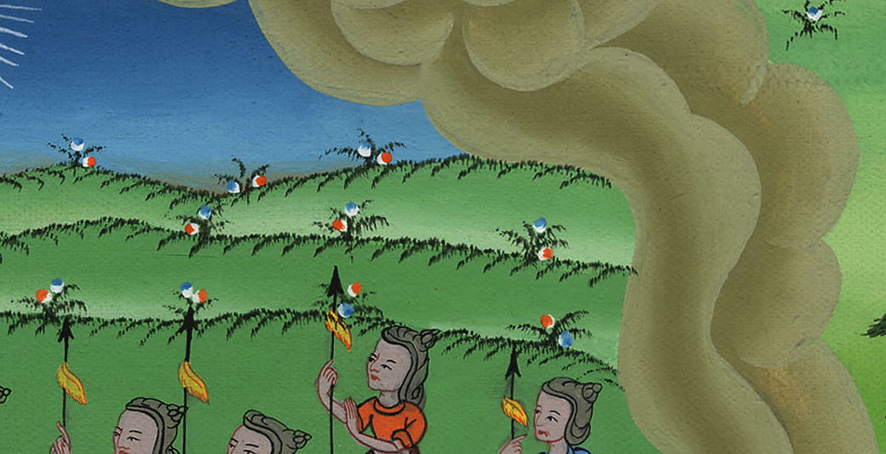
Joshua 10:4

Slide 9
6The men of Gibeon sent to Joshua at the camp at Gilgal, saying, “Don’t abandon your servants! Come up to us quickly and save us! Help us; for all the kings of the Amorites that dwell in the hill country have gathered together against us.”

Slide 10
Joshua 10:6

Slide 11
8Yahweh said to Joshua, “Don’t fear them, for I have delivered them into your hands. Not a man of them will stand before you.”

Slide 12
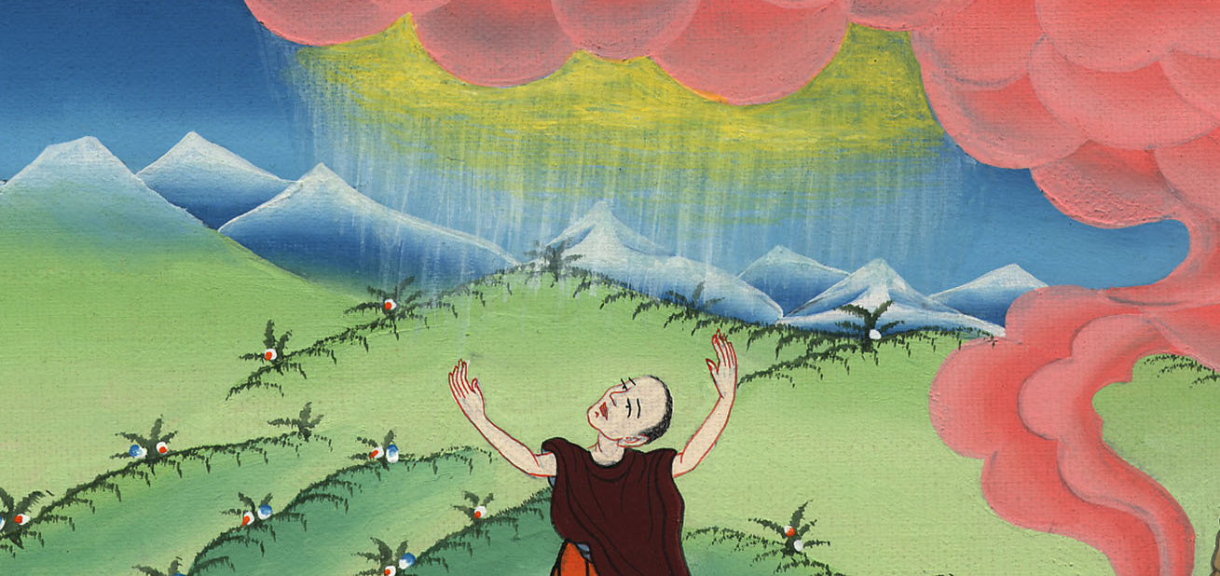
Joshua 10:8

Slide 13
9Joshua therefore came to them suddenly. He marched from Gilgal all night.

Slide 14
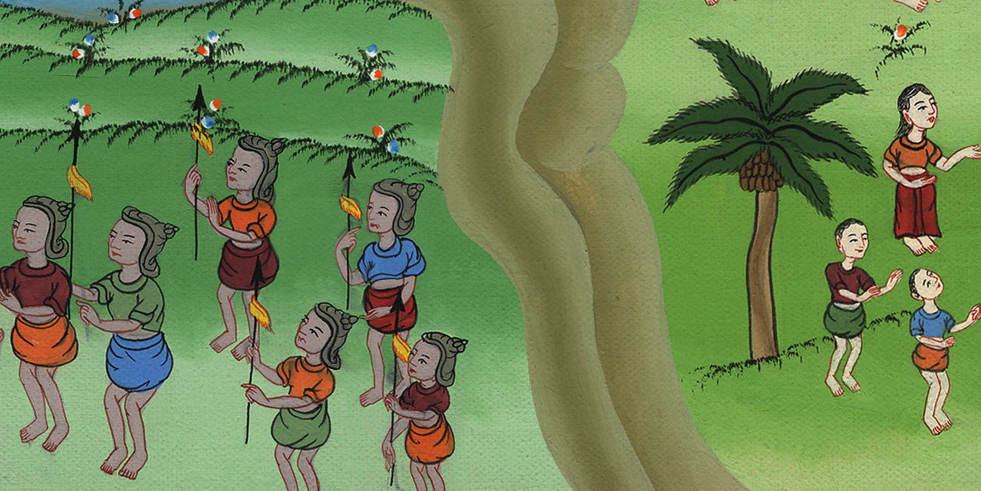
Joshua 10:9

Slide 15
10Yahweh confused them before Israel…

Slide 16
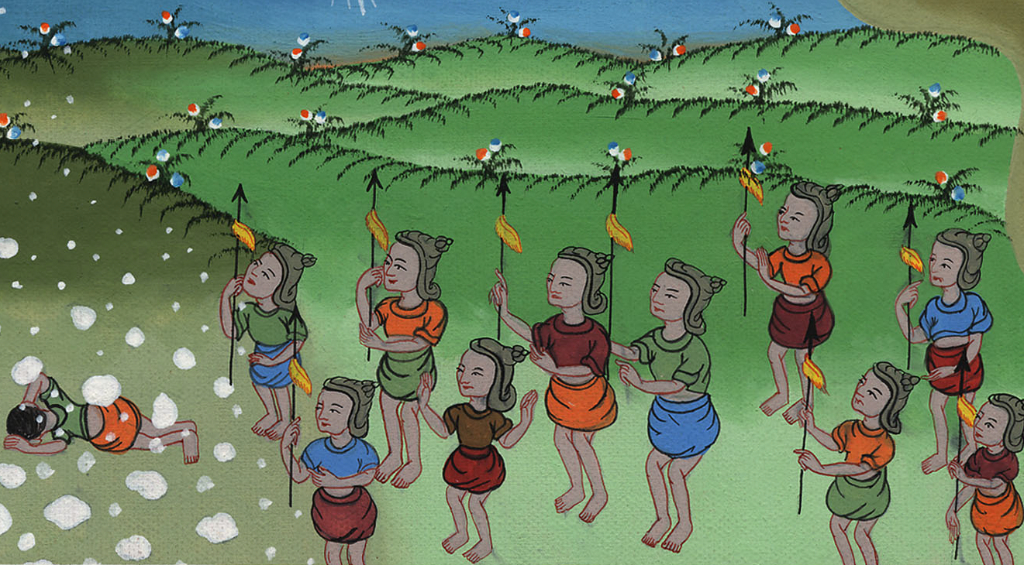
Joshua 10:10

Slide 17
11As they fled from before Israel, Yahweh hurled down great stones from the sky on them to Azekah, and they died. There were more who died from the hailstones than those whom the children of Israel killed with the sword.

Slide 18
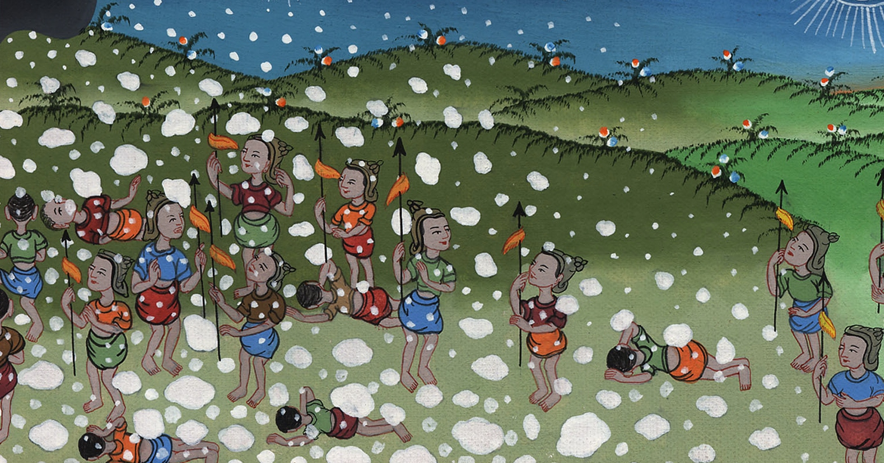
Joshua 10:11

Slide 19
[It was becoming dark, and the battle was not yet finished.
The battle was continuing into the evening. The Israelites were winning, but they would not be able to finish before it became dark]

Slide 20
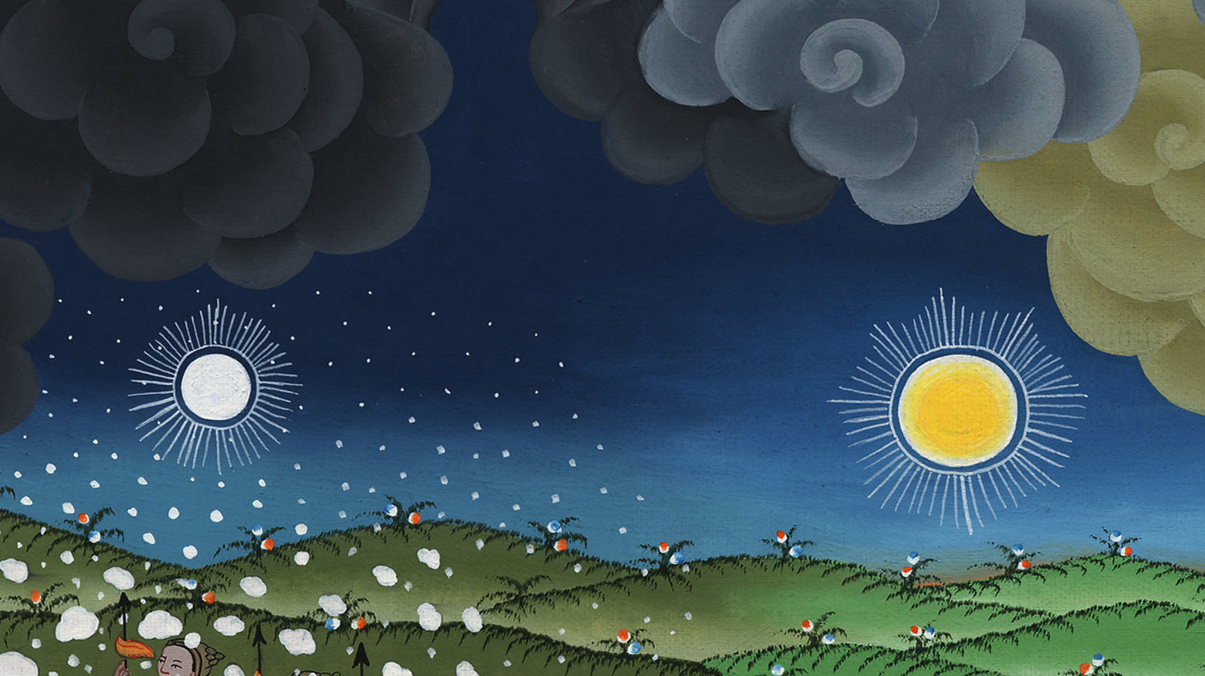

Slide 21
12Then Joshua spoke to Yahweh in the day when Yahweh delivered up the Amorites before the children of Israel. He said in the sight of Israel, “Sun, stand still on Gibeon! You, moon, stop in the valley of Aijalon!”

Slide 22
Joshua 10:12

Slide 23
13The sun stood still, and the moon stayed, until the nation had avenged themselves of their enemies… The sun stayed in the middle of the sky, and didn’t hurry to go down about a whole day.

Slide 24
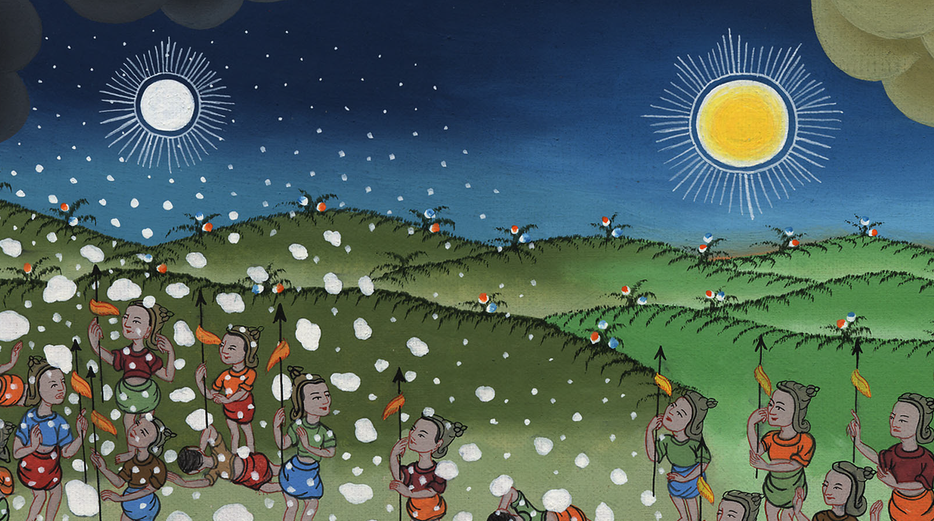
Joshua 10:13

Slide 25
14There was no day like that before it or after it, that Yahweh listened to the voice of a man; for Yahweh fought for Israel.

Slide 26
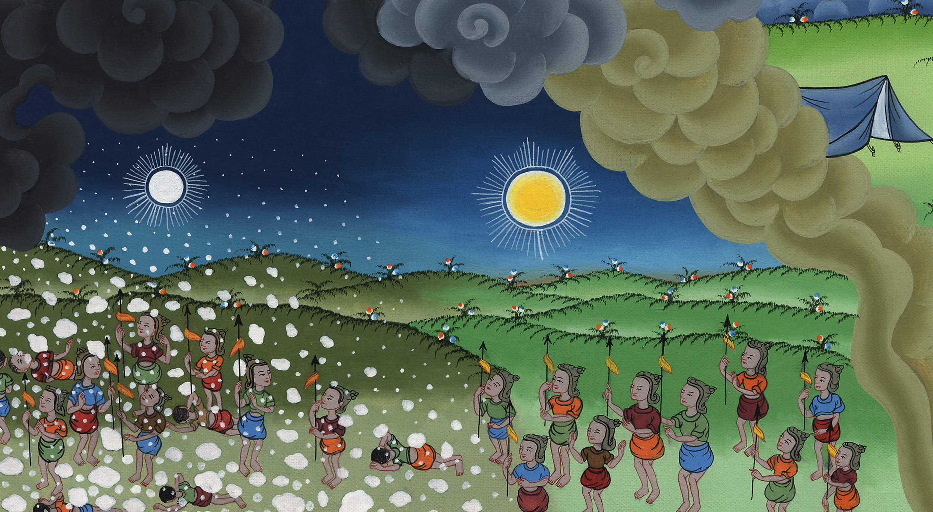
Joshua 10:14

