Slide 1
13-1
This work is licensed under a Creative Commons Attribution-ShareAlike 4.0 International License.
Please add this statement to all the videos you create.
English Bible quotes are from the World English Bible US, which is in the public domain.
Notes:
Checked
13 Gideon
1. Gideon’s Call – Judges 6:1-18 (Left Top)
2. Offering – Judges 6:19-24 (Center Top)
3. Pulling down Altar – Judges 6:25-32 (Right Top)
4. Fleece – Judges 6:33-40 (Right Bottom)
5. Thinning the Army – Judges 7:1-8 (Center Bottom)
6. Midianite’s dream – Judges 7:9-15 (Left Bottom)
7. Trumpets and Torches – Judges 7:16-22 (Center)

Slide 2
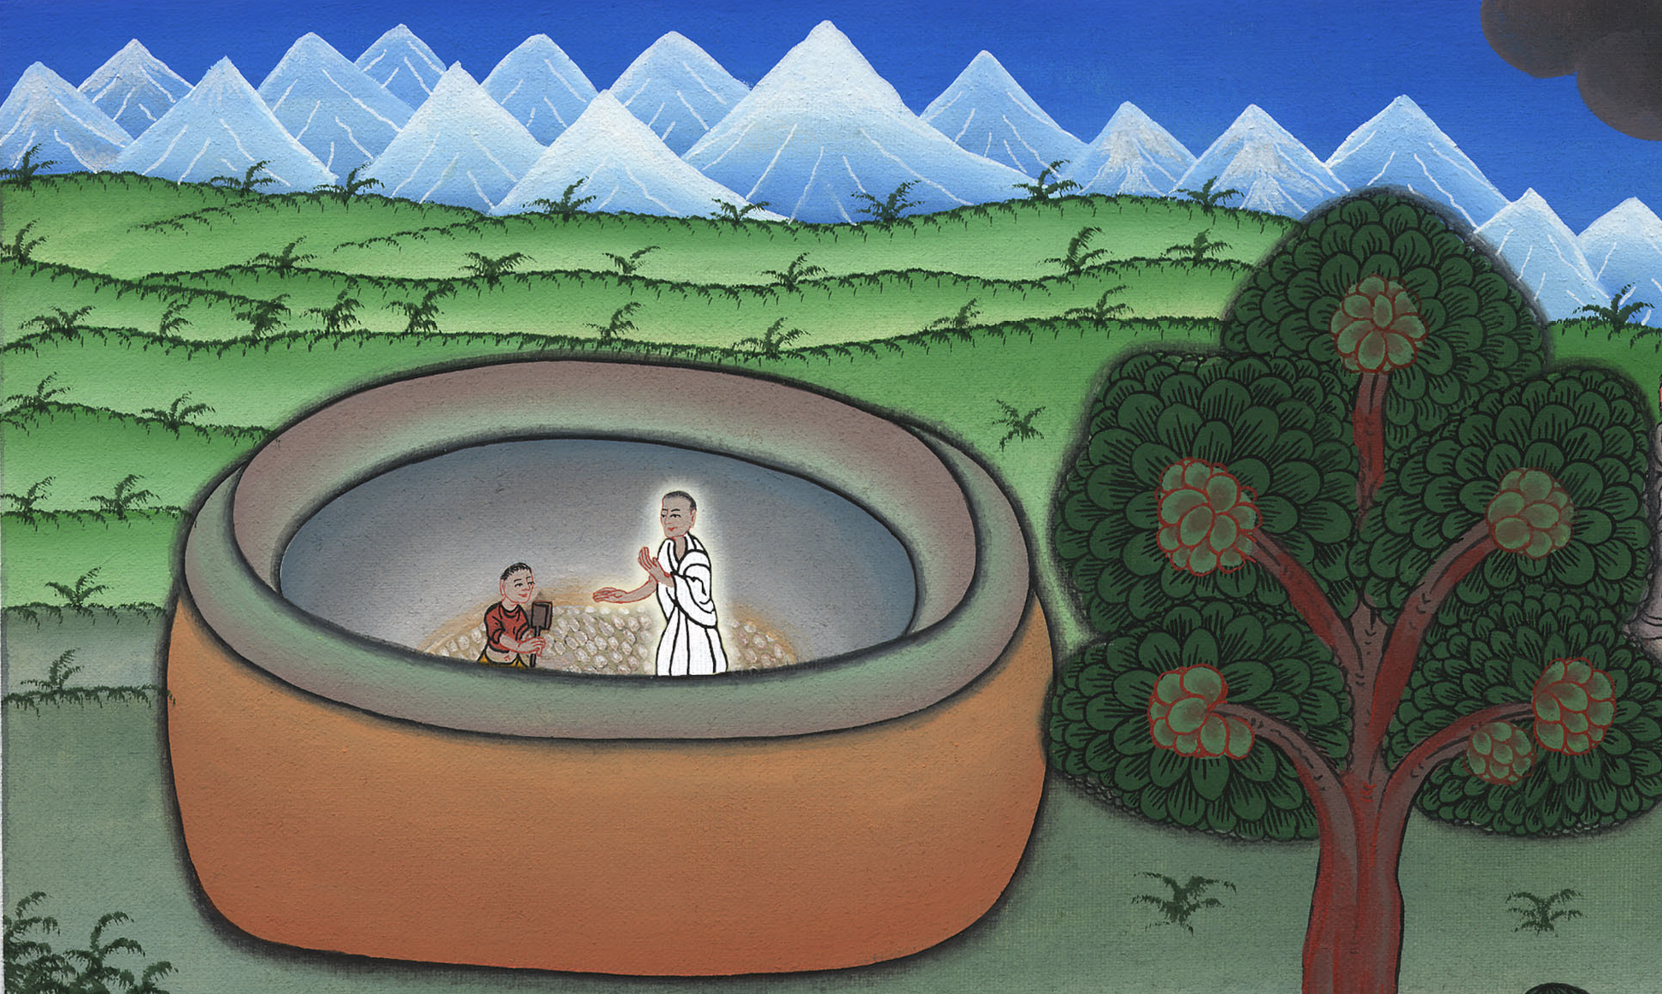
Gideon’s Call – Judges 6:1-18

Slide 3
Gideon’s Call – Judges 6:1-18

Slide 4
Gideon’s Call – Judges 6:1-18

Slide 5
1The children of Israel did that which was evil in Yahweh’s sight, so Yahweh delivered them into the hand of Midian seven years.

Slide 6
Judges 6:1

Slide 7
2The hand of Midian prevailed against Israel; and because of Midian the children of Israel made themselves the dens which are in the mountains, the caves, and the strongholds.

Slide 8
Judges 6:2

Slide 9
3So it was, when Israel had sown, that the Midianites, the Amalekites, and the children of the east came up against them. 5…They came into the land to destroy it.

Slide 10
Judges 6:3

Slide 11
6Israel was brought very low because of Midian; and the children of Israel cried to Yahweh.

Slide 12
Judges 6:6

Slide 13
8Yahweh sent a prophet to the children of Israel; and he said to them, “Yahweh, the God of Israel, says, ‘I brought you up from Egypt, and brought you out of the house of bondage.

Slide 14
Judges 6:8

Slide 15
9I delivered you out of the hand of the Egyptians and out of the hand of all who oppressed you, and drove them out from before you, and gave you their land.

Slide 16
Judges 6:9

Slide 17
10I said to you, “I am Yahweh your God. You shall not fear the gods of the Amorites, in whose land you dwell.” But you have not listened to my voice.’”

Slide 18
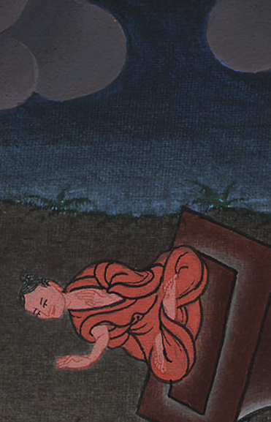
Judges 6:10

Slide 19
11 … Gideon was beating out wheat in the wine press, to hide it from the Midianites.

Slide 20
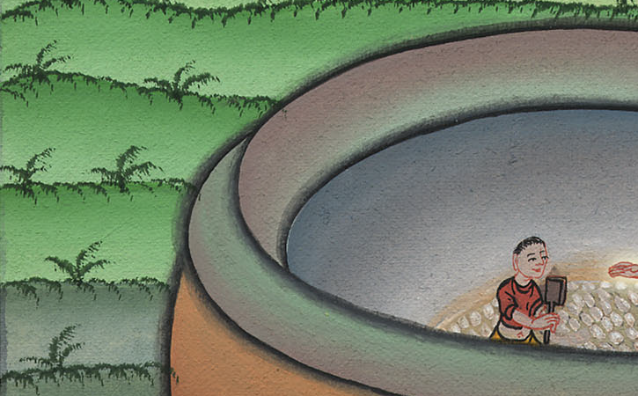
Judges 6:11

Slide 21
12Yahweh’s angel appeared to him, and said to him, “Yahweh is with you, you mighty man of valor!”

Slide 22
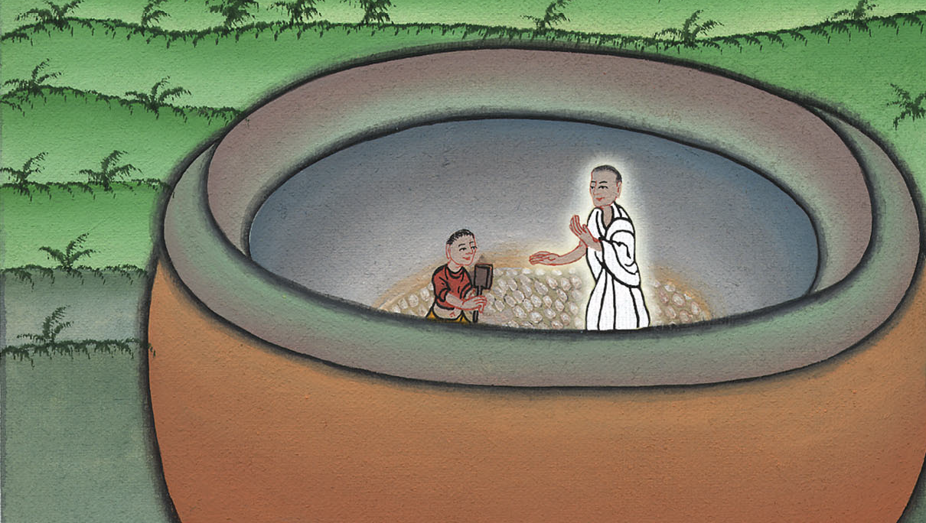
Judges 6:12

Slide 23
13Gideon said to him, “Oh, my lord, if Yahweh is with us, why then has all this happened to us? … Yahweh has cast us off.

Slide 24
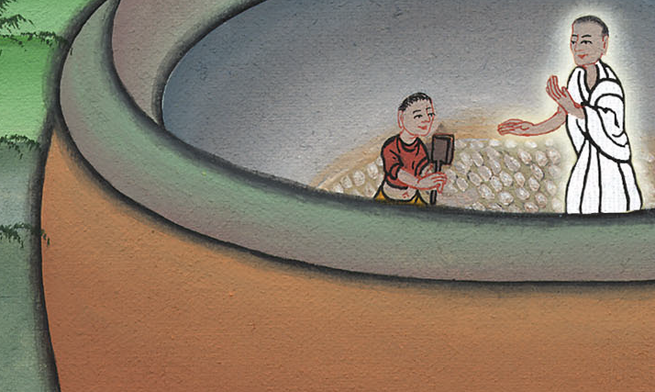
Judges 6:13

Slide 25
14Yahweh looked at him, and said, “Go in this your might, and save Israel from the hand of Midian. Haven’t I sent you?”

Slide 26
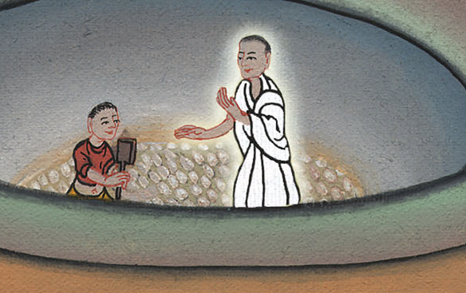
Judges 6:14

Slide 27
15He said to him, “O Lord, how shall I save Israel? Behold, my family is the poorest in Manasseh, and I am the least in my father’s house.”

Slide 28
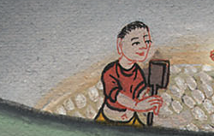
Judges 6:15

Slide 29
16Yahweh said to him, “Surely I will be with you, and you shall strike the Midianites as one man.”

Slide 30
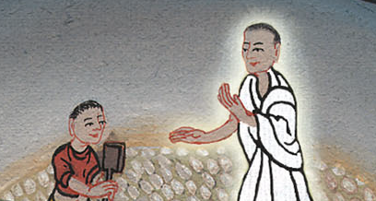
Judges 6:16

