Slide 1
13-2
This work is licensed under a Creative Commons Attribution-ShareAlike 4.0 International License.
Please add this statement to all the videos you create.
English Bible quotes are from the World English Bible US, which is in the public domain.
Notes:
ch

Slide 2
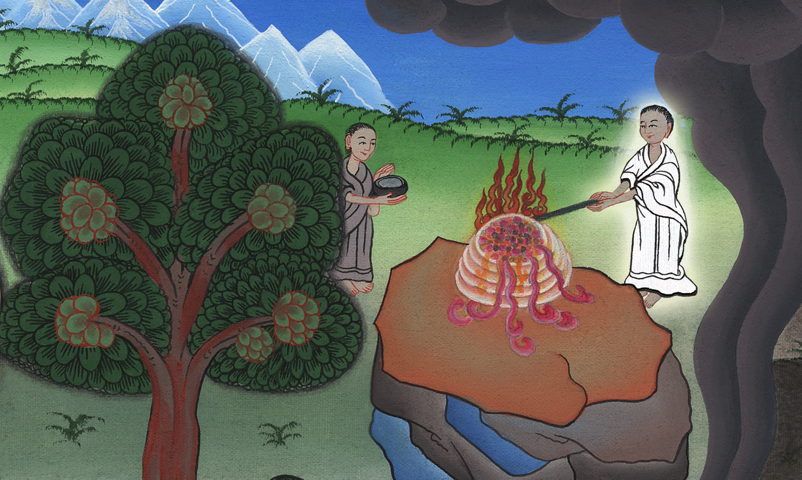
Offering –
Judges 6:16-24

Slide 3
Offering – Judges 6:16-24

Slide 4
Offering –
Judges 6:16-24

Slide 5
Gideon still did not believe that God would use him to defeat the Midianites. So he asked god for a special sign.

Slide 6
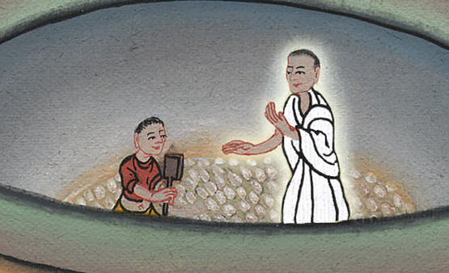

Slide 7
17He said to him, “If now I have found favor in your sight, then show me a sign that it is you who talk with me.

Slide 8
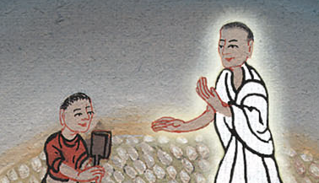
Judges 6:17

Slide 9
18Please don’t go away until I come to you, and bring out my present, and lay it before you.”
He said, “I will wait until you come back.”

Slide 10
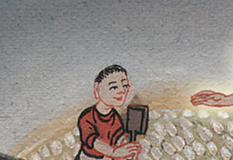
Judges 6:18

Slide 11
Gideon went in and prepared a young goat and unleavened cakes of an ephah of meal. He put the meat in a basket and he put the broth in a pot, and brought it out to him under the oak, and presented it.

Slide 12
Judges 6:19

Slide 13
20The angel of God said to him, “Take the meat and the unleavened cakes, and lay them on this rock, and pour out the broth.” He did so.

Slide 14
Judges 6:20

Slide 15
21Then Yahweh’s angel stretched out the end of the staff that was in his hand, and touched the meat and the unleavened cakes; and fire went up out of the rock and consumed the meat and the unleavened cakes. Then Yahweh’s angel departed out of his sight.

Slide 16
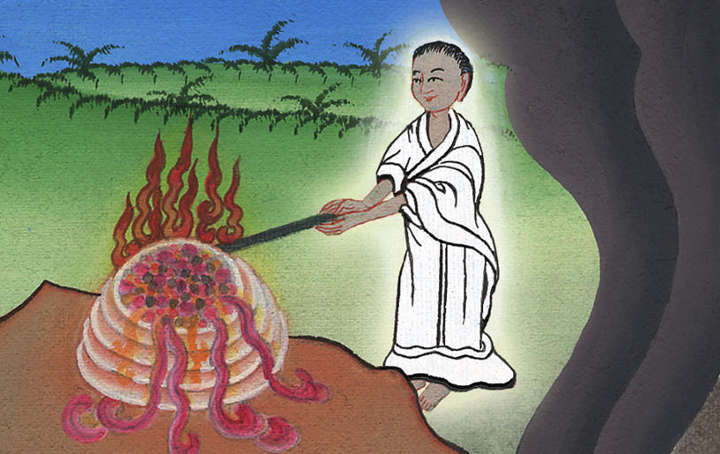
Judges 6:21

Slide 17
22Gideon saw that he was Yahweh’s angel; and Gideon said, “Alas, Lord Yahweh! Because I have seen Yahweh’s angel face to face!”

Slide 18
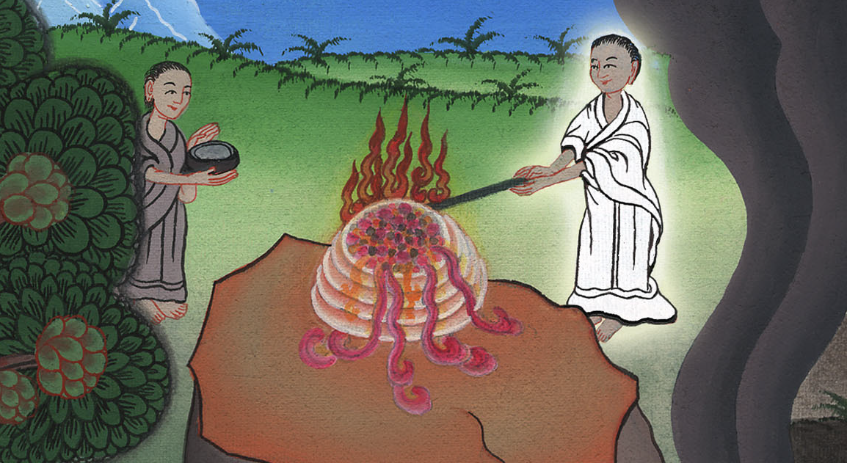
Judges 6:22

Slide 19
23Yahweh said to him, “Peace be to you! Don’t be afraid. You shall not die.”

Slide 20
Judges 6:23

Slide 21
24Then Gideon built an altar there to Yahweh, and called it “Yahweh is Peace.”

Slide 22
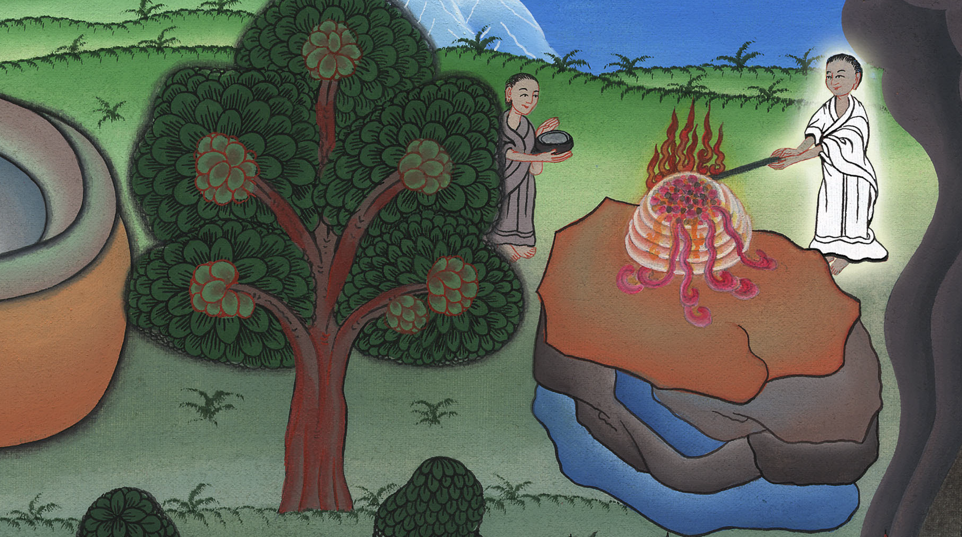
Judges 6:24

