Slide 1
13-3
This work is licensed under a Creative Commons Attribution-ShareAlike 4.0 International License.
Please add this statement to all the videos you create.
English Bible quotes are from the World English Bible US, which is in the public domain.
Notes:
ch

Slide 2
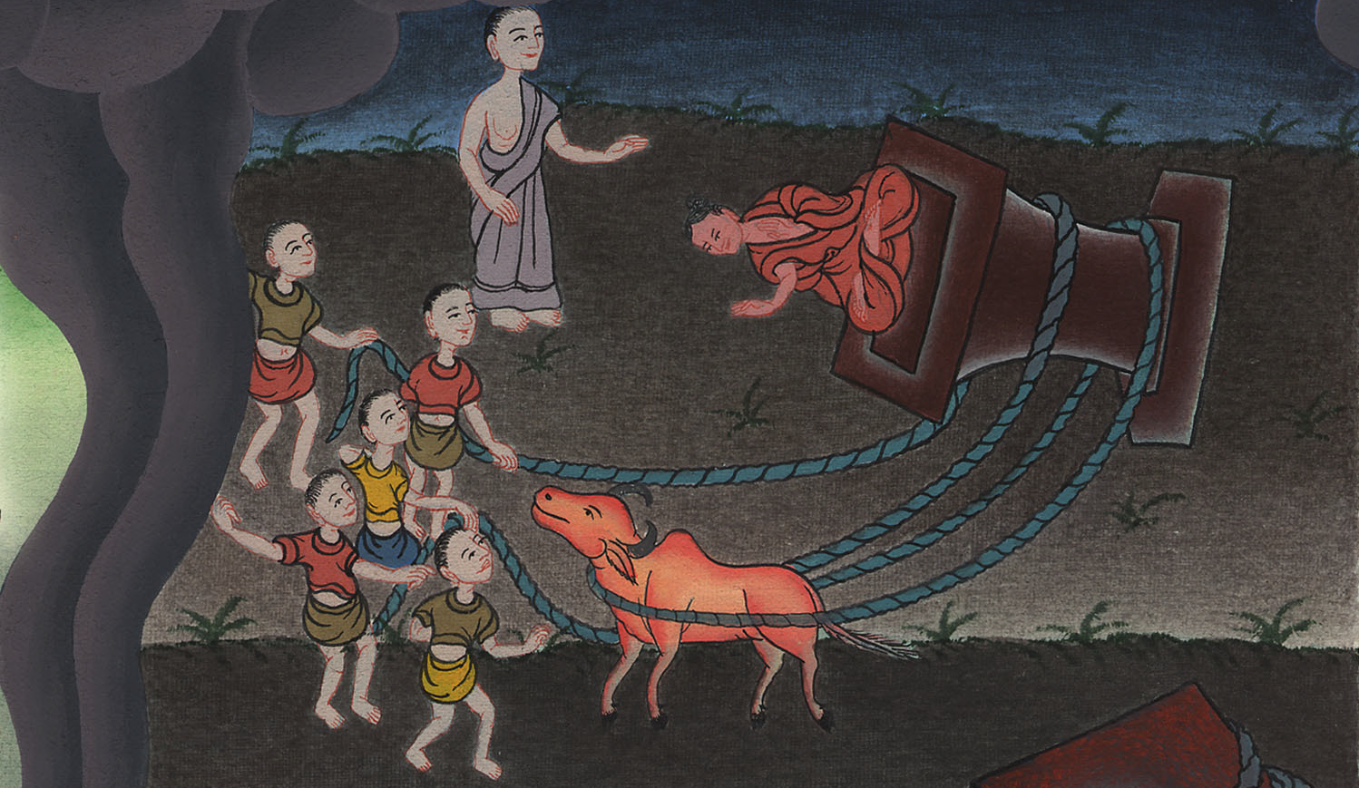
Pulling down the altar –
Judges 6:25-32

Slide 3
Pulling down the altar –
Judges 6:25-32

Slide 4
Pulling down the altar –
Judges 6:25-32

Slide 5
25That same night the Lord spoke to Gideon. He said, “Get the second bull from your father’s herd. Get the one that is seven years old

Slide 6
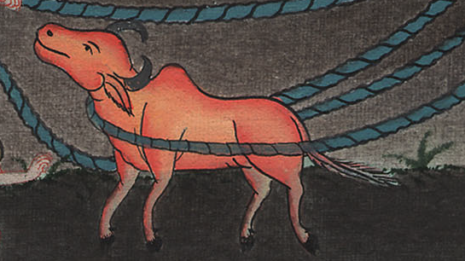
Judges 6:25

Slide 7
25That same night, Yahweh said to him, “Take your father’s bull, even the second bull seven years old, and throw down the altar of Baal that your father has, and cut down the Asherah that is by it.

Slide 8
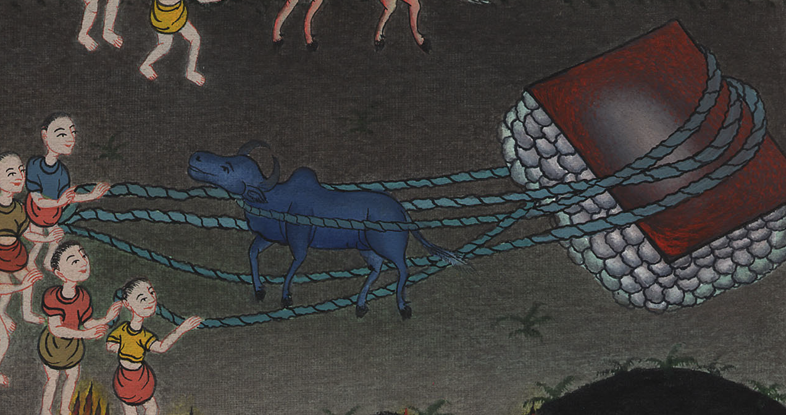
Judges 6:25

Slide 9
26Then build an altar to Yahweh your God on the top of this stronghold,

Slide 10
Judges 6:26

Slide 11
in an orderly way, and take the second bull, and offer a burnt offering with the wood of the Asherah which you shall cut down.”

Slide 12
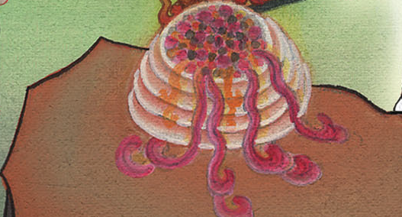
Judges 6:26

Slide 13
27Then Gideon took ten men of his servants, and did as Yahweh had spoken to him.

Slide 14
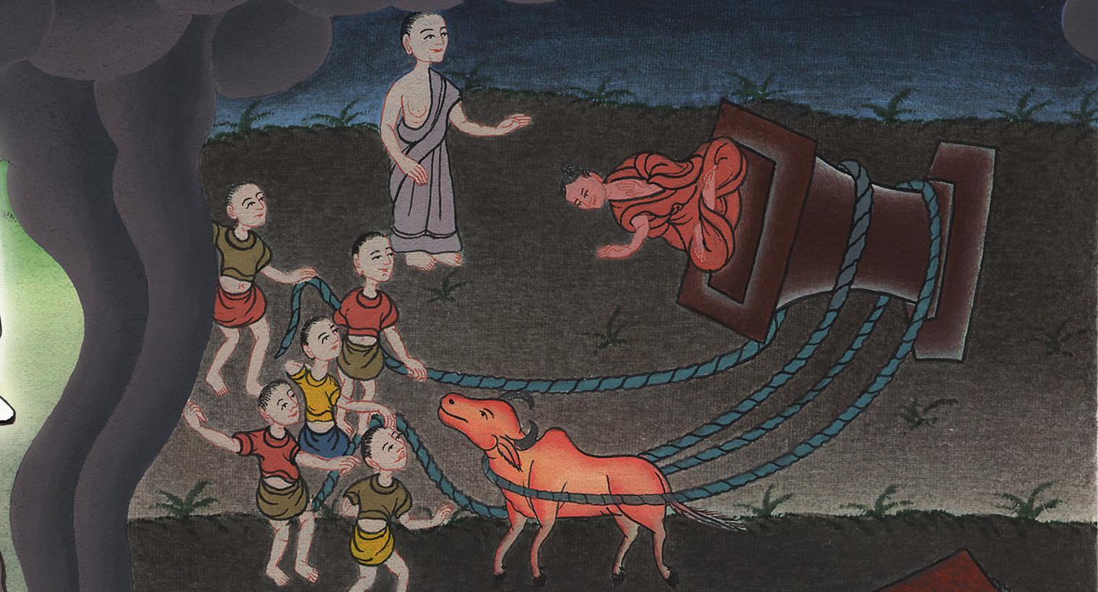
Judges 6:27

Slide 15
Because he feared his father’s household and the men of the city, he could not do it by day, but he did it by night.

Slide 16
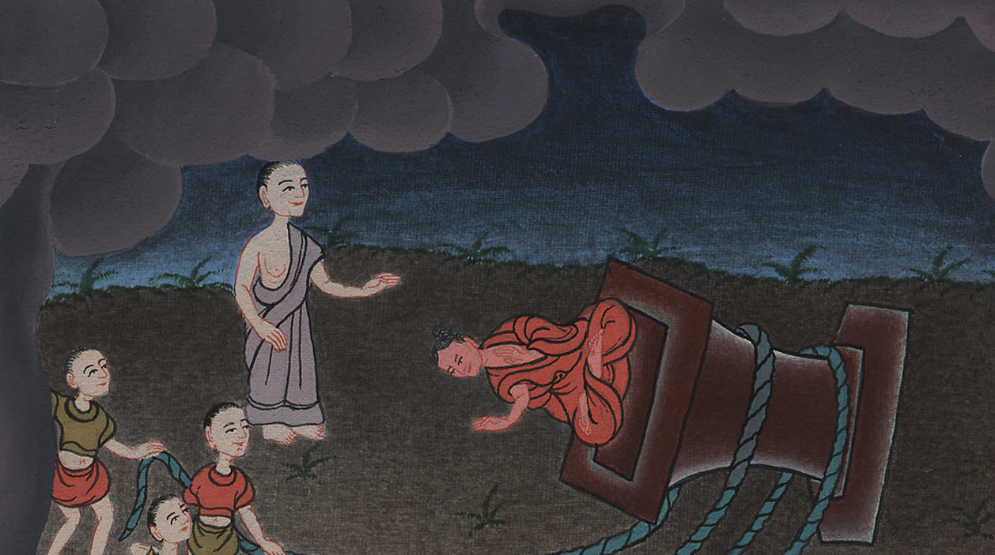
Judges 6:27

Slide 17
28When the men of the city arose early in the morning, behold, the altar of Baal was broken down, and the Asherah was cut down that was by it, and the second bull was offered on the altar that was built.

Slide 18
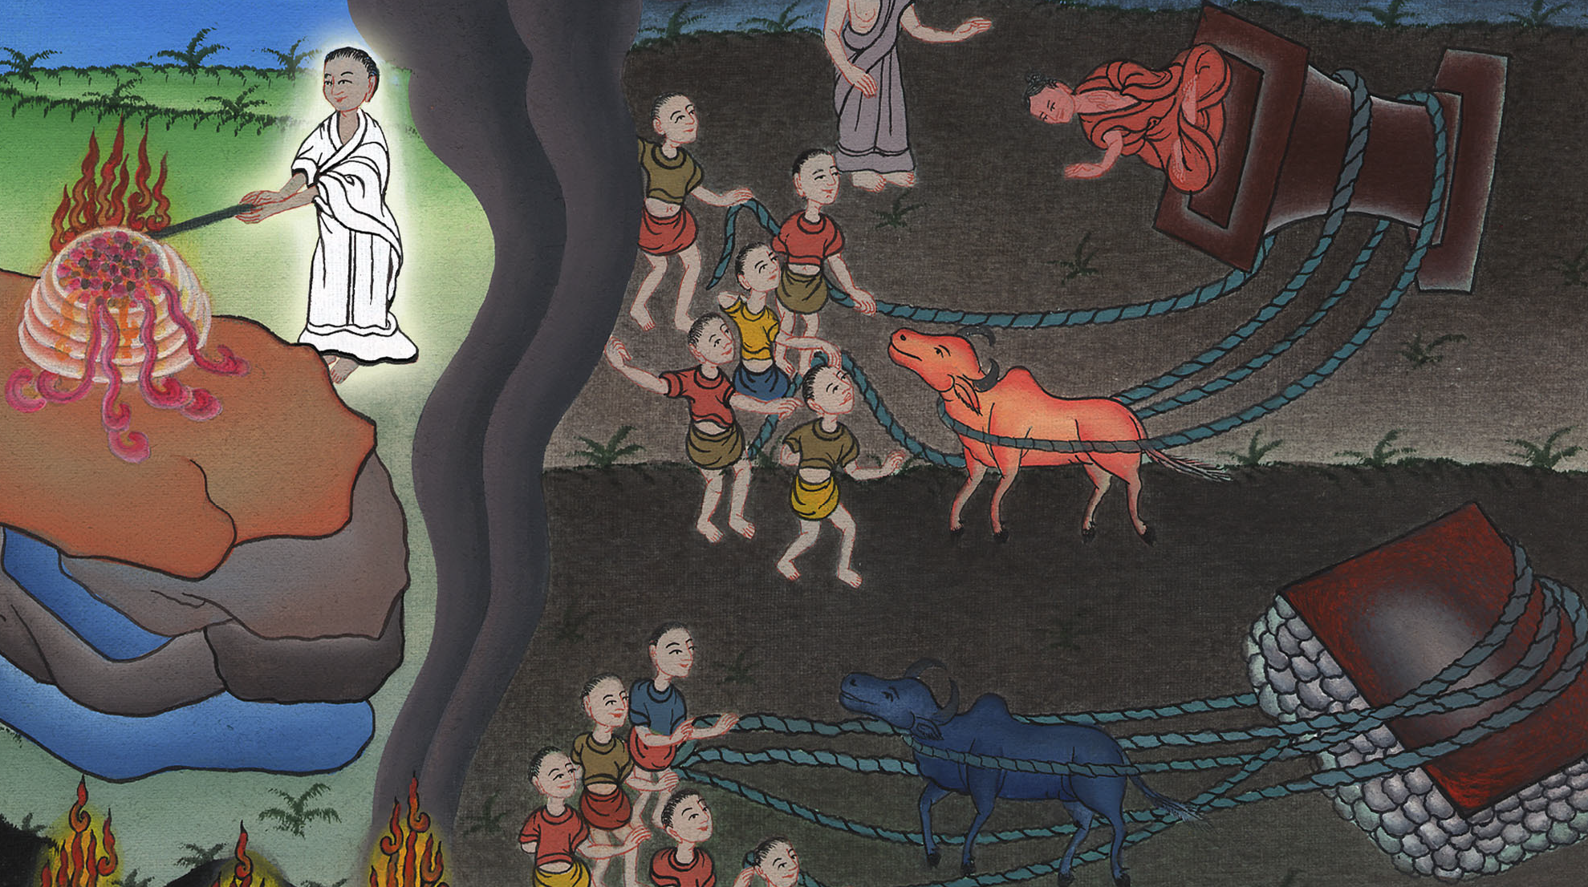
Judges 6:28

Slide 19
31(the people were very angry) oash said to all who stood against him, “Will you contend for Baal? Or will you save him? … If he is a god, let him contend for himself, because someone has broken down his altar!”

Slide 20
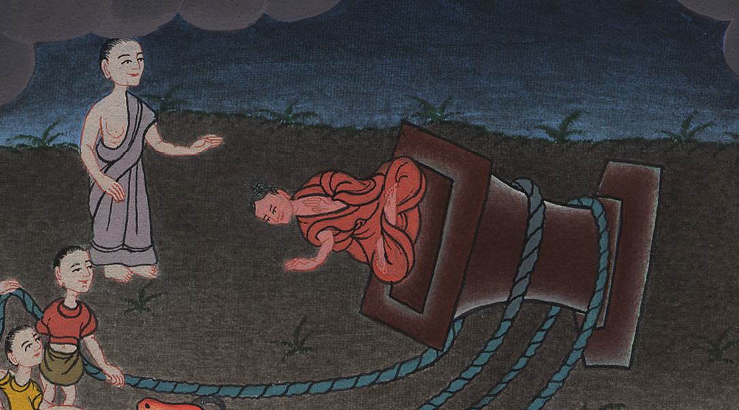
Judges 6:31

