Slide 1
13-4
This work is licensed under a Creative Commons Attribution-ShareAlike 4.0 International License.
Please add this statement to all the videos you create.
English Bible quotes are from the World English Bible US, which is in the public domain.
Notes:
ch

Slide 2
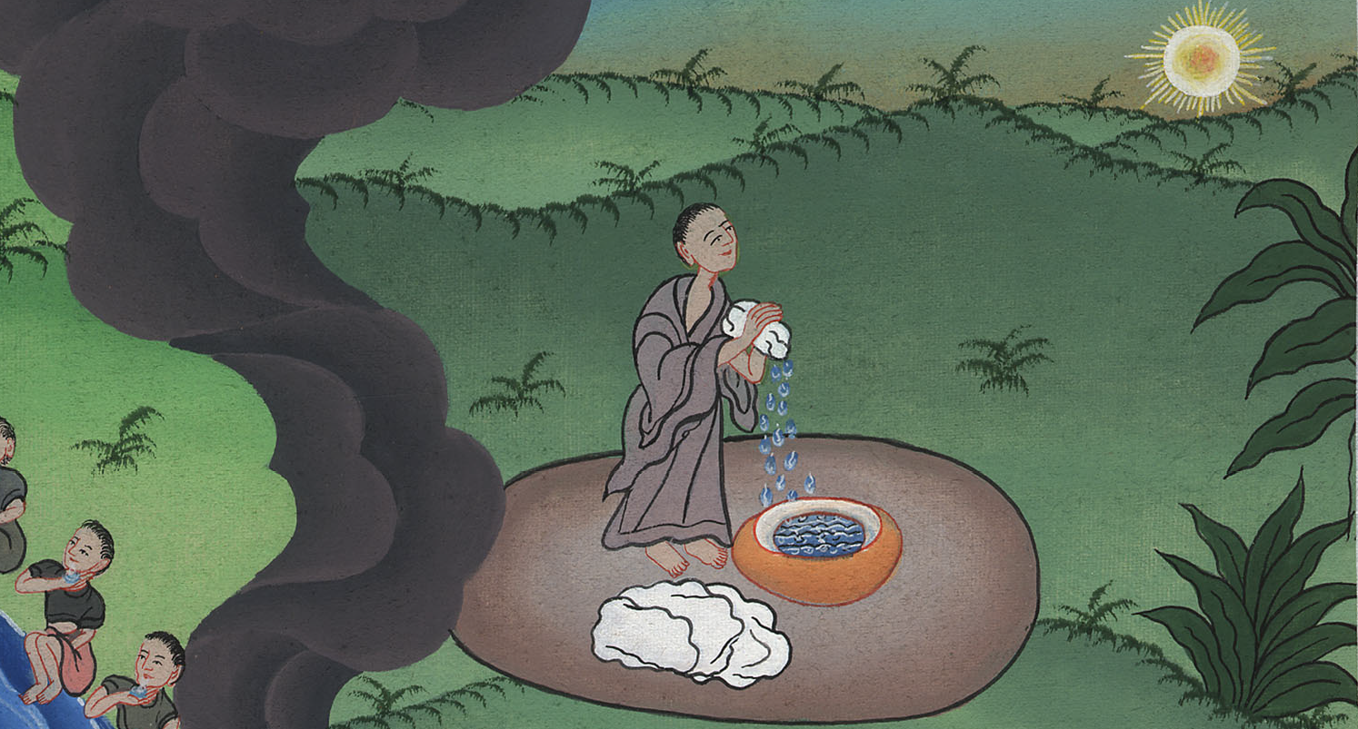
Gideon’s fleece –
Judges 6:33-40

Slide 3
Gideon’s fleece – Judges 6:33-40

Slide 4
Gideon’s fleece –
Judges 6:33-40

Slide 5
33Then all the Midianites and the Amalekites and the children of the east assembled themselves together; and they passed over, and encamped in the valley of Jezreel.

Slide 6
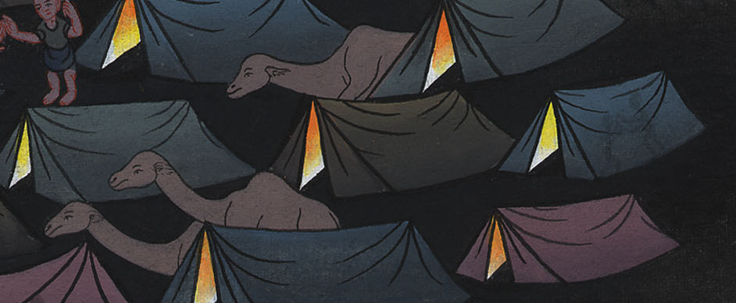
Judges 6:33

Slide 7
34But Yahweh’s Spirit came on Gideon, and he blew a trumpet; and Abiezer was gathered together to follow him.(He sent messengers to the other surrounding tribes and they also joined him.)

Slide 8
Judges 6:34

Slide 9
36Gideon said to God, “If you will save Israel by my hand, as you have spoken,

Slide 10
Judges 6:36

Slide 11
37behold, I will put a fleece of wool on the threshing floor. If there is dew on the fleece only, and it is dry on all the ground, then I’ll know that you will save Israel by my hand, as you have spoken.”

Slide 12
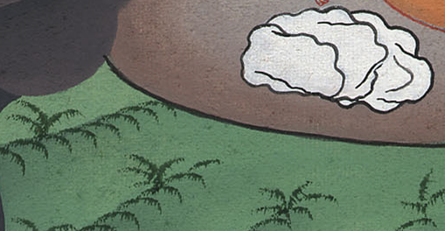
Judges 6:37

Slide 13
38It was so; for he rose up early on the next day, and pressed the fleece together, and wrung the dew out of the fleece, a bowl full of water.

Slide 14
Judges 6:38

Slide 15
39Gideon said to God, “Don’t let your anger be kindled against me, and I will speak but this once. Please let me make a trial just this once with the fleece. Let it now be dry only on the fleece, and on all the ground let there be dew.”

Slide 16
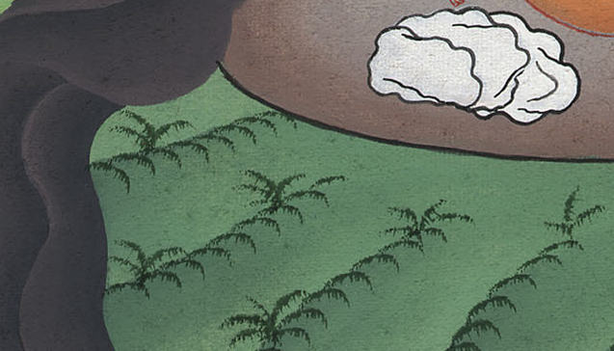
Judges 6:39

Slide 17
40God did so that night; for it was dry on the fleece only, and there was dew on all the ground.

Slide 18
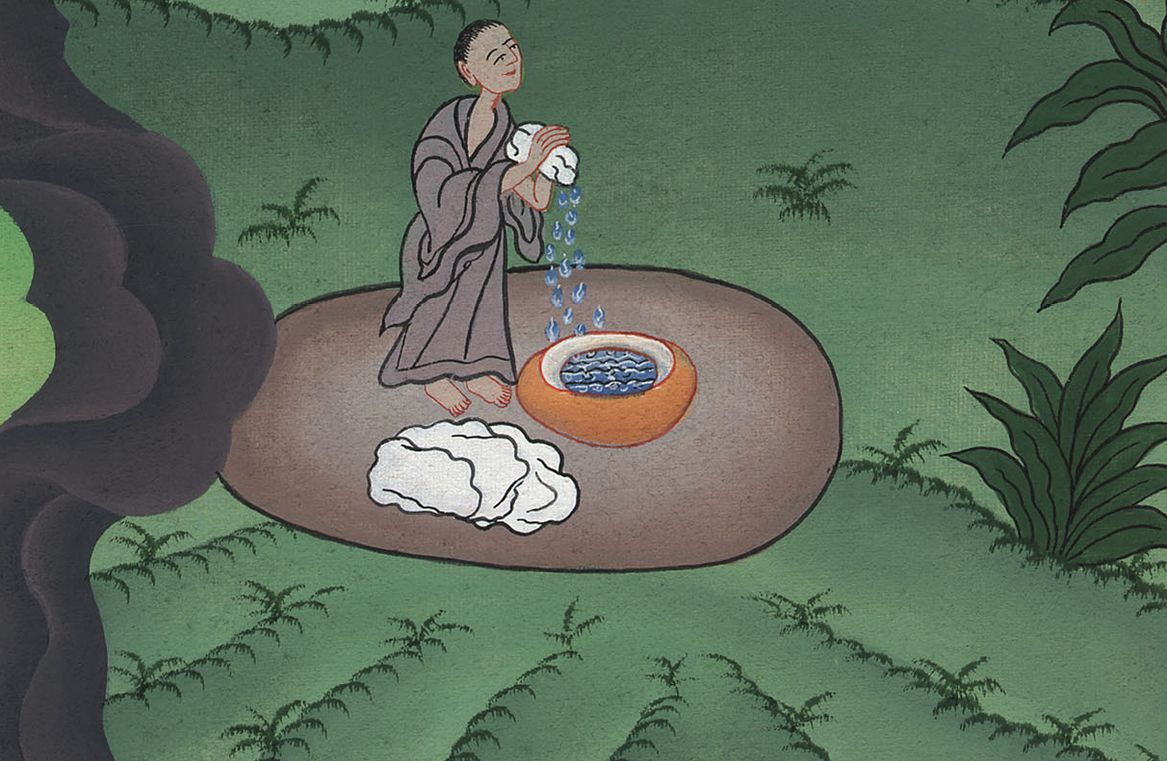
Judges 6:40

