Slide 1
13-5
This work is licensed under a Creative Commons Attribution-ShareAlike 4.0 International License.
Please add this statement to all the videos you create.
English Bible quotes are from the World English Bible US, which is in the public domain.
Notes:
ch

Slide 2
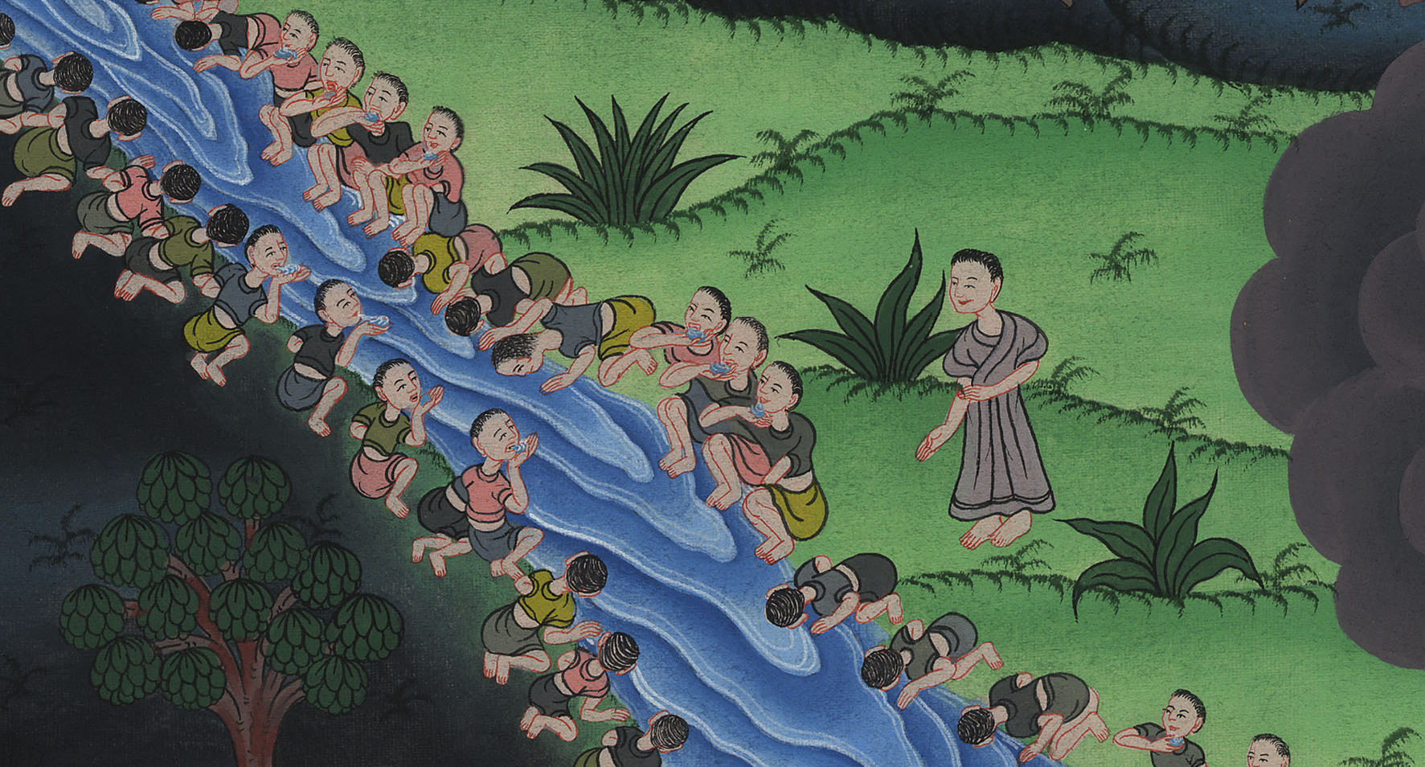
Thinning out the army –
Judges 7:1-8

Slide 3
Thinning out the army – Judges 7:1-8

Slide 4
Thinning out the army –
Judges 7:1-8

Slide 5
1Then Jerubbaal, who is Gideon, and all the people who were with him, rose up early and encamped beside the spring of Harod. Midian’s camp was on the north side of them, by the hill of Moreh, in the valley.

Slide 6
Judges 7:1

Slide 7
2Yahweh said to Gideon, “The people who are with you are too many for me to give the Midianites into their hand, lest Israel brag against me, saying, ‘My own hand has saved me.’

Slide 8
Judges 7:2

Slide 9
3Now therefore proclaim in the ears of the people, saying, ‘Whoever is fearful and trembling, let him return and depart from Mount Gilead.’” So twenty-two thousand of the people returned, and ten thousand remained.

Slide 10
Judges 7:3

Slide 11
4Yahweh said to Gideon, “There are still too many people. Bring them down to the water, and I will test them for you there. It shall be, that those whom I tell you, ‘This shall go with you,’ shall go with you; and whoever I tell you, ‘This shall not go with you,’ shall not go.”

Slide 12
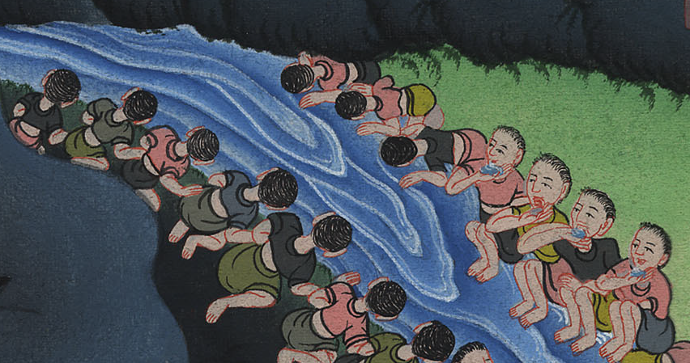
Judges 7:4

Slide 13
5So he brought down the people to the water; and Yahweh said to Gideon, “Everyone who laps of the water with his tongue, like a dog laps, you shall set him by himself; likewise everyone who bows down on his knees to drink.”

Slide 14
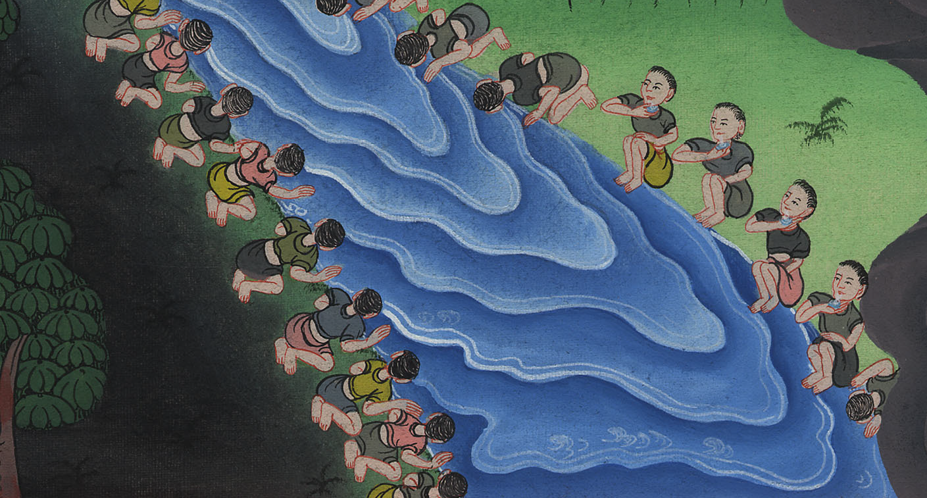
Judges 7:5

Slide 15
6The number of those who lapped, putting their hand to their mouth, was three hundred men; but all the rest of the people bowed down on their knees to drink water.

Slide 16
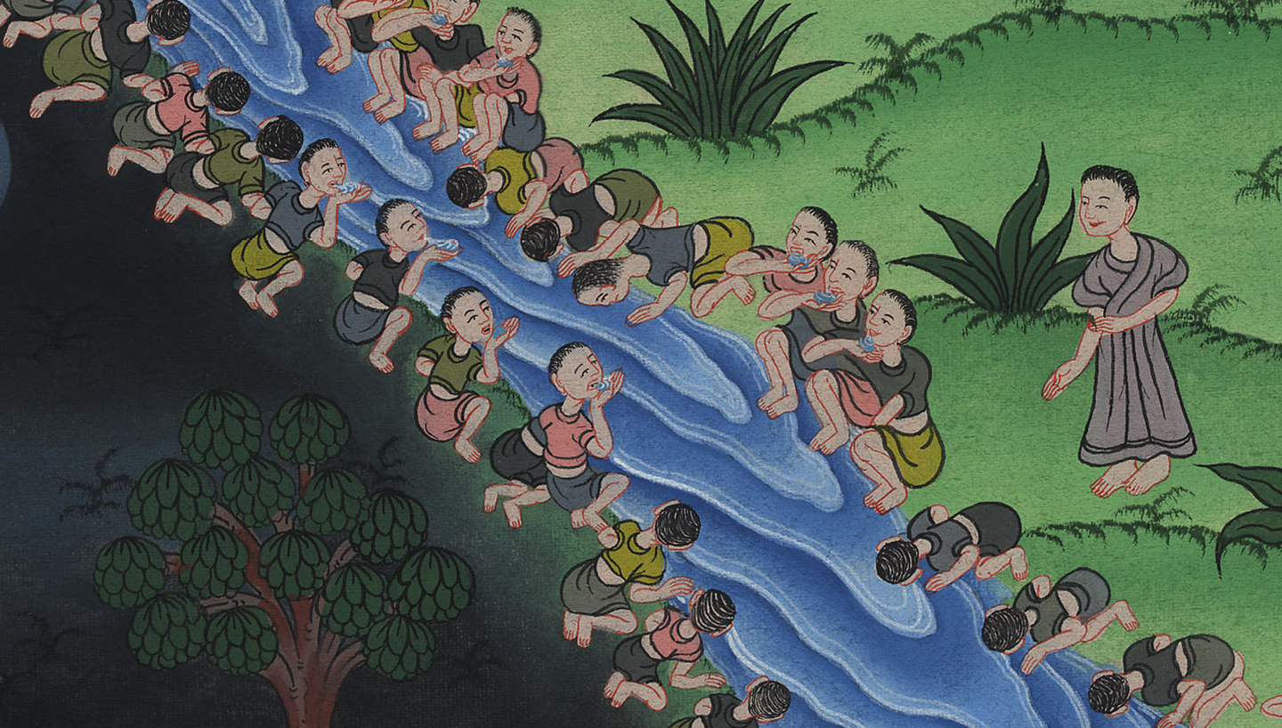
Judges 7:6

Slide 17
7Yahweh said to Gideon, “I will save you by the three hundred men who lapped, and deliver the Midianites into your hand. Let all the other people go, each to his own place.”

Slide 18
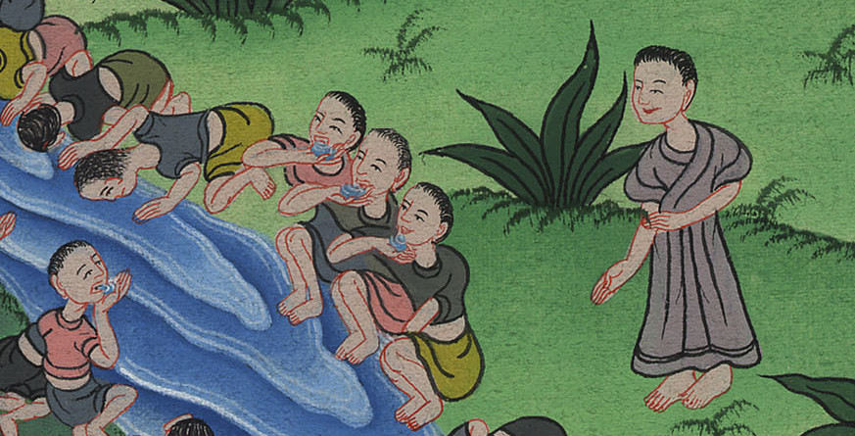
Judges 7:7

