Slide 1
13-6
This work is licensed under a Creative Commons Attribution-ShareAlike 4.0 International License.
Please add this statement to all the videos you create.
English Bible quotes are from the World English Bible US, which is in the public domain.
Notes:
ch

Slide 2
The Midianite’s dream – Judges 7:9-15

Slide 3
The Midianite’s dream – Judges 7:9-15

Slide 4
The Midianite’s dream – Judges 7:9-15

Slide 5
9That same night, Yahweh said to him, “Arise, go down into the camp, for I have delivered it into your hand.

Slide 6
Judges 7:9

Slide 7
10But if you are afraid to go down, go with Purah your servant down to the camp.

Slide 8
Judges 7:10

Slide 9
11You will hear what they say; and afterward your hands will be strengthened to go down into the camp.” Then went he down with Purah his servant to the outermost part of the armed men who were in the camp.

Slide 10
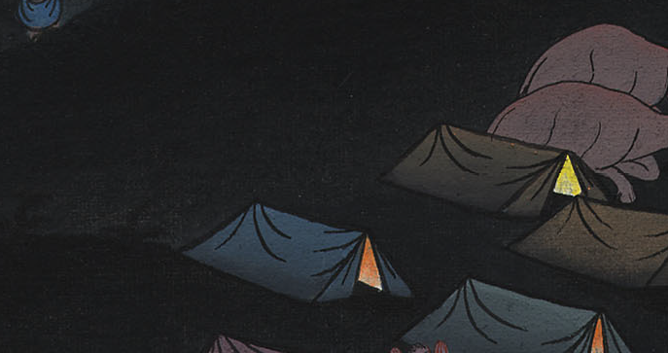
Judges 7:11

Slide 11
12The Midianites and the Amalekites and all the children of the east lay along in the valley like locusts for multitude; and their camels were without number, as the sand which is on the seashore for multitude.

Slide 12
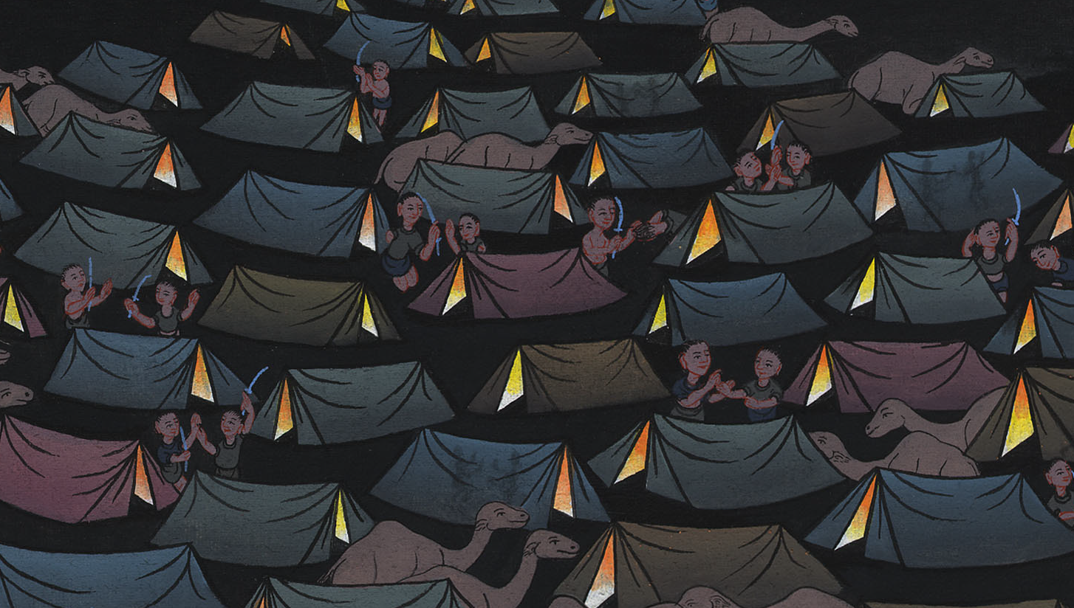
Judges 7:12

Slide 13
13When Gideon had come, behold, there was a man telling a dream to his fellow.

Slide 14
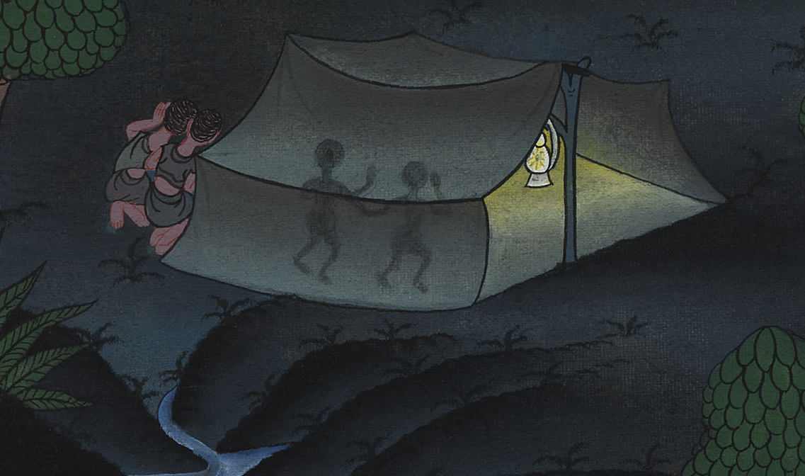
Judges 7:13

Slide 15
He said, “Behold, I dreamed a dream; and behold, a cake of barley bread tumbled into the camp of Midian, came to the tent, and struck it so that it fell, and turned it upside down, so that the tent lay flat.”

Slide 16
Judges 7:13

Slide 17
14His fellow answered, “This is nothing other than the sword of Gideon the son of Joash, a man of Israel. God has delivered Midian into his hand, with all the army.”

Slide 18
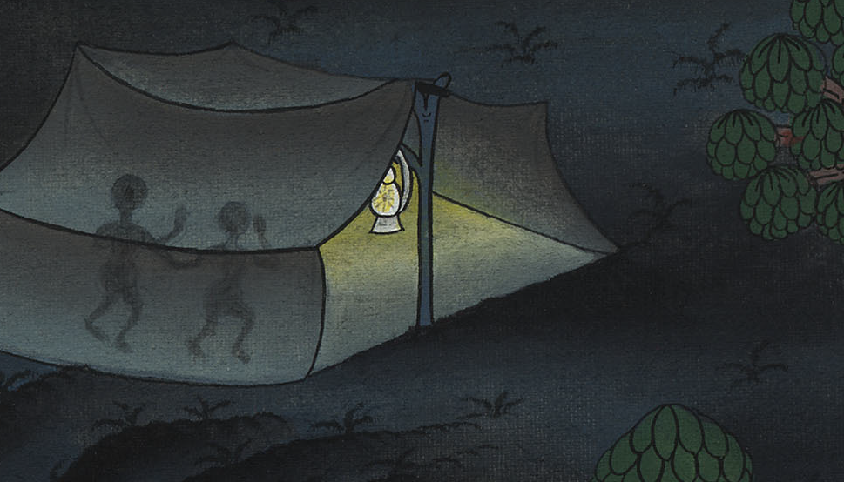
Judges 7:14

Slide 19
15It was so, when Gideon heard the telling of the dream and its interpretation, that he worshiped.

Slide 20
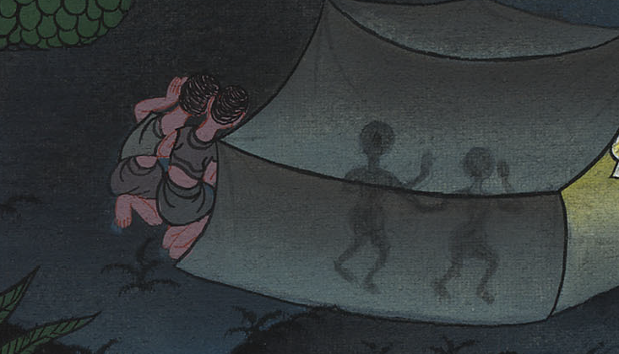
Judges 7:15

Slide 21
Then he returned into the camp of Israel and said, “Arise, for Yahweh has delivered the army of Midian into your hand!”

Slide 22
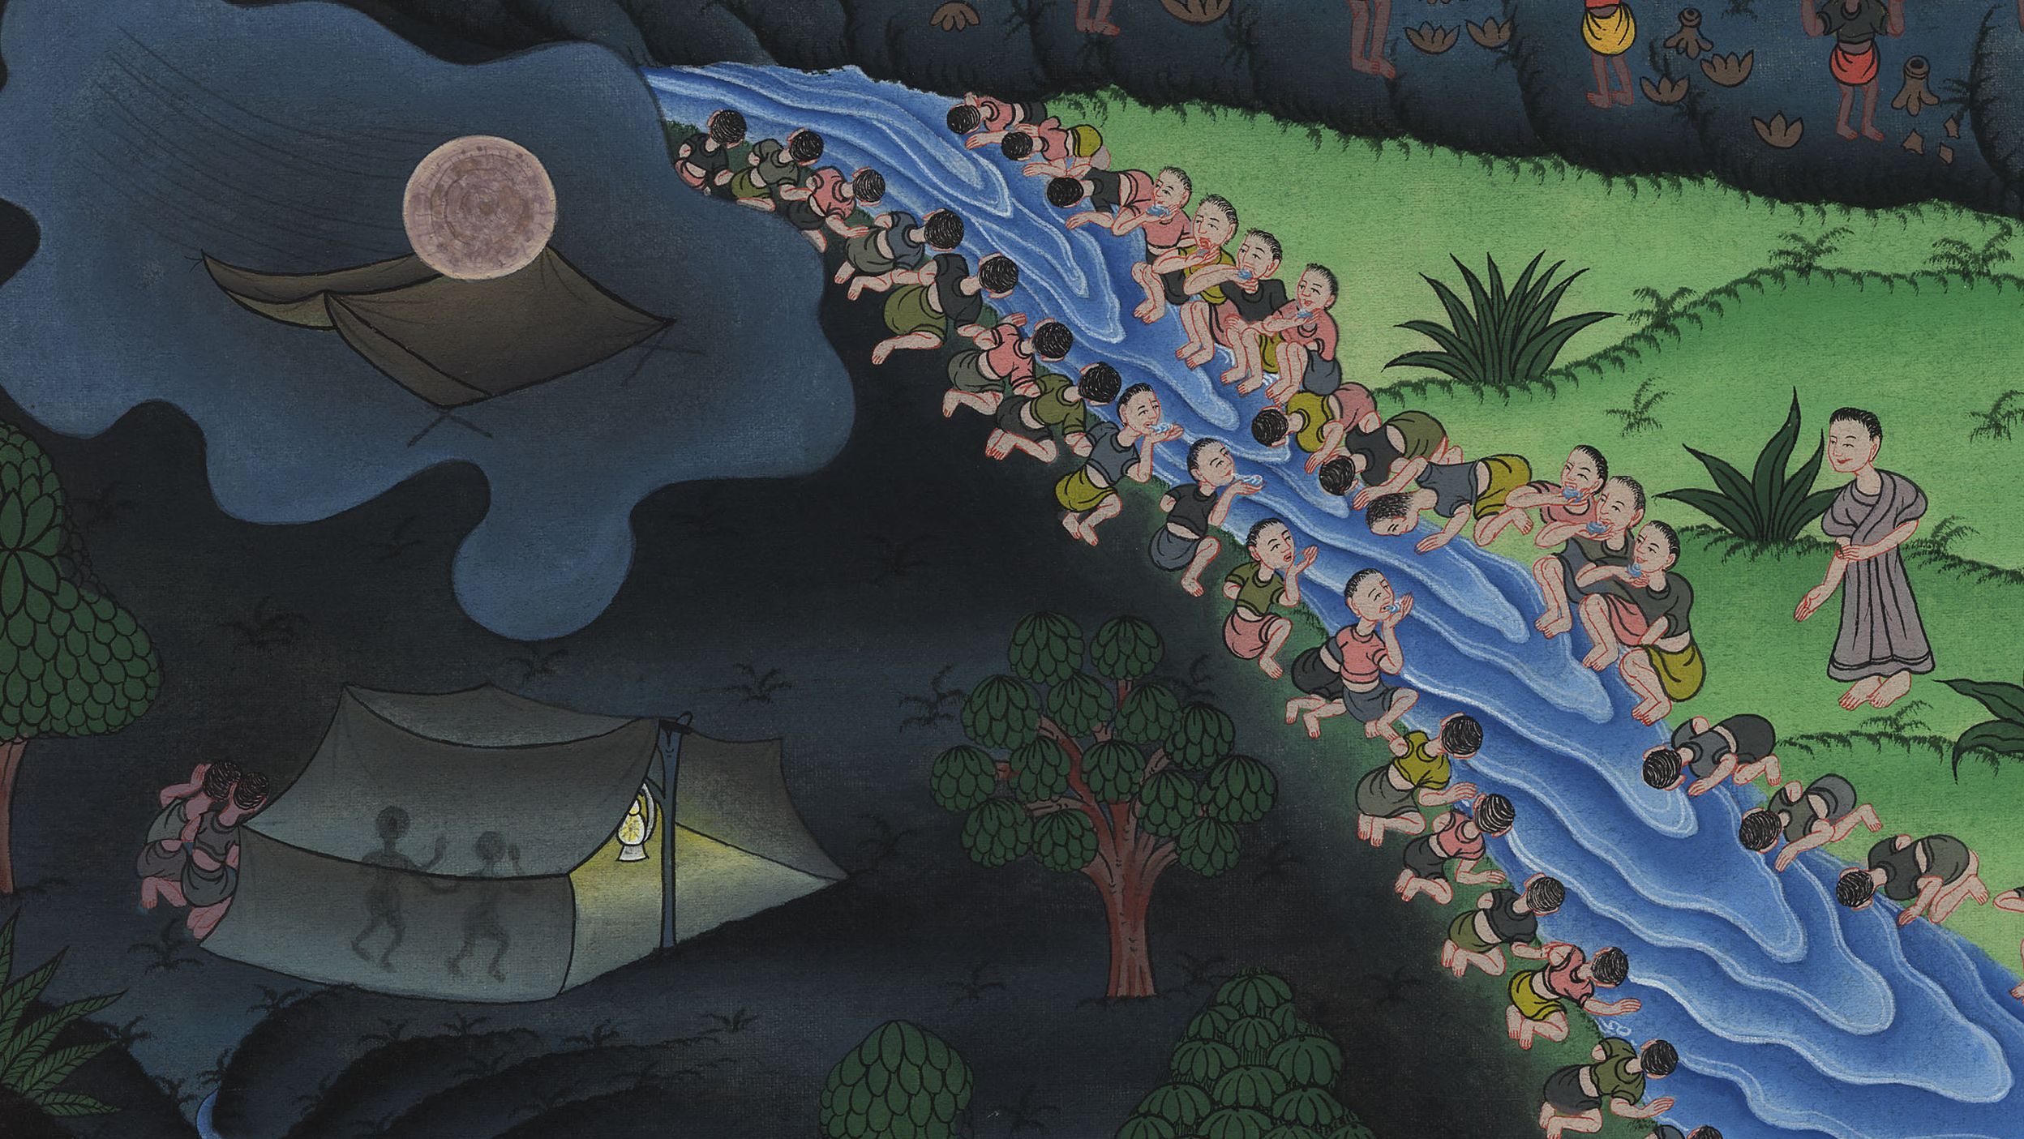
Judges 7:15

