Slide 1
14-1
This work is licensed under a Creative Commons Attribution-ShareAlike 4.0 International License.
Please add this statement to all the videos you create.
English Bible quotes are from the World English Bible US, which is in the public domain.
Notes:
Ch
14 Ruth
1. Naomi’s son’s die - Ruth 1:1-5 (Left Top)
2. Ruth stays with Naomi – Ruth 1:6-22 (Right Top)
3. Ruth gleaning in the field of Boaz – Ruth 2:1-16 (Right Center)
4. Naomi advises Ruth – Ruth 2:17-23 (Right Bottom)
5. Ruth goes to Boaz – Ruth 3:1-18 (Left Bottom)
6. Boaz arranges marriage with Ruth – Ruth 4:1-12 (Left Center)
7. Naomi receives her grandson – Ruth 4:13-22 (Center)

Slide 2
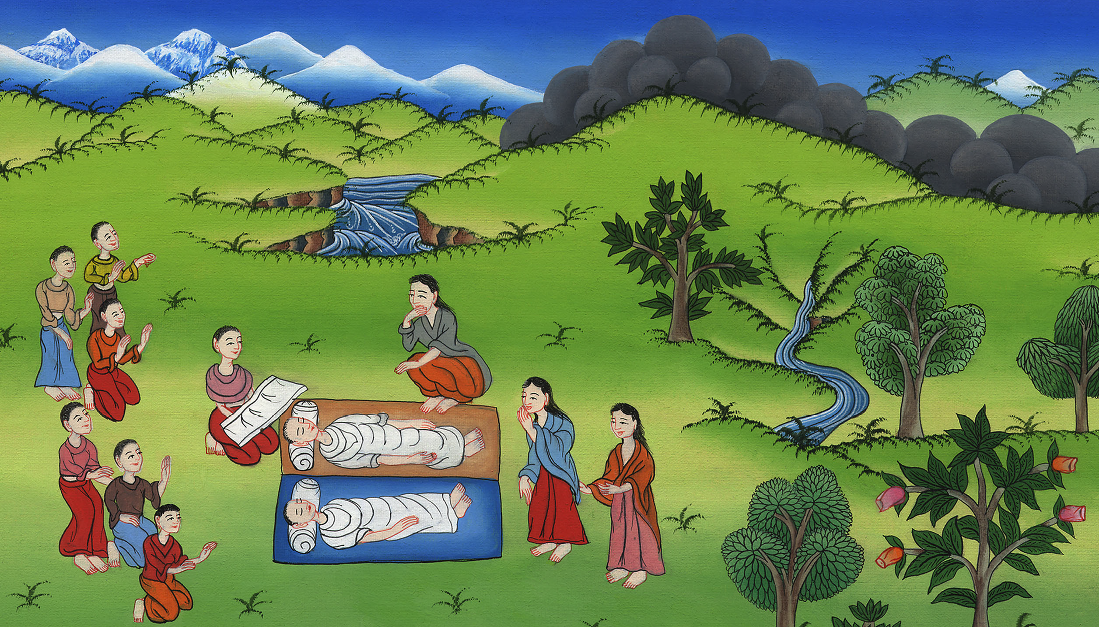
Naomi’s sons die – Ruth 1:1-5

Slide 3
Naomi’s sons die – Ruth 1:1-5

Slide 4
Naomi’s sons die – Ruth 1:1-5

Slide 5
1In the days when the judges judged, there was a famine in the land. A certain man of Bethlehem Judah went to live in the country of Moab with his wife and his two sons.

Slide 6
Ruth 1:1

Slide 7
2The name of the man was Elimelech, and the name of his wife Naomi. The names of his two sons were Mahlon and Chilion,

Slide 8
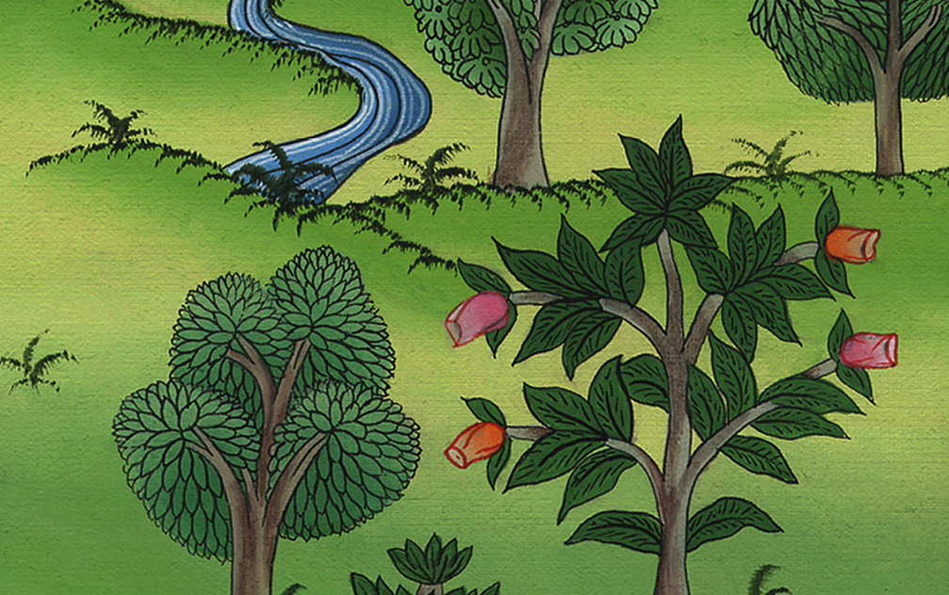
Ruth 1:2

Slide 9
there was a famine in the land. A certain man of Bethlehem Judah went to live in the country of Moab with his wife and his two sons.

Slide 10
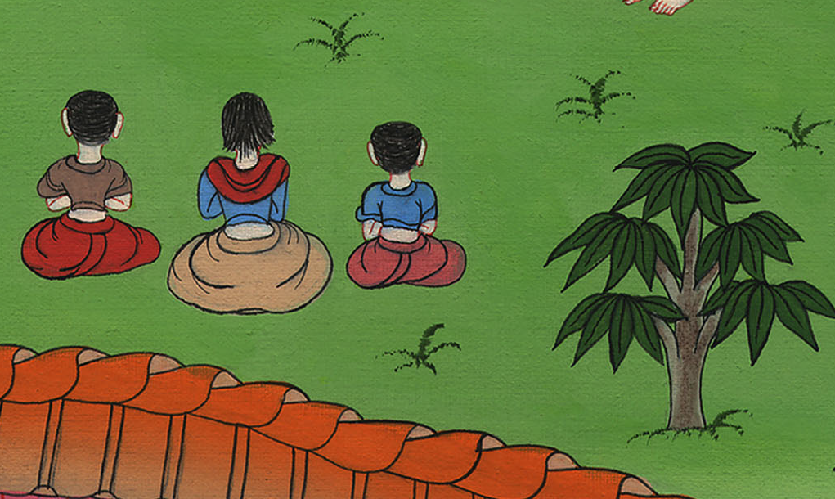
Ruth 1:2

Slide 11
3Elimelech, Naomi’s husband, died; and she was left with her two sons.

Slide 12
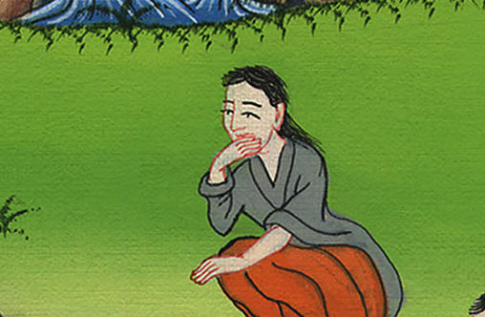
Ruth 1:3

Slide 13
4They took for themselves wives of the women of Moab. The name of the one was Orpah, and the name of the other was Ruth. They lived there about ten years.

Slide 14
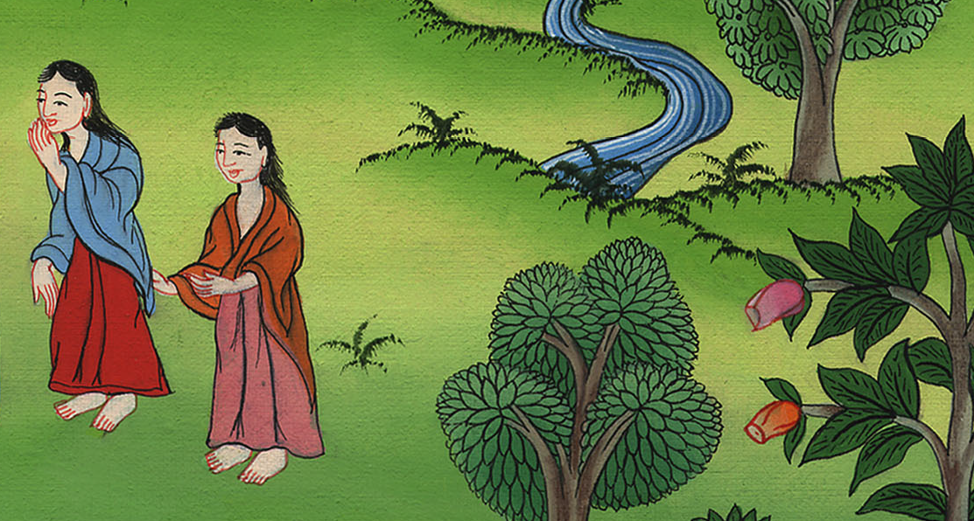
Ruth 1:4

Slide 15
5Mahlon and Chilion both died, and the woman was bereaved of her two children and of her husband.

Slide 16
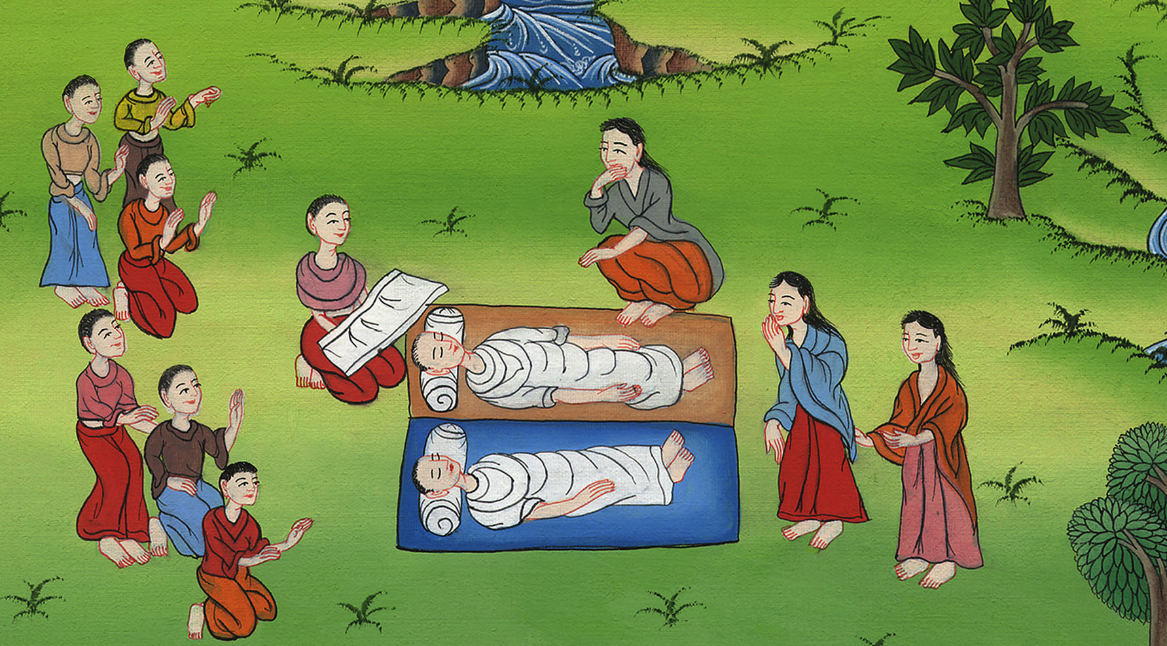
Ruth 1:5

