Slide 1
14-2
This work is licensed under a Creative Commons Attribution-ShareAlike 4.0 International License.
Please add this statement to all the videos you create.
English Bible quotes are from the World English Bible US, which is in the public domain.
Notes:
Ch –Possibly combine with 14-1

Slide 2
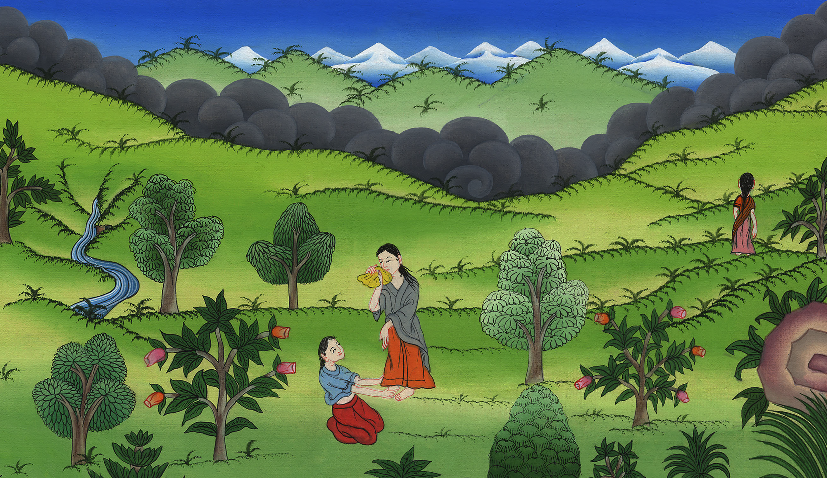
Ruth stays with Naomi –
Ruth 1:6-22

Slide 3
Ruth stays with Naomi – Ruth 1:6-22

Slide 4
Ruth stays with Naomi –
Ruth 1:6-22

Slide 5
1:6 Then she arose with her daughters-in-law, that she might return from the country of Moab for she had heard in the country of Moab how Yahweh had visited his people in giving them bread.

Slide 6
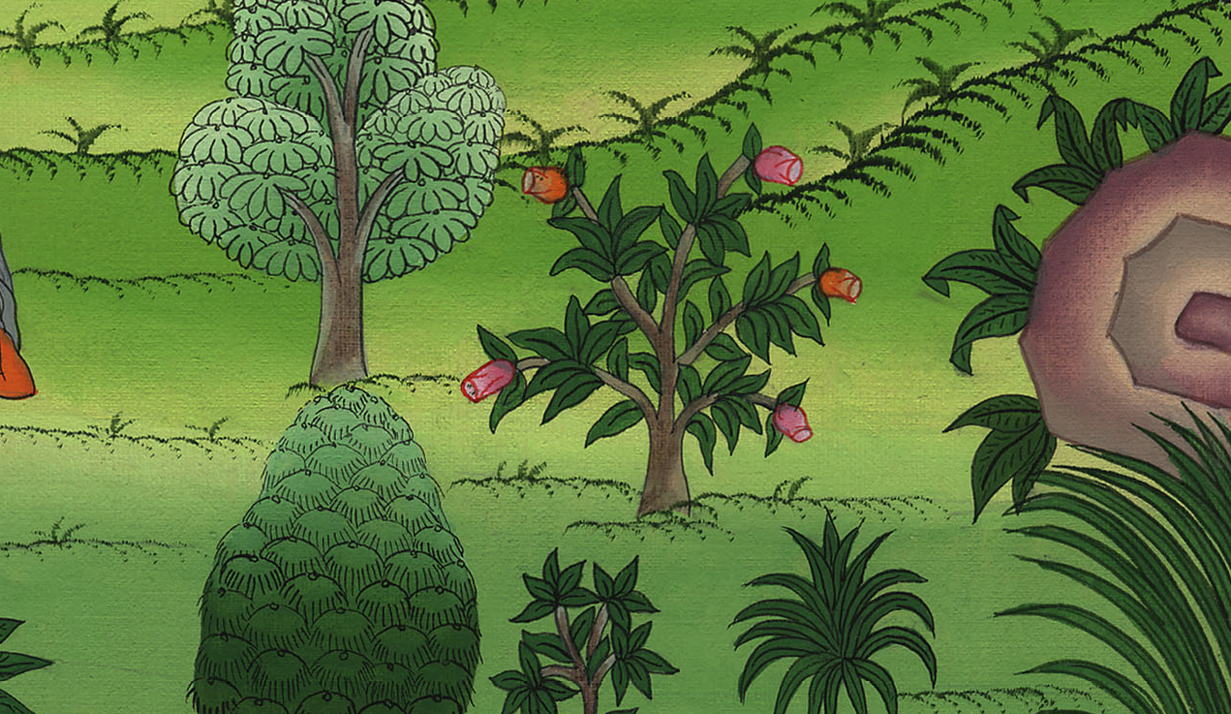
Ruth 1:6

Slide 7
7She went out of the place where she was, and her two daughters-in-law with her. They went on the way to return to the land of Judah.

Slide 8
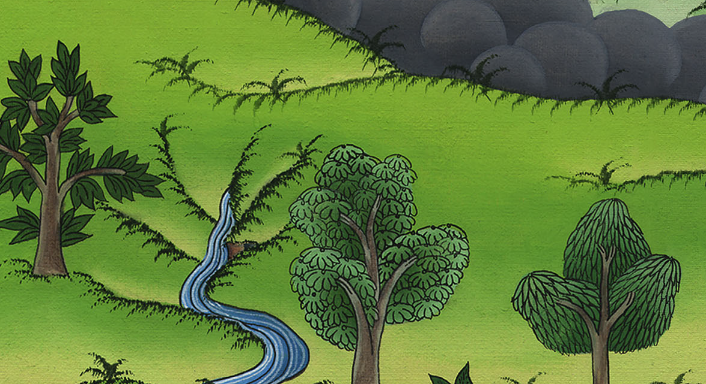
Ruth 1:7

Slide 9
8Naomi said to her two daughters-in-law, “Go, return each of you to her mother’s house.

Slide 10
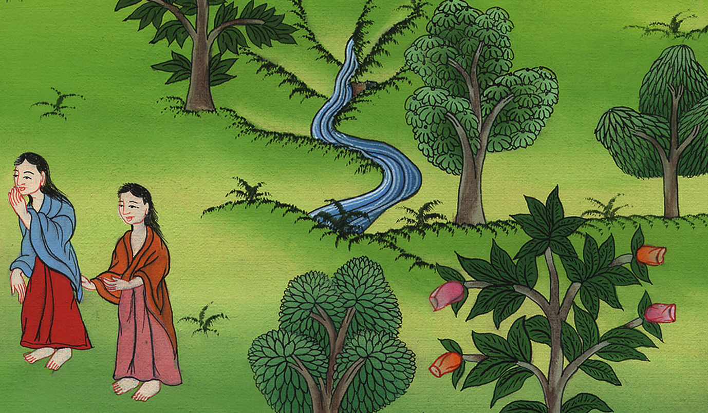
Ruth 1:8

Slide 11
9May Yahweh grant you that you may find rest, each of you in the house of her husband.”
Then she kissed them, and they lifted up their voices, and wept.

Slide 12
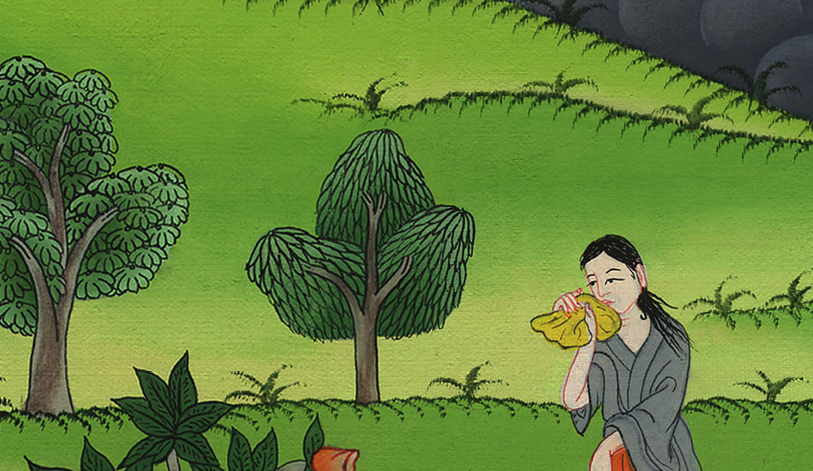
Ruth 1:9

Slide 13
10They said to her, “No, but we will return with you to your people.”

Slide 14
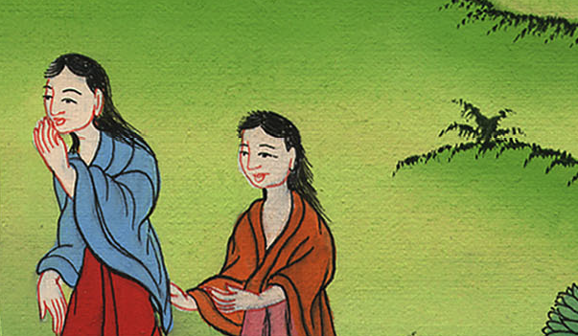
Ruth 1:10

Slide 15
13…. No, my daughters, for it grieves me seriously for your sakes, for Yahweh’s hand has gone out against me.”

Slide 16
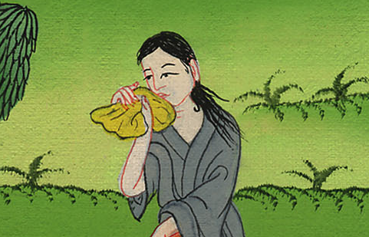
Ruth 1:13

Slide 17
14They lifted up their voices and wept again; then Orpah kissed her mother-in-law, but Ruth stayed with her.

Slide 18
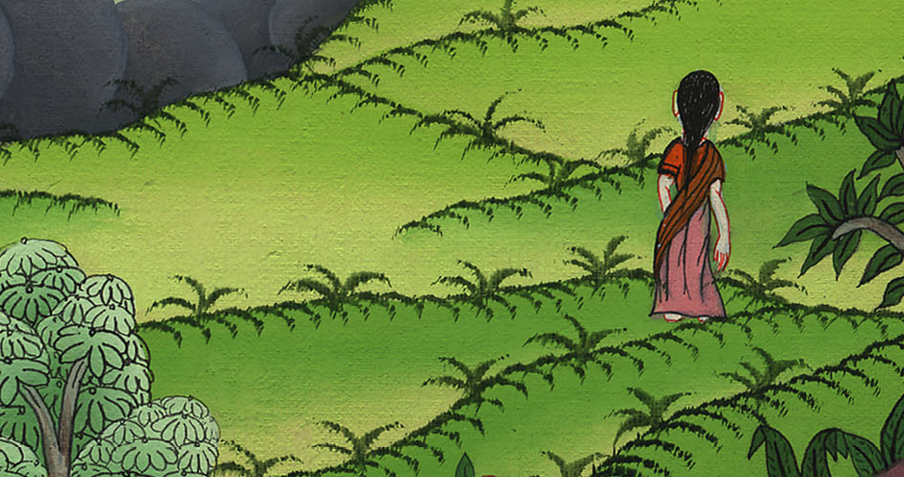
Ruth 1:14

Slide 19
15She said, “Behold, your sister-in-law has gone back to her people and to her god. Follow your sister-in-law.”

Slide 20
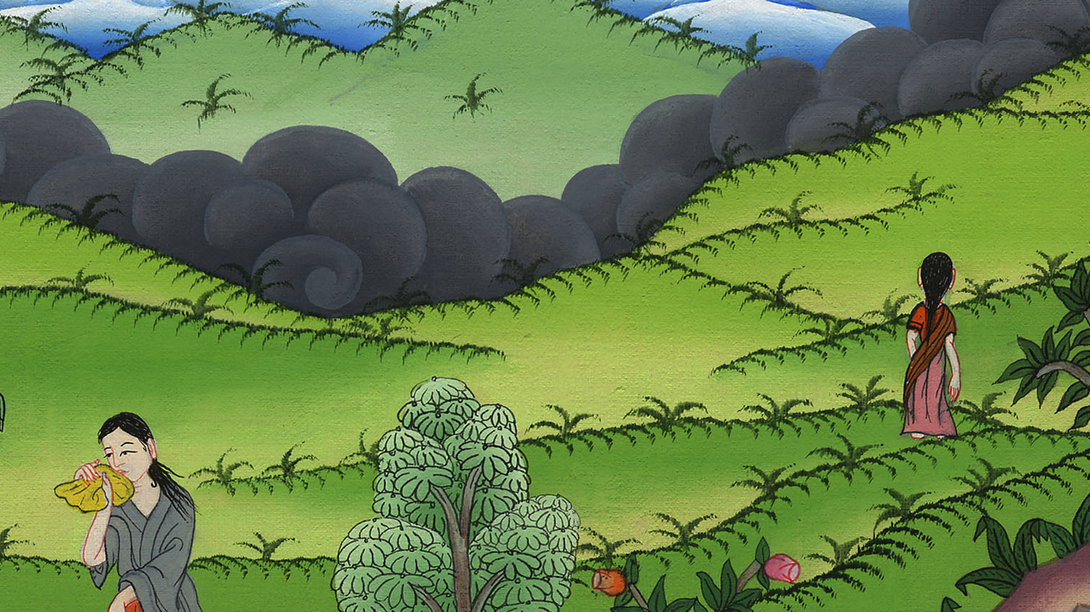
Ruth 1:15

Slide 21
16Ruth said, “Don’t urge me to leave you, and to return from following you, for where you go, I will go; and where you stay, I will stay. Your people will be my people, and your God my God.

Slide 22
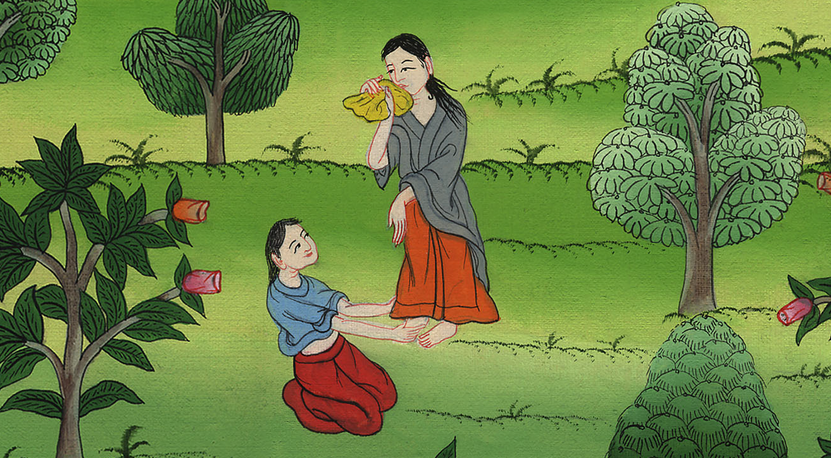
Ruth 1:16

Slide 23
18When Naomi saw that she was determined to go with her, she stopped urging her.

Slide 24
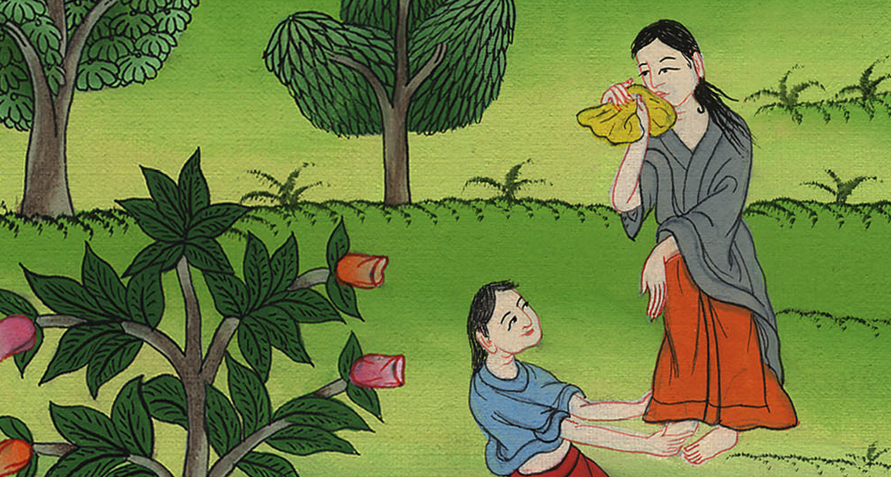
Ruth 1:18

Slide 25
22So Naomi returned, and Ruth the Moabitess, her daughter-in-law, with her, who returned out of the country of Moab. They came to Bethlehem in the beginning of barley harvest.

Slide 26
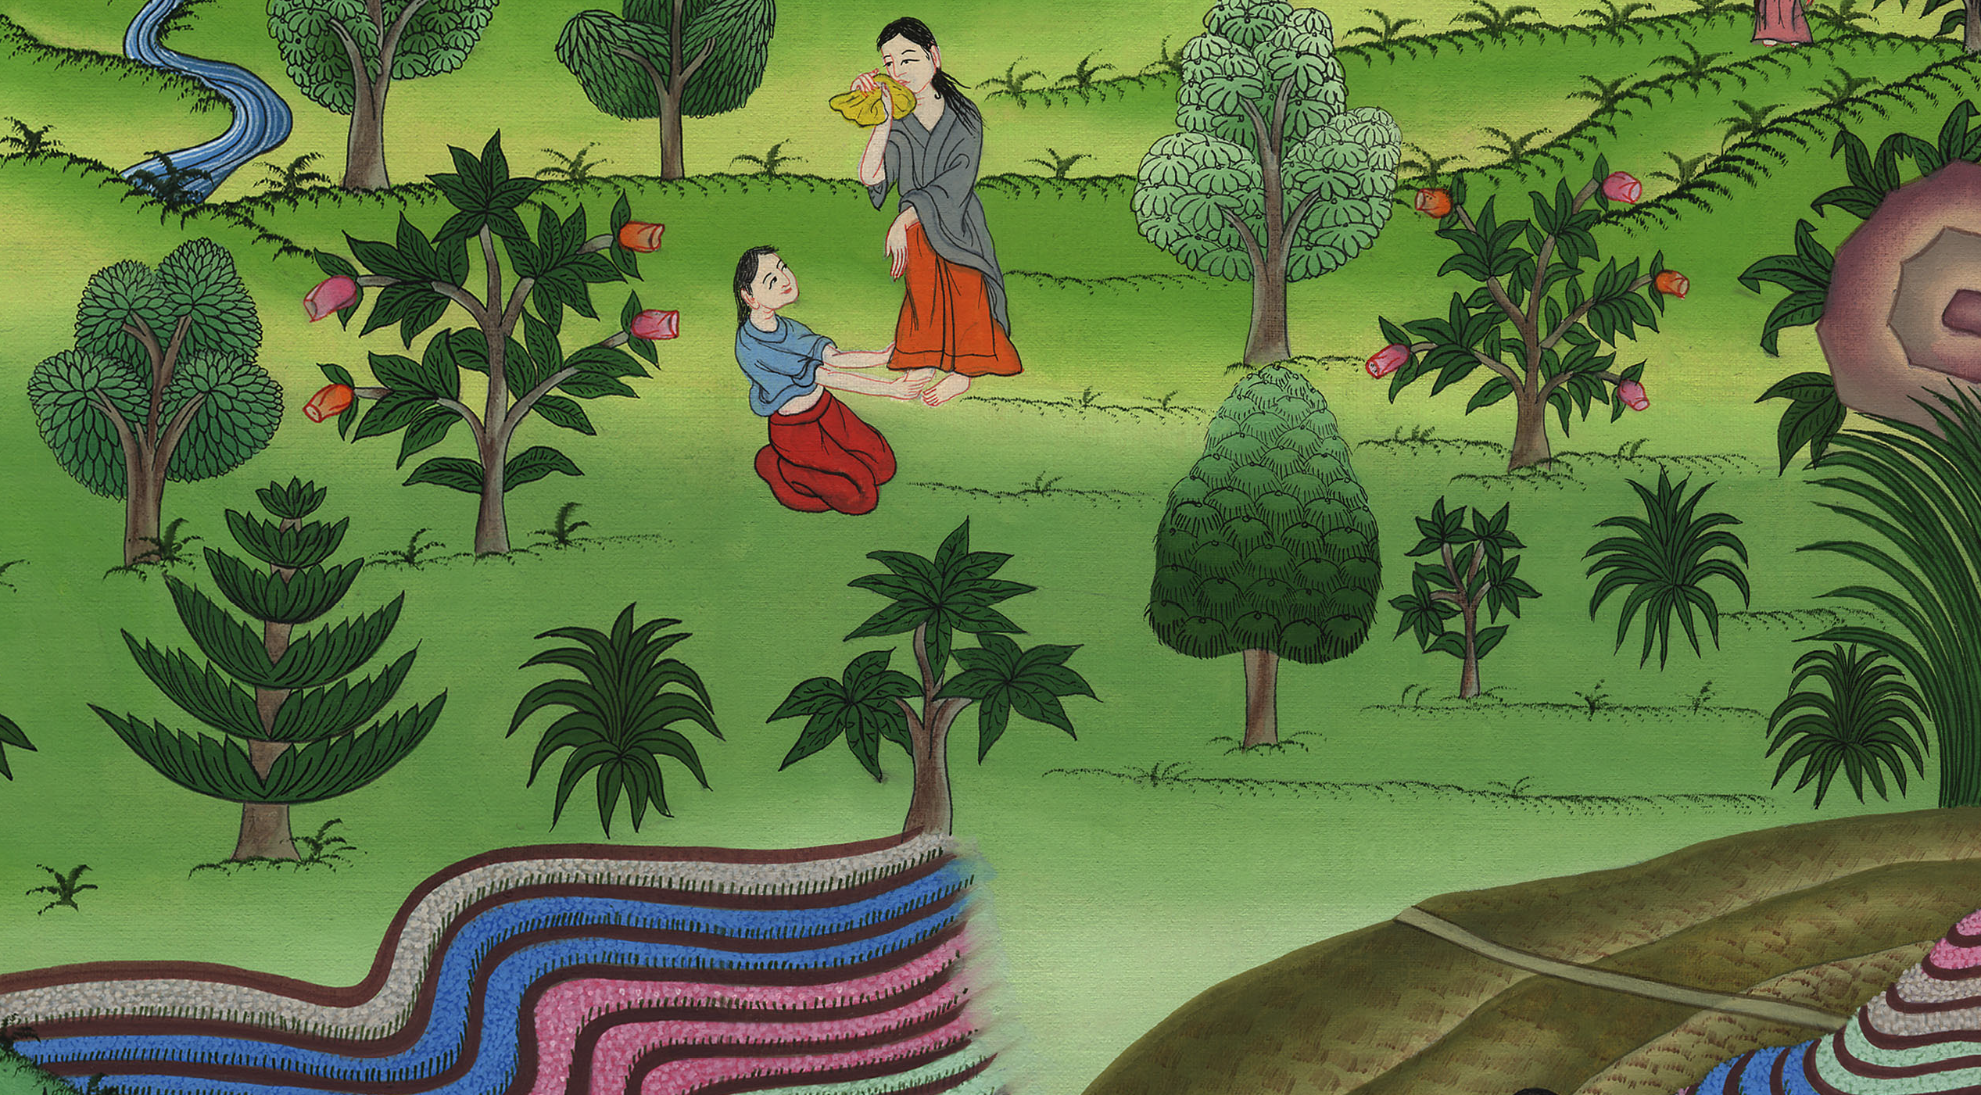
Ruth 1:22

