Slide 1
14-4
This work is licensed under a Creative Commons Attribution-ShareAlike 4.0 International License.
Please add this statement to all the videos you create.
English Bible quotes are from the World English Bible US, which is in the public domain.
Notes:
Ch
14 Ruth
1. Naomi’s son’s die - Ruth 1:1-5 (Left Top)
2. Ruth stays with Naomi – Ruth 1:6-22 (Right Top)
3. Ruth gleaning in the field of Boaz – Ruth 2:1-16 (Right Center)
4. Naomi advises Ruth – Ruth 2:17-23 (Right Bottom)
5. Ruth goes to Boaz – Ruth 3:1-18 (Left Bottom)
6. Boaz arranges marriage with Ruth – Ruth 4:1-12 (Left Center)
7. Naomi receives her grandson – Ruth 4:13-22 (Center)

Slide 2
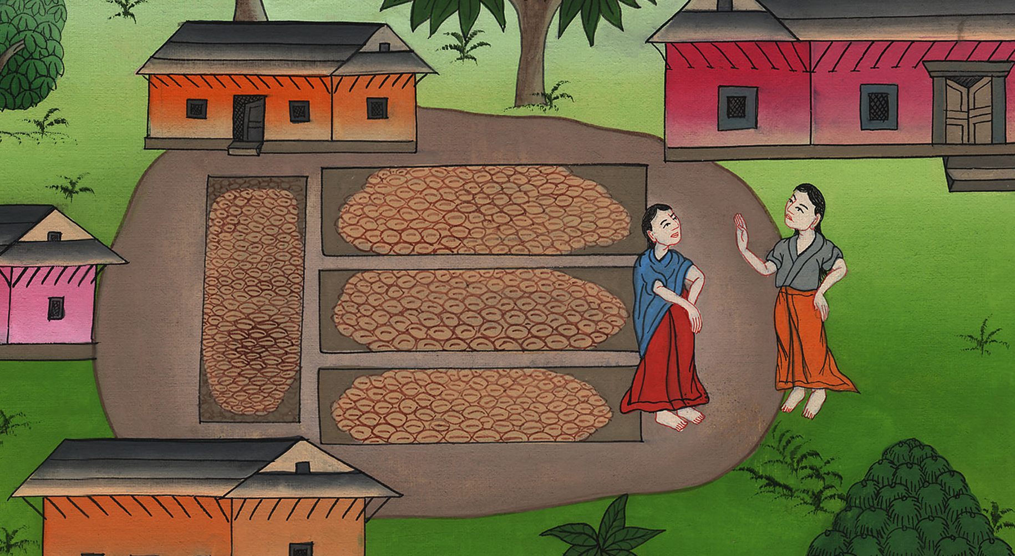
Naomi advises Ruth – Ruth 2:17-23

Slide 3
Naomi advises Ruth – Ruth 2:17-23

Slide 4
Naomi advises Ruth – Ruth 2:17-23

Slide 5
17So she gleaned in the field until evening; and she beat out that which she had gleaned, and it was about an ephah of barley.

Slide 6
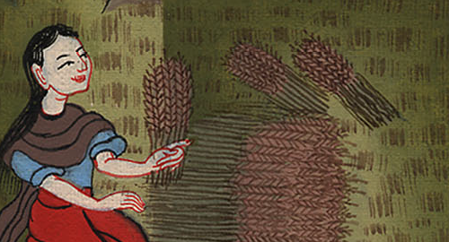
Ruth 2:17

Slide 7
18She took it up, and went into the city. Then her mother-in-law saw what she had gleaned; and she brought out and gave to her that which she had left after she had enough.

Slide 8
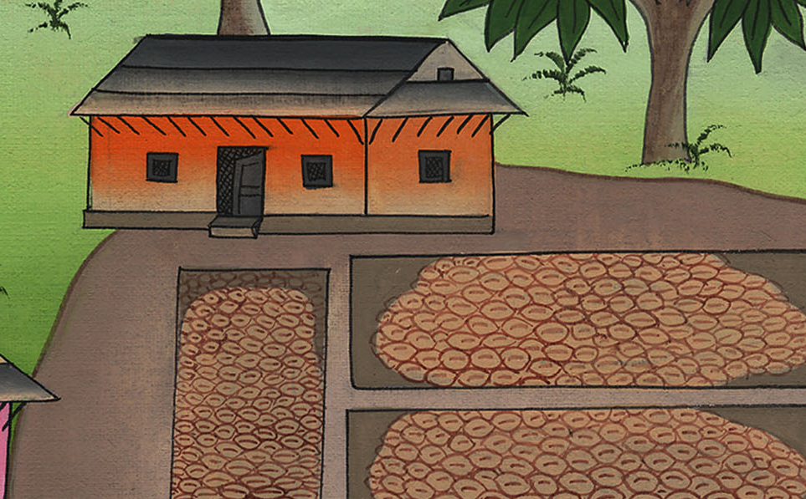
Ruth 2:18

Slide 9
19Her mother-in-law said to her, “Where have you gleaned today? Where have you worked? Blessed be he who noticed you.”

Slide 10
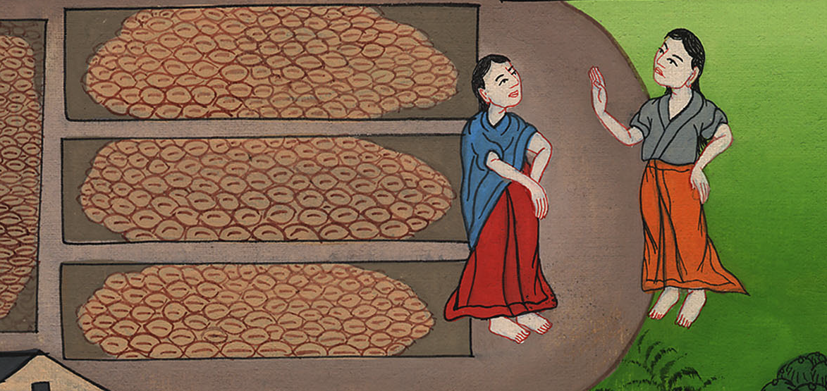
Ruth 2:19

Slide 11
She told her mother-in-law with whom she had worked, “The man’s name with whom I worked today is Boaz.”

Slide 12
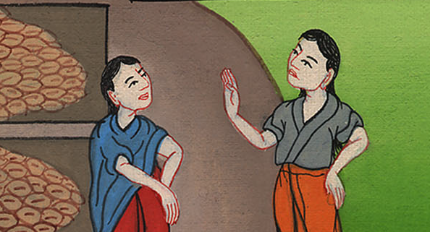
Ruth 2:19

Slide 13
20Naomi said to her daughter-in-law, “May he be blessed by Yahweh, who has not abandoned his kindness to the living and to the dead.” Naomi said to her, “The man is a close relative to us, one of our near kinsmen.”

Slide 14
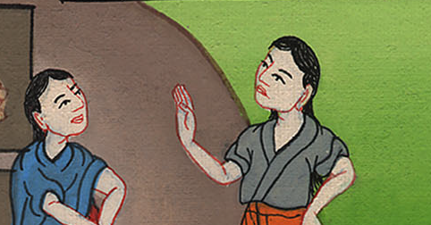
Ruth 2:20

Slide 15
21Ruth the Moabitess said, “Yes, he said to me, ‘You shall stay close to my young men until they have finished all my harvest.’”

Slide 16
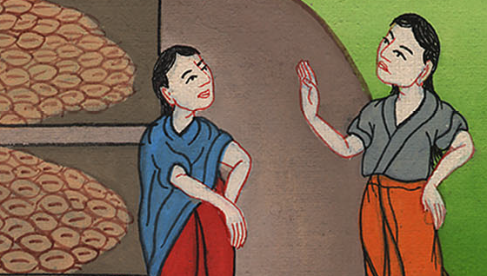
Ruth 2:21

Slide 17
22Naomi said to Ruth her daughter-in-law, “It is good, my daughter, that you go out with his maidens, and that they not meet you in any other field.”

Slide 18
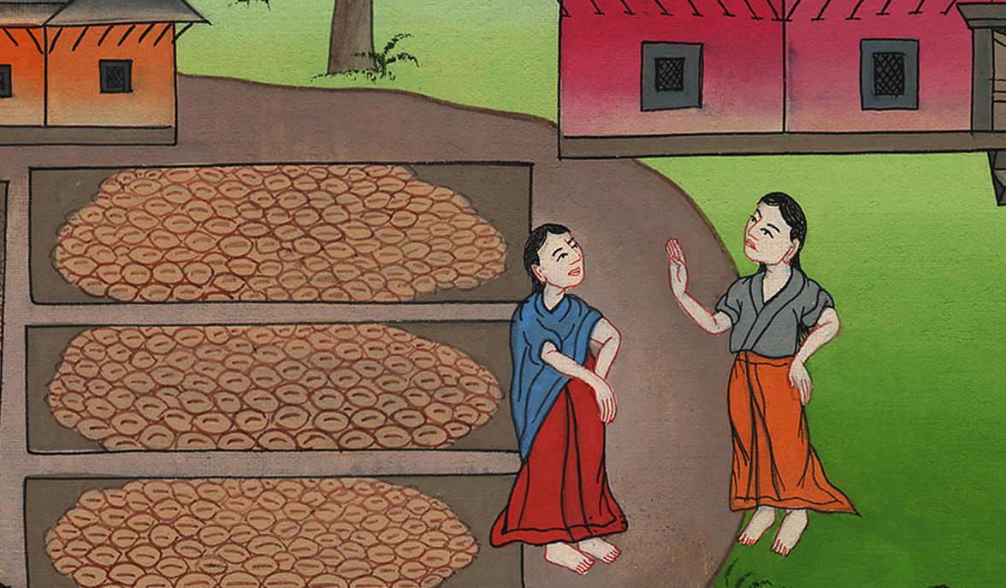
Ruth 2:22

Slide 19
23So she stayed close to the maidens of Boaz, to glean to the end of barley harvest and of wheat harvest; and she lived with her mother-in-law.

Slide 20
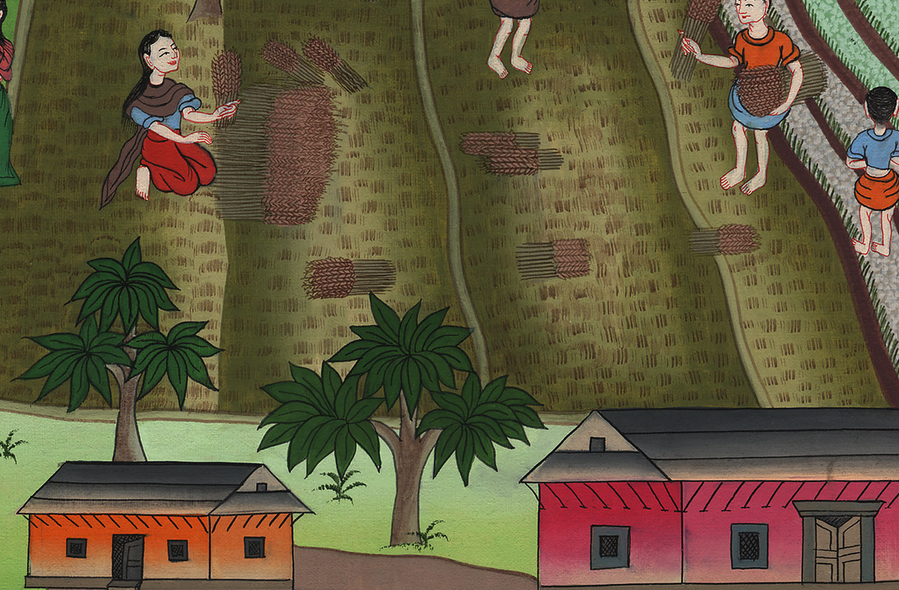
Ruth 2:23

