Slide 1
14-5
This work is licensed under a Creative Commons Attribution-ShareAlike 4.0 International License.
Please add this statement to all the videos you create.
English Bible quotes are from the World English Bible US, which is in the public domain.
Notes:
Ch
14 Ruth
1. Naomi’s son’s die - Ruth 1:1-5 (Left Top)
2. Ruth stays with Naomi – Ruth 1:6-22 (Right Top)
3. Ruth gleaning in the field of Boaz – Ruth 2:1-16 (Right Center)
4. Naomi advises Ruth – Ruth 2:17-23 (Right Bottom)
5. Ruth goes to Boaz – Ruth 3:1-18 (Left Bottom)
6. Boaz arranges marriage with Ruth – Ruth 4:1-12 (Left Center)
7. Naomi receives her grandson – Ruth 4:13-22 (Center)

Slide 2
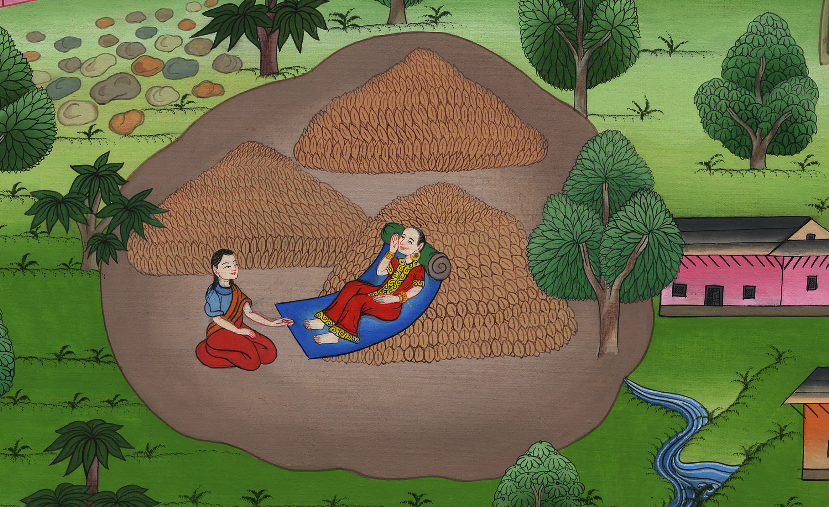
Ruth goes to Boaz – Ruth 3:1-18

Slide 3
Ruth goes to Boaz – Ruth 3:1-18

Slide 4
Ruth goes to Boaz – Ruth 3:1-18

Slide 5
1Naomi her mother-in-law said to her, “My daughter, shall I not seek rest for you, that it may be well with you?

Slide 6
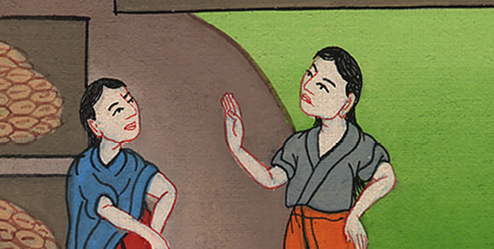
Ruth 3:1

Slide 7
2Now isn’t Boaz our kinsman, with whose maidens you were? Behold, he will be winnowing barley tonight on the threshing floor.

Slide 8
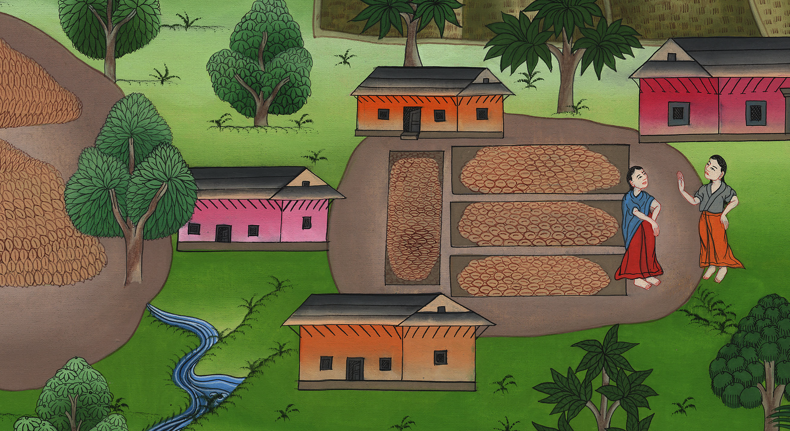
Ruth 3:2

Slide 9
3Therefore wash yourself, anoint yourself, get dressed, and go down to the threshing floor; but don’t make yourself known to the man until he has finished eating and drinking.

Slide 10
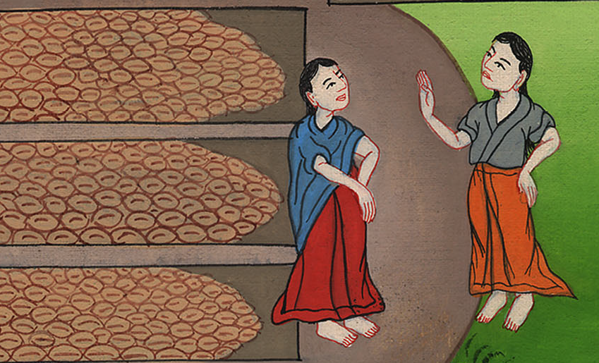
Ruth 3:3

Slide 11
4It shall be, when he lies down, that you shall note the place where he is lying. Then you shall go in, uncover his feet, and lie down. Then he will tell you what to do.”

Slide 12
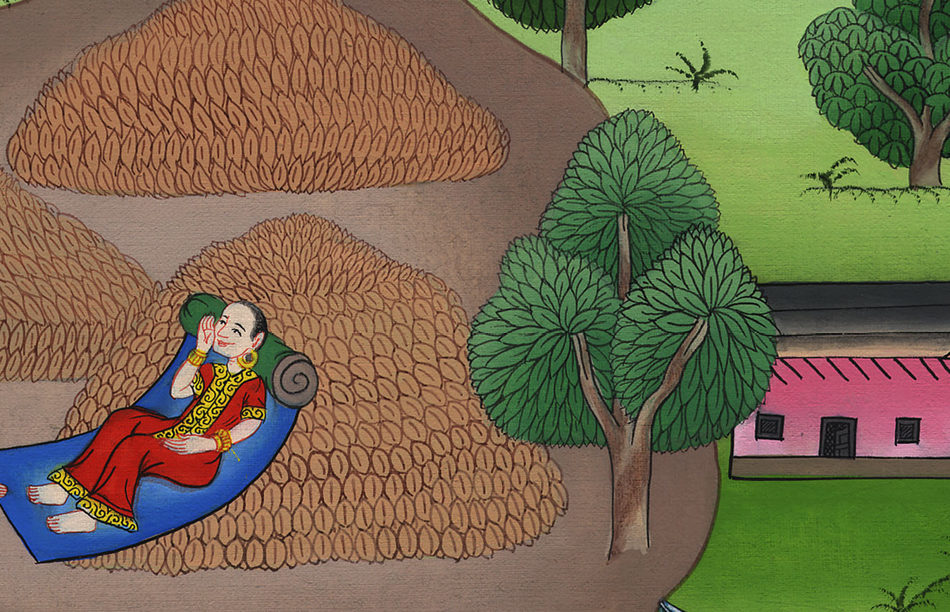
Ruth 3:4

Slide 13
5She said to her, “All that you say, I will do.” 6She went down to the threshing floor, and did everything that her mother-in-law told her.

Slide 14
Ruth 3:5

Slide 15
7When Boaz had eaten and drunk, and his heart was merry, he went to lie down at the end of the heap of grain. She came softly, uncovered his feet, and lay down.

Slide 16
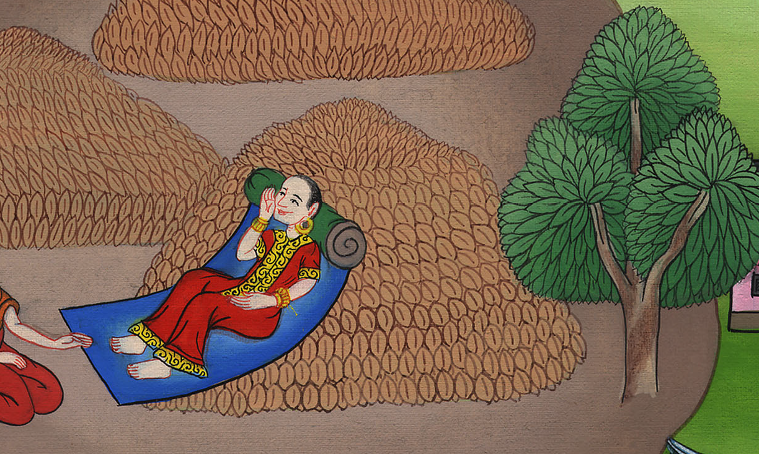
Ruth 3:7

Slide 17
8At midnight, the man was startled and turned himself; and behold, a woman lay at his feet.

Slide 18
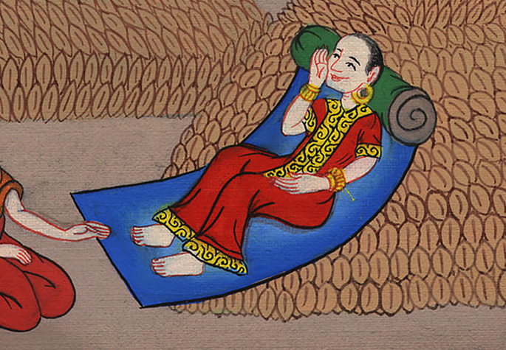
Ruth 3:8

Slide 19
9He said, “Who are you?”
She answered, “I am Ruth your servant. Therefore spread the corner of your garment over your servant; for you are a near kinsman.”

Slide 20
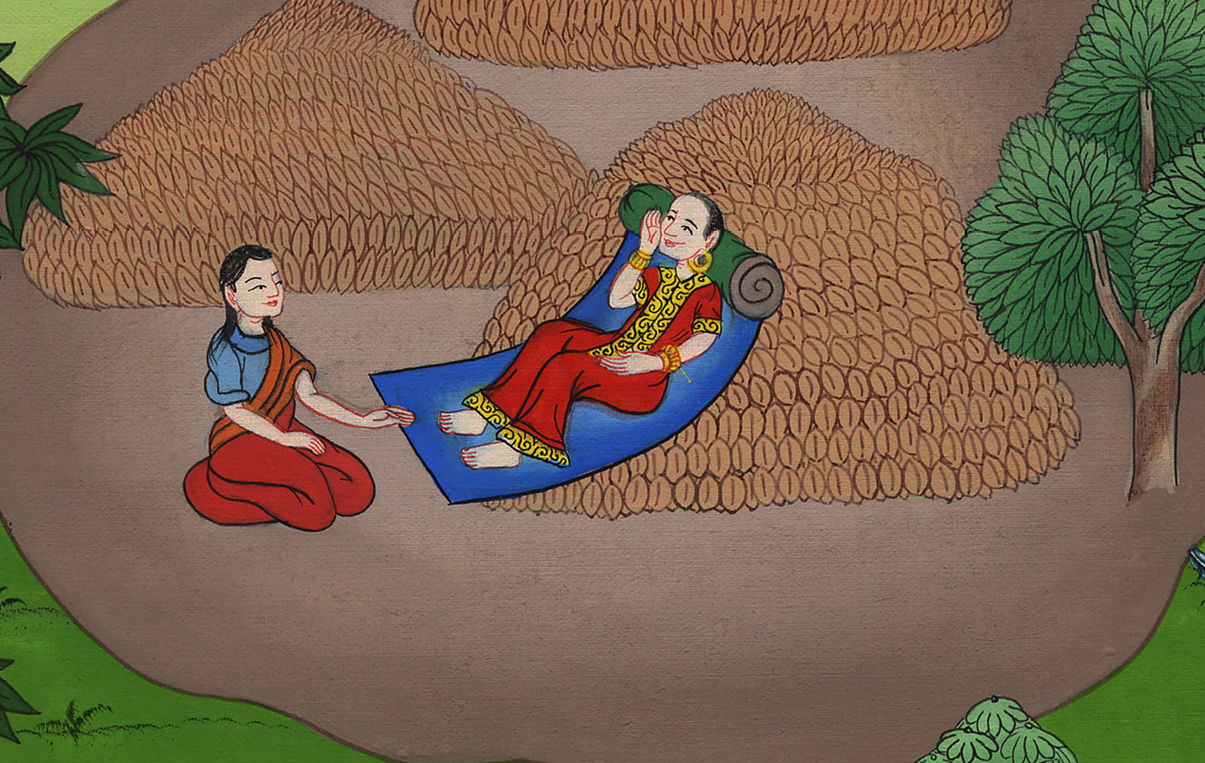
Ruth 3:9

Slide 21
10He said, “You are blessed by Yahweh, my daughter. You have shown more kindness in the latter end than at the beginning, because you didn’t follow young men, whether poor or rich.

Slide 22
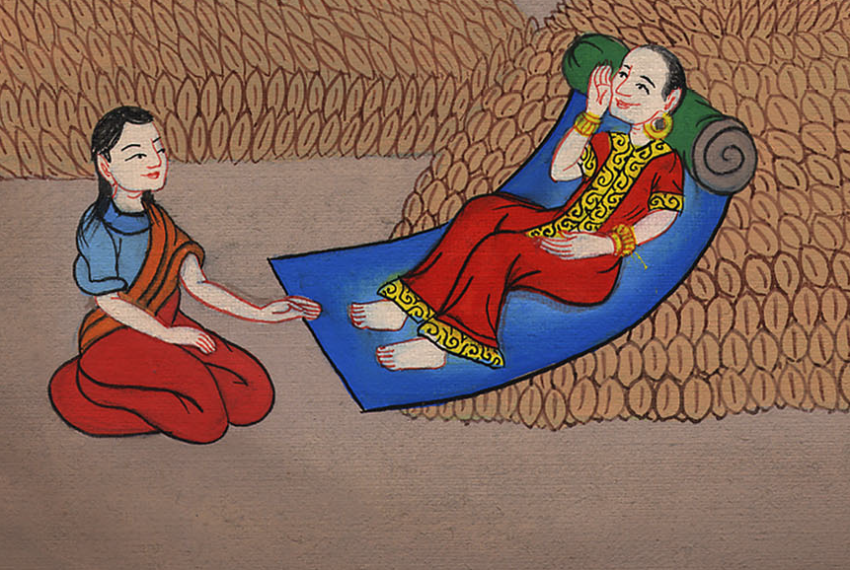
Ruth 3:10

Slide 23
11Now, my daughter, don’t be afraid. I will do to you all that you say; for all the city of my people knows that you are a worthy woman.

Slide 24
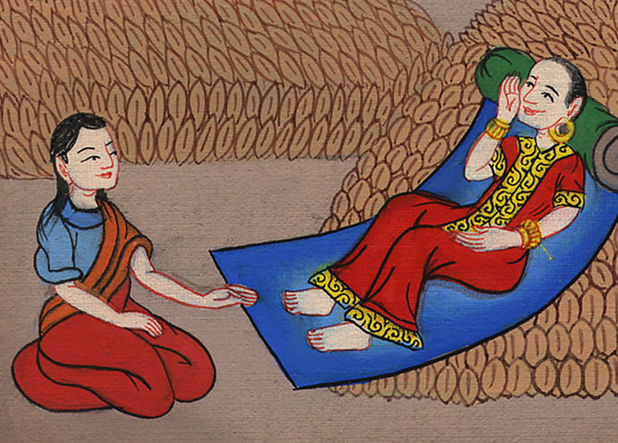
Ruth 3:11

Slide 25
12Now it is true that I am a near kinsman. However, there is a kinsman nearer than I.

Slide 26
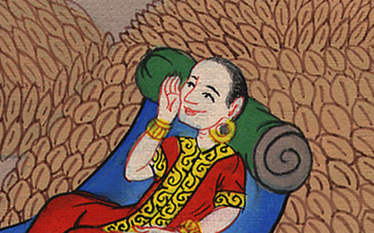
Ruth 3:12

Slide 27
13Stay this night, and in the morning, if he will perform for you the part of a kinsman, good. Let him do the kinsman’s duty. But if he will not do the duty of a kinsman for you, then I will do the duty of a kinsman for you, as Yahweh lives. Lie down until the morning.”

Slide 28
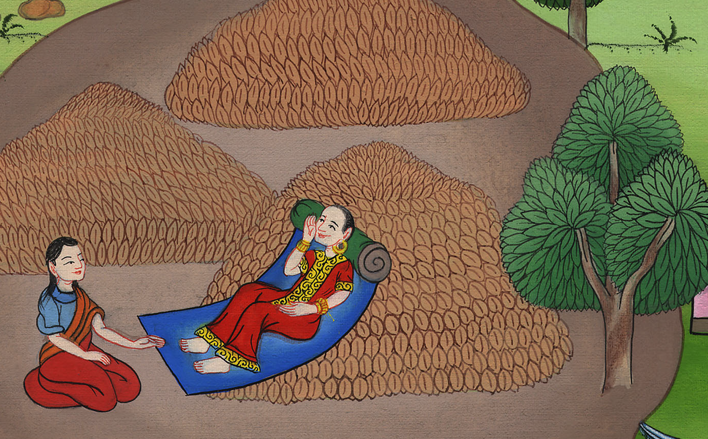
Ruth 3:13

Slide 29
14She lay at his feet until the morning, then she rose up before one could discern another. For he said, “Let it not be known that the woman came to the threshing floor.”

Slide 30
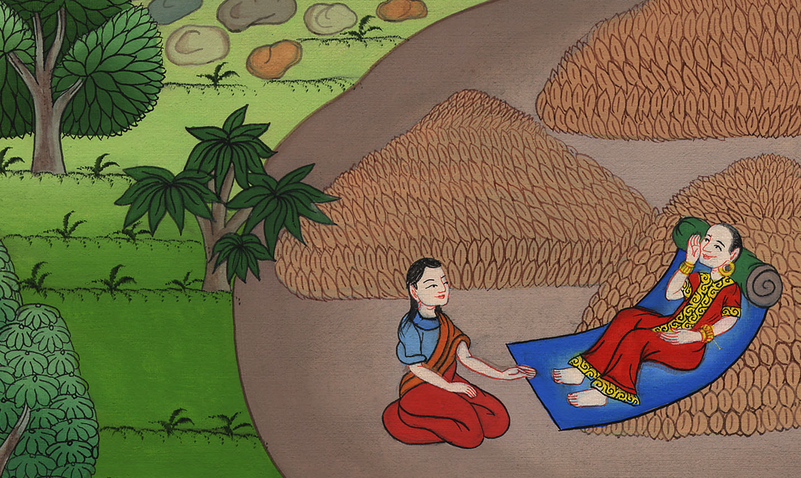
Ruth 3:14

Slide 31
15He said, “Bring the mantle that is on you, and hold it.” She held it; and he measured six measures of barley, and laid it on her; then he went into the city.

Slide 32
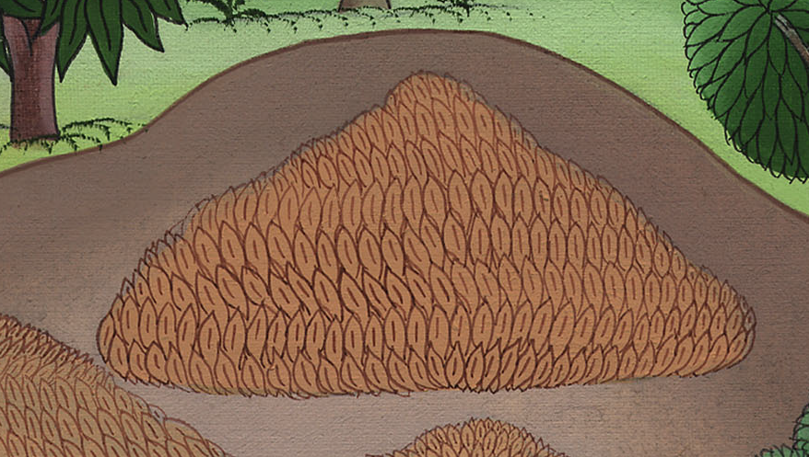
Ruth 3:15

Slide 33
16When she came to her mother-in-law, she said, “How did it go, my daughter?”
She told her all that the man had done for her.

Slide 34
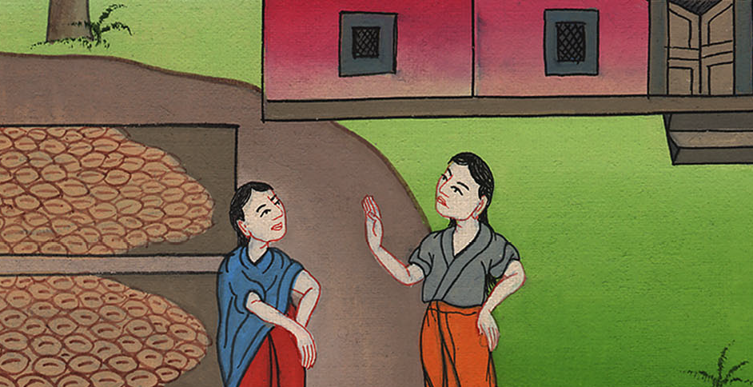
Ruth 3:16

Slide 35
17She said, “He gave me these six measures of barley; for he said, ‘Don’t go empty to your mother-in-law.’”

Slide 36
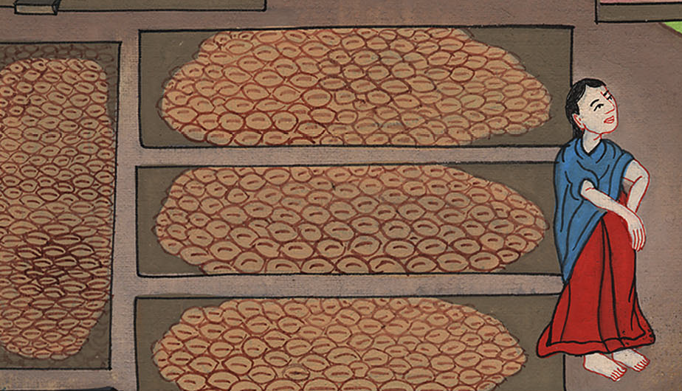
Ruth 3:17

Slide 37
18Then she said, “Wait, my daughter, until you know what will happen; for the man will not rest until he has settled this today.”

Slide 38
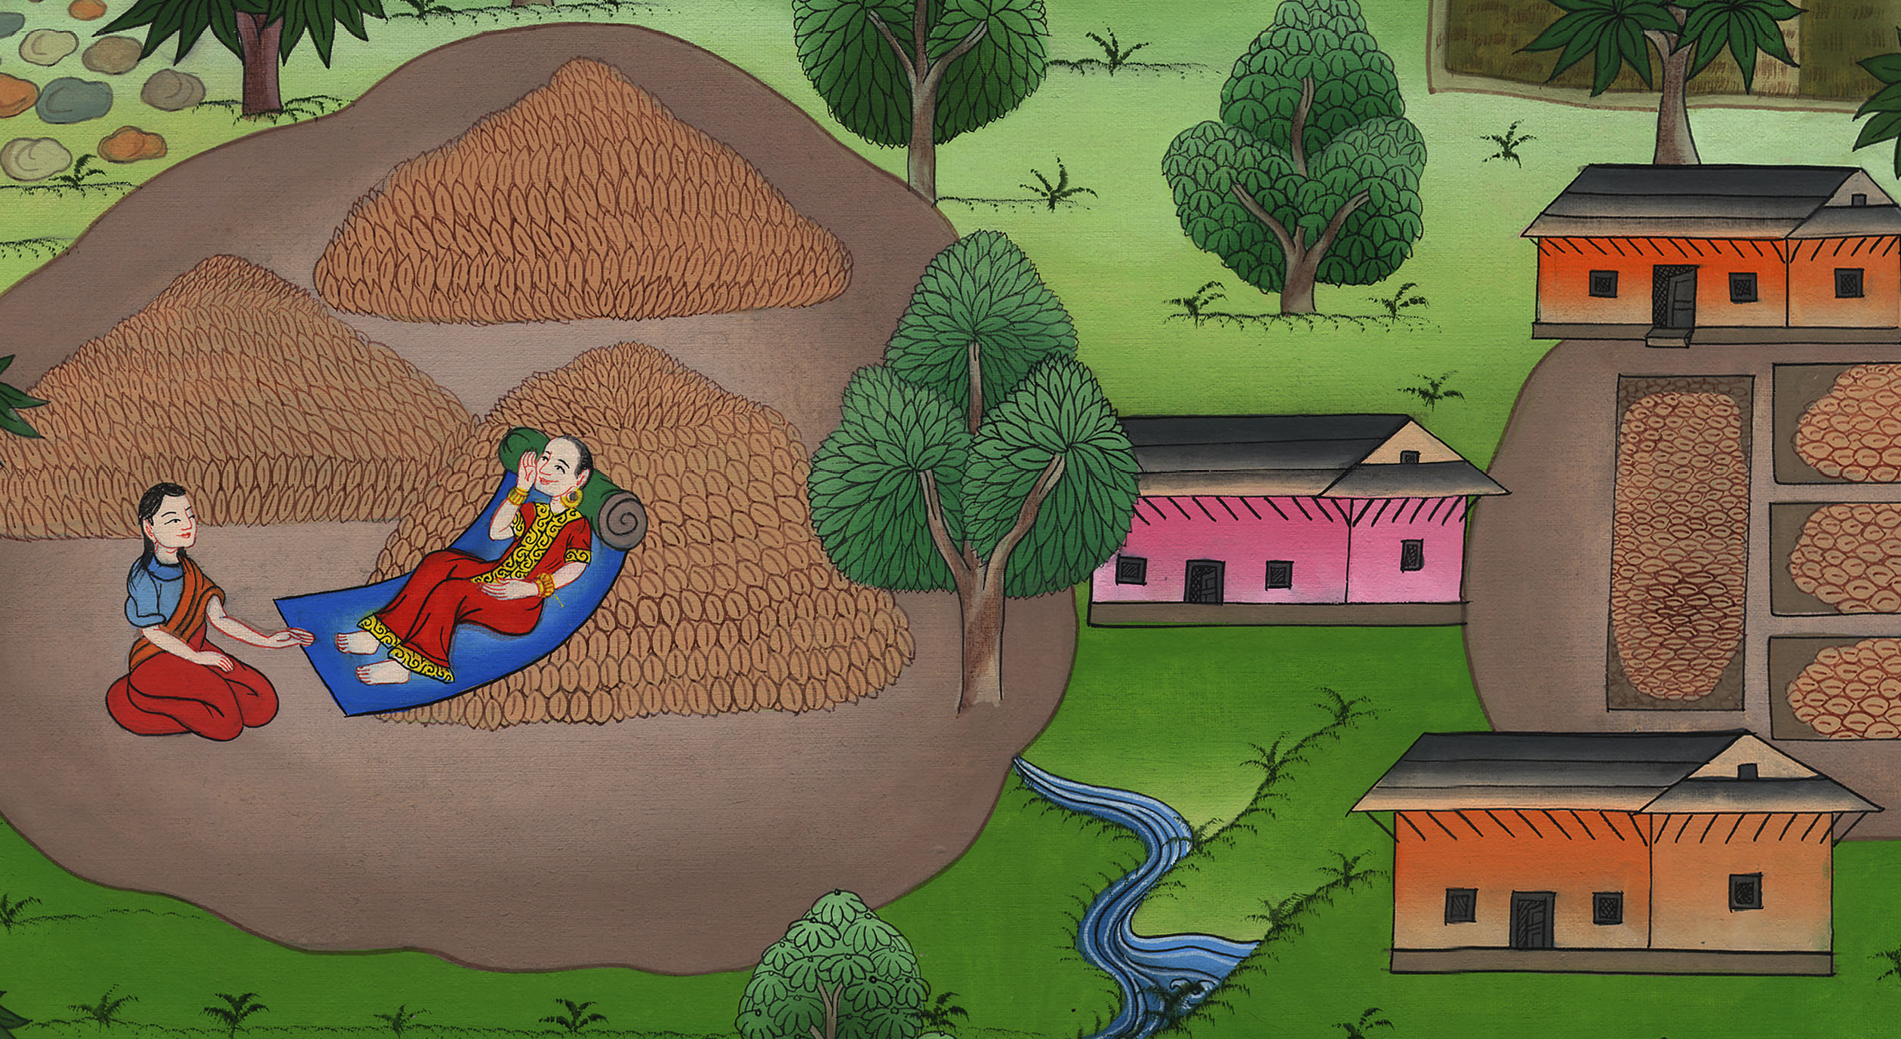
Ruth 3:18

