Slide 1
14-6
This work is licensed under a Creative Commons Attribution-ShareAlike 4.0 International License.
Please add this statement to all the videos you create.
English Bible quotes are from the World English Bible US, which is in the public domain.
Notes:
ch
14 Ruth
1. Naomi’s son’s die - Ruth 1:1-5 (Left Top)
2. Ruth stays with Naomi – Ruth 1:6-22 (Right Top)
3. Ruth gleaning in the field of Boaz – Ruth 2:1-16 (Right Center)
4. Naomi advises Ruth – Ruth 2:17-23 (Right Bottom)
5. Ruth goes to Boaz – Ruth 3:1-18 (Left Bottom)
6. Boaz arranges marriage with Ruth – Ruth 4:1-12 (Left Center)
7. Naomi receives her grandson – Ruth 4:13-22 (Center)

Slide 2
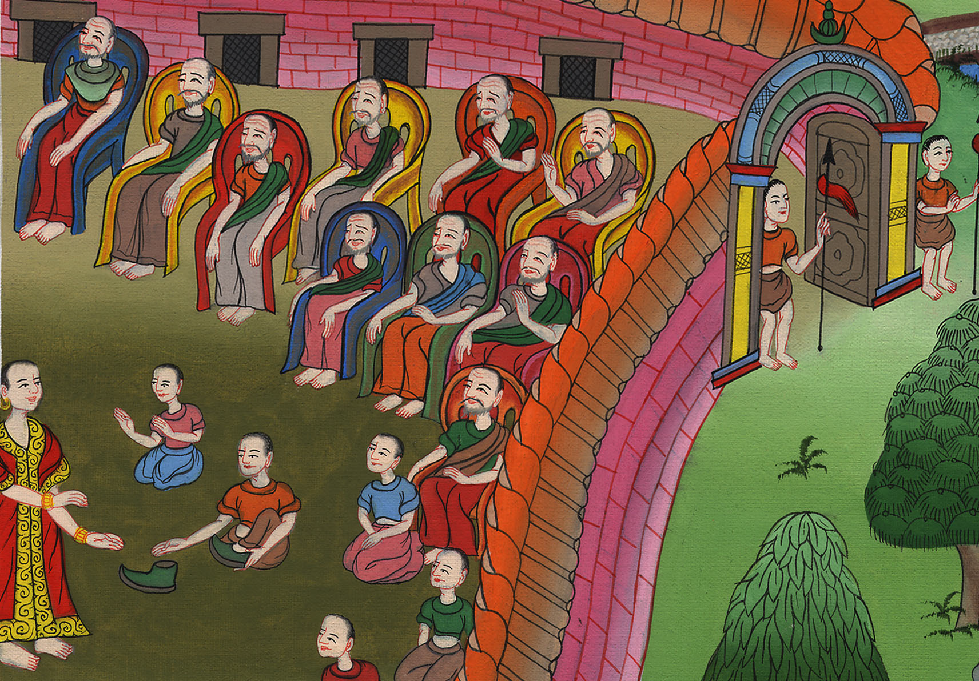
Boaz arranges marriage with Ruth –
Ruth 4:1-12

Slide 3
Boaz arranges marriage with Ruth – Ruth 4:1-12

Slide 4
Boaz arranges marriage with Ruth –
Ruth 4:1-12

Slide 5
1Now Boaz went up to the gate and sat down there. Behold, the near kinsman of whom Boaz spoke came by. Boaz said to him, “Come over here, friend, and sit down!” He came over, and sat down.

Slide 6
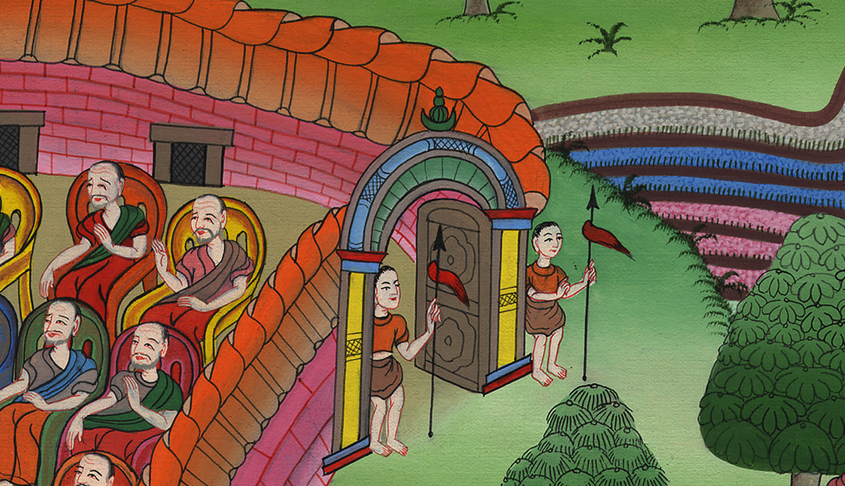
Ruth 4:1

Slide 7
2Boaz took ten men of the elders of the city, and said, “Sit down here,” and they sat down.

Slide 8
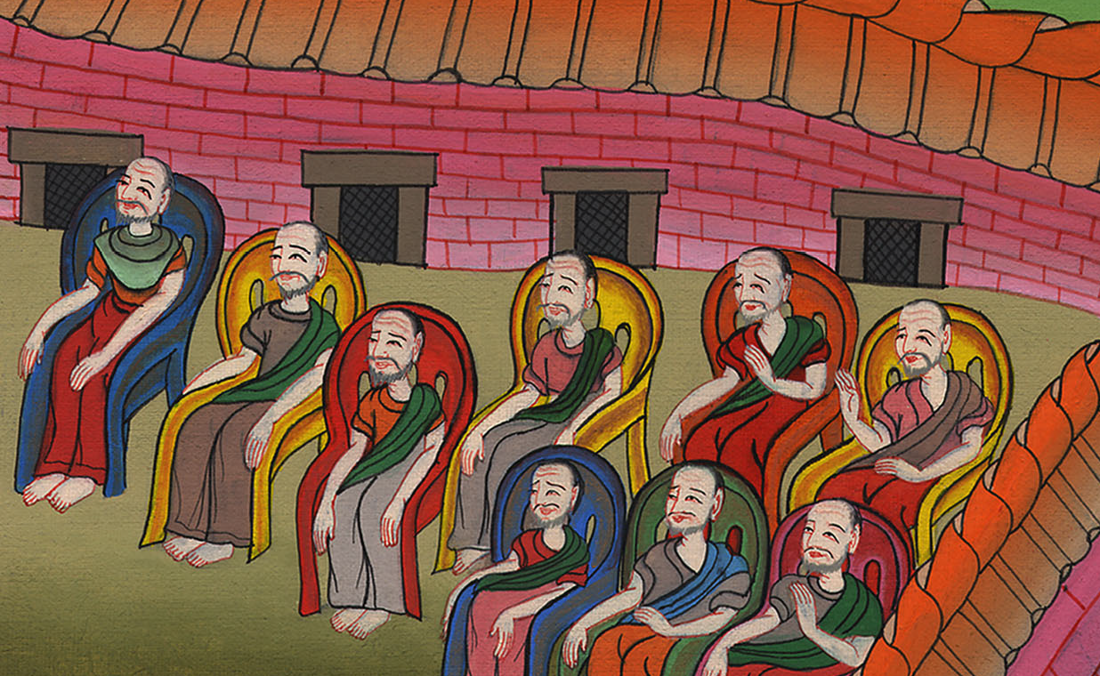
Ruth 4:2

Slide 9
3He said to the near kinsman, “Naomi, who has come back out of the country of Moab, is selling the parcel of land, which was our brother Elimelech’s.

Slide 10
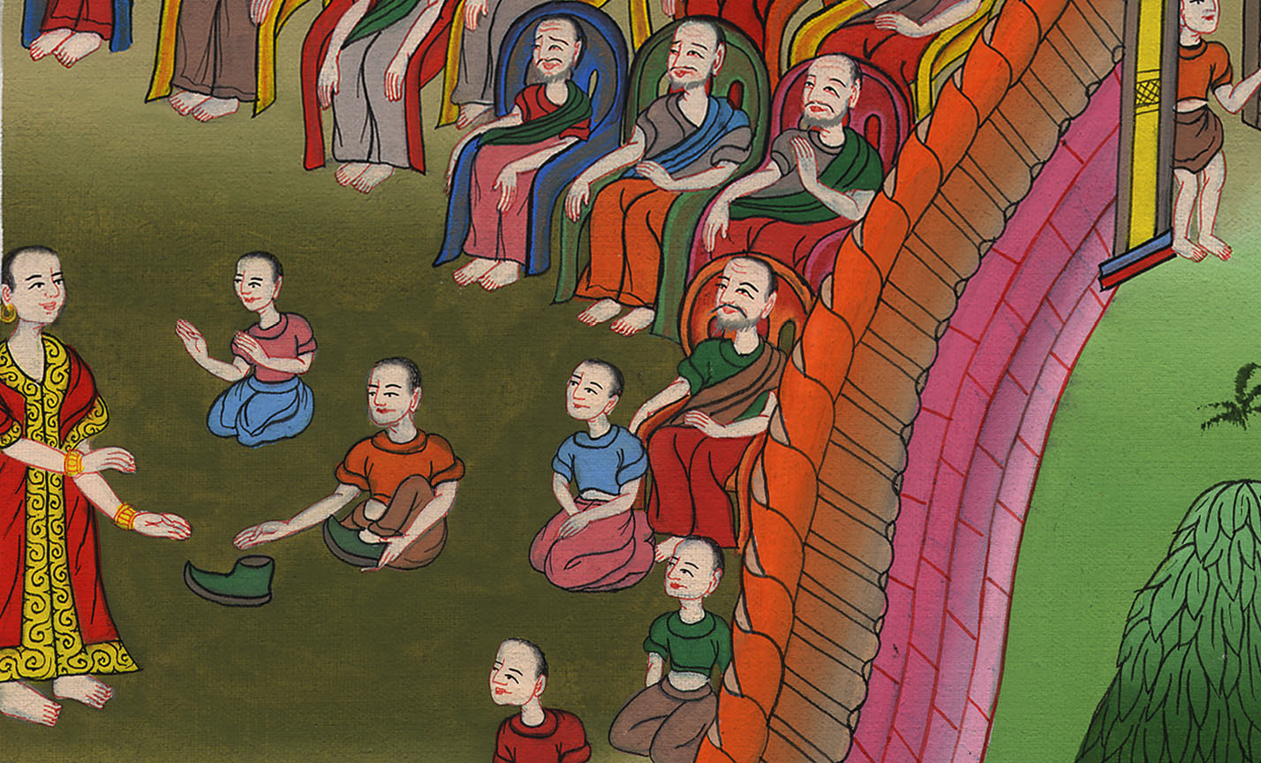
Ruth 4:3

Slide 11
4I thought I should tell you, saying, ‘Buy it before those who sit here, and before the elders of my people.’ If you will redeem it, redeem it; but if you will not redeem it, then tell me, that I may know. For there is no one to redeem it besides you; and I am after you.”
He said, “I will redeem it.”

Slide 12
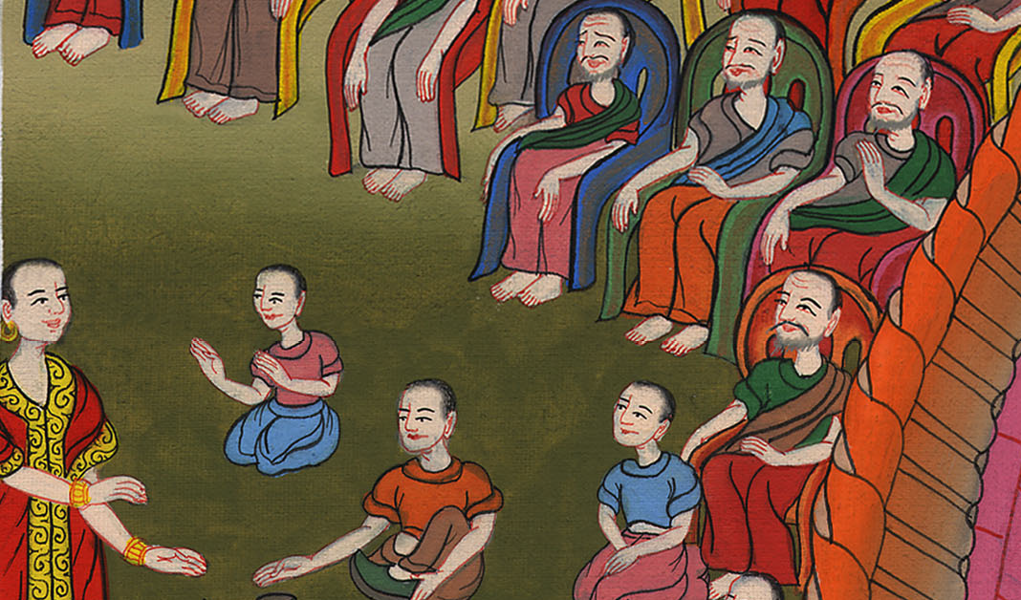
Ruth 4:4

Slide 13
5Then Boaz said, “On the day you buy the field from the hand of Naomi, you must buy it also from Ruth the Moabitess, the wife of the dead, to raise up the name of the dead on his inheritance.”

Slide 14
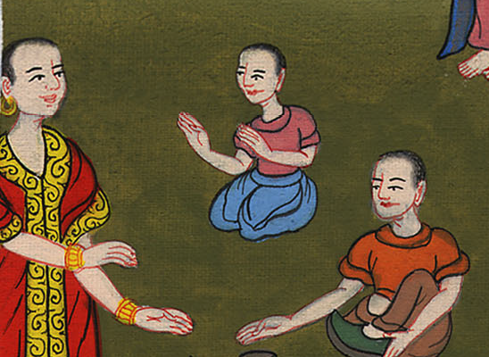
Ruth 4:5

Slide 15
6The near kinsman said, “I can’t redeem it for myself, lest I endanger my own inheritance. Take my right of redemption for yourself; for I can’t redeem it.”

Slide 16
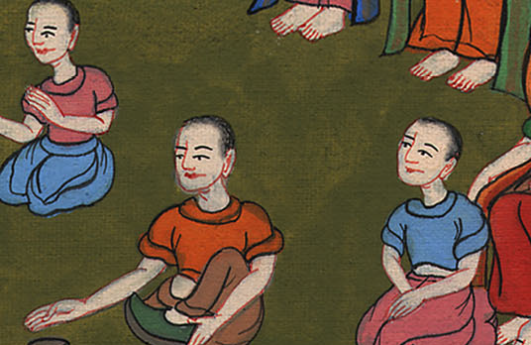
Ruth 4:6

Slide 17
7Now this was the custom in former time in Israel concerning redeeming and concerning exchanging, to confirm all things: a man took off his sandal, and gave it to his neighbor; and this was the way of formalizing transactions in Israel.

Slide 18
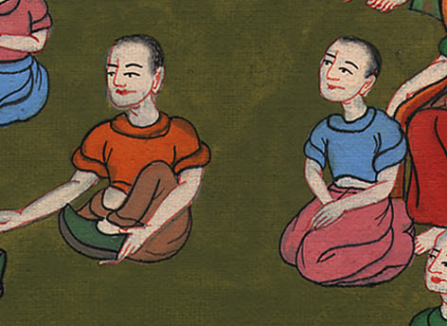
Ruth 4:7

Slide 19
8So the near kinsman said to Boaz, “Buy it for yourself,” then he took off his sandal.

Slide 20
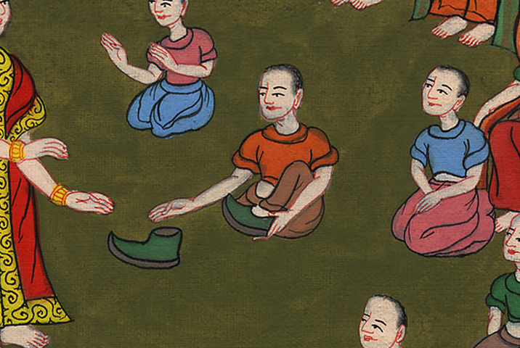
Ruth 4:8

Slide 21
9Boaz said to the elders and to all the people, “You are witnesses today, that I have bought all that was Elimelech’s, and all that was Chilion’s and Mahlon’s, from the hand of Naomi.

Slide 22
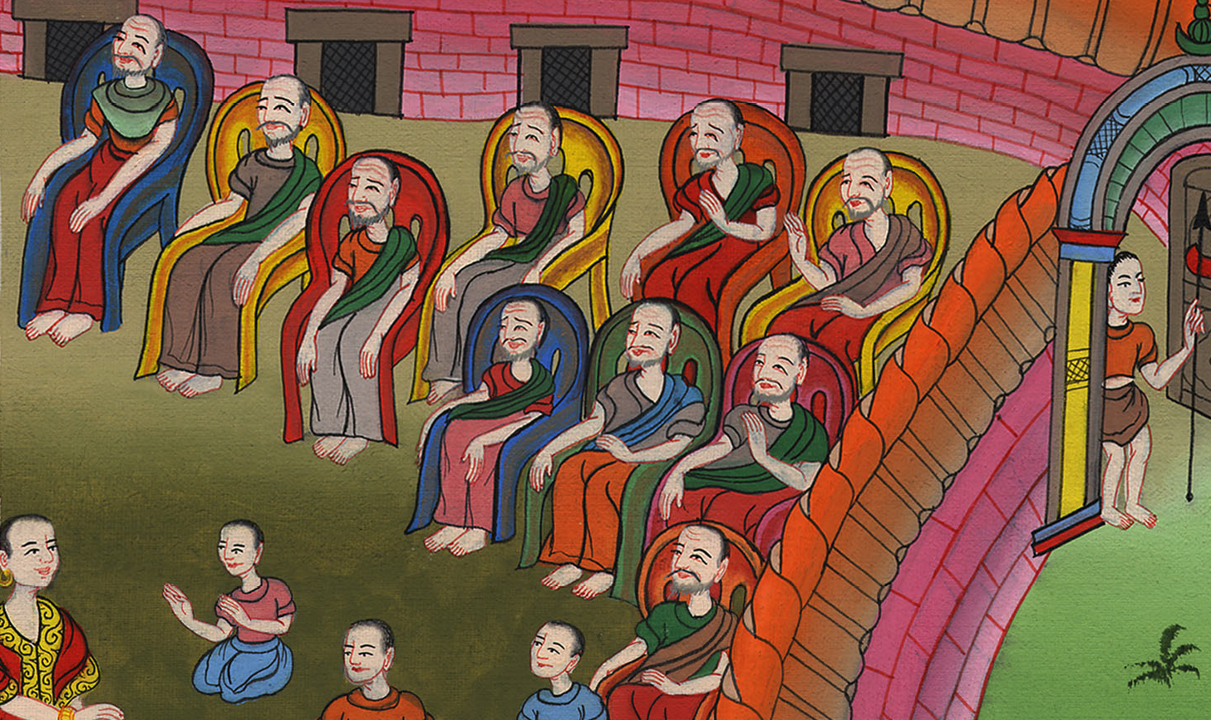
Ruth 4:9

Slide 23
10Moreover, Ruth the Moabitess, the wife of Mahlon, I have purchased to be my wife, to raise up the name of the dead on his inheritance, that the name of the dead may not be cut off from among his brothers and from the gate of his place. You are witnesses today.”

Slide 24
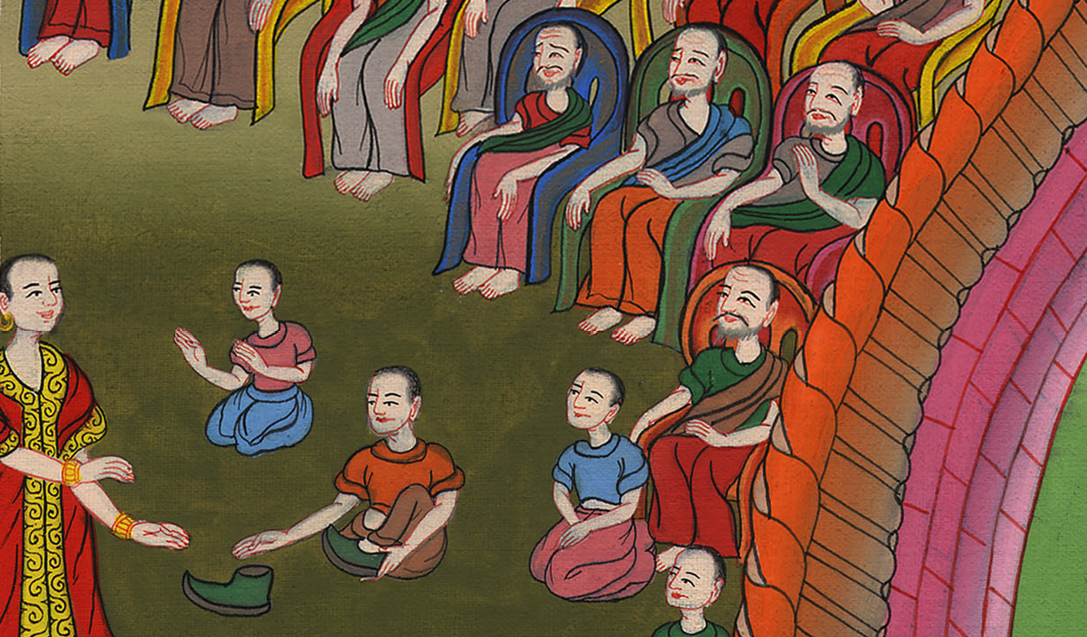
Ruth 4:10

Slide 25
11All the people who were in the gate, and the elders, said, “We are witnesses. May Yahweh make the woman who has come into your house like Rachel and like Leah, which both built the house of Israel; and treat you worthily in Ephrathah, and be famous in Bethlehem.

Slide 26
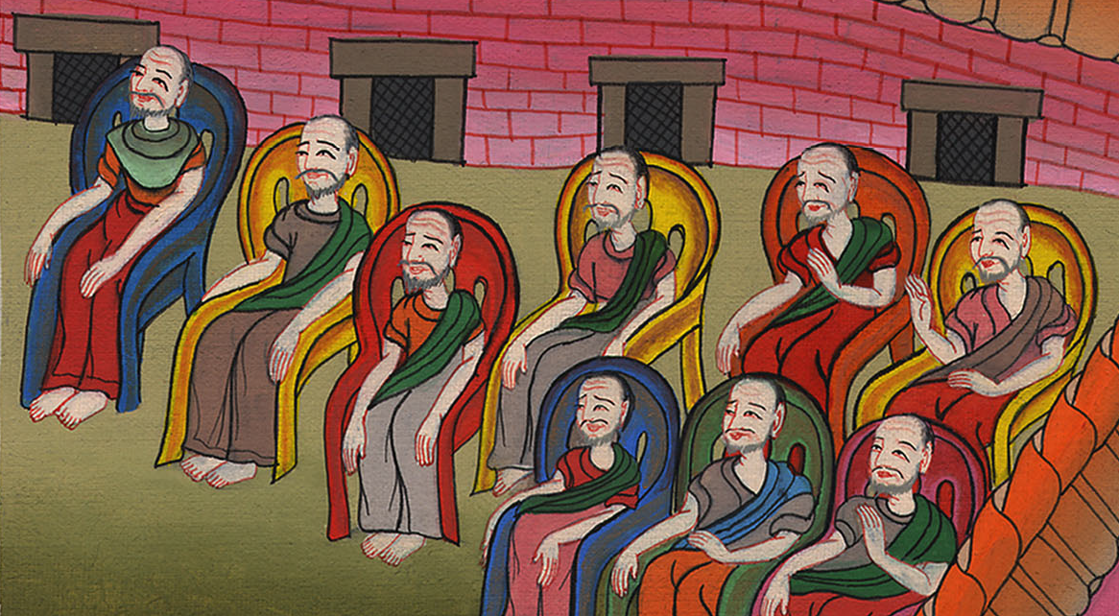
Ruth 4:11

Slide 27
12Let your house be like the house of Perez, whom Tamar bore to Judah, of the offspring which Yahweh will give you by this young woman.”

Slide 28
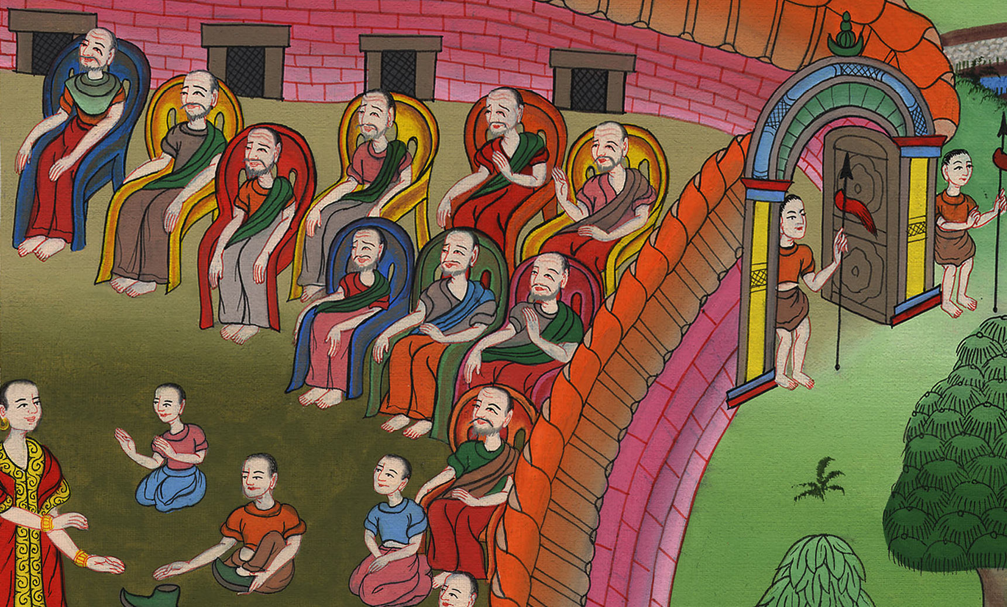
Ruth 4:12

