Slide 1
14-7
This work is licensed under a Creative Commons Attribution-ShareAlike 4.0 International License.
Please add this statement to all the videos you create.
English Bible quotes are from the World English Bible US, which is in the public domain.
Notes:
Ch
14 Ruth
1. Naomi’s son’s die - Ruth 1:1-5 (Left Top)
2. Ruth stays with Naomi – Ruth 1:6-22 (Right Top)
3. Ruth gleaning in the field of Boaz – Ruth 2:1-16 (Right Center)
4. Naomi advises Ruth – Ruth 2:17-23 (Right Bottom)
5. Ruth goes to Boaz – Ruth 3:1-18 (Left Bottom)
6. Boaz arranges marriage with Ruth – Ruth 4:1-12 (Left Center)
7. Naomi receives her grandson – Ruth 4:13-22 (Center)

Slide 2
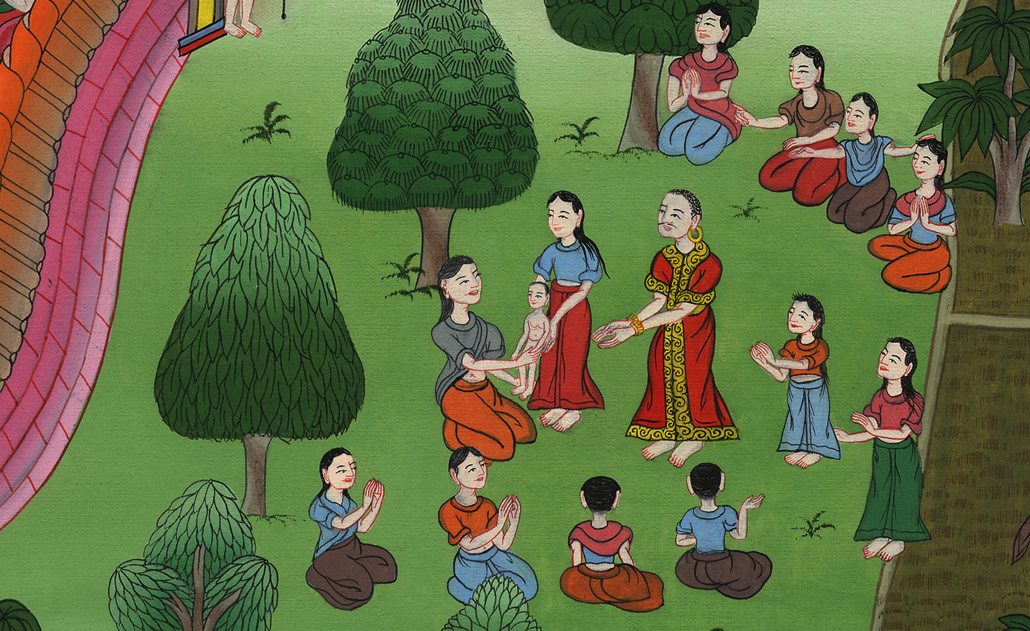
Naomi receives her grandson – Ruth 4:13-22

Slide 3
Naomi receives her grandson – Ruth 4:13-22

Slide 4
Naomi receives her grandson – Ruth 4:13-22

Slide 5
13So Boaz took Ruth and she became his wife; and he went in to her, and Yahweh enabled her to conceive, and she bore a son.

Slide 6
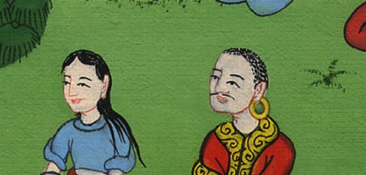
Ruth 4:13

Slide 7
14The women said to Naomi, “Blessed be Yahweh, who has not left you today without a near kinsman. Let his name be famous in Israel.

Slide 8
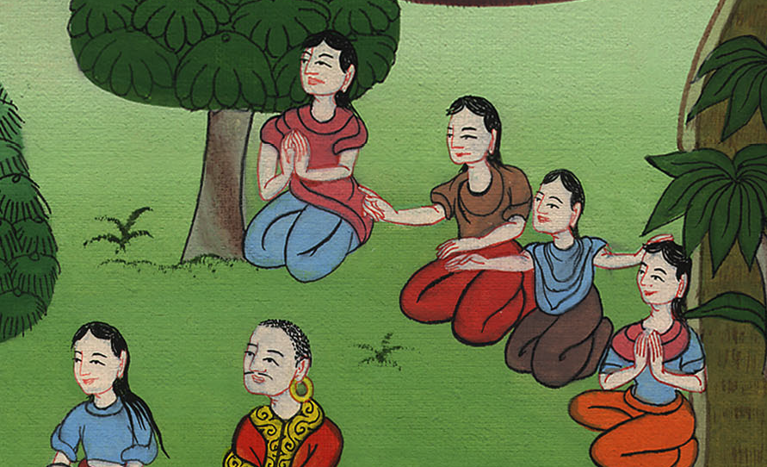
Ruth 4:14

Slide 9
15He shall be to you a restorer of life and sustain you in your old age; for your daughter-in-law, who loves you, who is better to you than seven sons, has given birth to him.”

Slide 10
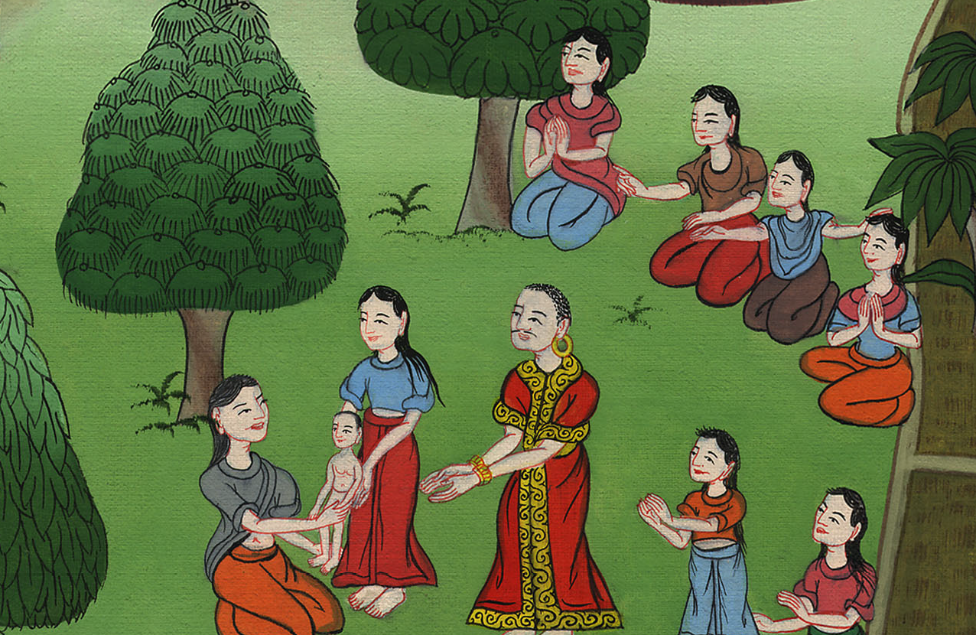
Ruth 4:15

Slide 11
16Naomi took the child, laid him in her bosom, and became nurse to him.

Slide 12
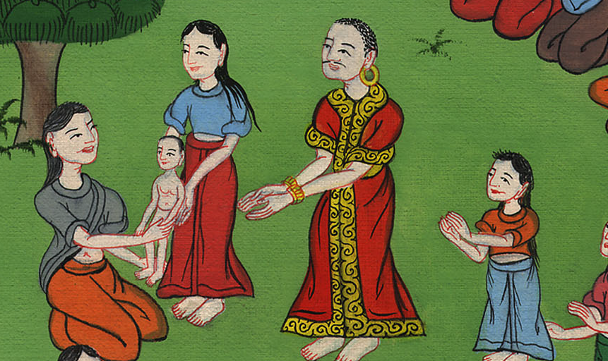
Ruth 4:16

Slide 13
17The women, her neighbors, gave him a name, saying, “A son is born to Naomi”. They named him Obed. He is the father of Jesse, the father of David.

Slide 14
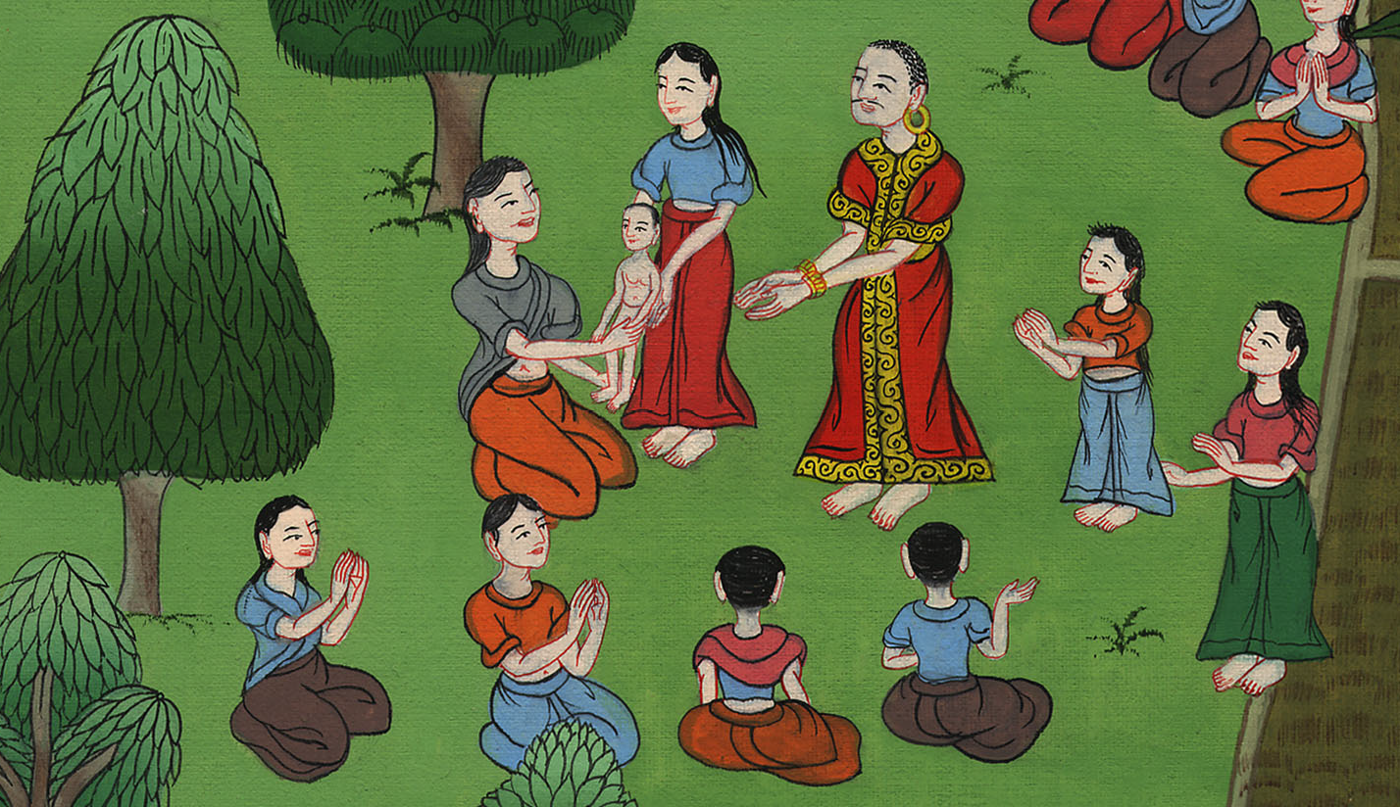
Ruth 4:17

