Slide 1
15-1
This work is licensed under a Creative Commons Attribution-Sharealike 4.0 International License.
Please add this statement to all the videos you create.
English Bible quotes are from the World English Bible US, which is in the public domain.
Notes:
ch

Slide 2
Hannah crying out to God –
1 Samuel 1:1-28

Slide 3
1. Hannah crying out to God - 1 Samuel1:1-28 (Left Top)
1 Samuel
Notes:
15 Life of Samuel 1. Hannah crying out to God - 1 Samuel 1:1-28 (Left Top) 2. Samuel hears God’s voice – 1 Saumel 3:1-21 (Center Top) 3. Death of Eli – 1 Samuel 4:1-18 (Right Top) 4. Dagon idol bows to Arc – 1 Samuel 5:1-12 (Right Center) 5. Arc returned to Israel – 1 Samuel 6:1 – 7:4 (Bottom) 6. Assembly at Mizpah & victory over Philistines – 1 Samuel 7:3-17 (Left Center)

Slide 4
Hannah crying out to God –
1 Samuel 1:1-28

Slide 5
1 Samuel1:1Now there was a certain man of Ramathaim Zophim, of the hill country of Ephraim, and his name was Elkanah,…
1 Samuel

Slide 6
1 Samuel 1:1

Slide 7
2He had two wives. The name of one was Hannah, and the name of the other Peninnah. Peninnah had children, but Hannah had no children.
1 Samuel

Slide 8
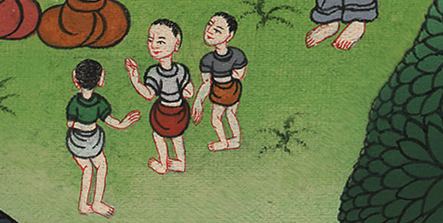
1 Samuel 1:2

Slide 9
3This man went up out of his city from year to year to worship and to sacrifice to Yahweh of Armies in Shiloh.
1 Samuel

Slide 10
1 Samuel 1:3

Slide 11
6Her rival provoked her severely, to irritate her, because Yahweh had shut up her womb.
1 Samuel

Slide 12
1 Samuel 1:6

Slide 13
7So year by year, when she went up to Yahweh’s house, her rival provoked her. Therefore she wept, and didn’t eat.
1 Samuel

Slide 14
1 Samuel 1:7

Slide 15
8Elkanah her husband said to her, “Hannah, why do you weep? Why don’t you eat? Why is your heart grieved? Am I not better to you than ten sons?”
1 Samuel

Slide 16
1 Samuel 1:8

Slide 17
9So Hannah rose up after they had finished eating and drinking in Shiloh.
1 Samuel

Slide 18
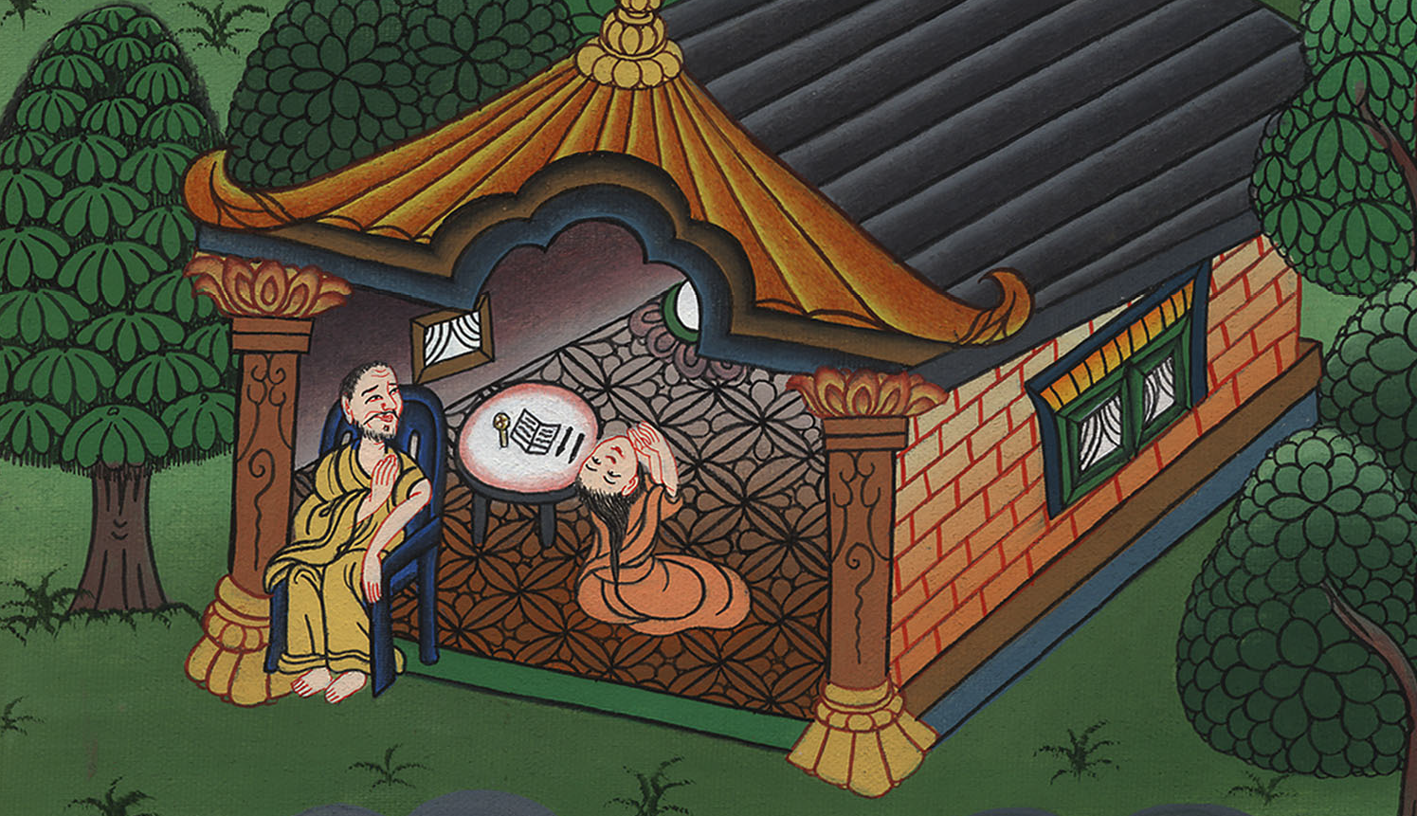
1 Samuel 1:9

Slide 19
Now Eli the priest was sitting on his seat by the doorpost of Yahweh’s temple. 10She was in bitterness of soul, and prayed to Yahweh, weeping bitterly.
1 Samuel

Slide 20
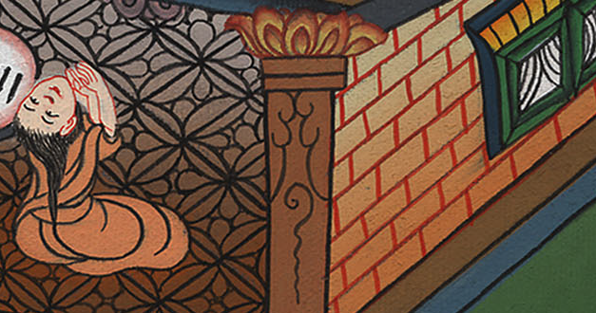
1 Samuel 1:10

Slide 21
11She vowed a vow, and said, “Yahweh of Armies, if you will indeed look at the affliction of your servant and remember me, and not forget your servant,
1 Samuel

Slide 22
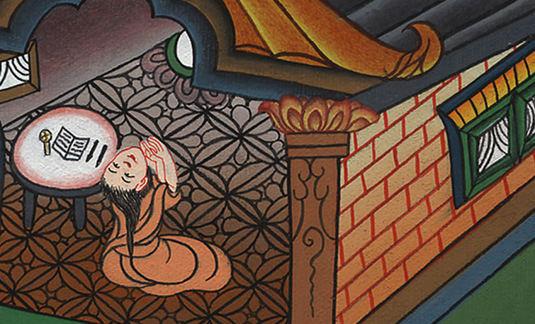
1 Samuel 1:11

Slide 23
but will give to your servant a boy, then I will give him to Yahweh all the days of his life, and no razor shall come on his head.”
1 Samuel

Slide 24
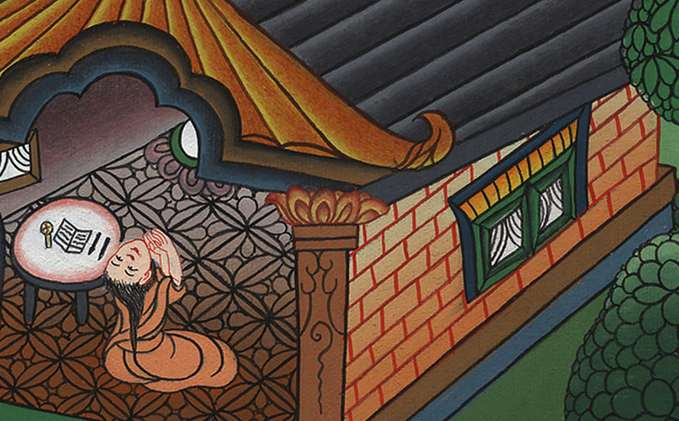
1 Samuel 1:11

Slide 25
12As she continued praying before Yahweh, Eli saw her mouth.
1 Samuel

Slide 26
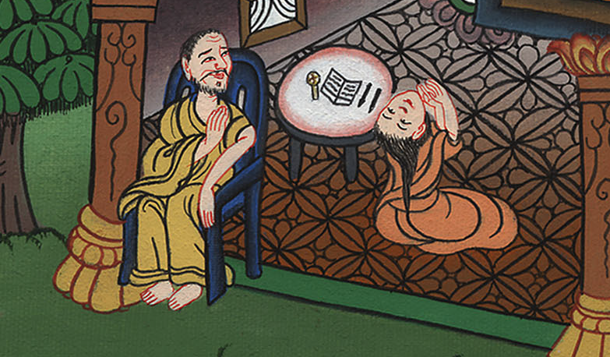
1 Samuel 1:12

Slide 27
13Now Hannah spoke in her heart. Only her lips moved, but her voice was not heard. Therefore Eli thought she was drunk.
1 Samuel

Slide 28
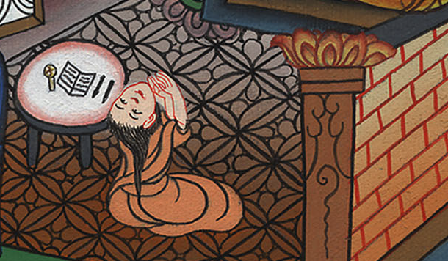
1 Samuel 1:13

Slide 29
14Eli said to her, “How long will you be drunk? Get rid of your wine!”
1 Samuel

Slide 30
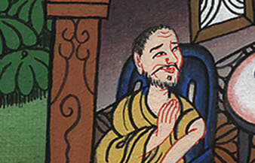
1 Samuel 1:14

Slide 31
15Hannah answered, “No, my lord, I am a woman of a sorrowful spirit. I have not been drinking wine or strong drink, but I poured out my soul before Yahweh.
1 Samuel

Slide 32
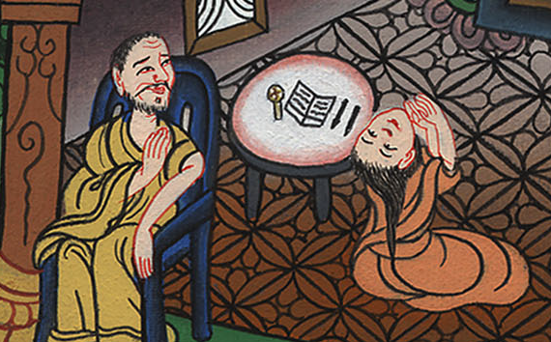
1 Samuel 1:15

Slide 33
16Don’t consider your servant a wicked woman; for I have been speaking out of the abundance of my complaint and my provocation.”
1 Samuel

Slide 34
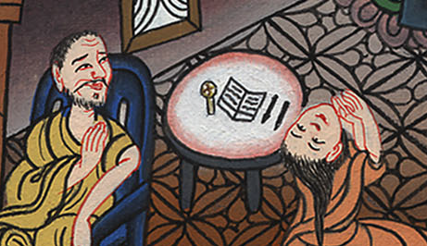
1 Samuel 1:16

Slide 35
17Then Eli answered, “Go in peace; and may the God of Israel grant your petition that you have asked of him.”
1 Samuel

Slide 36
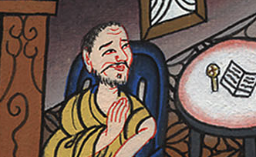
1 Samuel 1:17

Slide 37
18She said, “Let your servant find favor in your sight.” So the woman went her way and ate; and her facial expression wasn’t sad any more.
1 Samuel

Slide 38
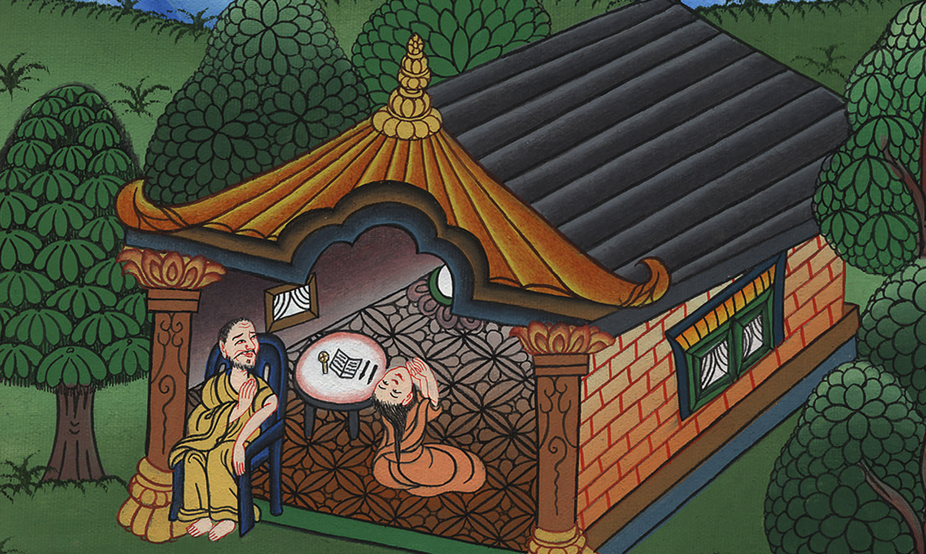
1 Samuel 1:18

