Slide 1
15-2
This work is licensed under a Creative Commons Attribution-Sharealike 4.0 International License.
Please add this statement to all the videos you create.
English Bible quotes are from the World English Bible US, which is in the public domain.
Notes:
ch

Slide 2
1 Samuel 1, 2
Hannah Gives Samuel to the Lord

Slide 3
1 SAMUEL 1, 2
Hannah Gives Samuel to the Lord
1 Samuel

Slide 4
1 Samuel 1, 2
Hannah Gives Samuel to the Lord

Slide 5
1 Samuel1:20When the time had come, Hannah conceived, and bore a son; and she named him Samuel,
1 Samuel

Slide 6
1 Samuel 1:20

Slide 7
24When she had weaned him, she took him up with her, … to Yahweh’s house in Shiloh. The child was young.
1 Samuel

Slide 8
1 Samuel 1:24

Slide 9
26She said, “Oh, my lord, as your soul lives, my lord, I am the woman who stood by you here, praying to Yahweh.
1 Samuel

Slide 10
1 Samuel 1:26

Slide 11
27I prayed for this child, and Yahweh has given me my petition which I asked of him.
1 Samuel

Slide 12
1 Samuel 1:27

Slide 13
28Therefore I have also given him to Yahweh. As long as he lives he is given to Yahweh.”
1 Samuel

Slide 14
1 Samuel 1:28

Slide 15
(Eli the priest had two sons who served in the temple. They did many sinful things)

Slide 16
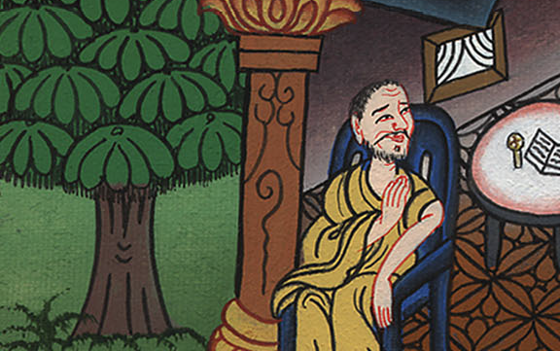

Slide 17
2:18But Samuel ministered before Yahweh, being a child, clothed with a linen ephod.
1 Samuel

Slide 18
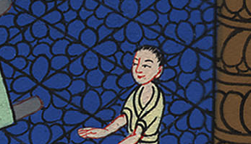
1 Samuel 2:18

Slide 19
19Moreover his mother made him a little robe, and brought it to him from year to year when she came up with her husband to offer the yearly sacrifice.
1 Samuel

Slide 20
1 Samuel 2:19

Slide 21
21Yahweh visited Hannah, and she conceived and bore three sons and two daughters. The child Samuel grew before Yahweh.
1 Samuel

Slide 22
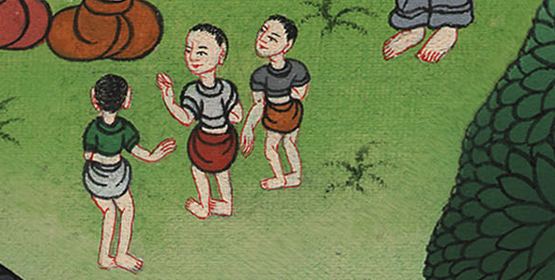
1 Samuel 2:21

Slide 23
26The child Samuel grew on, and increased in favor both with Yahweh and also with men.
1 Samuel

Slide 24
1 Samuel 2:26

