Slide 1
15-3
This work is licensed under a Creative Commons Attribution-Sharealike 4.0 International License.
Please add this statement to all the videos you create.
English Bible quotes are from the World English Bible US, which is in the public domain.
Notes:
Ch ) 2. Samuel hears God’s voice – 1 Saumel 3:1-21 (Center Top)

Slide 2
Samuel hears God’s voice –
1 Samuel 3:1-21

Slide 3
Samuel hears God’s voice – 1 Samuel 3:1-21
1 Samuel

Slide 4
Samuel hears God’s voice –
1 Samuel 3:1-21

Slide 5
1The child Samuel ministered to Yahweh before Eli. Yahweh’s word was rare in those days. There were not many visions, then.
1 Samuel

Slide 6
1 Samuel 3:1

Slide 7
2At that time, when Eli was laid down in his place (now his eyes had begun to grow dim, so that he could not see),
1 Samuel

Slide 8
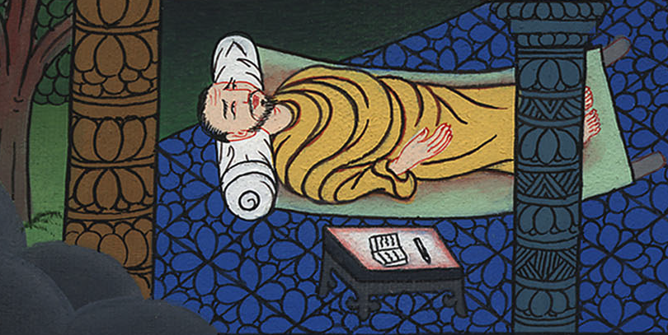
1 Samuel 3:2

Slide 9
3and God’s lamp hadn’t yet gone out, and Samuel had laid down in Yahweh’s temple where God’s ark was,
1 Samuel

Slide 10
1 Samuel 3:3

Slide 11
4Yahweh called Samuel. He said, “Here I am.”
1 Samuel

Slide 12
1 Samuel 3:4

Slide 13
5He ran to Eli and said, “Here I am; for you called me.”
He said, “I didn’t call. Lie down again.”
He went and lay down
1 Samuel

Slide 14
1 Samuel 3:5

Slide 15
6Yahweh called yet again, “Samuel!”
Samuel arose and went to Eli and said, “Here I am; for you called me.”
He answered, “I didn’t call, my son. Lie down again.”
1 Samuel

Slide 16
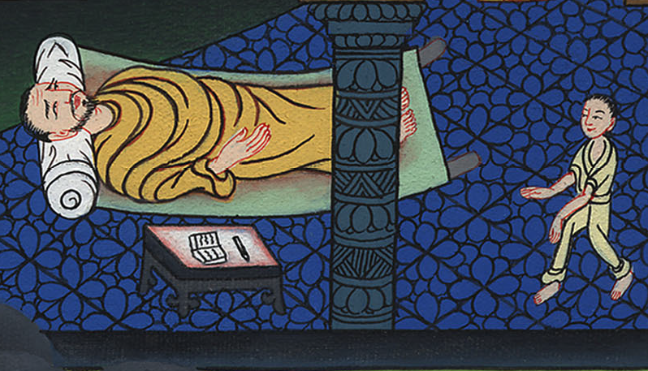
1 Samuel 3:6

Slide 17
7Now Samuel didn’t yet know Yahweh, neither was Yahweh’s word yet revealed to him.
1 Samuel

Slide 18
1 Samuel 3:7

Slide 19
8Yahweh called Samuel again the third time. He arose and went to Eli and said, “Here I am; for you called me.”
1 Samuel

Slide 20
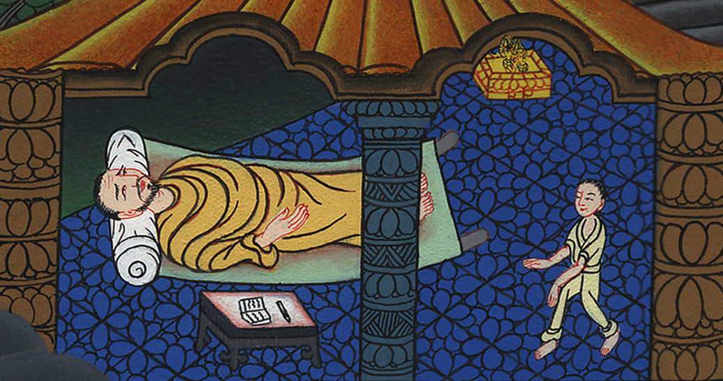
1 Samuel 3:8

Slide 21
Eli perceived that Yahweh had called the child.
1 Samuel

Slide 22
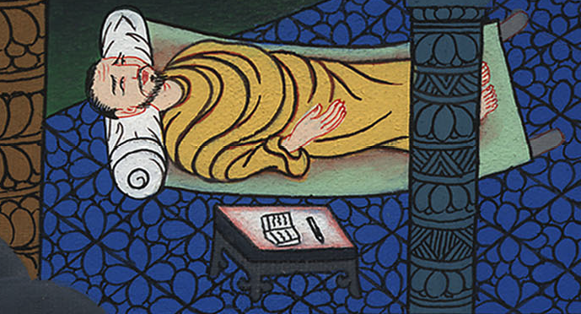
1 Samuel 3:8

Slide 23
9Therefore Eli said to Samuel, “Go, lie down. It shall be, if he calls you, that you shall say, ‘Speak, Yahweh; for your servant hears.’” So Samuel went and lay down in his place.
1 Samuel

Slide 24
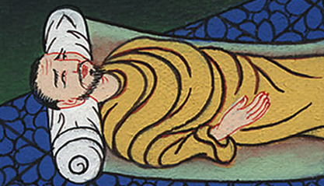
1 Samuel 3:9

Slide 25
10Yahweh came, and stood, and called as at other times, “Samuel! Samuel!”
Then Samuel said, “Speak; for your servant hears.”
1 Samuel

Slide 26
1 Samuel 3:10

Slide 27
11Yahweh said to Samuel, “Behold, I will do a thing in Israel at which both the ears of everyone who hears it will tingle.
1 Samuel

Slide 28
1 Samuel 3:11

Slide 29
13For I have told him that I will judge his house forever for the iniquity which he knew, because his sons brought a curse on themselves, and he didn’t restrain them.
1 Samuel

Slide 30
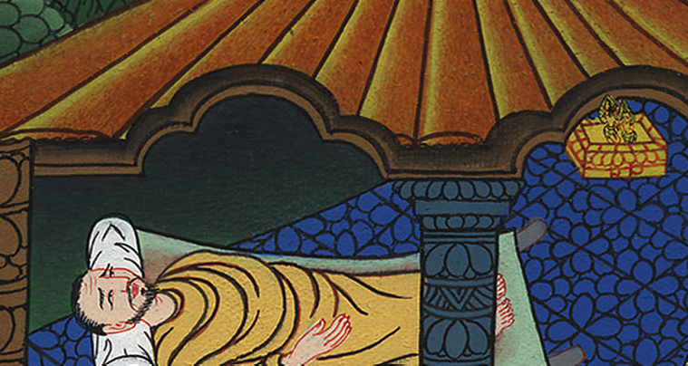
1 Samuel 3:13

Slide 31
15Samuel lay until the morning, and opened the doors of Yahweh’s house. Samuel was afraid to show Eli the vision.
1 Samuel

Slide 32
1 Samuel 3:15

Slide 33
16Then Eli called Samuel and said, “Samuel, my son!”
He said, “Here I am.”
1 Samuel

Slide 34
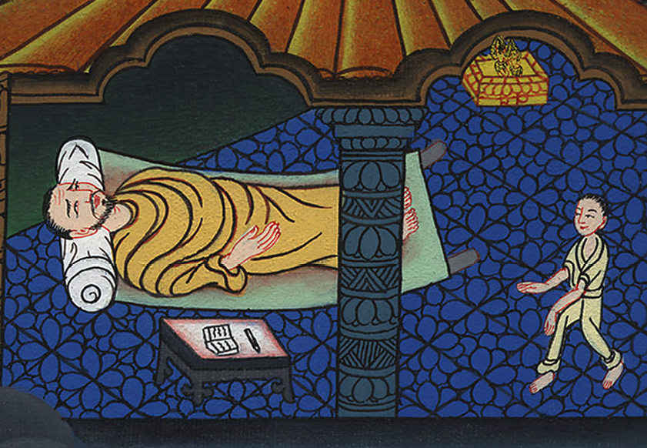
1 Samuel 3:16

Slide 35
18Samuel told him every bit, and hid nothing from him.
He said, “It is Yahweh. Let him do what seems good to him.”
1 Samuel

Slide 36
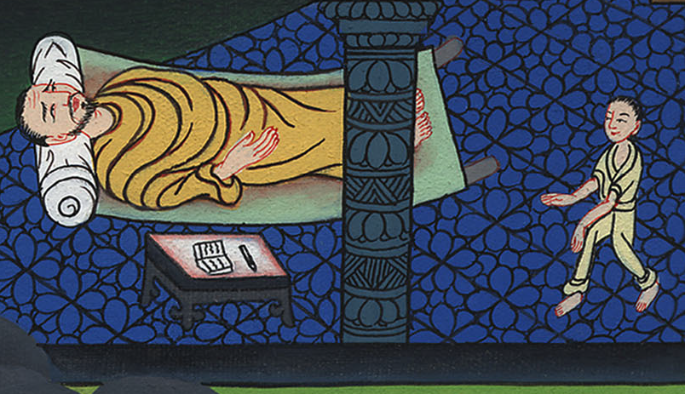
1 Samuel 3:18

Slide 37
19Samuel grew, and Yahweh was with him and let none of his words fall to the ground.
1 Samuel

Slide 38
1 Samuel 3:19

Slide 39
20All Israel from Dan even to Beersheba knew that Samuel was established to be a prophet of Yahweh.
1 Samuel

Slide 40
1 Samuel 3:20

