Slide 1
15-4
This work is licensed under a Creative Commons Attribution-Sharealike 4.0 International License.
Please add this statement to all the videos you create.
English Bible quotes are from the World English Bible US, which is in the public domain.
Notes:
Ch Death of Eli – 1 Samuel 4:1-18 (Right Top)

Slide 2
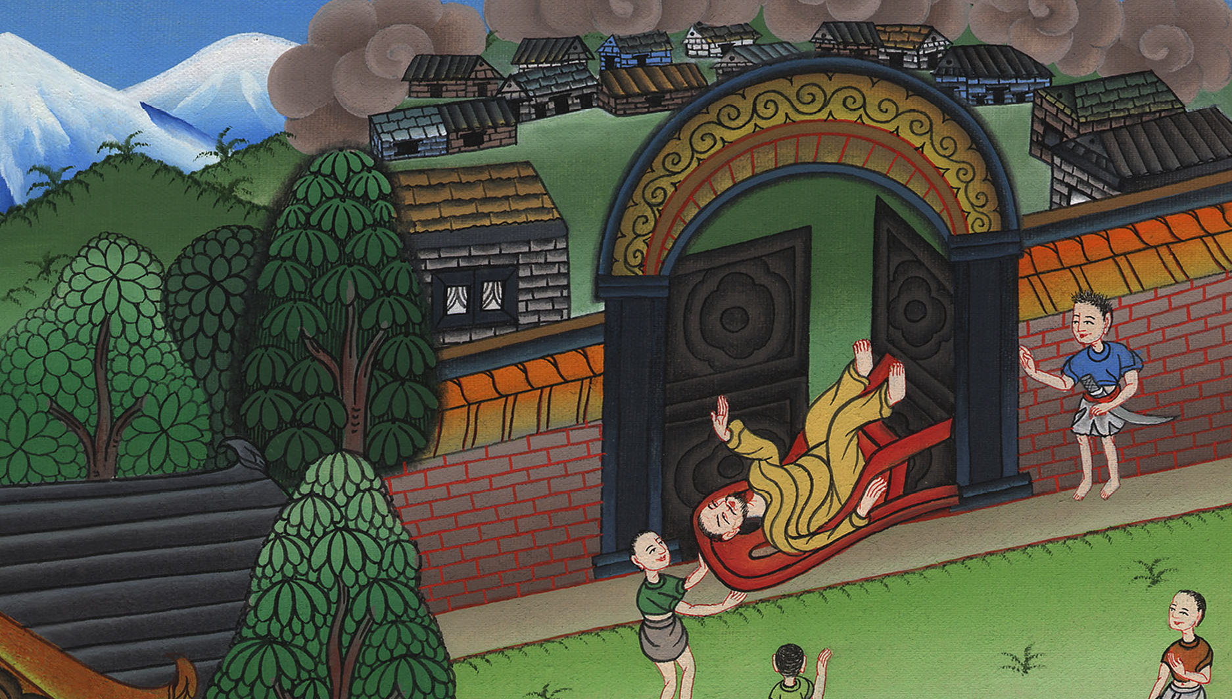
Death of Eli –
1 Samuel 4:1-18

Slide 3
Death of Eli – 1 Samuel 4:1-18
1 Samuel

Slide 4
Death of Eli –
1 Samuel 4:1-18

Slide 5
1Samuel4:2The Philistines put themselves in array against Israel. When they joined battle, Israel was defeated by the Philistines, who killed about four thousand men of the army in the field.
1 Samuel

Slide 6
1 Samuel 4:2

Slide 7
3When the people had come into the camp, the elders of Israel said, “Why has Yahweh defeated us today before the Philistines? Let’s get the ark of Yahweh’s covenant out of Shiloh and bring it to us, that it may come among us and save us out of the hand of our enemies.”
1 Samuel

Slide 8
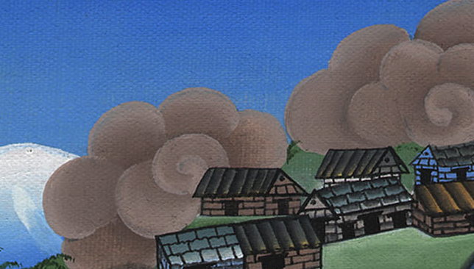
1 Samuel 4:3

Slide 9
5When the ark of Yahweh’s covenant came into the camp, all Israel shouted with a great shout, so that the earth resounded.
1 Samuel

Slide 10
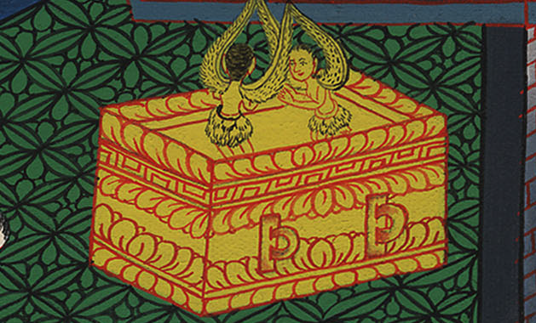
1 Samuel 4:5

Slide 11
(The Philistines were afraid that the Israelites would destroy them, so they decided to fight very hard.) 9Be strong and behave like men, O you Philistines, that you not be servants to the Hebrews, as they have been to you. Strengthen yourselves like men, and fight!”
1 Samuel

Slide 12
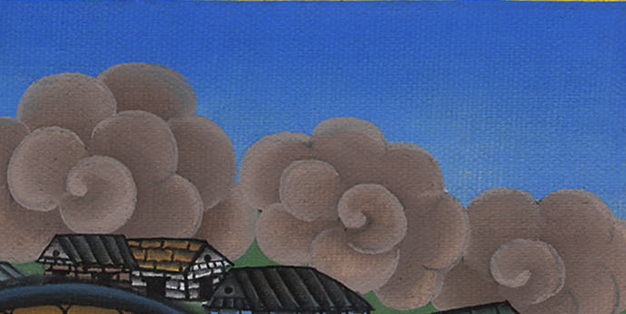
1 Samuel 4:9

Slide 13
10The Philistines fought, and Israel was defeated, and each man fled to his tent. There was a very great slaughter; for thirty thousand footmen of Israel fell.
1 Samuel

Slide 14
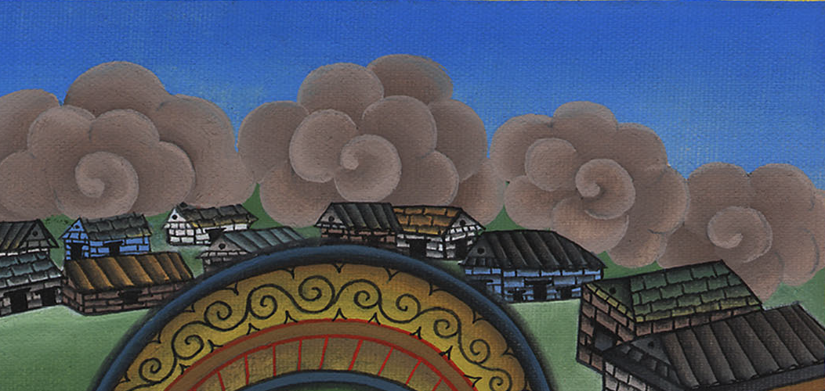
1 Samuel 4:10

Slide 15
11God’s ark was taken; and the two sons of Eli, Hophni and Phinehas, were slain.
1 Samuel

Slide 16
1 Samuel 4:11

Slide 17
(Eli sitting on his chair. He was by the side of the road. He was watching because his heart was really concerned about the ark of God.
1 Samuel

Slide 18
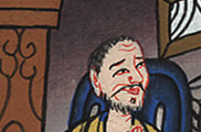
1 Samuel 4:13

Slide 19
(A messenger ran to tell the people) 13When he came, behold, Eli was sitting on his seat by the road watching, for his heart trembled for God’s ark. When the man came into the city and told about it, all the city cried out.
1 Samuel

Slide 20
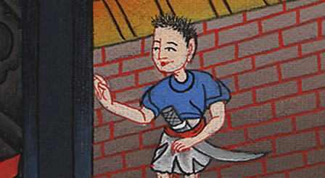
1 Samuel 4:13

Slide 21
14When Eli heard the noise of the crying, he said, “What does the noise of this tumult mean?”
The man hurried, and came and told Eli. 15Now Eli was ninety-eight years old. His eyes were set, so that he could not see
1 Samuel

Slide 22
1 Samuel 4:14

Slide 23
17He who brought the news answered, “Israel has fled before the Philistines, and there has been also a great slaughter among the people. Your two sons also, Hophni and Phinehas, are dead, and God’s ark has been captured.”
1 Samuel

Slide 24
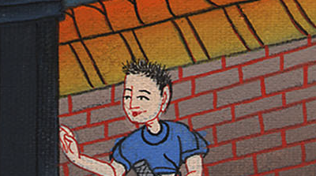
1 Samuel 4:17

Slide 25
18When he made mention of God’s ark, Eli fell from off his seat backward by the side of the gate; and his neck broke, and he died, for he was an old man and heavy. He had judged Israel forty years.
1 Samuel

Slide 26
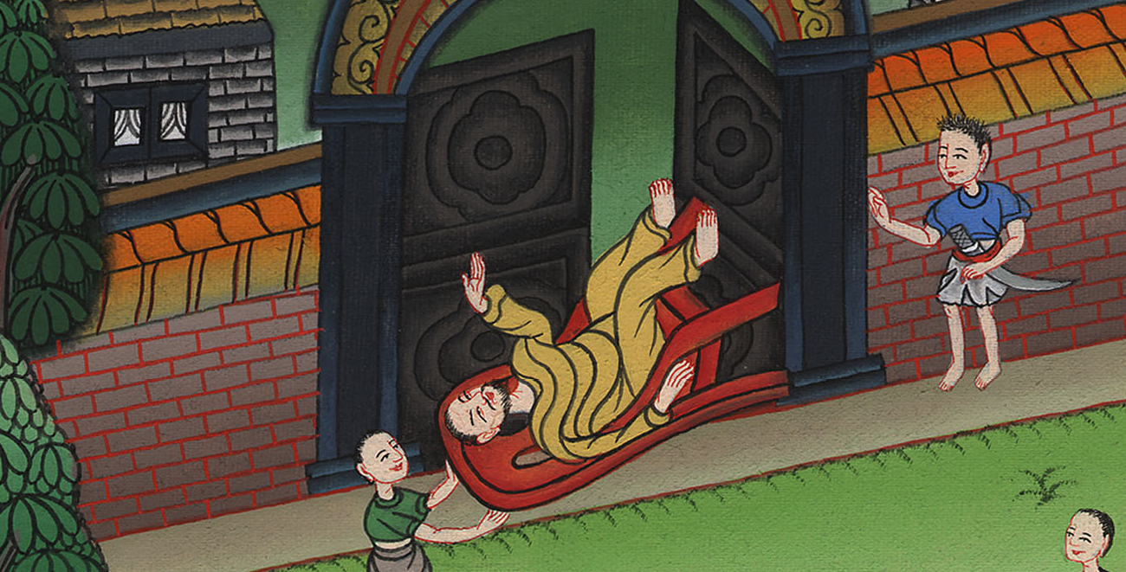
1 Samuel 4:18

