Slide 1
15-5
This work is licensed under a Creative Commons Attribution-Sharealike 4.0 International License.
Please add this statement to all the videos you create.
English Bible quotes are from the World English Bible US, which is in the public domain.
Notes:
ch5. Dagon idol bows to Arc – 1 Samuel 5:1-12 (Right Center)

Slide 2
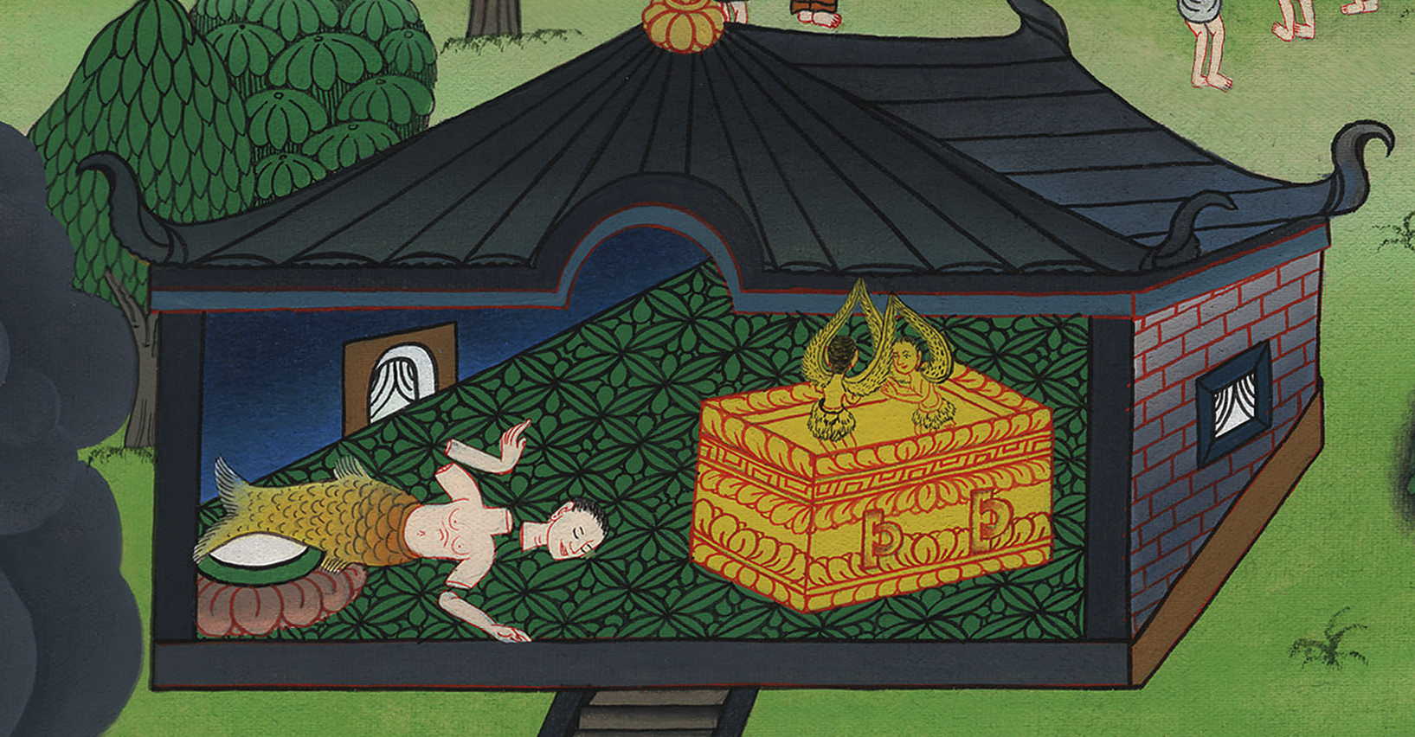
Dagon idol bows to Ark –
1 Samuel 5:1-12

Slide 3
Dagon idol bows to Ark – 1 Samuel 5:1-12
1 Samuel

Slide 4
Dagon idol bows to Ark –
1 Samuel 5:1-12

Slide 5
1 Samuel 5:1Now the Philistines had taken God’s ark, and they brought it from Ebenezer to Ashdod.
1 Samuel

Slide 6
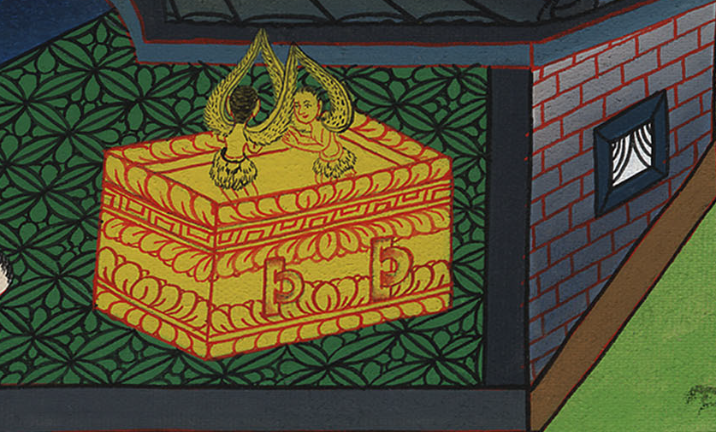
1 Samuel 5:1

Slide 7
2The Philistines took God’s ark, and brought it into the house of Dagon and set it by Dagon.
1 Samuel

Slide 8
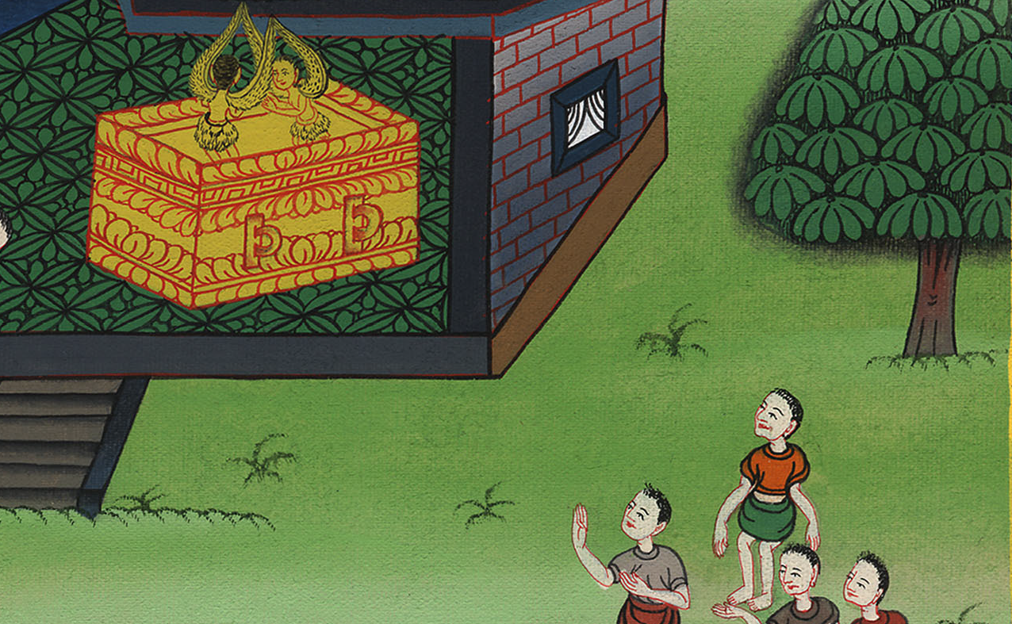
1 Samuel 5:2

Slide 9
3When the people of Ashdod arose early on the next day, behold, Dagon had fallen on his face to the ground before Yahweh’s ark. They took Dagon and set him in his place again.
1 Samuel

Slide 10
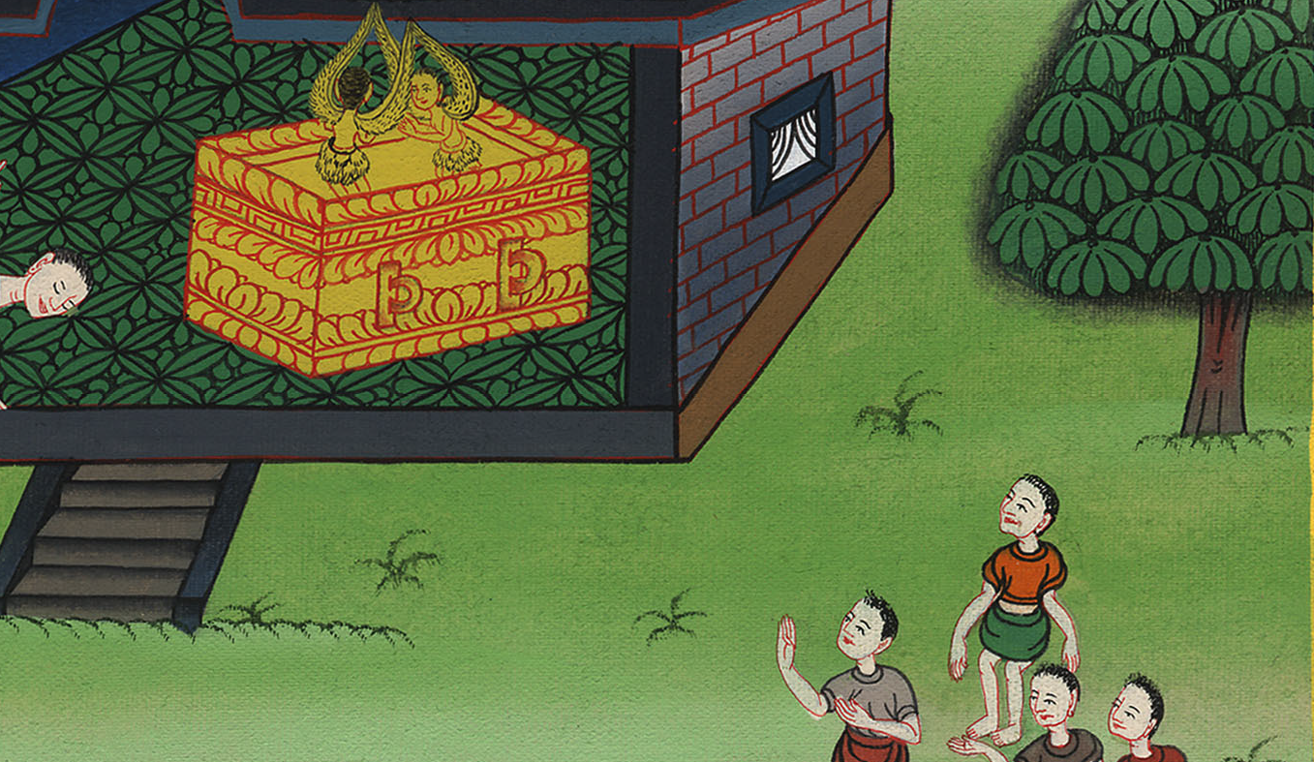
1 Samuel 5:3

Slide 11
4When they arose early on the following morning, behold, Dagon had fallen on his face to the ground before Yahweh’s ark; and the head of Dagon and both the palms of his hands were cut off on the threshold. Only Dagon’s torso was intact.
1 Samuel

Slide 12
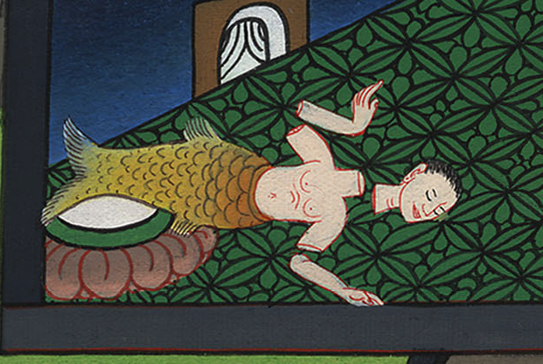
1 Samuel 5:4

Slide 13
6But Yahweh’s hand was heavy on the people of Ashdod, and he destroyed them and struck them with tumors, even Ashdod and its borders.
1 Samuel

Slide 14
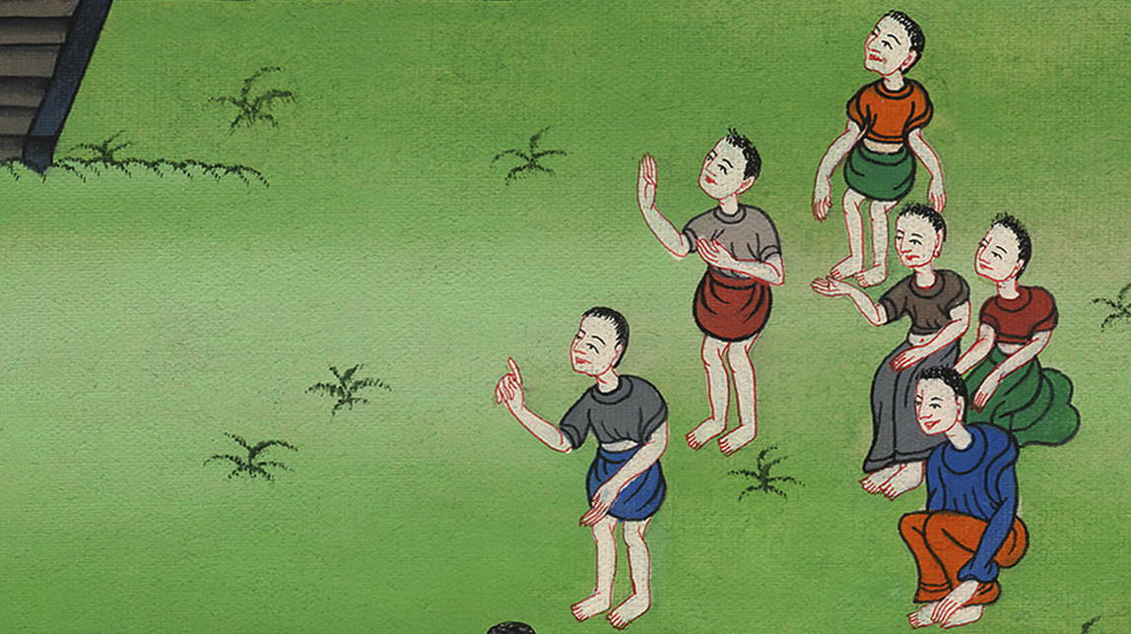
1 Samuel 5:6

Slide 15
7When the men of Ashdod saw that it was so, they said, “The ark of the God of Israel shall not stay with us, for his hand is severe on us and on Dagon our god.”
1 Samuel

Slide 16
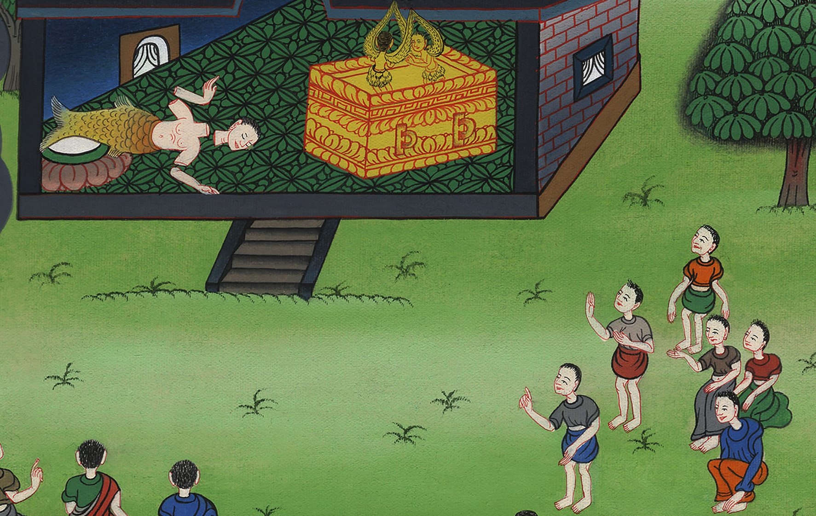
1 Samuel 5:7

Slide 17
8… (The lords of the Philistines) answered, “Let the ark of the God of Israel be carried over to Gath.” They carried the ark of the God of Israel there.
1 Samuel

Slide 18
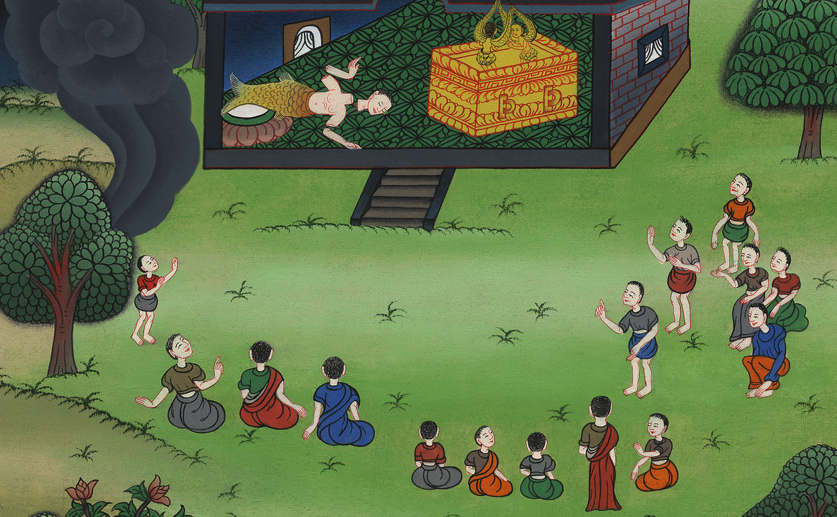
1 Samuel 5:8

Slide 19
9It was so, that after they had carried it there, Yahweh’s hand was against the city with a very great confusion; and he struck the men of the city, both small and great, so that tumors broke out on them.
1 Samuel

Slide 20
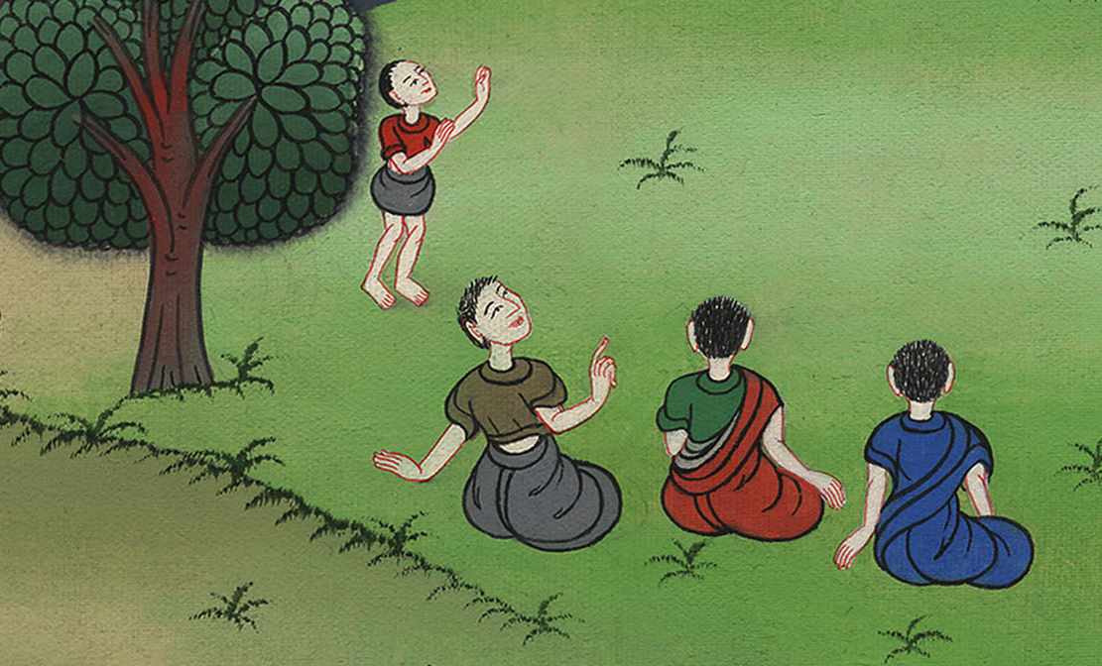
1 Samuel 5:9

Slide 21
10So they sent God’s ark to Ekron.
As God’s ark came to Ekron, the Ekronites cried out, saying, “They have brought the ark of the God of Israel here to us, to kill us and our people.”
1 Samuel

Slide 22
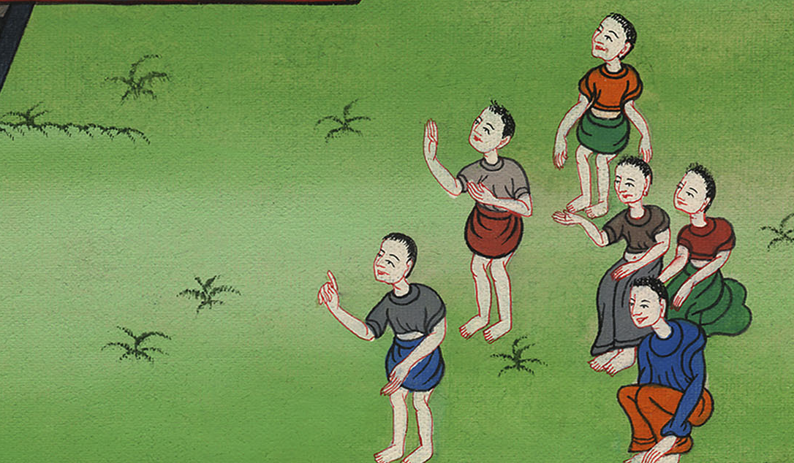
1 Samuel 5:10

Slide 23
11They sent therefore and gathered together all the lords of the Philistines, and they said, “Send the ark of the God of Israel away, and let it go again to its own place, that it not kill us and our people.” For there was a deadly panic throughout all the city. The hand of God was very heavy there.
1 Samuel

Slide 24
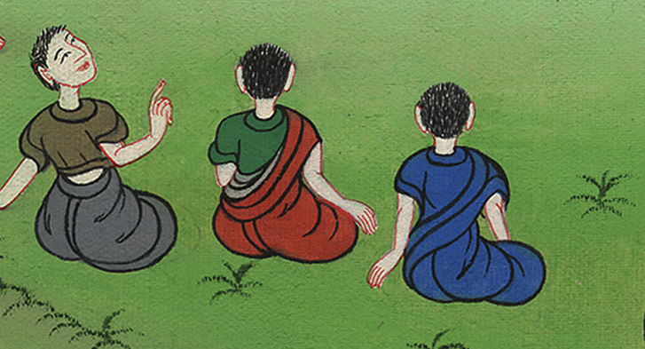
1 Samuel 5:11

Slide 25
12The men who didn’t die were struck with the tumors; and the cry of the city went up to heaven.
1 Samuel

Slide 26
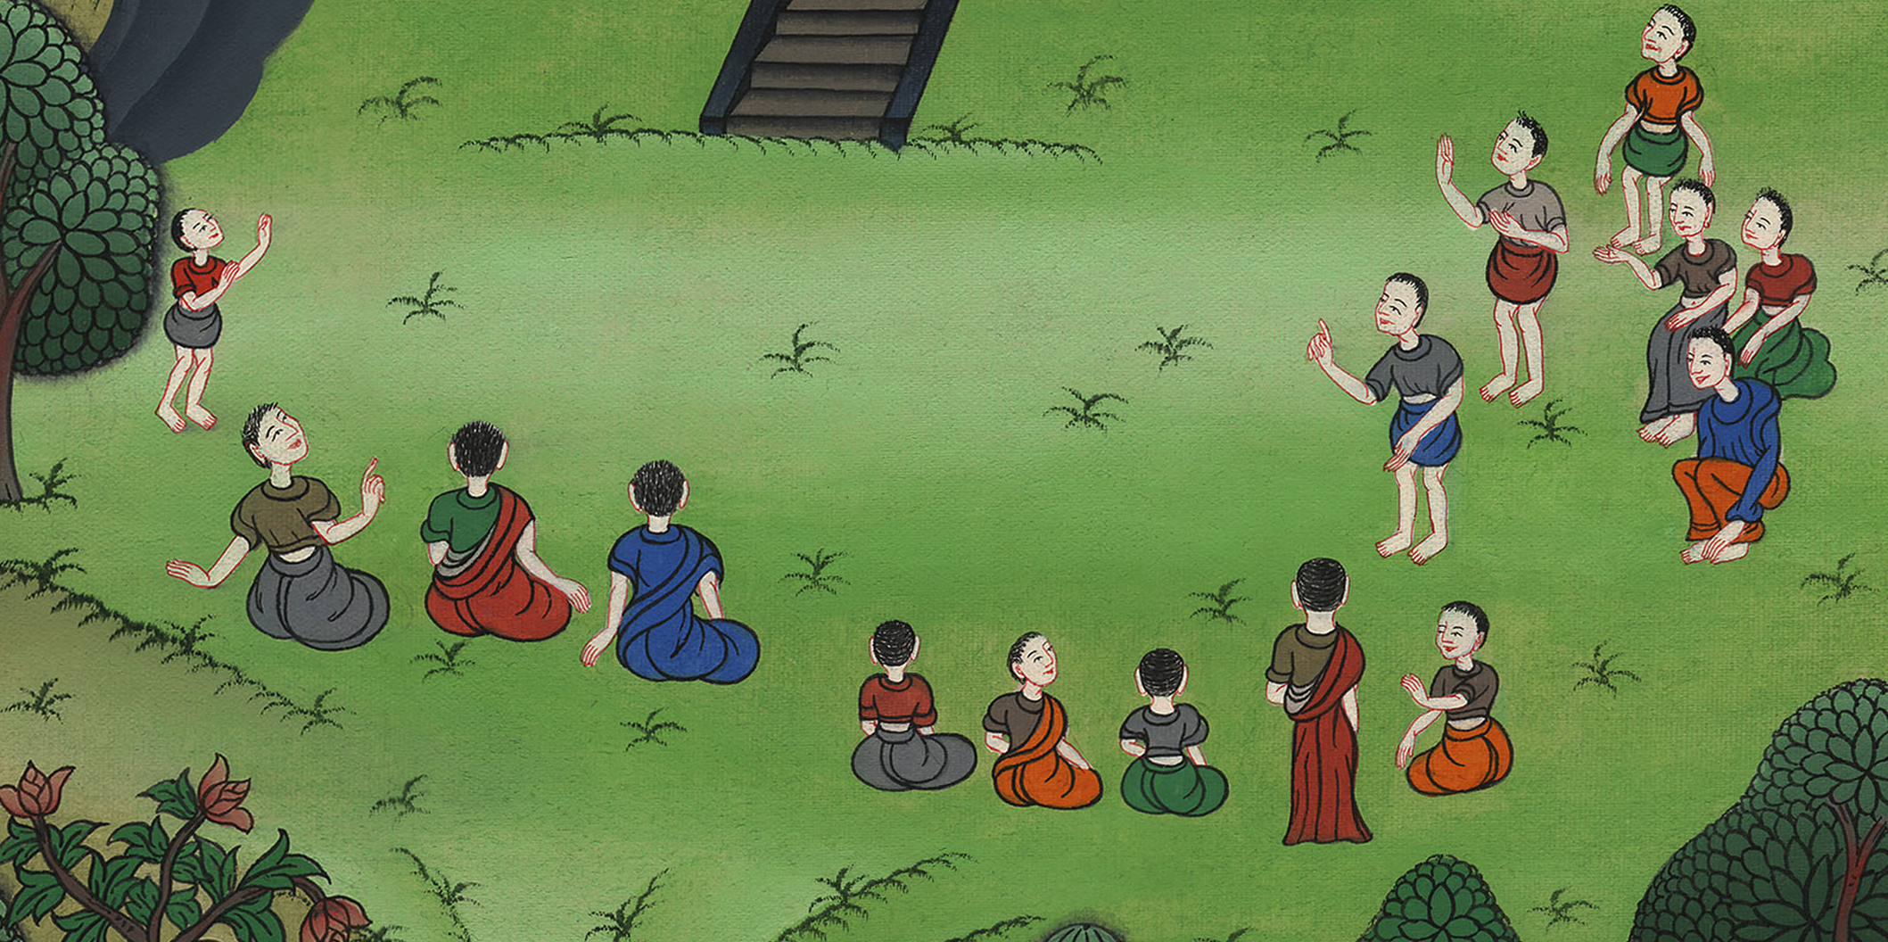
1 Samuel 5:12

