Slide 1
15-6
This work is licensed under a Creative Commons Attribution-ShareAlike 4.0 International License.
Please add this statement to all the videos you create.
English Bible quotes are from the World English Bible US, which is in the public domain.
Notes:
ch

Slide 2
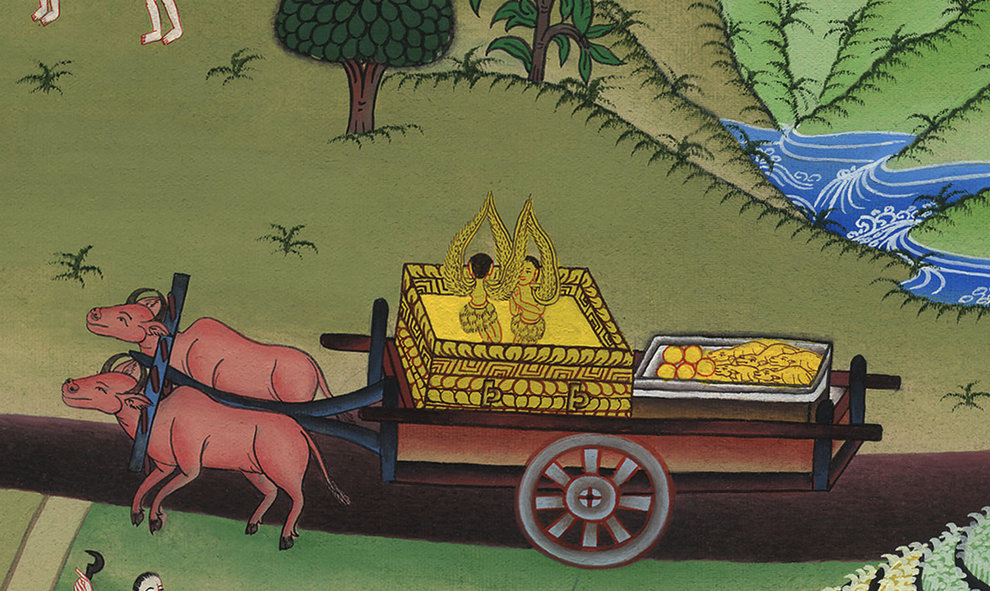
Ark returned to Israel –
1 Samuel 6

Slide 3
Ark returned to Israel – 1 Samuel 6

Slide 4
Ark returned to Israel –
1 Samuel 6

Slide 5
1Yahweh’s ark was in the country of the Philistines seven months.

Slide 6
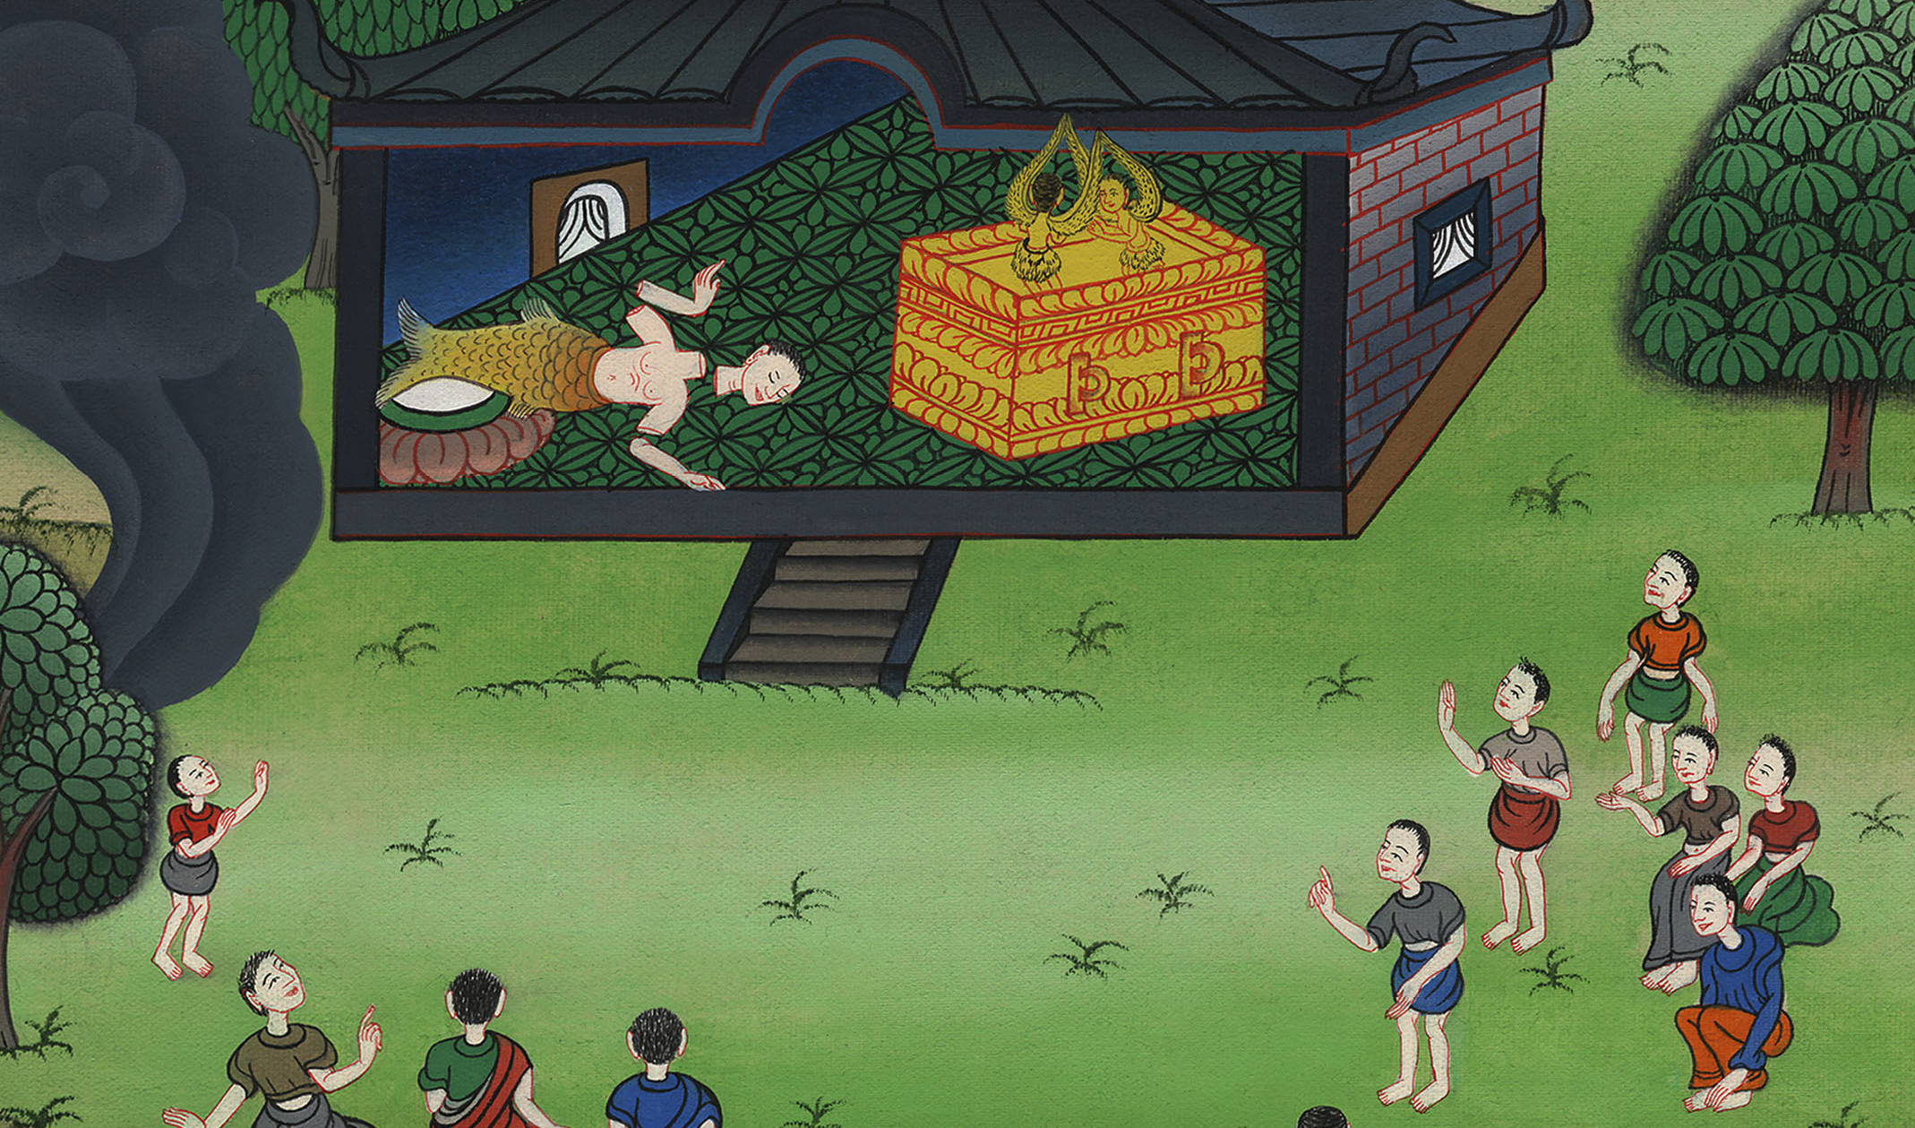
1 Samuel 6:1

Slide 7
2The Philistines called for the priests and the diviners, saying, “What shall we do with Yahweh’s ark? Show us how we should send it to its place.”

Slide 8
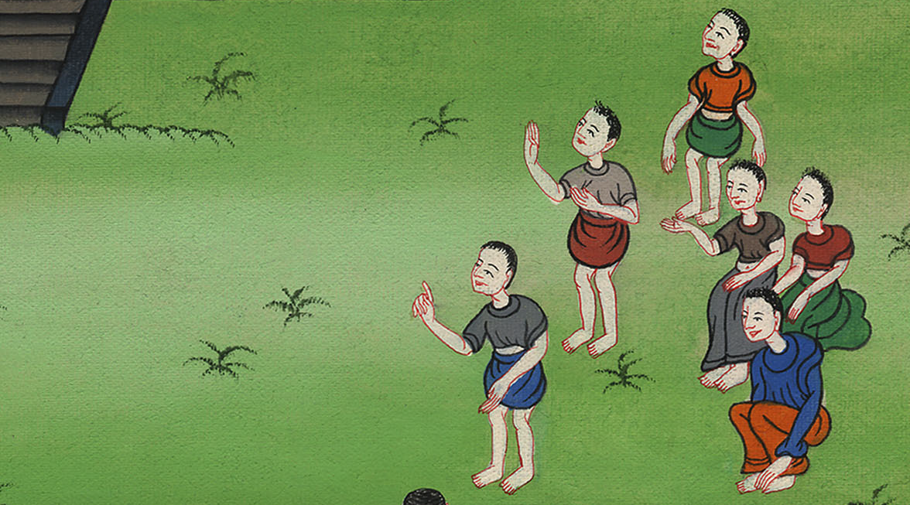
1 Samuel 6:2

Slide 9
3They said, “If you send away the ark of the God of Israel, don’t send it empty; but by all means return a trespass offering to him. Then you will be healed,

Slide 10
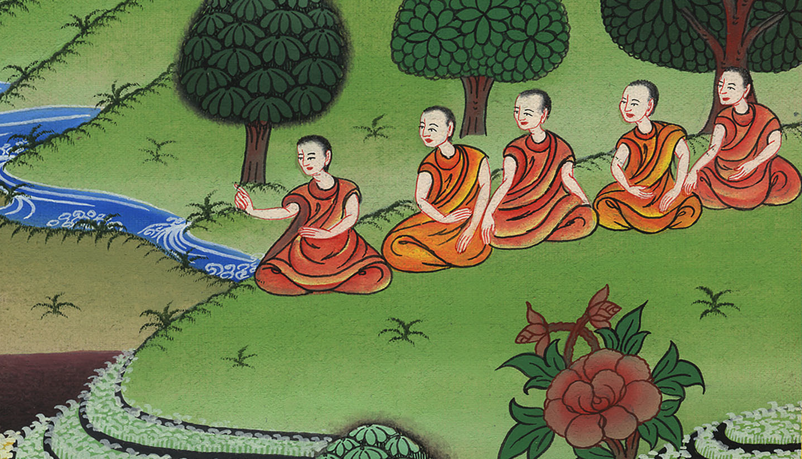
1 Samuel 6:3

Slide 11
4Then they said, “What should the trespass offering be which we shall return to him?”

Slide 12
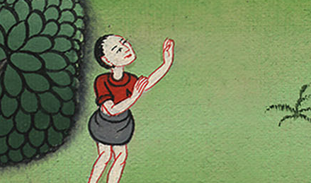
1 Samuel 6:4

Slide 13
They said, “Five golden tumors and five golden mice, for the number of the lords of the Philistines; for one plague was on you all, and on your lords.

Slide 14
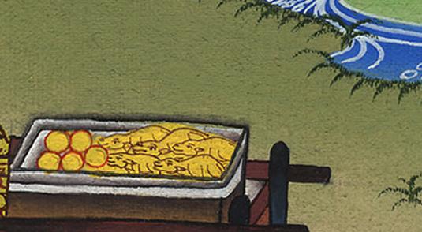
1 Samuel 6:4

Slide 15
7“Now therefore take and prepare yourselves a new cart and two milk cows on which there has come no yoke; and tie the cows to the cart, and bring their calves home from them;

Slide 16
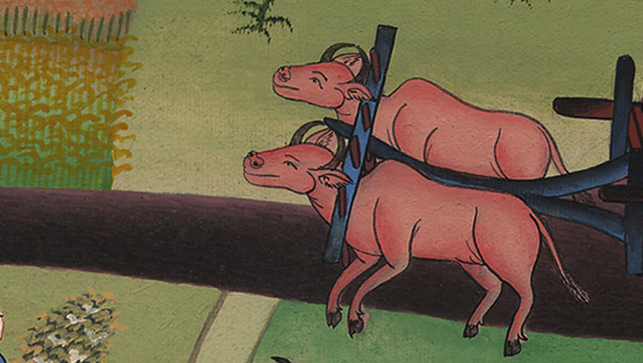
1 Samuel 6:7

Slide 17
8and take Yahweh’s ark and lay it on the cart. Put the jewels of gold, which you return him for a trespass offering, in a box by its side; and send it away, that it may go.

Slide 18
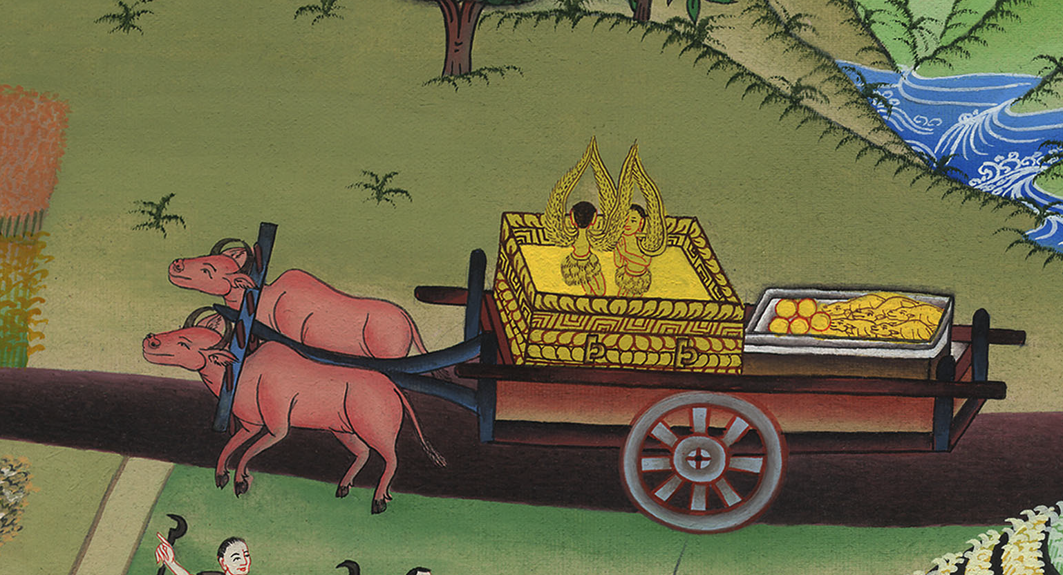
1 Samuel 6:8

Slide 19
9Behold, if it goes up by the way of its own border to Beth Shemesh, then he has done us this great evil; but if not, then we shall know that it is not his hand that struck us. It was a chance that happened to us.”

Slide 20
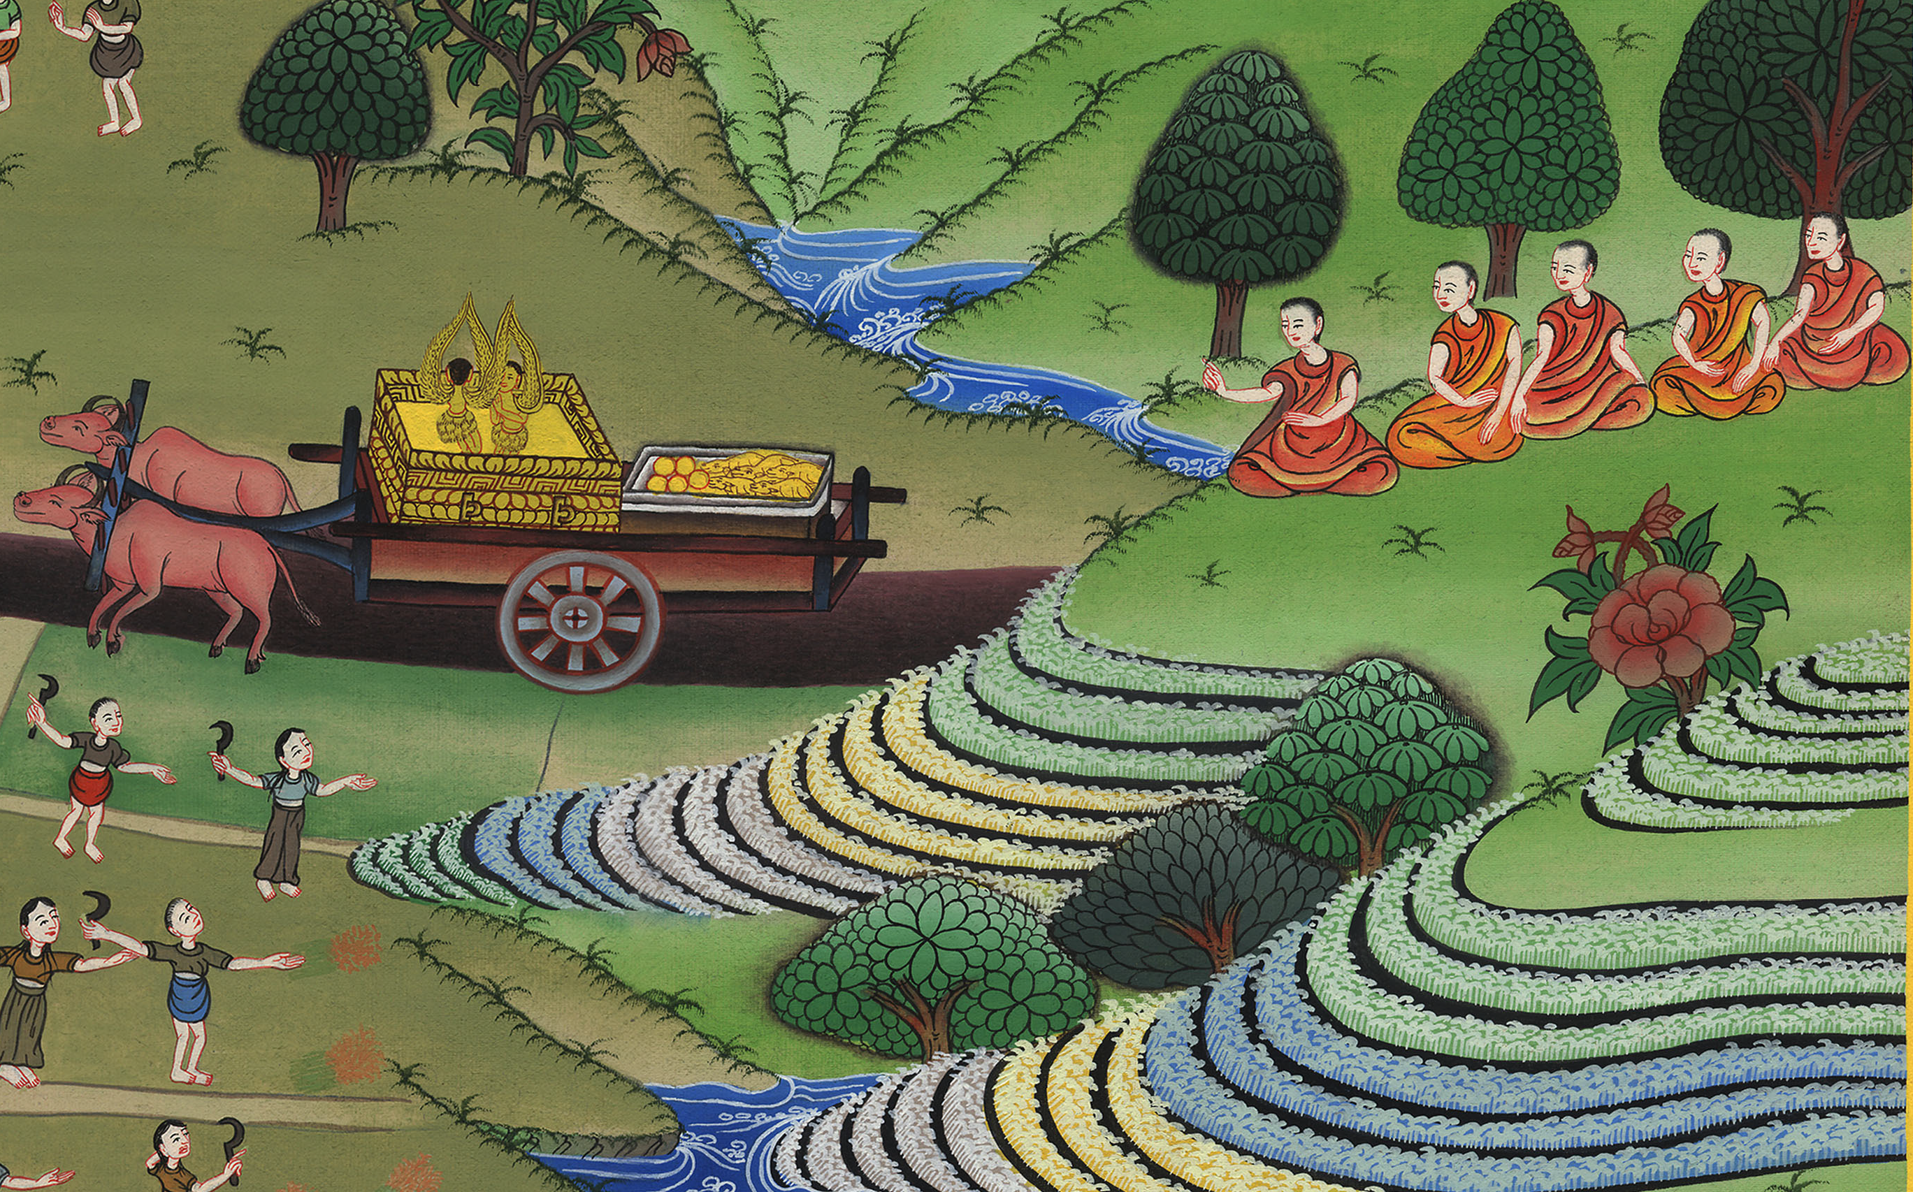
1 Samuel 6:9

Slide 21
10The men did so, and took two milk cows and tied them to the cart, and shut up their calves at home.

Slide 22
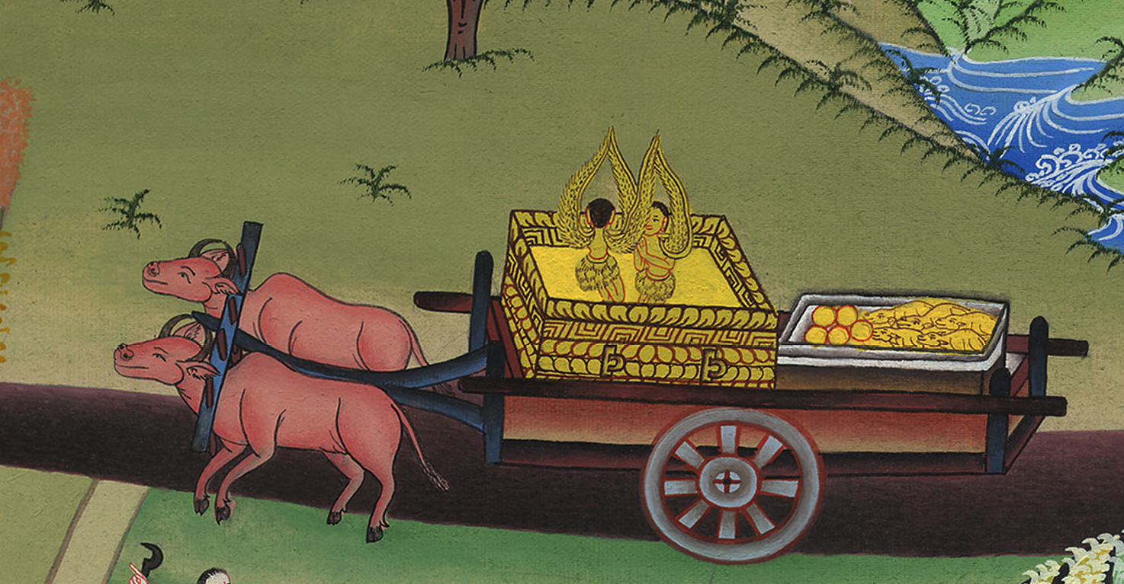
1 Samuel 6:10

Slide 23
12The cows took the straight way by the way to Beth Shemesh. They went along the highway, lowing as they went, and didn’t turn away to the right hand or to the left; and the lords of the Philistines went after them to the border of Beth Shemesh.

Slide 24
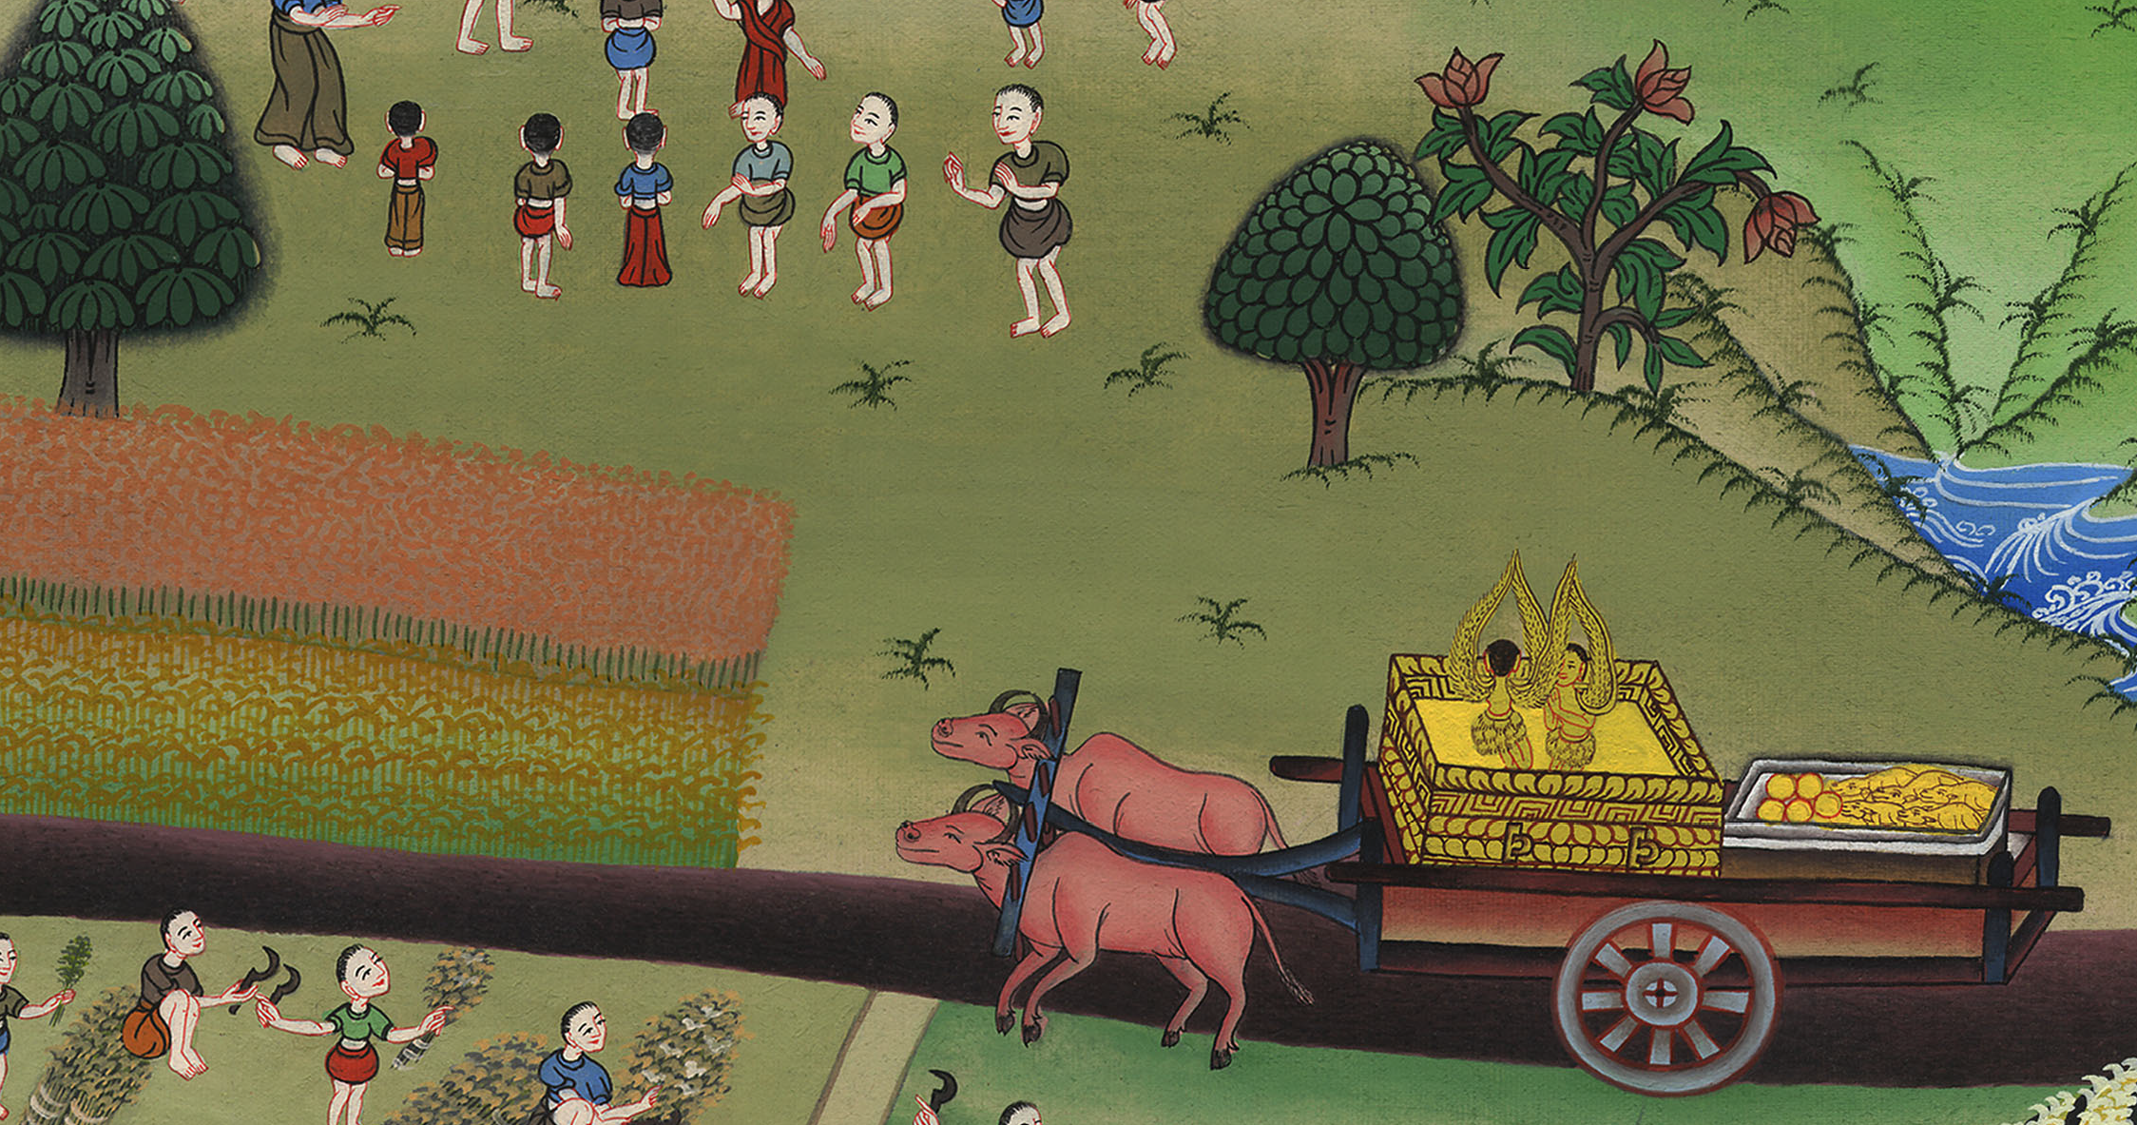
1 Samuel 6:12

Slide 25
13The people of Beth Shemesh were reaping their wheat harvest in the valley; and they lifted up their eyes and saw the ark, and rejoiced to see it.

Slide 26
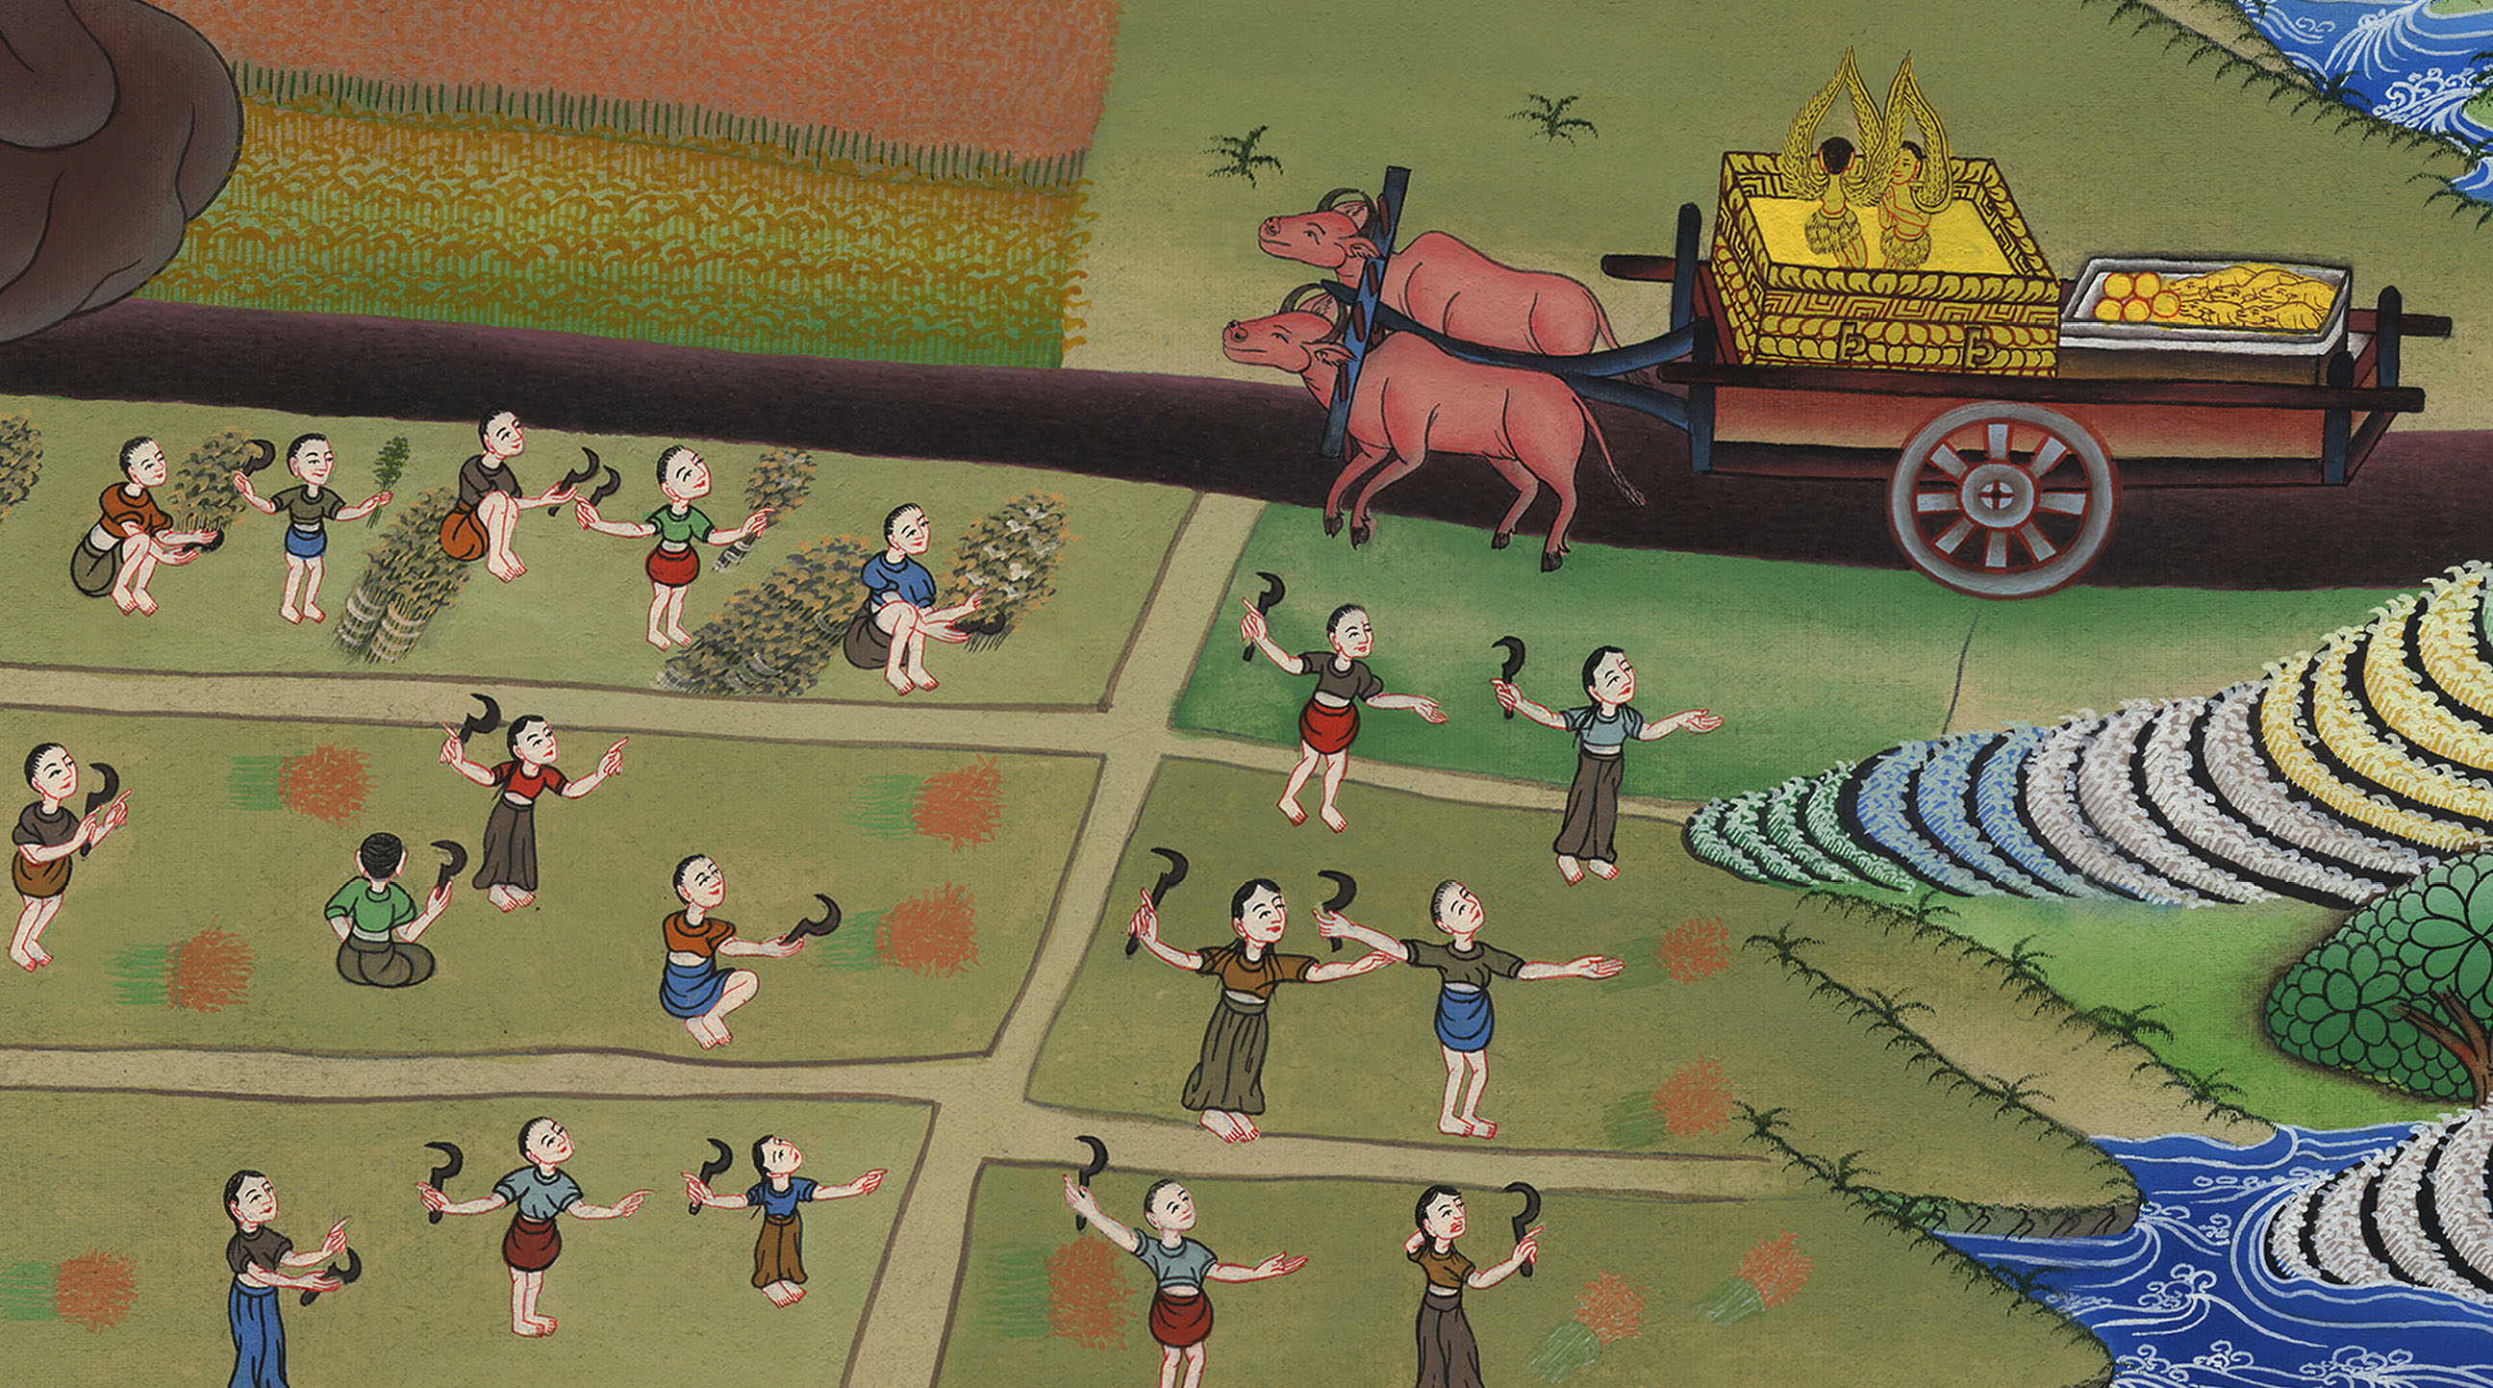
1 Samuel 6:13

