Slide 1
16-1
This work is licensed under a Creative Commons Attribution-Sharealike 4.0 International License.
Please add this statement to all the videos you create.
English Bible quotes are from the World English Bible US, which is in the public domain.
Notes:
ch

Slide 2
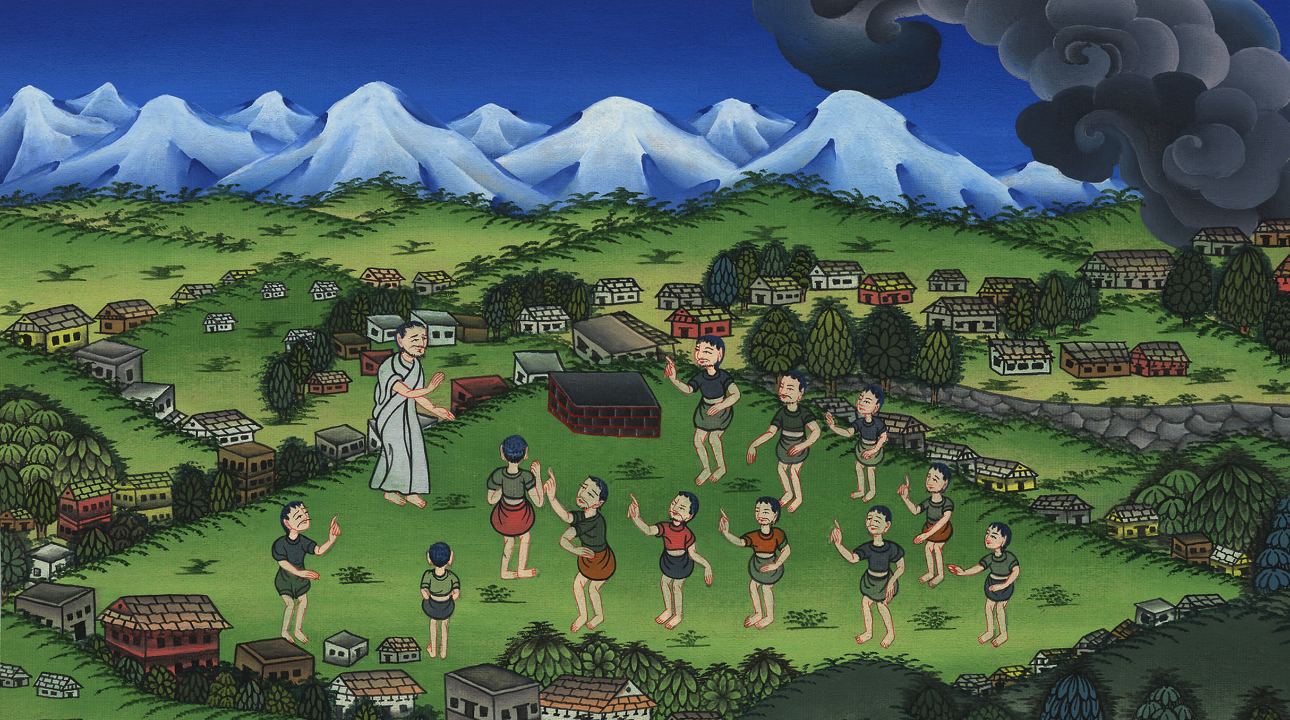
People demand a King –
1 Samuel 8:4-22

Slide 3
1. People demand a King - 1 Samuel 8:4-22 (Left Top)
Notes:
16 Saul
1. People demand a King - 1 Samuel 8:4-22 (Left Top)
2. Samuel anoints Saul – 1 Samuel 9:1 – 10:9 (Right Top)
3. Election of Saul as King – 1 Samuel 10:17-27 (Right Center)
4. Address at Gilgal - 1 Samuel 11:14 – 12:25 (Right Bottom)
5. Saul doesn’t wait for Samuel – 1 Samuel 13:5-14 (Left Bottom)
6. Saul’s Disobedience – 1 Samuel 15:1-35 (Left Center)
7. Samuel anoints David – 1 Samuel 16:1-14 (Center)

Slide 4
People demand a King –
1 Samuel 8:4-22

Slide 5
1Samuel8:4Then all the elders of Israel gathered themselves together and came to Samuel to Ramah.

Slide 6
1 Samuel 8:4

Slide 7
5They said to him, “Behold, you are old, and your sons don’t walk in your ways. Now make us a king to judge us like all the nations.”

Slide 8
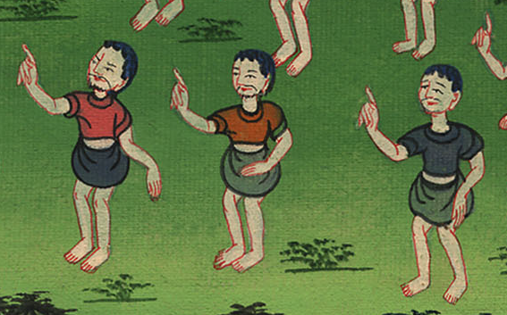
1 Samuel 8:5

Slide 9
But the thing displeased Samuel when they said, “Give us a king to judge us.”
Samuel prayed to Yahweh.

Slide 10
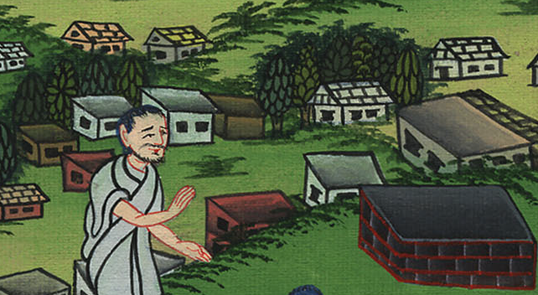
1 Samuel པོ། 8:6

Slide 11
7Yahweh said to Samuel, “Listen to the voice of the people in all that they tell you; for they have not rejected you, but they have rejected me as the king over them.

Slide 12
1 Samuel 8:7

Slide 13
8According to all the works which they have done since the day that I brought them up out of Egypt even to this day, in that they have forsaken me and served other gods, so they also do to you.

Slide 14
1 Samuel 8:8

Slide 15
9Now therefore, listen to their voice. However, you shall protest solemnly to them, and shall show them the way of the king who will reign over them.”

Slide 16
1 Samuel 8:9

Slide 17
10Samuel told all Yahweh’s words to the people who asked him for a king.

Slide 18
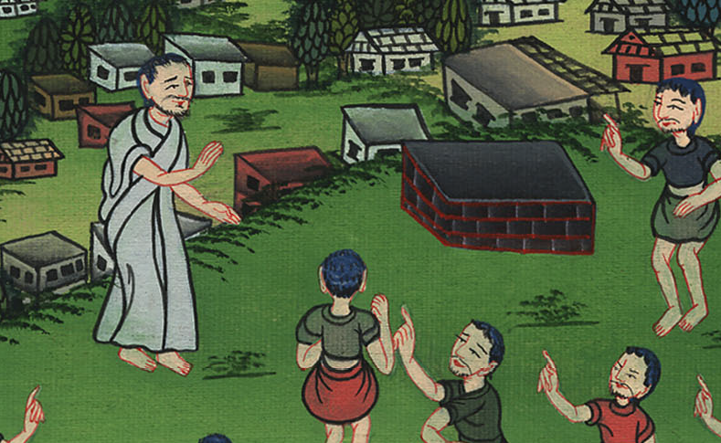
1 Samuel 8:10

Slide 19
11He said, “This will be the way of the king who shall reign over you: he will take your sons and appoint them as his servants, for his chariots and to be his horsemen; and they will run before his chariots.

Slide 20
1 Samuel 8:11

Slide 21
13He will take your daughters to be perfumers, to be cooks, and to be bakers.

Slide 22
1 Samuel 8:13

Slide 23
14He will take your fields, your vineyards, and your olive groves, even your best, and give them to his servants.

Slide 24
1 Samuel 8:14

Slide 25
17He will take one tenth of your flocks; and you will be his servants.

Slide 26
1 Samuel 8:17

Slide 27
18You will cry out in that day because of your king whom you will have chosen for yourselves; and Yahweh will not answer you in that day.”

Slide 28
1 Samuel 8:18

Slide 29
19But the people refused to listen to the voice of Samuel; and they said, “No, but we will have a king over us,

Slide 30
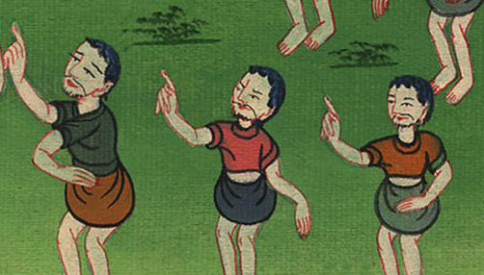
1 Samuel 8:19

Slide 31
20that we also may be like all the nations; and that our king may judge us, and go out before us, and fight our battles.”

Slide 32
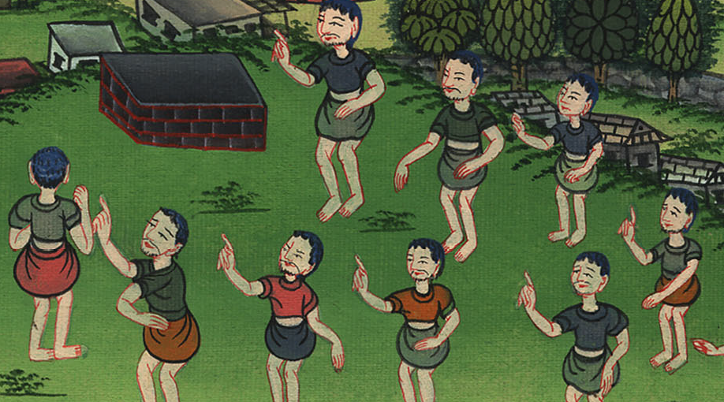
1 Samuel 8:20

Slide 33
21Samuel heard all the words of the people, and he rehearsed them in the ears of Yahweh.

Slide 34
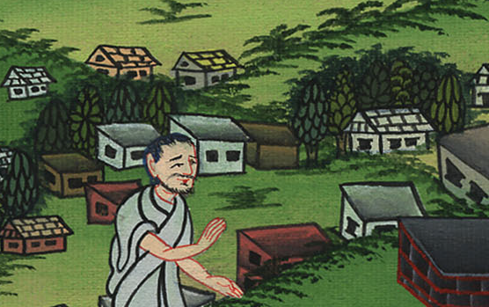
1 Samuel 8:21

Slide 35
22Yahweh said to Samuel, “Listen to their voice, and make them a king.”

Slide 36
1 Samuel 8:22

