Slide 1
16-3
This work is licensed under a Creative Commons Attribution-Sharealike 4.0 International License.
Please add this statement to all the videos you create.
English Bible quotes are from the World English Bible US, which is in the public domain.
Notes:
ch

Slide 2
Election of Saul as King –
1 Samuel 10:17-27
Notes:
16 Saul
1. People demand a King - 1 Samuel 8:4-22 (Left Top)
2. Samuel anoints Saul – 1 Samuel 9:1 – 10:9 (Right Top)
3. Election of Saul as King – 1 Samuel 10:17-27 (Right Center)
4. Address at Gilgal - 1 Samuel 11:14 – 12:25 (Right Bottom)
5. Saul doesn’t wait for Samuel – 1 Samuel 13:5-14 (Left Bottom)
6. Saul’s Disobedience – 1 Samuel 15:1-35 (Left Center)
7. Samuel anoints David – 1 Samuel 16:1-14 (Center)

Slide 3
3. Election of Saul as King – 1 Samuel 10:17-27 (Right Center)
1 Samuel

Slide 4
Election of Saul as King –
1 Samuel 10:17-27

Slide 5
1Samuel10:17 Samuel called the people together to Yahweh to Mizpah;
1 Samuel

Slide 6
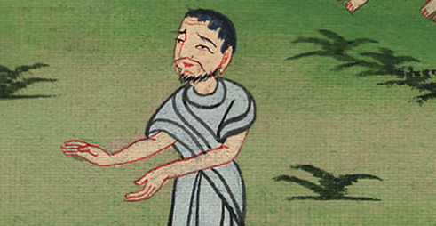
1 Samuel 10:17

Slide 7
18and he said to the children of Israel, “Yahweh, the God of Israel, says ‘I brought Israel up out of Egypt and I delivered you out of the hand of the Egyptians, and out of the hand of all the kingdoms that oppressed you.’
1 Samuel

Slide 8
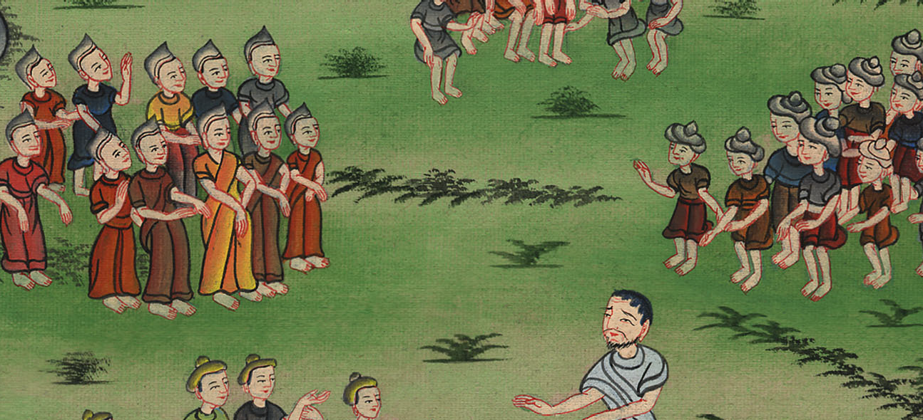
1 Samuel 10:18

Slide 9
19But you have today rejected your God, who himself saves you out of all your calamities and your distresses; and you have said to him, ‘No! Set a king over us!’ Now therefore present yourselves before Yahweh by your tribes and by your thousands.”
1 Samuel

Slide 10
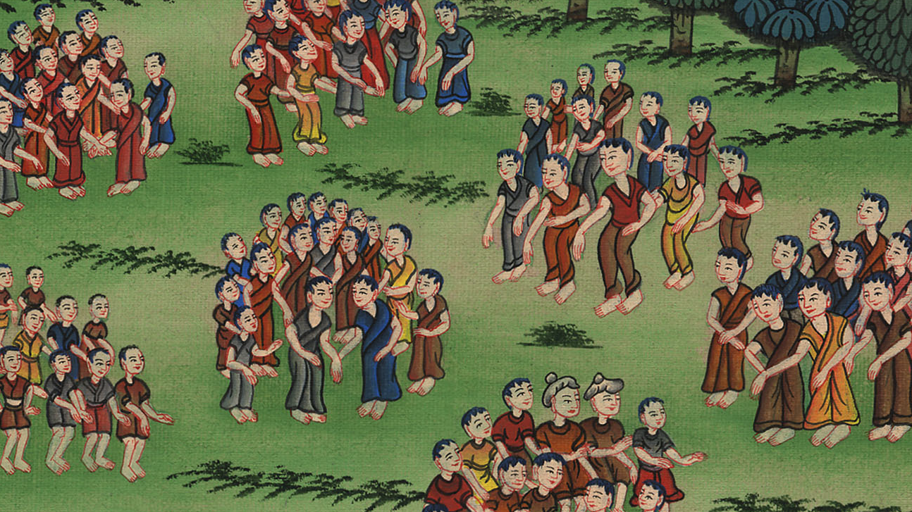
1 Samuel 10:19

Slide 11
20So Samuel brought all the tribes of Israel near, and the tribe of Benjamin was chosen.
1 Samuel

Slide 12
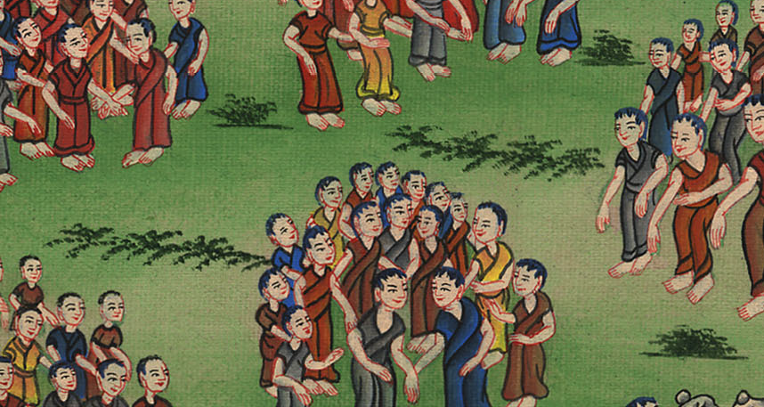
1 Samuel 10:20

Slide 13
21He brought the tribe of Benjamin near by their families and the family of the Matrites was chosen. Then Saul the son of Kish was chosen; but when they looked for him, he could not be found.
1 Samuel

Slide 14
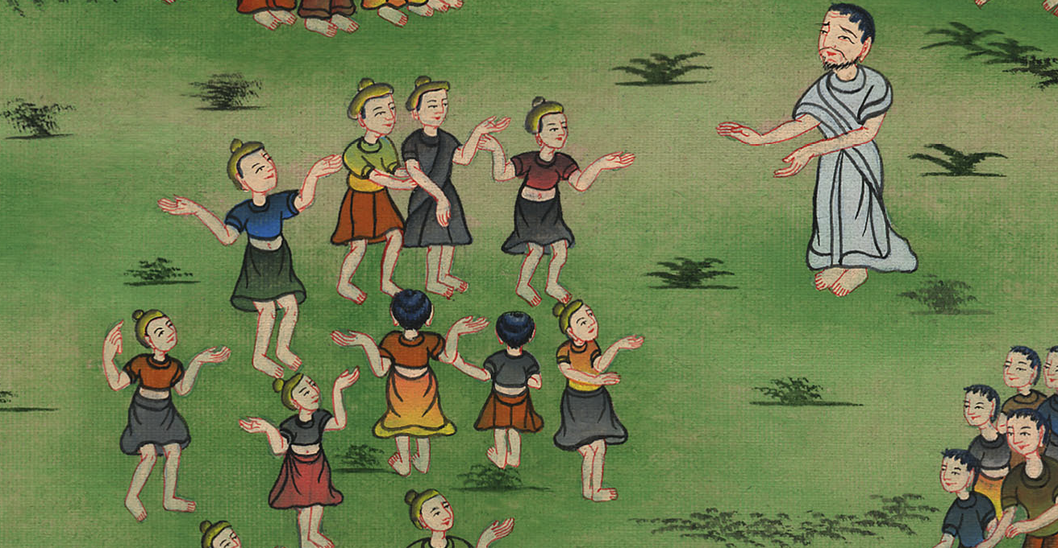
1 Samuel 10:21

Slide 15
22Therefore they asked of Yahweh further, “Is there yet a man to come here?”
Yahweh answered, “Behold, he has hidden himself among the baggage.”
1 Samuel

Slide 16
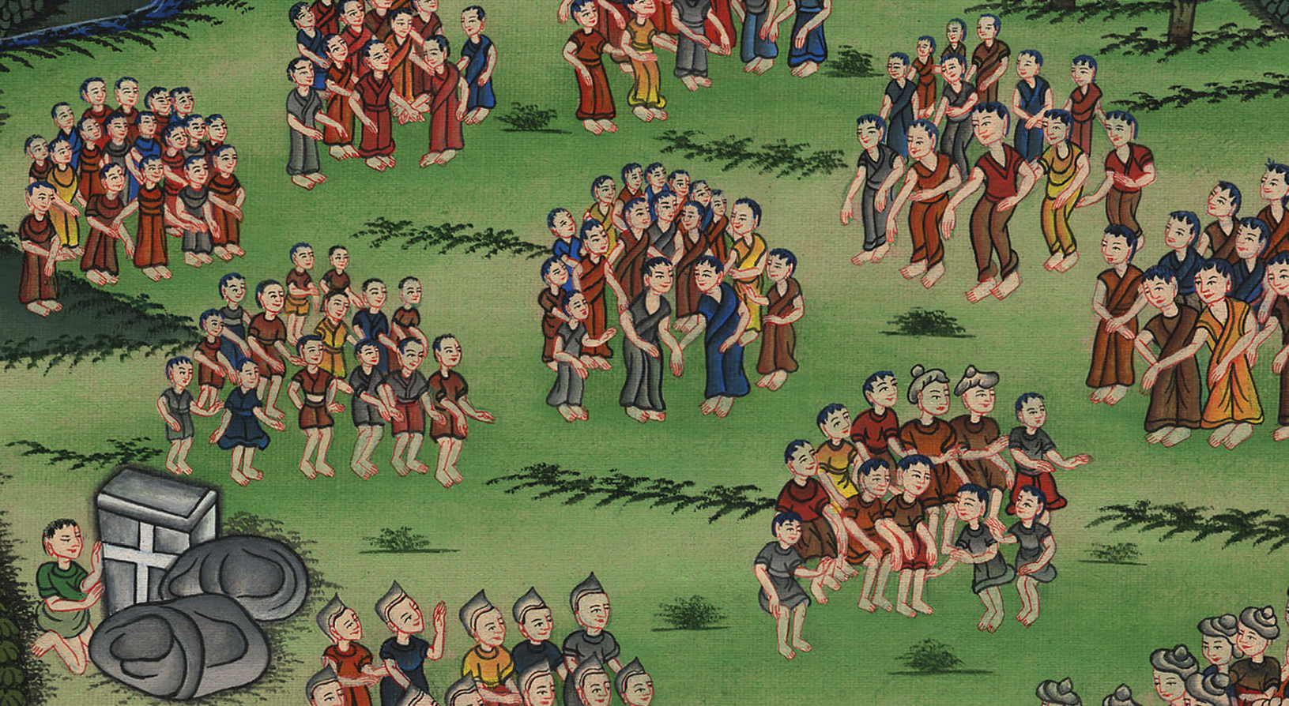
1 Samuel 10:22

Slide 17
23They ran and got him there. When he stood among the people, he was higher than any of the people from his shoulders and upward.
1 Samuel

Slide 18
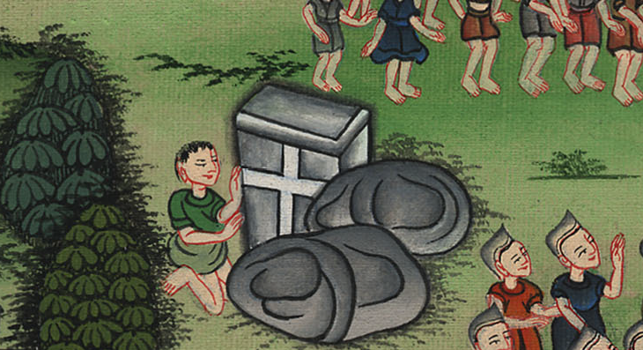
1 Samuel 10:23

Slide 19
24Samuel said to all the people, “Do you see him whom Yahweh has chosen, that there is no one like him among all the people?”
All the people shouted and said, “Long live the king!”
1 Samuel

Slide 20
1 Samuel 10:24

