Slide 1
16-4
This work is licensed under a Creative Commons Attribution-Sharealike 4.0 International License.
Please add this statement to all the videos you create.
English Bible quotes are from the World English Bible US, which is in the public domain.
Notes:
Ch

Slide 2
Address at Gilgal –
1 Samuel 11:14 – 12:25
Notes:
16 Saul
1. People demand a King - 1 Samuel 8:4-22 (Left Top)
2. Samuel anoints Saul – 1 Samuel 9:1 – 10:9 (Right Top)
3. Election of Saul as King – 1 Samuel 10:17-27 (Right Center)
4. Address at Gilgal - 1 Samuel 11:14 – 12:25 (Right Bottom)
5. Saul doesn’t wait for Samuel – 1 Samuel 13:5-14 (Left Bottom)
6. Saul’s Disobedience – 1 Samuel 15:1-35 (Left Center)
7. Samuel anoints David – 1 Samuel 16:1-14 (Center)

Slide 3
4. Address at Gilgal - 1 Samuel 11:14 – 12:25 (Right Bottom)
1 Samuel

Slide 4
Address at Gilgal –
1 Samuel 11:14 – 12:25

Slide 5
1Samuel11:15All the people went to Gilgal; and there they made Saul king before Yahweh in Gilgal. There they offered sacrifices of peace offerings before Yahweh; and there Saul and all the men of Israel rejoiced greatly.
1 Samuel

Slide 6
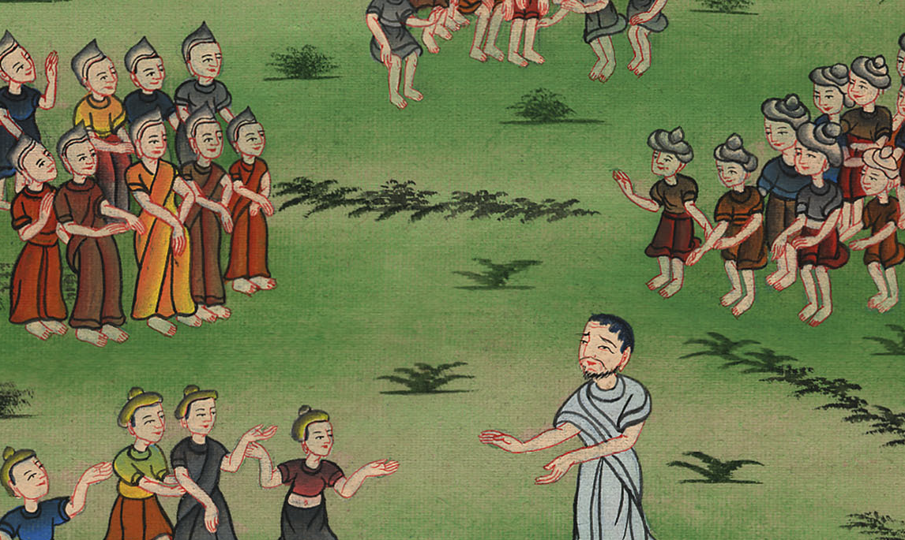
1 Samuel 11:15

Slide 7
13Now therefore see the king whom you have chosen and whom you have asked for. Behold, Yahweh has set a king over you.
1 Samuel

Slide 8
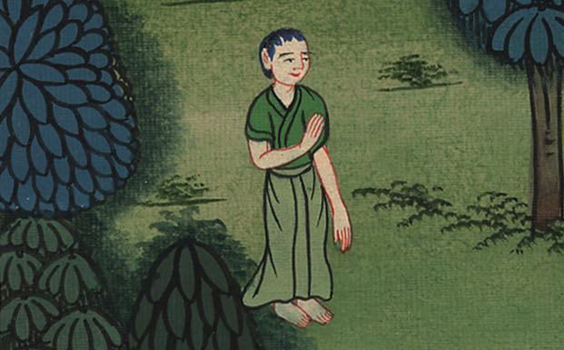
1 Samuel 12:13

Slide 9
16“Now therefore stand still and see this great thing, which Yahweh will do before your eyes.
1 Samuel

Slide 10
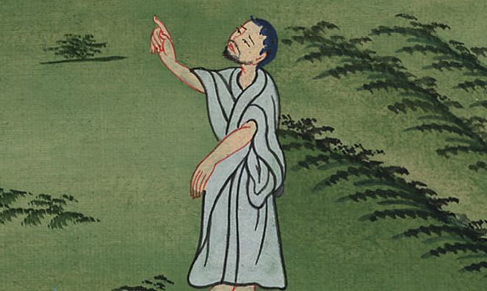
1 Samuel 12:16

Slide 11
17Isn’t it wheat harvest today? I will call to Yahweh, that he may send thunder and rain; and you will know and see that your wickedness is great, which you have done in Yahweh’s sight, in asking for a king.”
1 Samuel

Slide 12
1 Samuel 12:17

Slide 13
18So Samuel called to Yahweh, and Yahweh sent thunder and rain that day. Then all the people greatly feared Yahweh and Samuel.
1 Samuel

Slide 14
1 Samuel 12:18

Slide 15
19All the people said to Samuel, “Pray for your servants to Yahweh your God, that we not die; for we have added to all our sins this evil, to ask for a king.”
1 Samuel

Slide 16
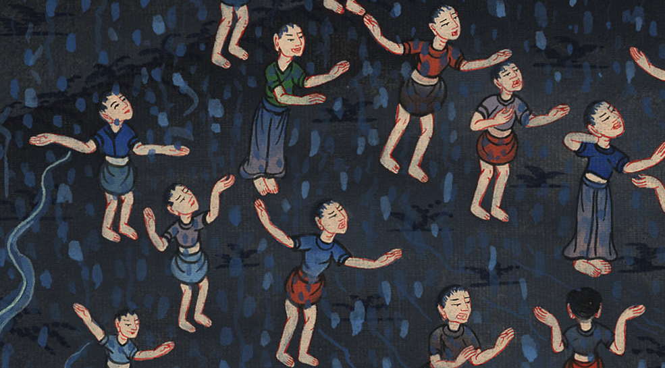
1 Samuel 12:19

Slide 17
20Samuel said to the people, “Don’t be afraid. You have indeed done all this evil; yet don’t turn away from following Yahweh, but serve Yahweh with all your heart.
1 Samuel

Slide 18
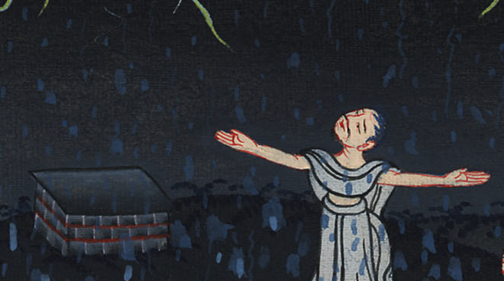
1 Samuel 12:20

Slide 19
21Don’t turn away to go after vain things which can’t profit or deliver, for they are vain.
1 Samuel

Slide 20
1 Samuel 12:21

Slide 21
22For Yahweh will not forsake his people for his great name’s sake, because it has pleased Yahweh to make you a people for himself.
1 Samuel

Slide 22
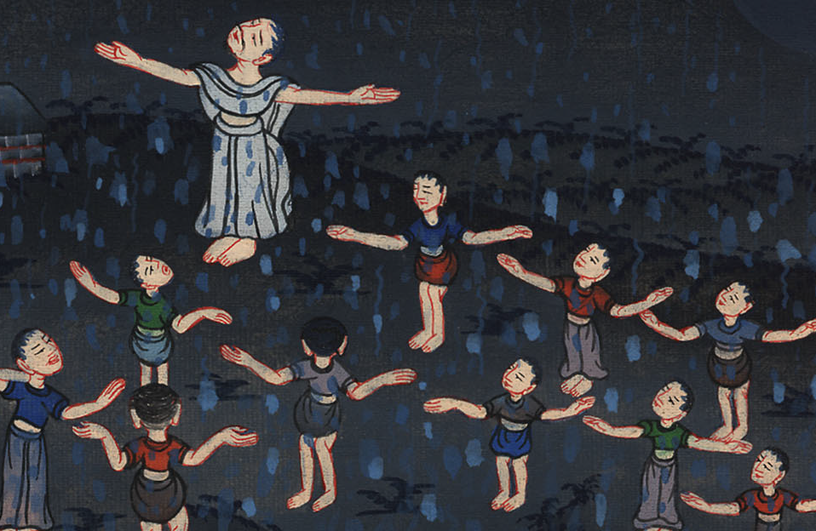
1 Samuel 12:22

Slide 23
24Only fear Yahweh, and serve him in truth with all your heart; for consider what great things he has done for you.
1 Samuel

Slide 24
1 Samuel 12:24

