Slide 1
16-5
This work is licensed under a Creative Commons Attribution-Sharealike 4.0 International License.
Please add this statement to all the videos you create.
English Bible quotes are from the World English Bible US, which is in the public domain.
Notes:
ch

Slide 2
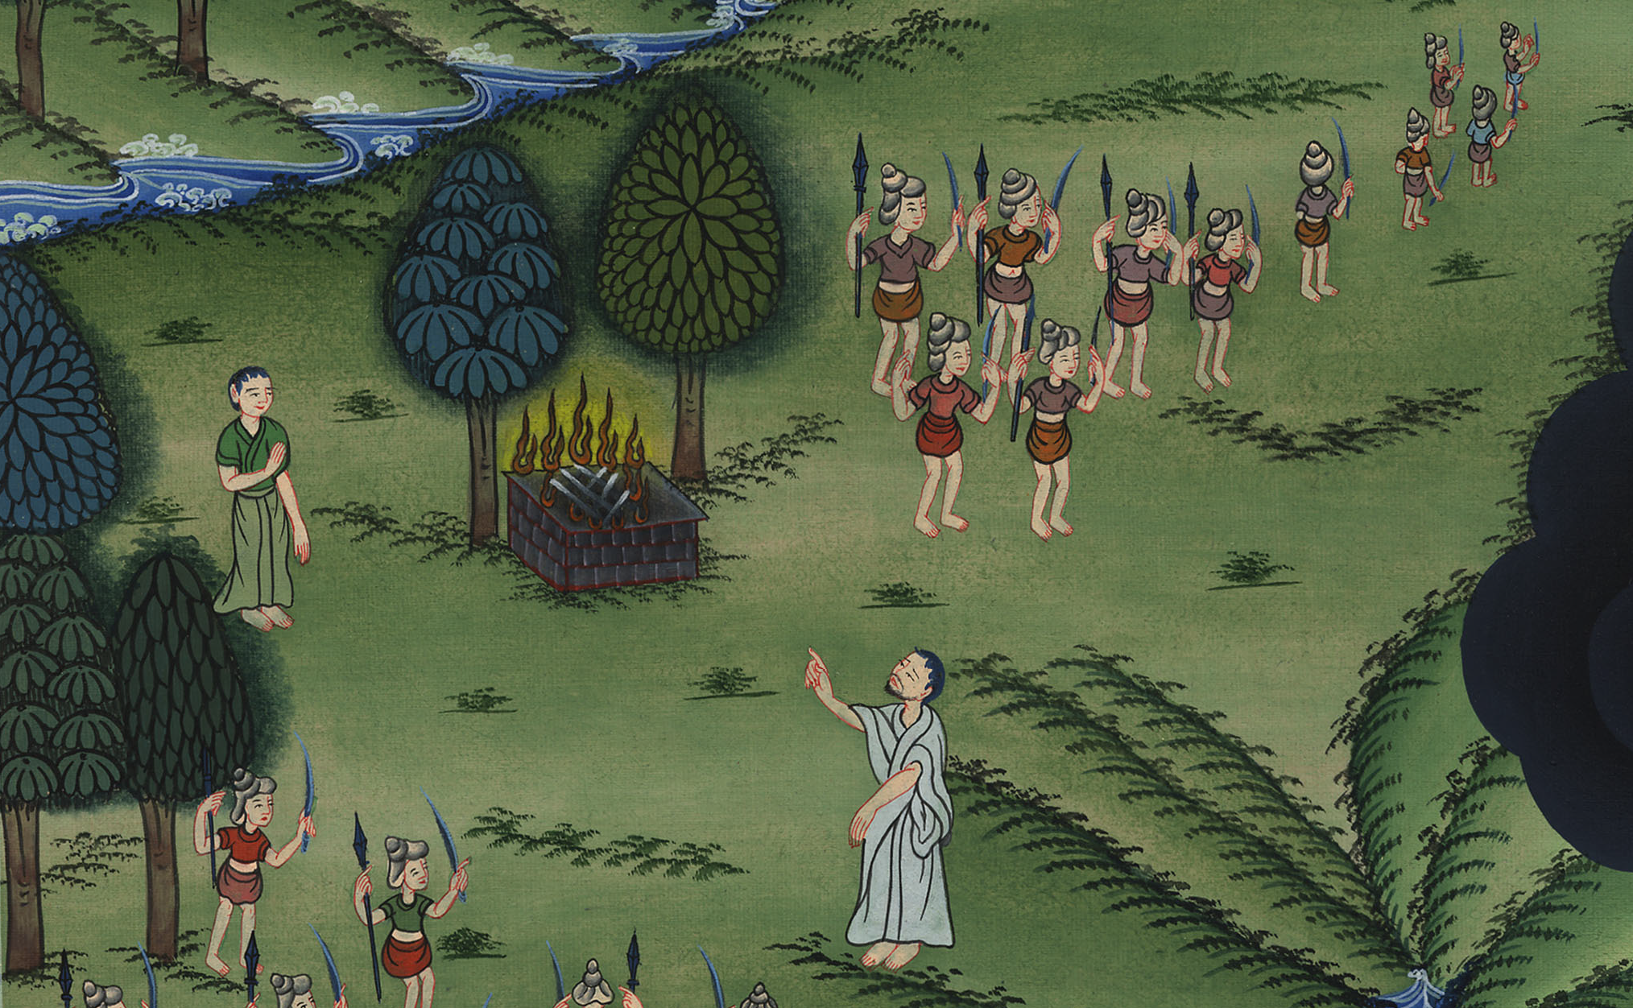
Saul doesn’t wait for Samuel –
1 Samuel 13:5-14

Slide 3
5. Saul doesn’t wait for Samuel – 1 Samuel 13:5-14 (Left Bottom)
1 Samuel
Notes:
16 Saul
1. People demand a King - 1 Samuel 8:4-22 (Left Top)
2. Samuel anoints Saul – 1 Samuel 9:1 – 10:9 (Right Top)
3. Election of Saul as King – 1 Samuel 10:17-27 (Right Center)
4. Address at Gilgal - 1 Samuel 11:14 – 12:25 (Right Bottom)
6. Saul’s Disobedience – 1 Samuel 15:1-35 (Left Center)
7. Samuel anoints David – 1 Samuel 16:1-14 (Center)

Slide 4
Saul doesn’t wait for Samuel –
1 Samuel 13:5-14

Slide 5
1Samuel13:5The Philistines assembled themselves together to fight with Israel: thirty thousand chariots, six thousand horsemen, and people as the sand which is on the seashore in multitude.
1 Samuel

Slide 6
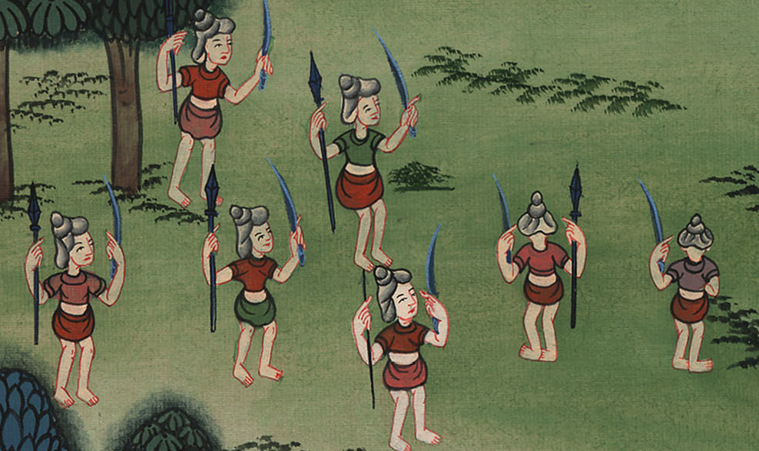
1 Samuel 13:5

Slide 7
6When the men of Israel saw that they were in trouble (for the people were distressed), then the people hid themselves in caves, in thickets, in rocks, in tombs, and in pits.
1 Samuel

Slide 8
1 Samuel 13:6

Slide 9
7Now some of the Hebrews had gone over the Jordan to the land of Gad and Gilead; but as for Saul, he was yet in Gilgal, and all the people followed him trembling.
1 Samuel

Slide 10
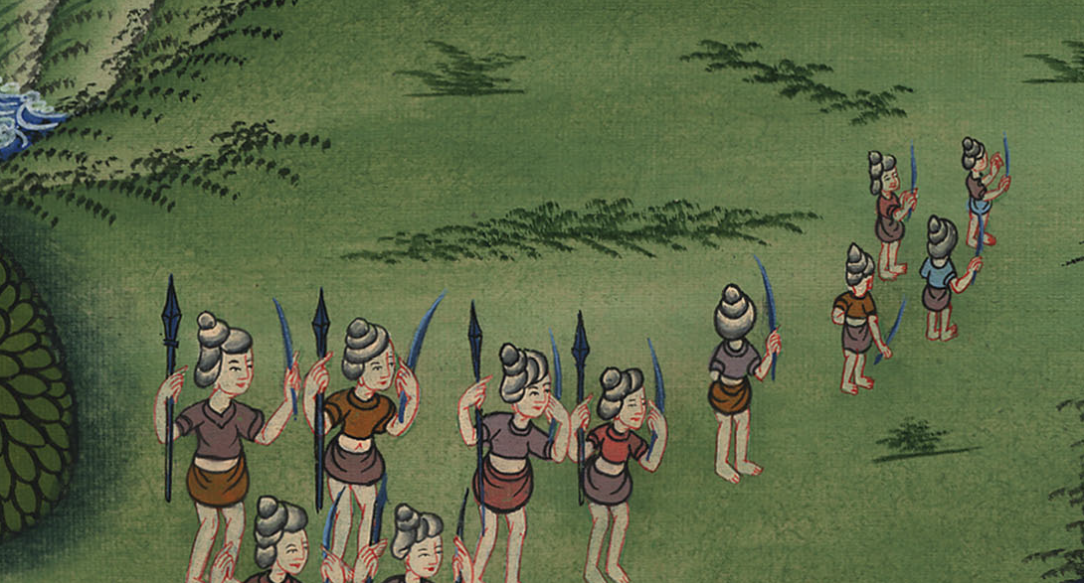
1 Samuel 13:7

Slide 11
8He stayed seven days, according to the time set by Samuel; but Samuel didn’t come to Gilgal, and the people were scattering from him.
1 Samuel

Slide 12
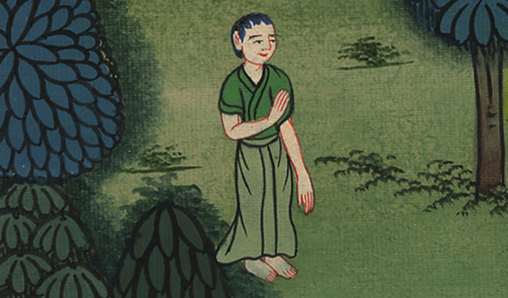
1 Samuel 13:8

Slide 13
9Saul said, “Bring the burnt offering to me here, and the peace offerings.” He offered the burnt offering.
1 Samuel

Slide 14
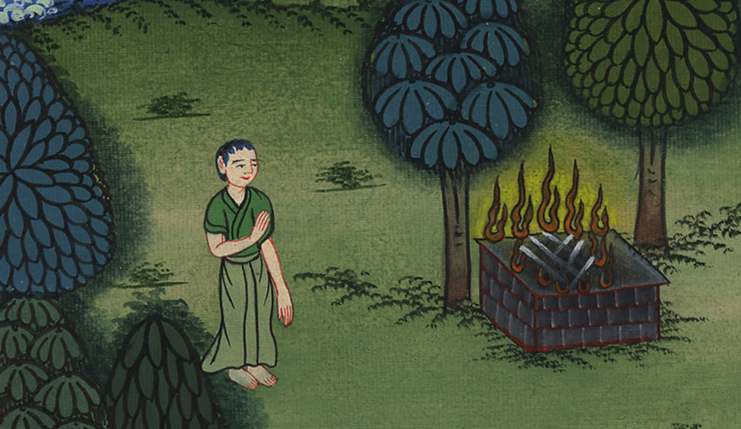
1 Samuel 13:9

Slide 15
10It came to pass that as soon as he had finished offering the burnt offering, behold, Samuel came; and Saul went out to meet him, that he might greet him.
1 Samuel

Slide 16
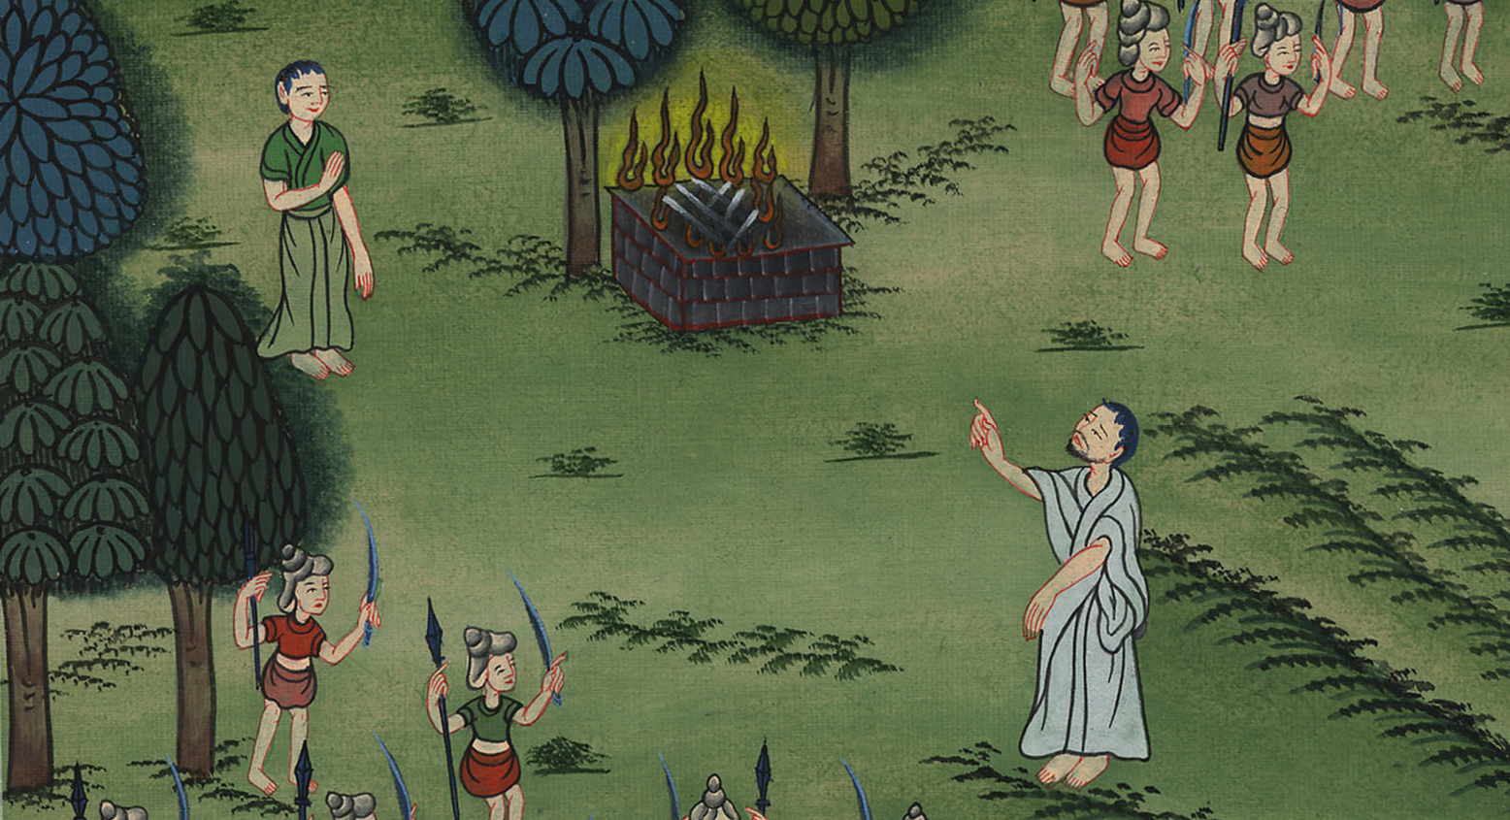
1 Samuel 13:10

Slide 17
11Samuel said, “What have you done?”
Saul said, “Because I saw that the people were scattered from me, and that you didn’t come within the days appointed, and that the Philistines assembled themselves together at Michmash,
1 Samuel

Slide 18
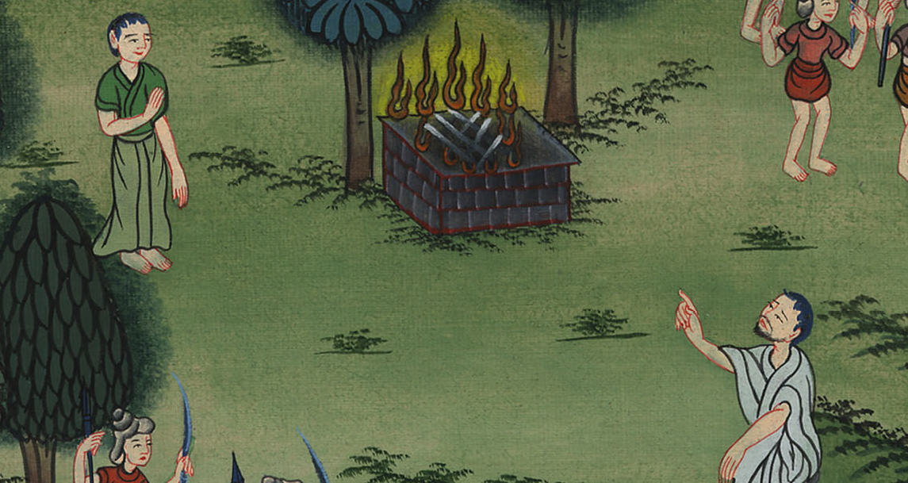
1 Samuel 13:11

Slide 19
12therefore I said, ‘Now the Philistines will come down on me to Gilgal, and I haven’t entreated the favor of Yahweh.’ I forced myself therefore, and offered the burnt offering.”
1 Samuel

Slide 20
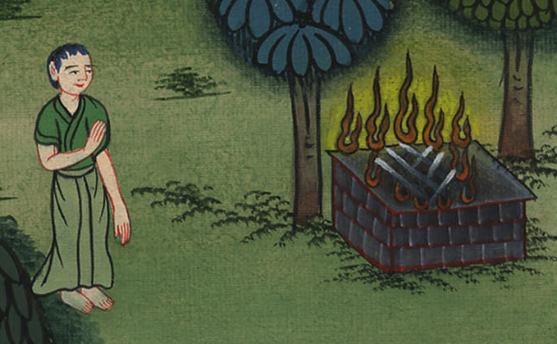
1 Samuel 13:12

Slide 21
13Samuel said to Saul, “You have done foolishly. You have not kept the commandment of Yahweh your God, which he commanded you; for now Yahweh would have established your kingdom on Israel forever.
1 Samuel

Slide 22
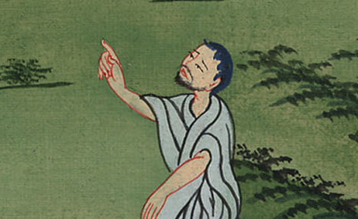
1 Samuel 13:13

Slide 23
14But now your kingdom will not continue. Yahweh has sought for himself a man after his own heart, and Yahweh has appointed him to be prince over his people, because you have not kept that which Yahweh commanded you.”
1 Samuel

Slide 24
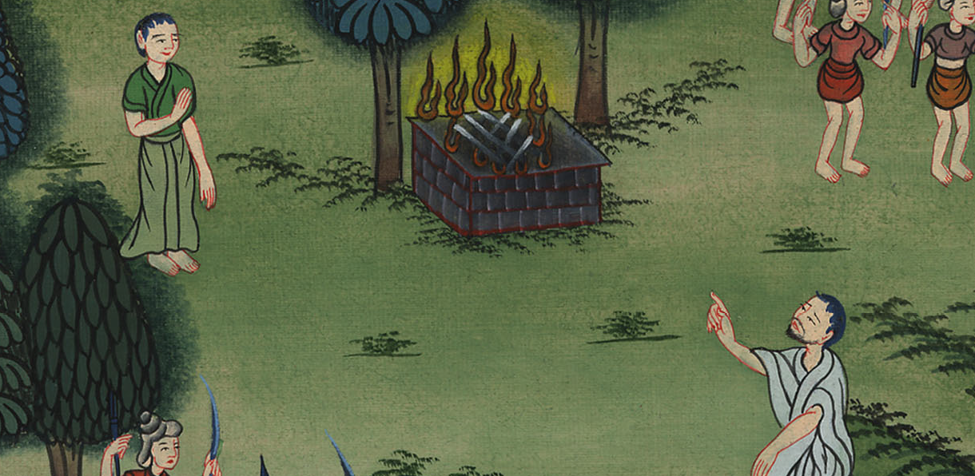
1 Samuel 13:14

