Slide 1
16-6
This work is licensed under a Creative Commons Attribution-Sharealike 4.0 International License.
Please add this statement to all the videos you create.
English Bible quotes are from the World English Bible US, which is in the public domain.
Notes:
ch

Slide 2
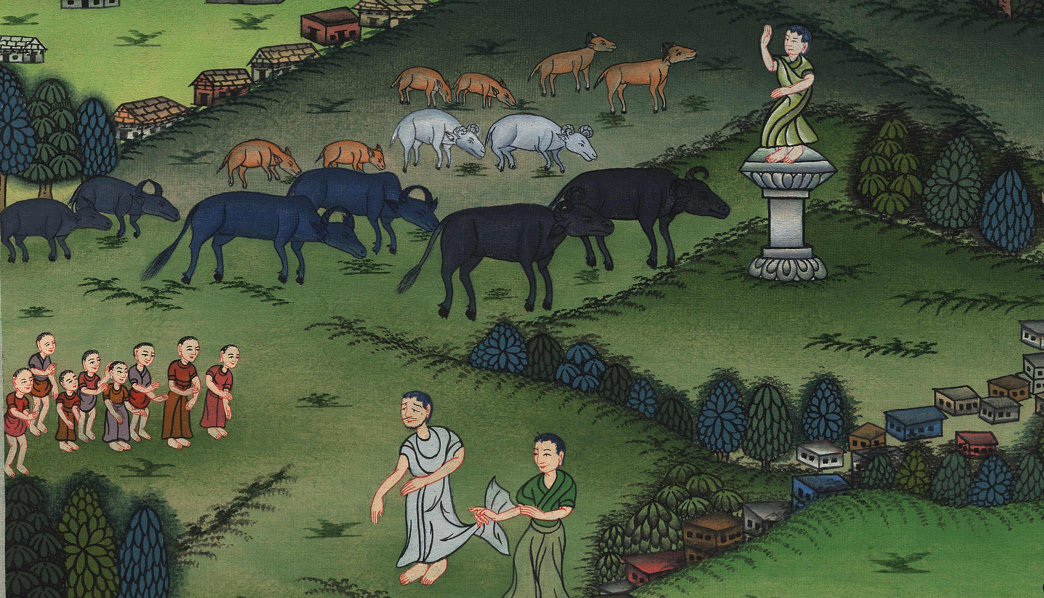
Saul’s Disobedience –
1 Samuel 15:1-35

Slide 3
6. Saul’s Disobedience – 1 Samuel 15:1-35 (Left Center)
1 Samuel
Notes:
16 Saul
1. People demand a King - 1 Samuel 8:4-22 (Left Top)
2. Samuel anoints Saul – 1 Samuel 9:1 – 10:9 (Right Top)
3. Election of Saul as King – 1 Samuel 10:17-27 (Right Center)
4. Address at Gilgal - 1 Samuel 11:14 – 12:25 (Right Bottom)
5. Saul doesn’t wait for Samuel – 1 Samuel 13:5-14 (Left Bottom)
6. Saul’s Disobedience – 1 Samuel 15:1-35 (Left Center)
7. Samuel anoints David – 1 Samuel 16:1-14 (Center)

Slide 4
Saul’s Disobedience –
1 Samuel 15:1-35

Slide 5
1Samuel15:1Samuel said to Saul, “Yahweh sent me to anoint you to be king over his people, over Israel. Now therefore listen to the voice of Yahweh’s words.
1 Samuel

Slide 6
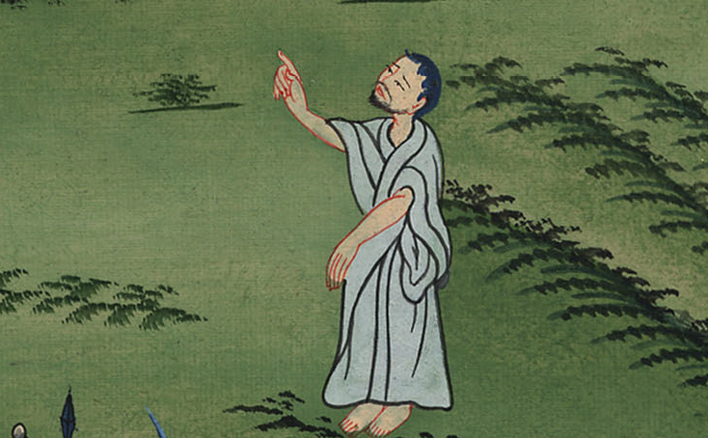
1 Samuel 15:1

Slide 7
2Yahweh of Armies says, ‘I remember what Amalek did to Israel, how he set himself against him on the way when he came up out of Egypt.
1 Samuel

Slide 8
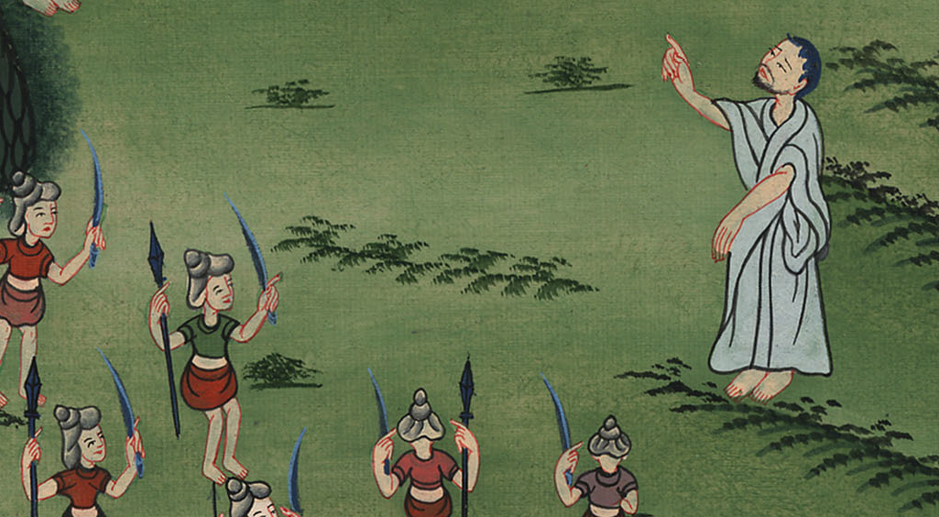
1 Samuel 15:2

Slide 9
3Now go and strike Amalek, and utterly destroy all that they have, and don’t spare them; but kill both man and woman, infant and nursing baby, ox and sheep, camel and donkey.’”
1 Samuel

Slide 10
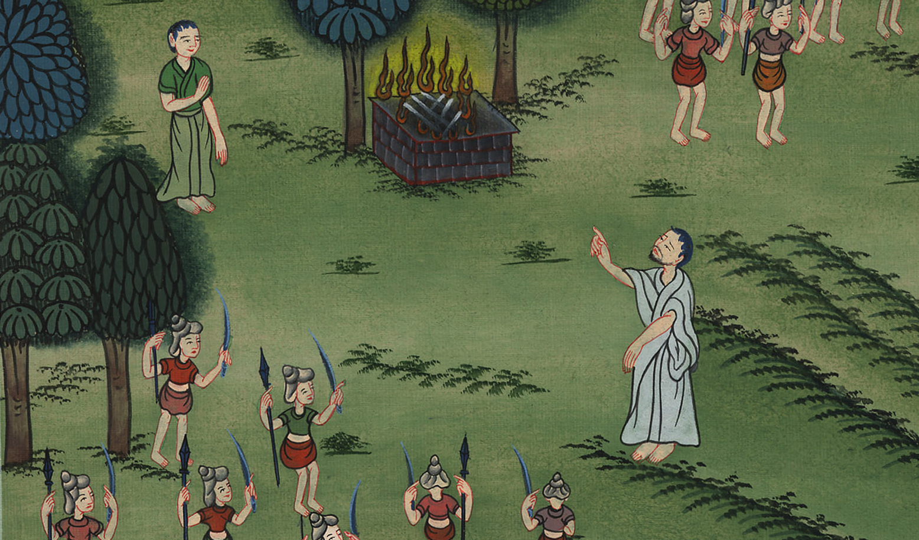
1 Samuel 15:3

Slide 11
7Saul struck the Amalekites, from Havilah as you go to Shur, which is before Egypt. 8He took Agag the king of the Amalekites alive, and utterly destroyed all the people with the edge of the sword.
1 Samuel

Slide 12
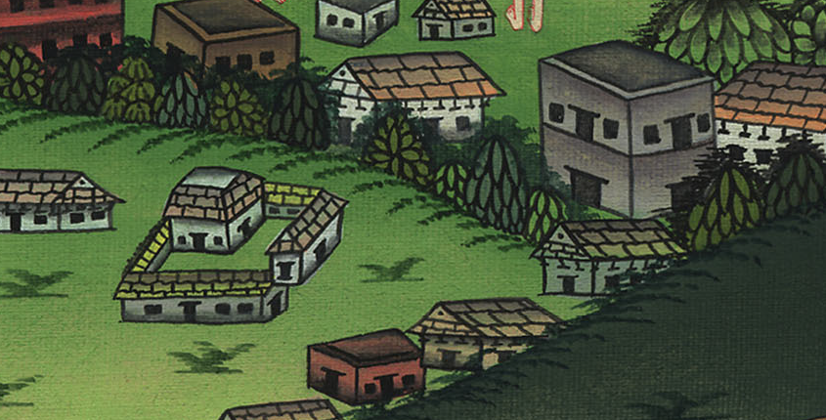
1 Samuel 15:7

Slide 13
9But Saul and the people spared Agag and the best of the sheep, of the cattle, of the fat calves, of the lambs, and all that was good, and were not willing to utterly destroy them; but everything that was vile and refuse, that they destroyed utterly.
1 Samuel

Slide 14
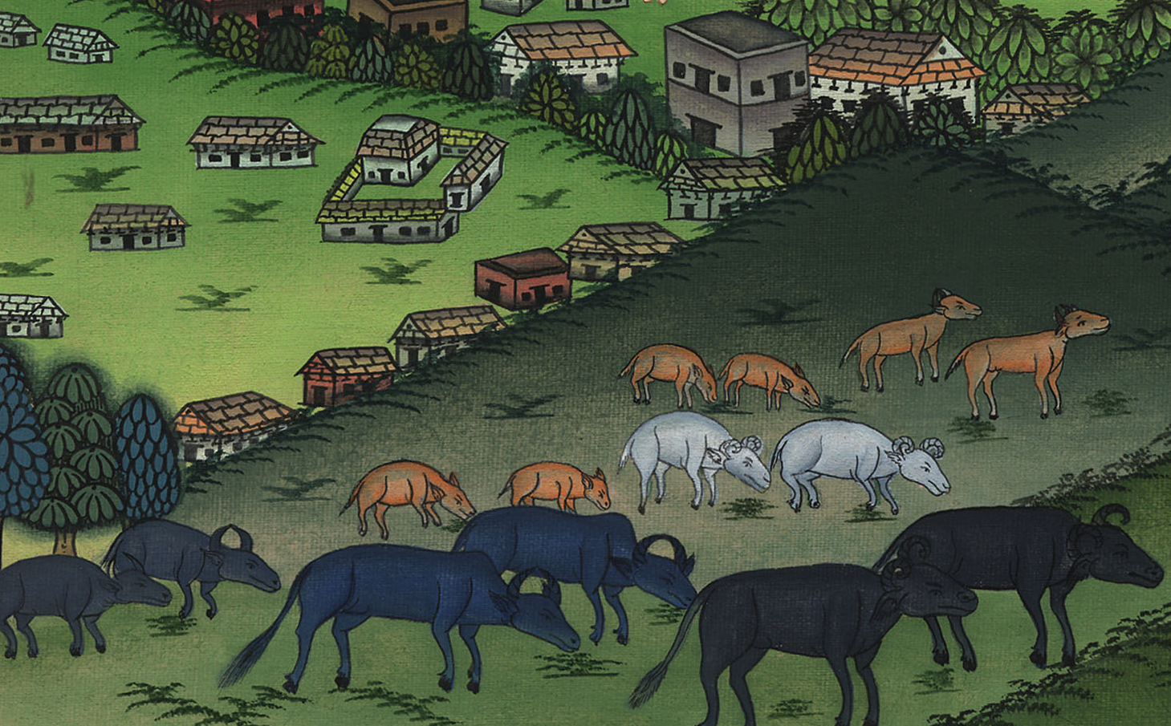
1 Samuel 15:9

Slide 15
10Then Yahweh’s word came to Samuel, saying, 11“It grieves me that I have set up Saul to be king, for he has turned back from following me, and has not performed my commandments.” Samuel was angry; and he cried to Yahweh all night.
1 Samuel

Slide 16
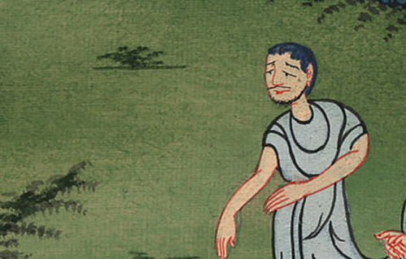
1 Samuel 15:10

Slide 17
12Samuel rose early to meet Saul in the morning; and Samuel was told, saying, “Saul came to Carmel, and behold, he set up a monument for himself, turned, passed on, and went down to Gilgal.”
1 Samuel

Slide 18
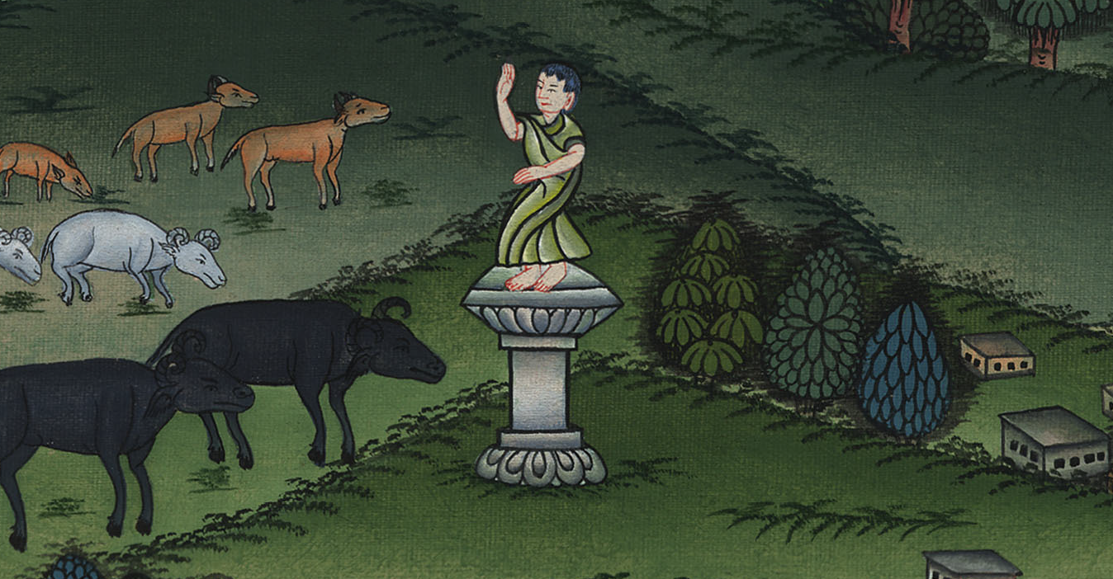
1 Samuel 15:12

Slide 19
13Samuel came to Saul; and Saul said to him, “You are blessed by Yahweh! I have performed the commandment of Yahweh.”
1 Samuel

Slide 20
1 Samuel 15:13

Slide 21
14Samuel said, “Then what does this bleating of the sheep in my ears and the lowing of the cattle which I hear mean?”
1 Samuel

Slide 22
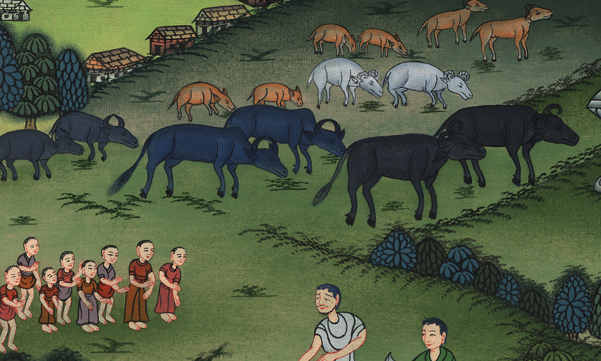
1 Samuel 15:14

Slide 23
15Saul said, “They have brought them from the Amalekites; for the people spared the best of the sheep and of the cattle, to sacrifice to Yahweh your God. We have utterly destroyed the rest.”
1 Samuel

Slide 24
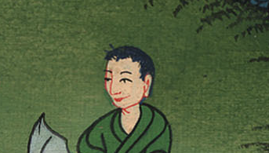
1 Samuel 15:15

Slide 25
16Then Samuel said to Saul, “Stay, and I will tell you what Yahweh said to me last night.”
He said to him, “Say on.”
1 Samuel

Slide 26
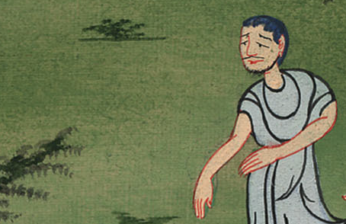
1 Samuel 15:16

Slide 27
19Why then didn’t you obey Yahweh’s voice, but took the plunder, and did that which was evil in Yahweh’s sight?”
1 Samuel

Slide 28
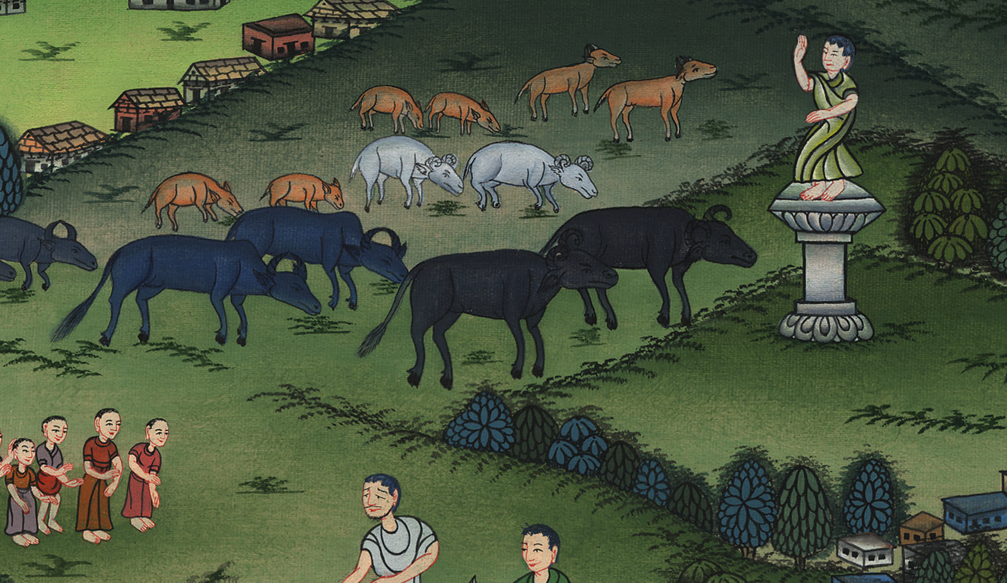
1 Samuel 15:19

Slide 29
20Saul said to Samuel, “But I have obeyed Yahweh’s voice, and have gone the way which Yahweh sent me, and have brought Agag the king of Amalek, and have utterly destroyed the Amalekites. ….(The soldiers took sheep and cattle to sacrifice to the Lord)
1 Samuel

Slide 30
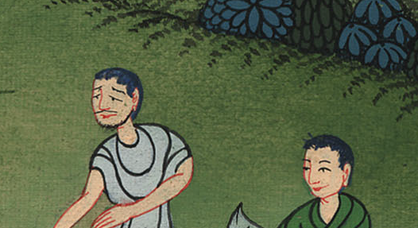
1 Samuel 15:20

Slide 31
22Samuel said, “Has Yahweh as great delight in burnt offerings and sacrifices, as in obeying Yahweh’s voice? Behold, to obey is better than sacrifice, and to listen than the fat of rams.
1 Samuel

Slide 32
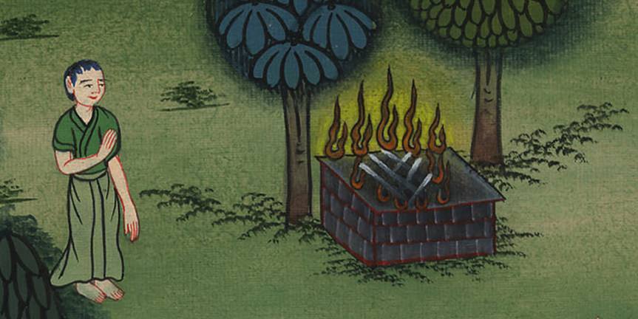
1 Samuel 15:22

Slide 33
23For rebellion is as the sin of witchcraft, and stubbornness is as idolatry and teraphim. Because you have rejected Yahweh’s word, he has also rejected you from being king.”
1 Samuel

Slide 34
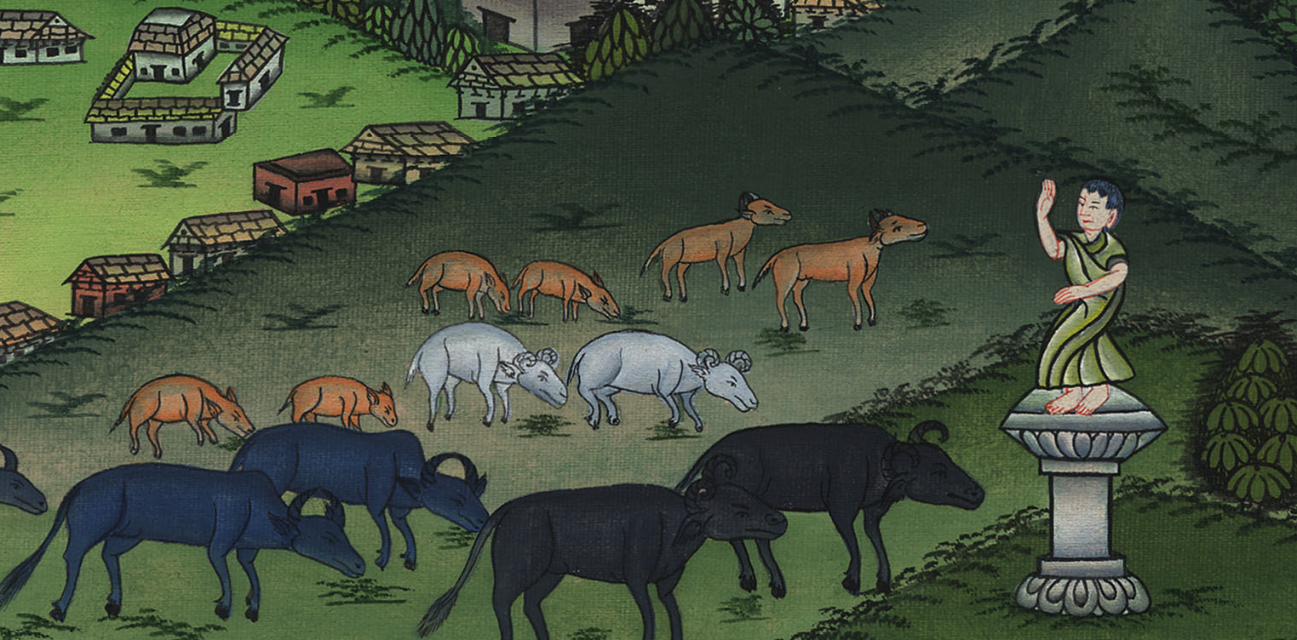
1 Samuel 15:23

Slide 35
27As Samuel turned around to go away, Saul grabbed the skirt of his robe, and it tore.
1 Samuel

Slide 36
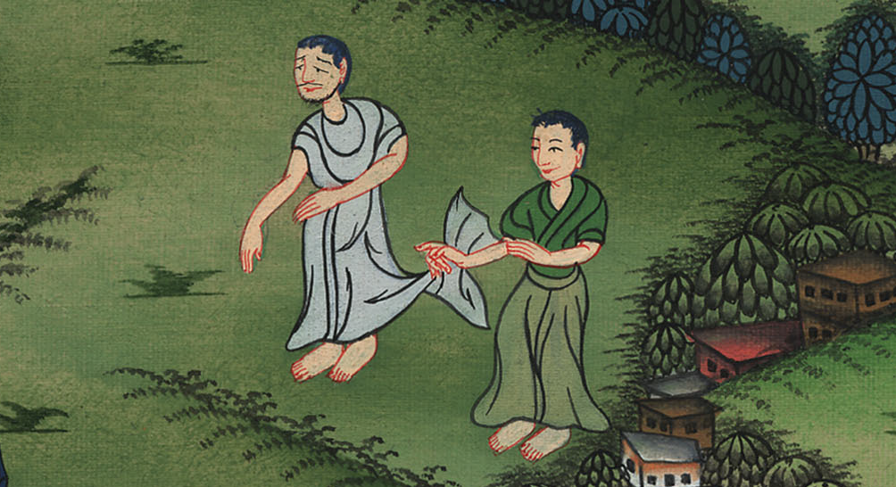
1 Samuel 15:27

Slide 37
28Samuel said to him, “Yahweh has torn the kingdom of Israel from you today, and has given it to a neighbor of yours who is better than you.
1 Samuel

Slide 38
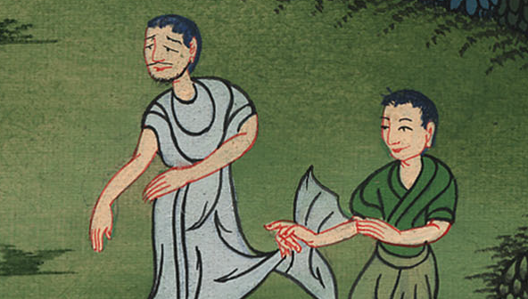
1 Samuel 15:28

Slide 39
35…Yahweh grieved that he had made Saul king over Israel.
1 Samuel

Slide 40
1 Samuel 15:35

