Slide 1
16-7
This work is licensed under a Creative Commons Attribution-Sharealike 4.0 International License.
Please add this statement to all the videos you create.
English Bible quotes are from the World English Bible US, which is in the public domain.
Notes:
ch

Slide 2
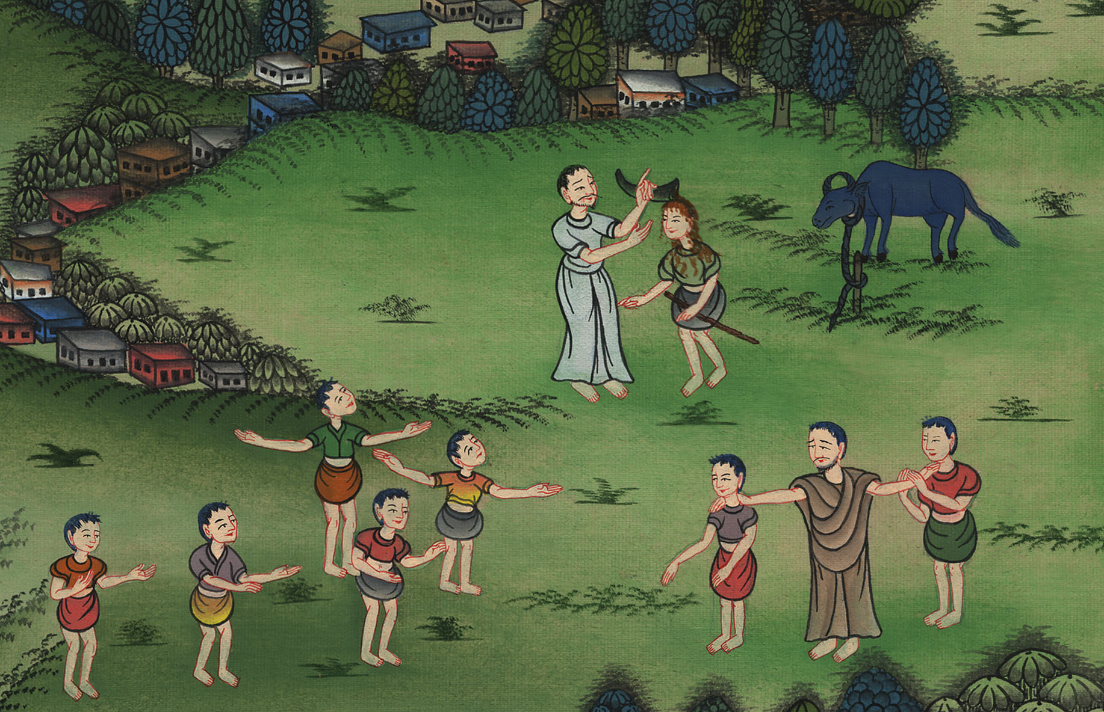
Samuel anoints David –
1 Samuel 16:1-14

Slide 3
7. Samuel anoints David – 1 Samuel 16:1-14 (Center)
1 Samuel
Notes:
16 Saul
1. People demand a King - 1 Samuel 8:4-22 (Left Top)
2. Samuel anoints Saul – 1 Samuel 9:1 – 10:9 (Right Top)
3. Election of Saul as King – 1 Samuel 10:17-27 (Right Center)
4. Address at Gilgal - 1 Samuel 11:14 – 12:25 (Right Bottom)
5. Saul doesn’t wait for Samuel – 1 Samuel 13:5-14 (Left Bottom)
6. Saul’s Disobedience – 1 Samuel 15:1-35 (Left Center)
7. Samuel anoints David – 1 Samuel 16:1-14 (Center)

Slide 4
Samuel anoints David –
1 Samuel 16:1-14

Slide 5
1Samuel16:1Yahweh said to Samuel, “How long will you mourn for Saul, since I have rejected him from being king over Israel? Fill your horn with oil, and go. I will send you to Jesse the Bethlehemite, for I have provided a king for myself among his sons.”
1 Samuel

Slide 6
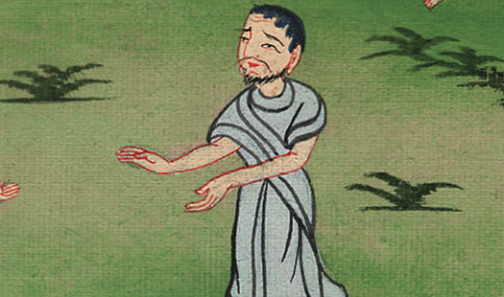
1 Samuel 16:1

Slide 7
2Samuel said, “How can I go? If Saul hears it, he will kill me.”
Yahweh said, “Take a heifer with you, and say, ‘I have come to sacrifice to Yahweh.’
1 Samuel

Slide 8
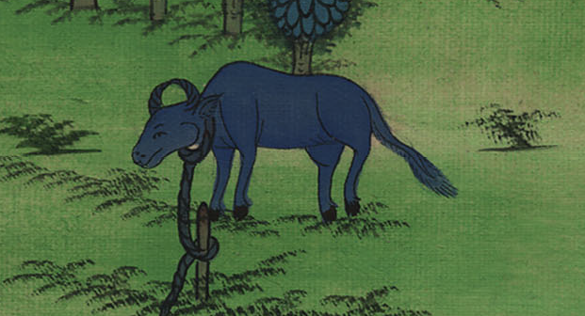
1 Samuel 16:2

Slide 9
3Call Jesse to the sacrifice, and I will show you what you shall do. You shall anoint to me him whom I name to you.”
1 Samuel

Slide 10
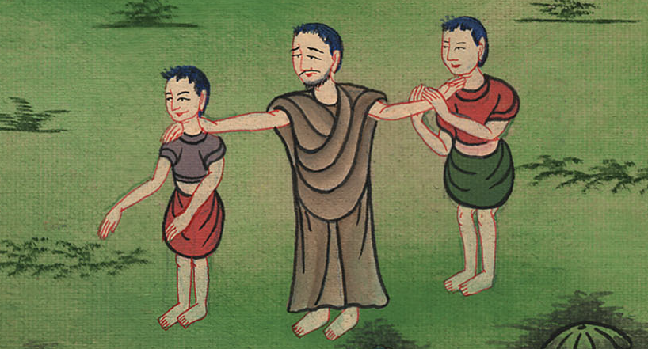
1 Samuel 16:3

Slide 11
4Samuel did that which Yahweh spoke, and came to Bethlehem. The elders of the city came to meet him trembling, and said, “Do you come peaceably?”
1 Samuel

Slide 12
1 Samuel 16:4

Slide 13
5He said, “Peaceably; I have come to sacrifice to Yahweh. Sanctify yourselves, and come with me to the sacrifice.” He sanctified Jesse and his sons, and called them to the sacrifice.
1 Samuel

Slide 14
1 Samuel 16:5

Slide 15
6When they had come, he looked at Eliab, and said, “Surely Yahweh’s anointed is before him.”
1 Samuel

Slide 16
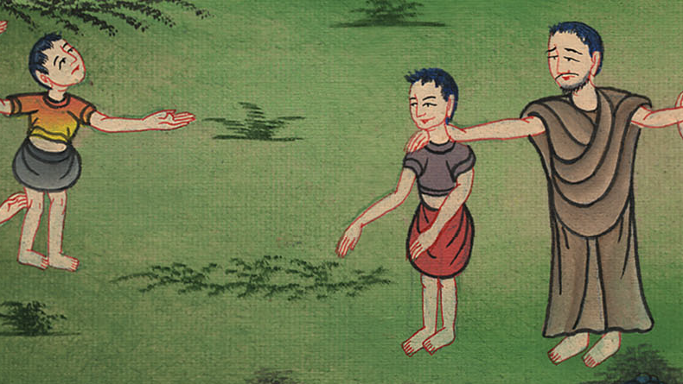
1 Samuel 16:6

Slide 17
7But Yahweh said to Samuel, “Don’t look on his face, or on the height of his stature, because I have rejected him; for I don’t see as man sees. For man looks at the outward appearance, but Yahweh looks at the heart.”
1 Samuel

Slide 18
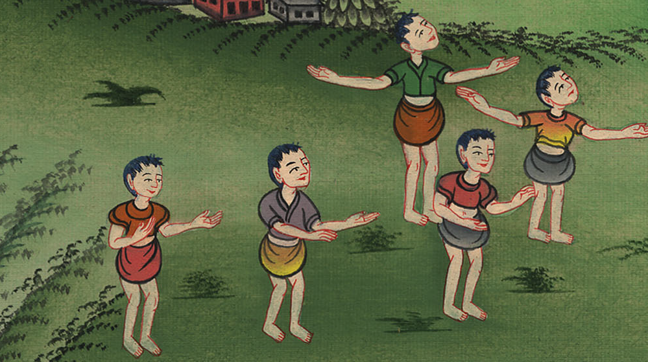
1 Samuel 16:7

Slide 19
8Then Jesse called Abinadab, and made him pass before Samuel. He said, “Yahweh has not chosen this one, either.”
1 Samuel

Slide 20
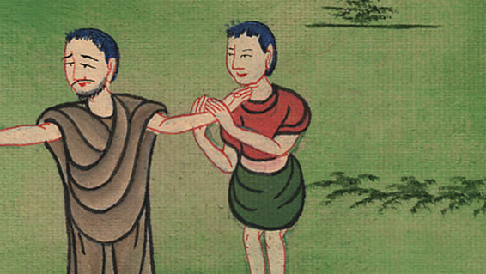
1 Samuel 16:8

Slide 21
9Then Jesse made Shammah to pass by. He said, “Yahweh has not chosen this one, either.”
1 Samuel

Slide 22
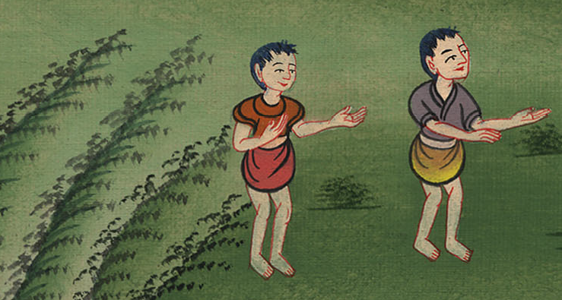
1 Samuel 16:9

Slide 23
10Jesse made seven of his sons to pass before Samuel. Samuel said to Jesse, “Yahweh has not chosen these.”
1 Samuel

Slide 24
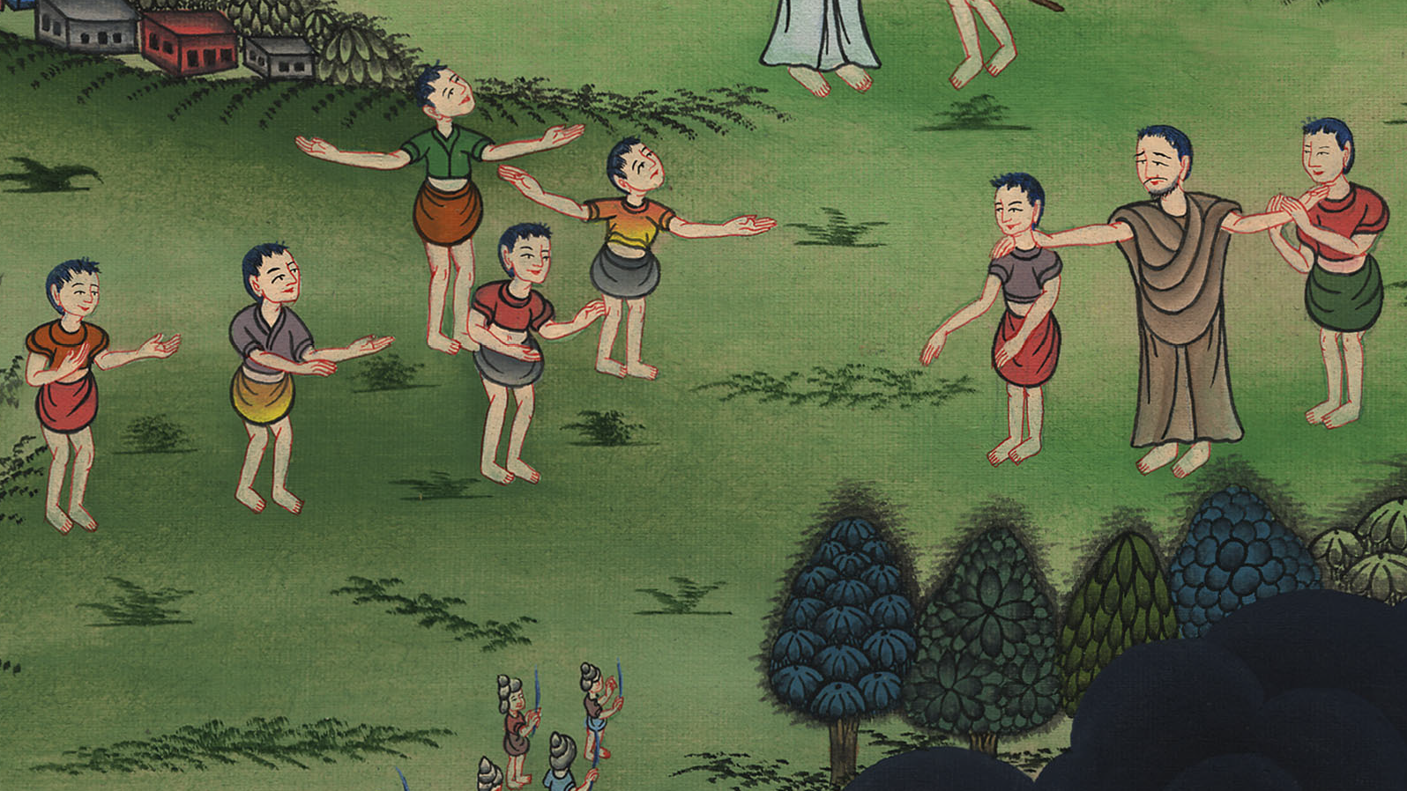
1 Samuel 16:10

Slide 25
11Samuel said to Jesse, “Are all your children here?”
He said, “There remains yet the youngest. Behold, he is keeping the sheep.”
Samuel said to Jesse, “Send and get him, for we will not sit down until he comes here.”
1 Samuel

Slide 26
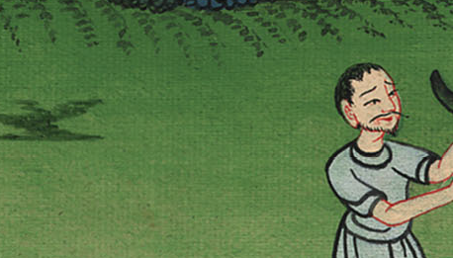
1 Samuel 16:11

Slide 27
12He sent, and brought him in. Now he was ruddy, with a handsome face and good appearance. Yahweh said, “Arise! Anoint him, for this is he.”
1 Samuel

Slide 28
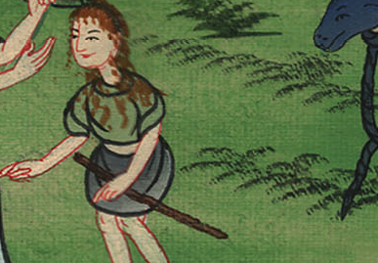
1 Samuel 16:12

Slide 29
13Then Samuel took the horn of oil and anointed him in the middle of his brothers. Then Yahweh’s Spirit came mightily on David from that day forward. So Samuel rose up and went to Ramah.
1 Samuel

Slide 30
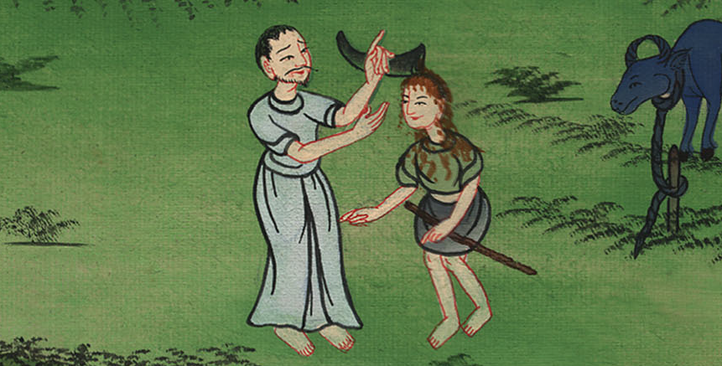
1 Samuel 16:13

