Slide 1
17-1
This work is licensed under a Creative Commons Attribution-Sharealike 4.0 International License.
Please add this statement to all the videos you create.
English Bible quotes are from the World English Bible US, which is in the public domain.
Notes:
ch

Slide 2
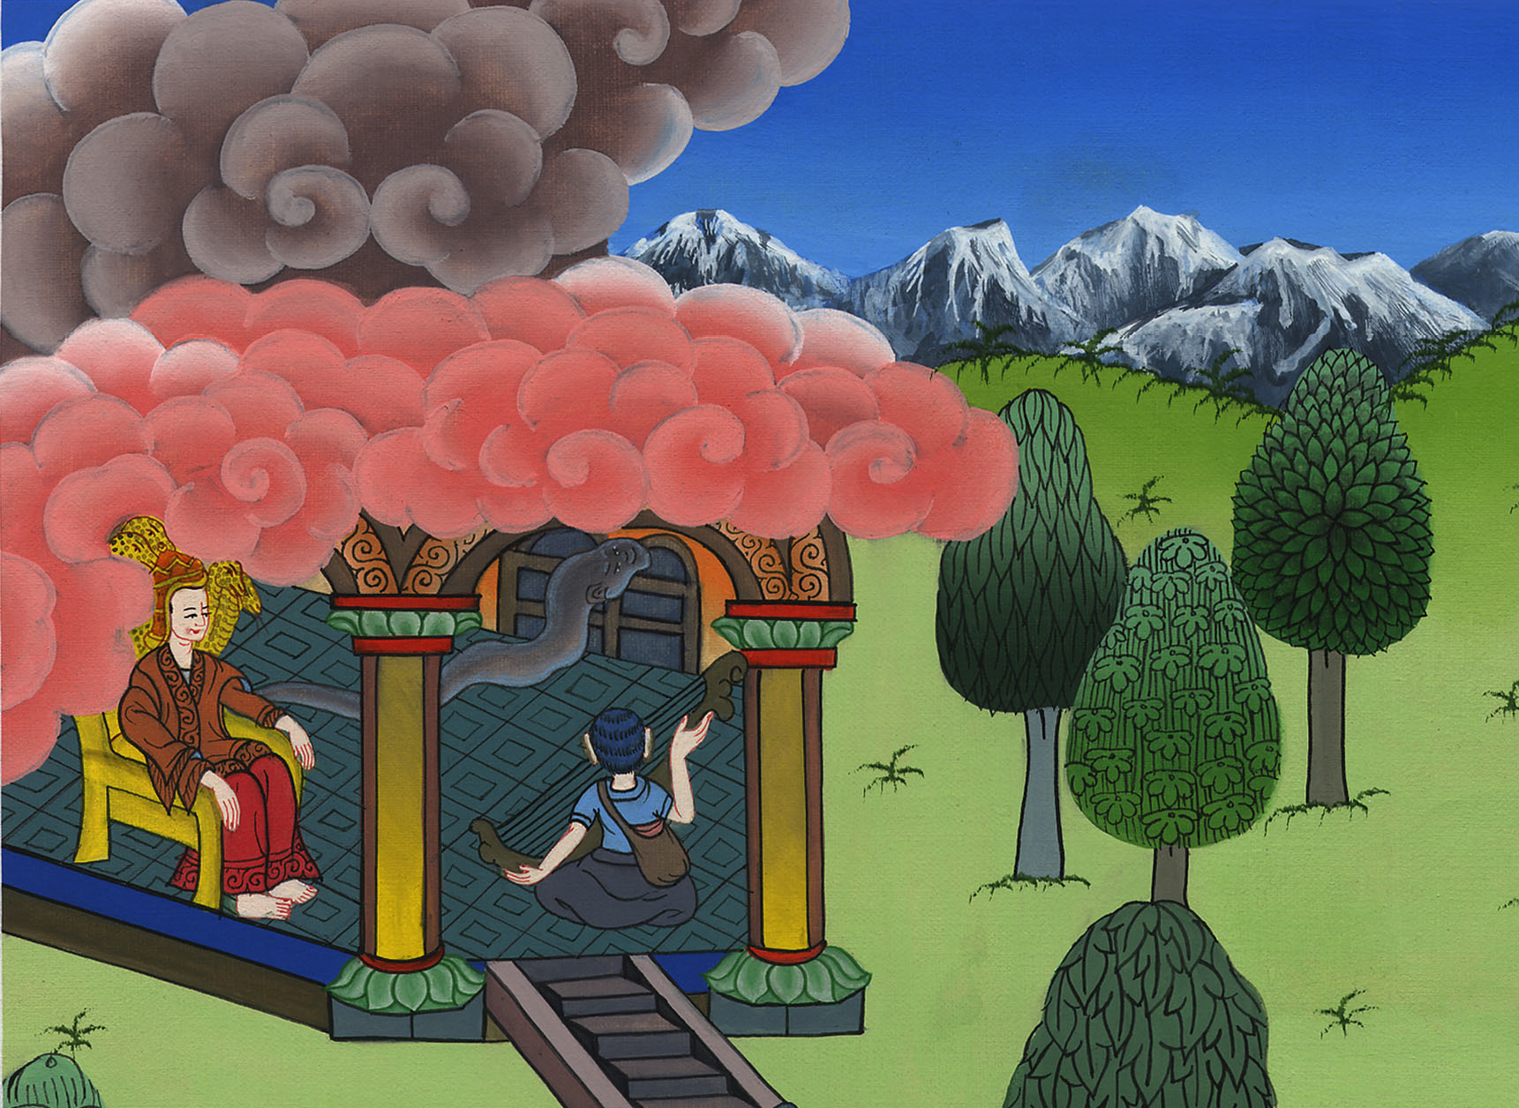
David plays before the king –
1 Samuel 16:14-23

Slide 3
David and Saul
1. David plays before the king - 1 Samuel 16:14-23 (Left Top)
Notes:
17 Saul and David
1. David plays before the king - 1 Samuel 16:14-23 (Left Top)
2. David and Goliath - 1 Sam 17 (Center)
3. David’s popularity & Saul’s jealousy - 1 Sam 18:5-16,29-30 (Center Top)
4. David's marries Saul’s daughter - 1 Sam 18:17-28 (Right Top)
5. Saul throws a spear at David - 1 Sam 19:8-10 (Right Center)
6. Michal helps David escape - 1 Sam 19:11-17 (Right Bottom)
7. David's escape to Ramah -1 Sam 19:18-24 (Center Bottom)
8. Saul tries to kill Jonathan -1 Sam 18:1-4; 19:1-7; 20:1-34 (Left Bottom)
9. Jonathan warns David - 1 Sam 20:35-42 (Left Center)

Slide 4
David plays before the king –
1 Samuel 16:14-23

Slide 5
1Samuel16:14Now Yahweh’s Spirit departed from Saul, and an evil spirit from Yahweh troubled him.

Slide 6
1 Samuel 16:14

Slide 7
15Saul’s servants said to him, “See now, an evil spirit from God troubles you.

Slide 8
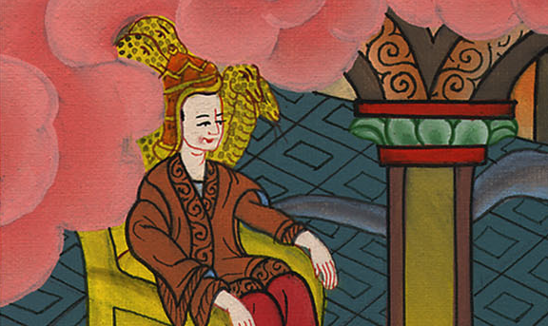
1 Samuel 16:15

Slide 9
16Let our lord now command your servants who are in front of you to seek out a man who is a skillful player on the harp. Then when the evil spirit from God is on you, he will play with his hand, and you will be well.”

Slide 10
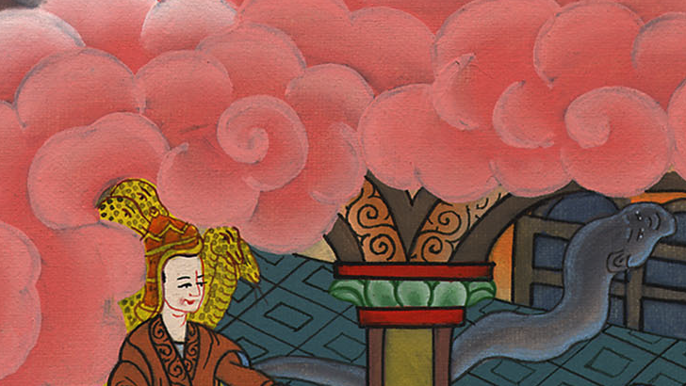
1 Samuel 16:16

Slide 11
17Saul said to his servants, “Provide me now a man who can play well, and bring him to me.”

Slide 12
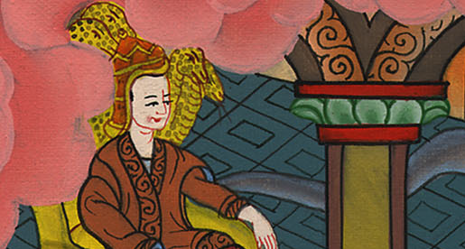
1 Samuel 16:17

Slide 13
8Then one of the young men answered and said, “Behold, I have seen a son of Jesse the Bethlehemite who is skillful in playing, a mighty man of valor, a man of war, prudent in speech, and a handsome person; and Yahweh is with him.”

Slide 14
1 Samuel 16:18

Slide 15
19Therefore Saul sent messengers to Jesse, and said, “Send me David your son, who is with the sheep.”

Slide 16
1 Samuel 16:19

Slide 17
20Jesse took a donkey loaded with bread, a container of wine, and a young goat, and sent them by David his son to Saul.

Slide 18
1 Samuel 16:20

Slide 19
21David came to Saul and stood before him. He loved him greatly; and he became his armor bearer.

Slide 20
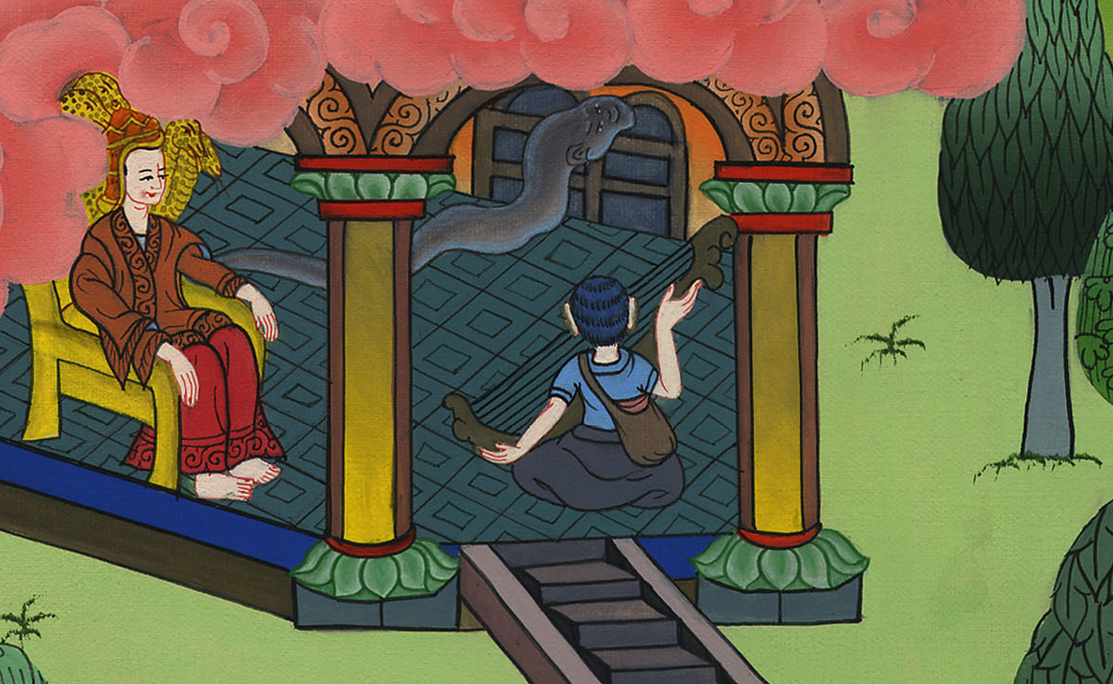
1 Samuel 16:21

Slide 21
22Saul sent to Jesse, saying, “Please let David stand before me, for he has found favor in my sight.”

Slide 22
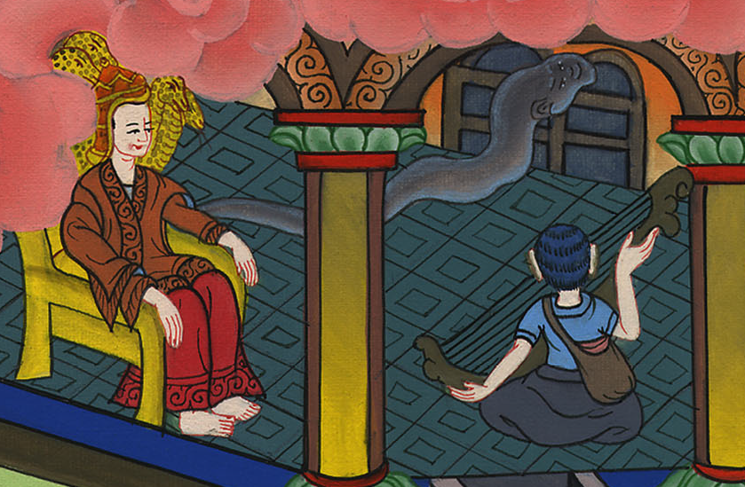
1 Samuel 16:22

Slide 23
23When the spirit from God was on Saul, David took the harp and played with his hand; so Saul was refreshed and was well, and the evil spirit departed from him.

Slide 24
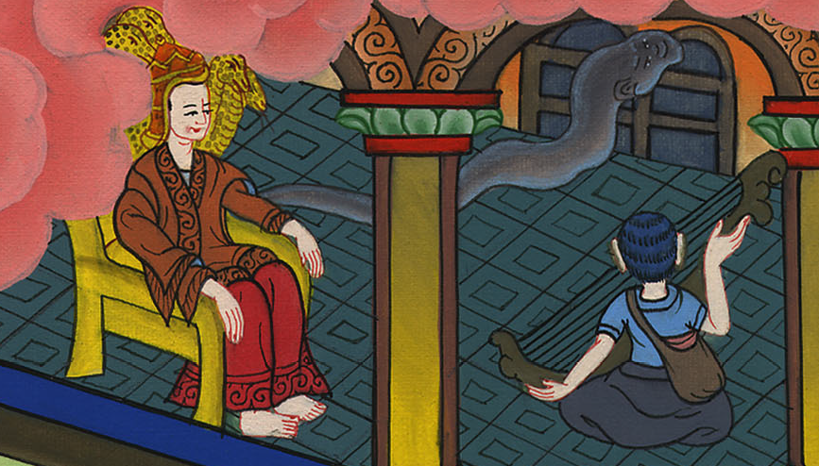
1 Samuel 16:23

