Slide 1
17-2
This work is licensed under a Creative Commons Attribution-Sharealike 4.0 International License.
Please add this statement to all the videos you create.
English Bible quotes are from the World English Bible US, which is in the public domain.
Notes:
ch

Slide 2
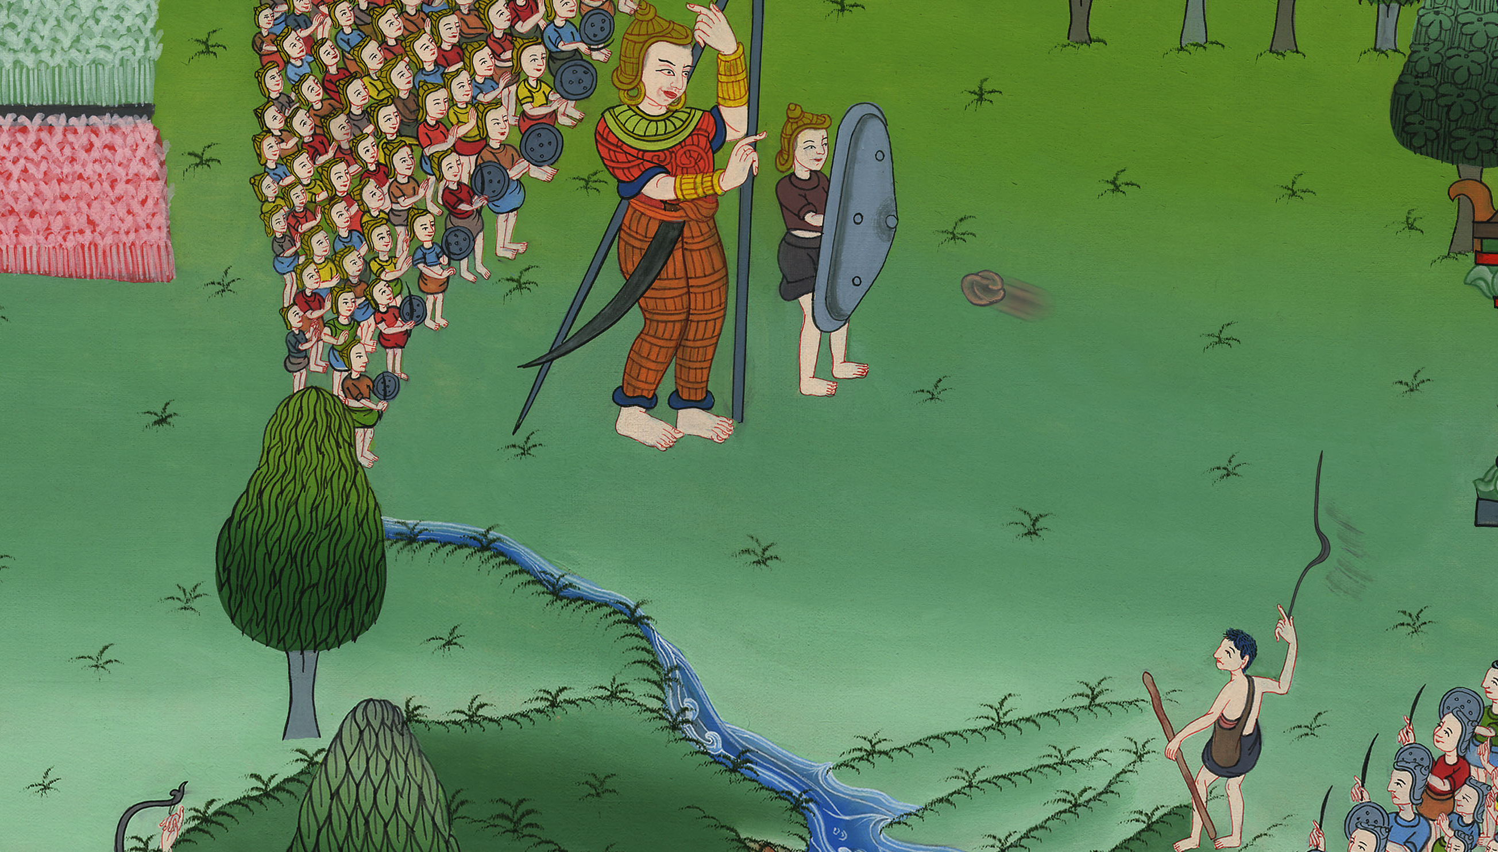
Goliath challenges the Israelites –
1 Samuel 17

Slide 3
2. Goliath challenges the Israelites - 1 Samuel 17 (Center)
Notes:
17 Saul and David
1. David plays before the king - 1 Samuel 16:14-23 (Left Top)
2. Goliath challenges the Israelites 1 Sam 17 (Center)
3. David defeats Goliath 1 Sam 17
4. David’s popularity & Saul’s jealousy - 1 Sam 18:5-16,29-30 (Center Top)
5. David's marries Saul’s daughter - 1 Sam 18:17-28 (Right Top)
6. Saul throws a spear at David - 1 Sam 19:8-10 (Right Center)
7. Michal helps David escape - 1 Sam 19:11-17 (Right Bottom)
8. David's escape to Ramah -1 Sam 19:18-24 (Center Bottom)
9. Saul tries to kill Jonathan -1 Sam 18:1-4; 19:1-7; 20:1-34 (Left Bottom)
10. Jonathan warns David - 1 Sam 20:35-42 (Left Center)

Slide 4
Goliath challenges the Israelites –
1 Samuel 17

Slide 5
1 Samuel17:1Now the Philistines gathered together their armies to battle; and they were gathered together at Socoh, which belongs to Judah,

Slide 6
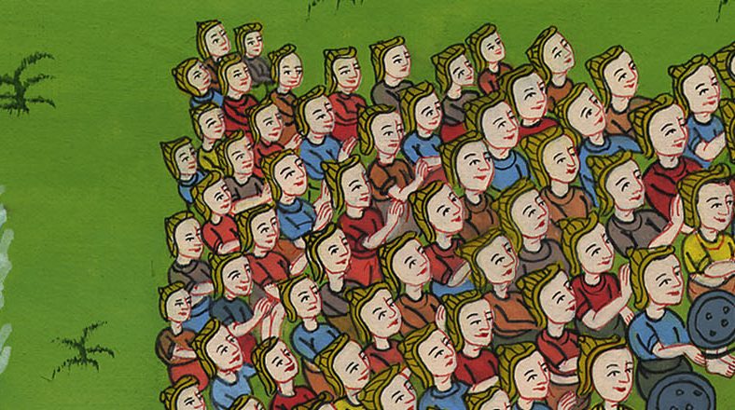
1 Samuel 17:1

Slide 7
2Saul and the men of Israel were gathered together, and encamped in the valley of Elah, and set the battle in array against the Philistines.

Slide 8
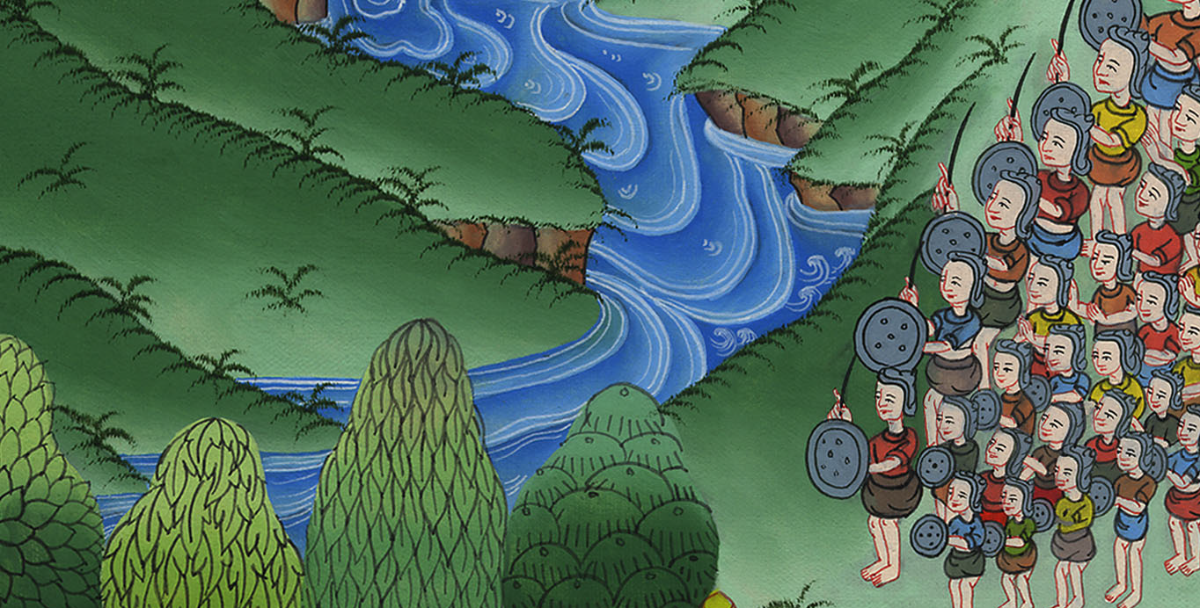
1 Samuel 17:2

Slide 9
4A champion out of the camp of the Philistines named Goliath of Gath, whose height was six cubits and a span (more than 9 feet) went out.

Slide 10
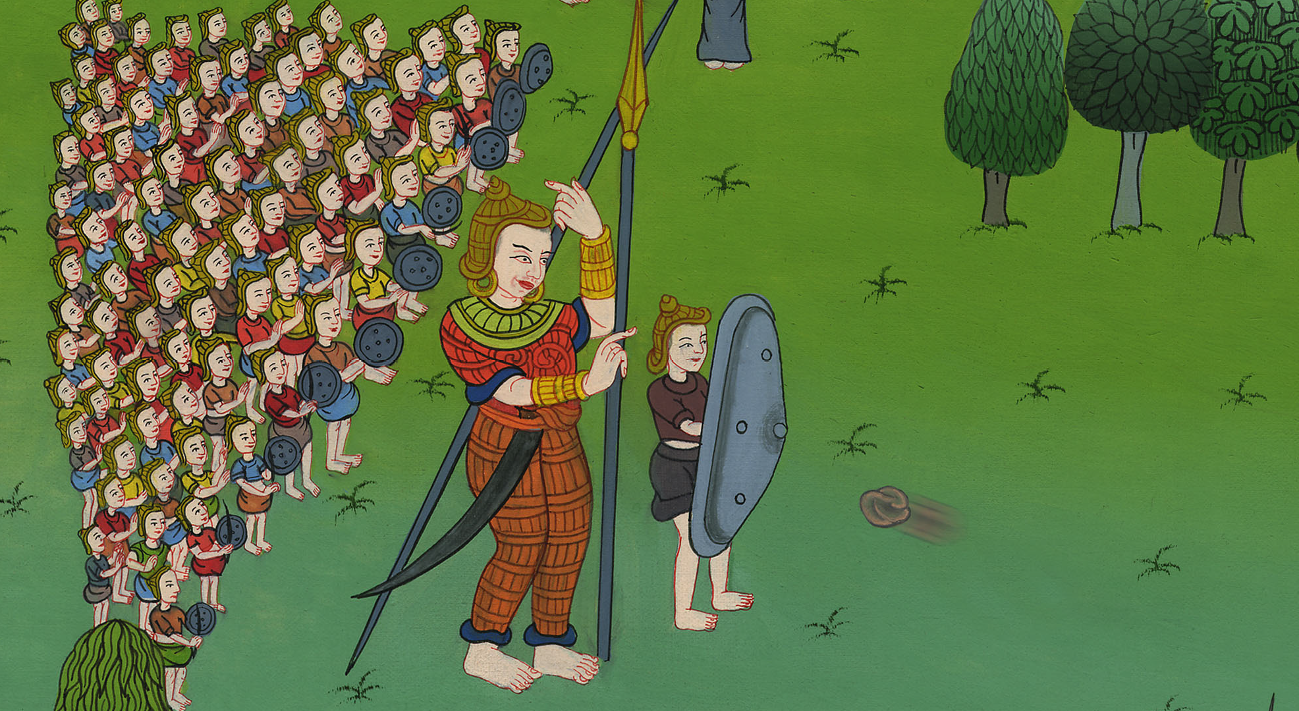
1 Samuel 17:4

Slide 11
8He stood and cried to the armies of Israel, and said to them, “Why have you come out to set your battle in array? Am I not a Philistine, and you servants to Saul? Choose a man for yourselves, and let him come down to me.

Slide 12
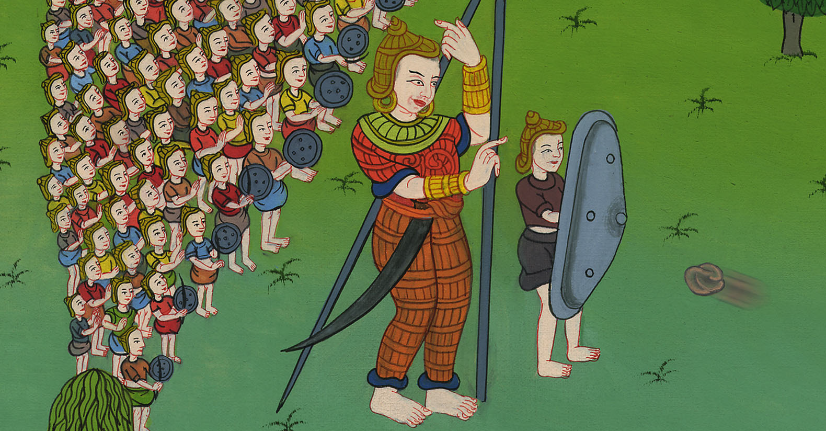
1 Samuel 17:8

Slide 13
9If he is able to fight with me and kill me, then will we be your servants; but if I prevail against him and kill him, then you will be our servants and serve us.”

Slide 14
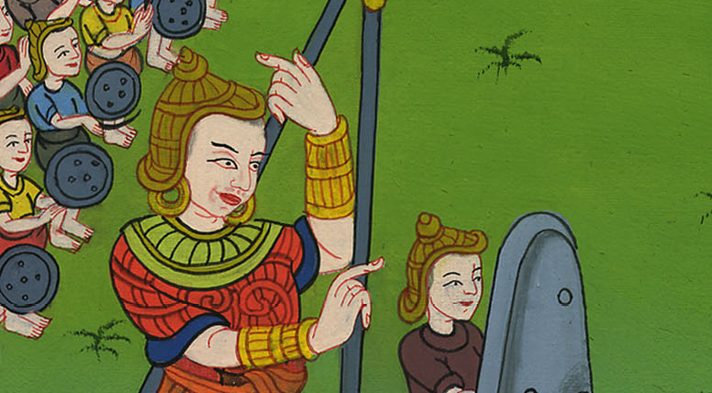
1 Samuel 17:9

Slide 15
11When Saul and all Israel heard those words of the Philistine, they were dismayed and greatly afraid.

Slide 16
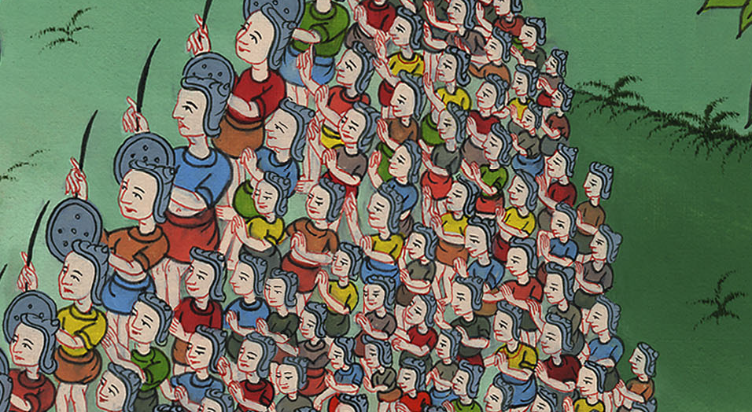
1 Samuel 17:11

Slide 17
16The Philistine came near morning and evening, and presented himself forty days.

Slide 18
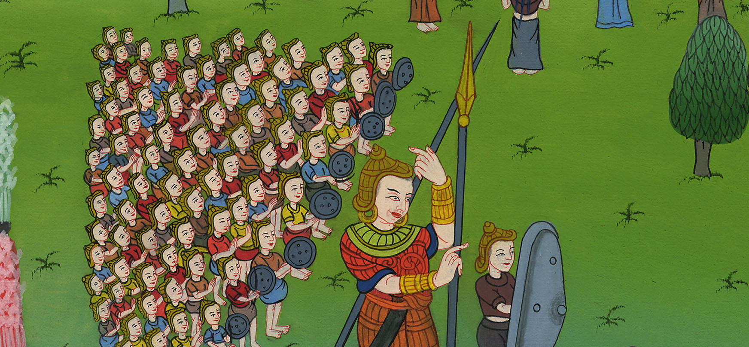
1 Samuel 17:16

