Slide 1
17-3
This work is licensed under a Creative Commons Attribution-Sharealike 4.0 International License.
Please add this statement to all the videos you create.
English Bible quotes are from the World English Bible US, which is in the public domain.
Notes:
ch

Slide 2
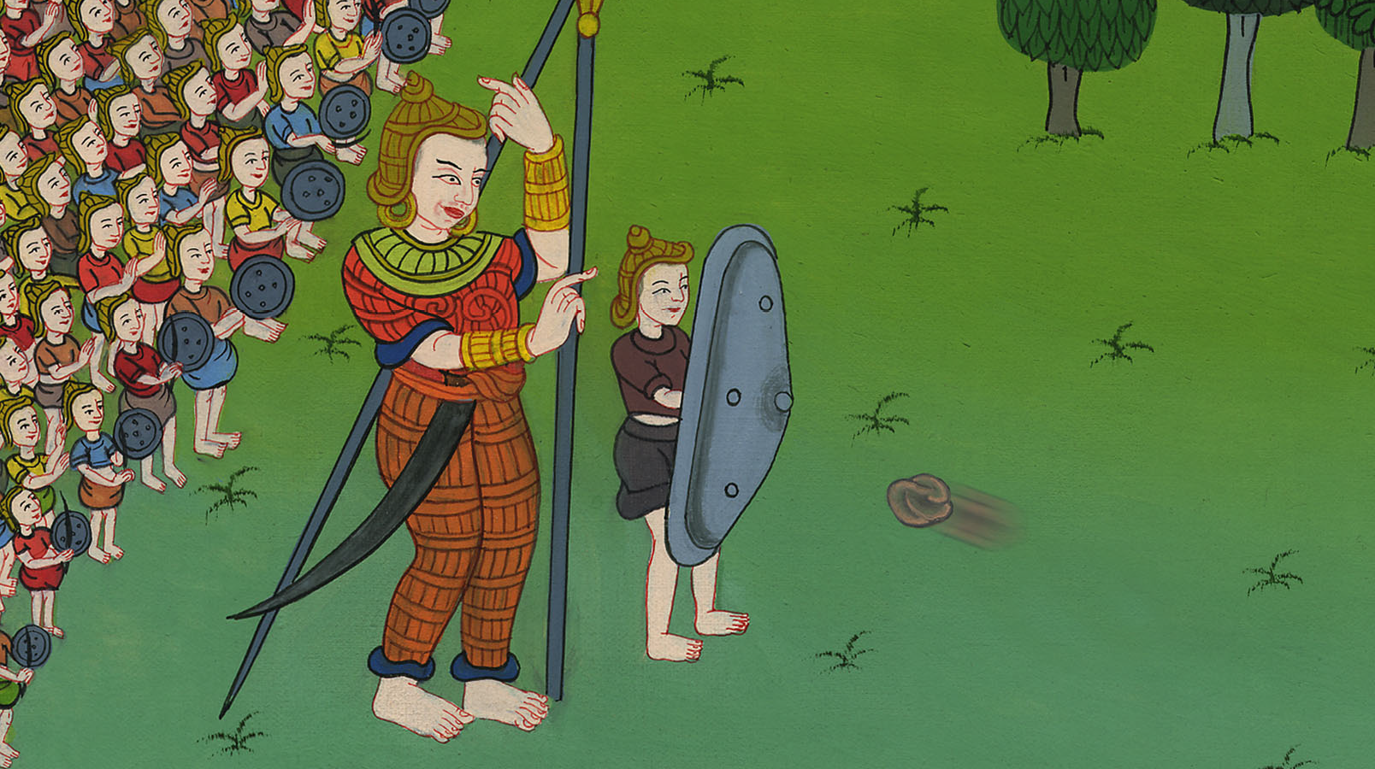
David defeats Goliath –
1 Samuel 17

Slide 3
2. David defeats Goliath - 1 Samuel 17 (Center)
Notes:
17 Saul and David
1. David plays before the king - 1 Samuel 16:14-23 (Left Top)
2. David and Goliath - 1 Sam 17 (Center)
3. David’s popularity & Saul’s jealousy - 1 Sam 18:5-16,29-30 (Center Top)
4. David's marries Saul’s daughter - 1 Sam 18:17-28 (Right Top)
5. Saul throws a spear at David - 1 Sam 19:8-10 (Right Center)
6. Michal helps David escape - 1 Sam 19:11-17 (Right Bottom)
7. David's escape to Ramah -1 Sam 19:18-24 (Center Bottom)
8. Saul tries to kill Jonathan -1 Sam 18:1-4; 19:1-7; 20:1-34 (Left Bottom)
9. Jonathan warns David - 1 Sam 20:35-42 (Left Center)

Slide 4
David defeats Goliath –
1 Samuel 17

Slide 5
Jesse’s three sons were also there. David stayed at home and looked after the sheep.

Slide 6
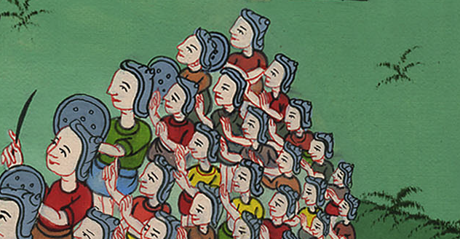

Slide 7
17Jesse said to David his son, “Now take for your brothers an ephah of this parched grain and these ten loaves, and carry them quickly to the camp to your brothers; 18… and see how your brothers are doing, and bring back news.”

Slide 8
1 Samuel 17:17

Slide 9
23As he talked with them, behold, the champion, the Philistine of Gath, Goliath by name, came up out of the ranks of the Philistines, and said the same words; and David heard them.

Slide 10
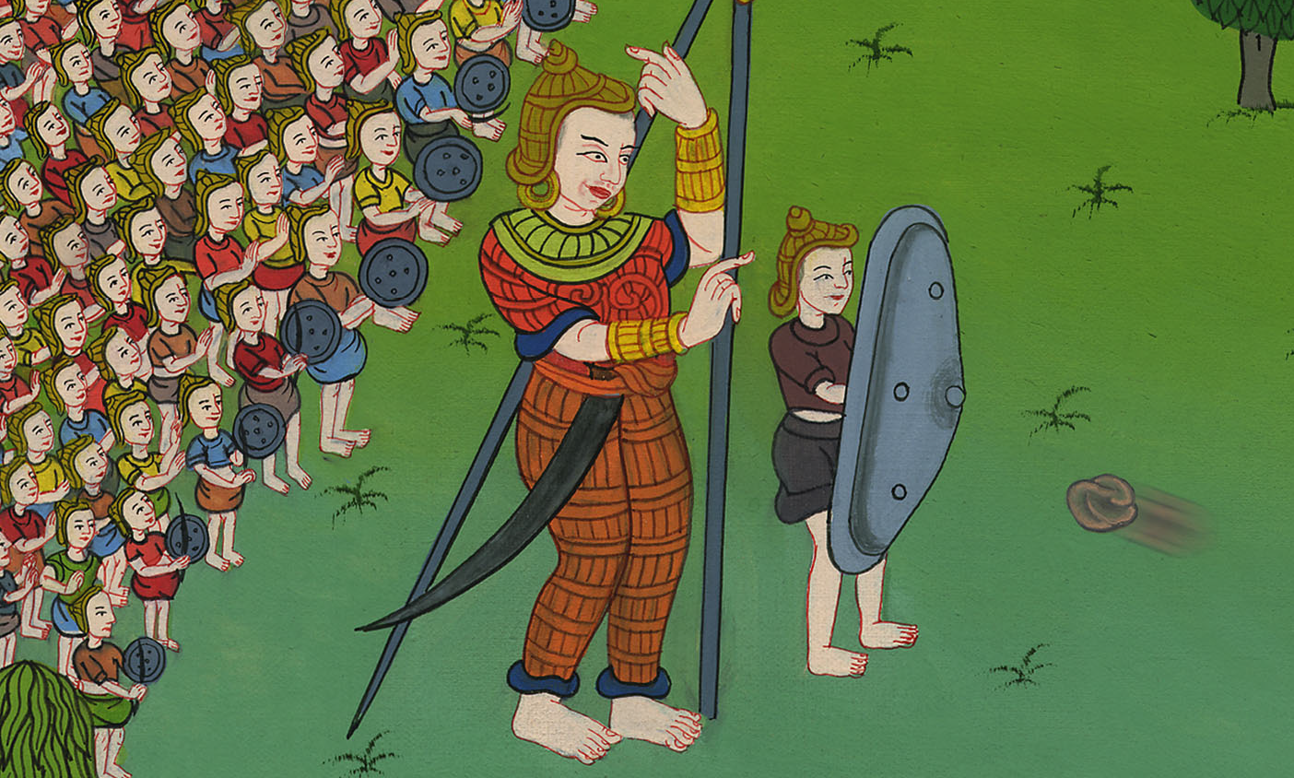
1 Samuel 17:23

Slide 11
26David spoke to the men who stood by him, saying, “What shall be done to the man who kills this Philistine and takes away the reproach from Israel? For who is this uncircumcised Philistine, that he should defy the armies of the living God?”

Slide 12
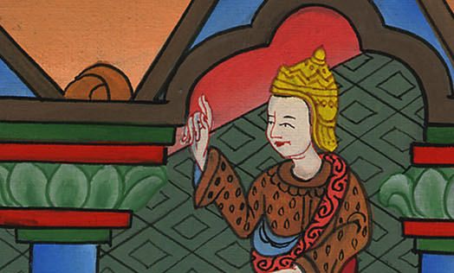
1 Samuel 17:26

Slide 13
25The men of Israel said, “Have you seen this man who has come up? He has surely come up to defy Israel. The king will give great riches to the man who kills him, and will give him his daughter, and will make his father’s house tax-free in Israel.”

Slide 14
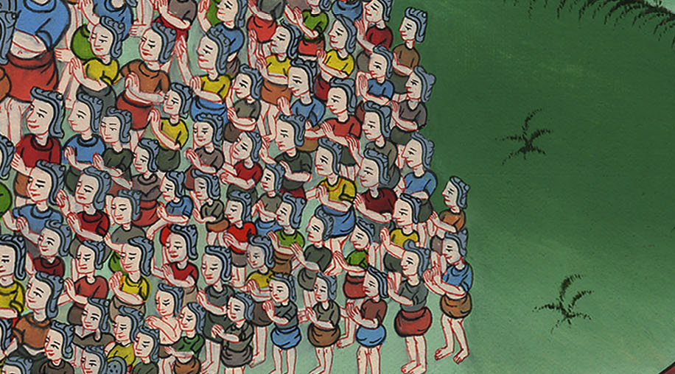
1 Samuel 17:25

Slide 15
31When the words were heard which David spoke, they rehearsed (reported) them before Saul; and he sent for him.

Slide 16
1 Samuel 17:31

Slide 17
32David said to Saul, “Let no man’s heart fail because of him. Your servant will go and fight with this Philistine.”
33Saul said to David, “You are not able to go against this Philistine to fight with him; for you are but a youth, and he a man of war from his youth.”

Slide 18
1 Samuel 17:32

Slide 19
34David said to Saul, “Your servant was keeping his father’s sheep; and when a lion or a bear came and took a lamb out of the flock, 35I went out after him, struck him, and rescued it out of his mouth. When he arose against me, I caught him by his beard, struck him, and killed him.

Slide 20
1 Samuel 17:34

Slide 21
37David said, “Yahweh, who delivered me out of the paw of the lion and out of the paw of the bear, will deliver me out of the hand of this Philistine.”

Slide 22
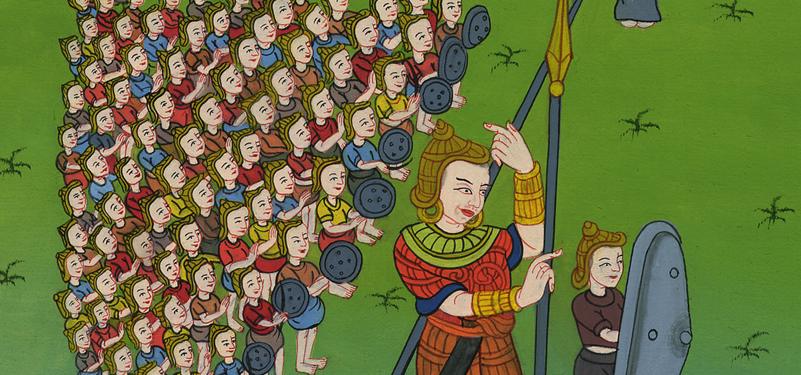
1 Samuel 17:37

Slide 23
38Saul dressed David with his clothing. He put a helmet of bronze on his head, and he clad him with a coat of mail.

Slide 24
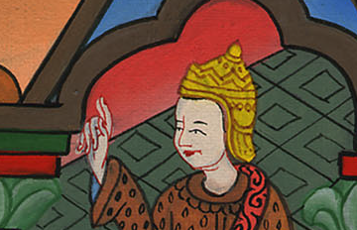
1 Samuel 17:38

Slide 25
39David strapped his sword on his clothing and he tried to move, for he had not tested it. David said to Saul, “I can’t go with these, for I have not tested them.” Then David took them off.

Slide 26
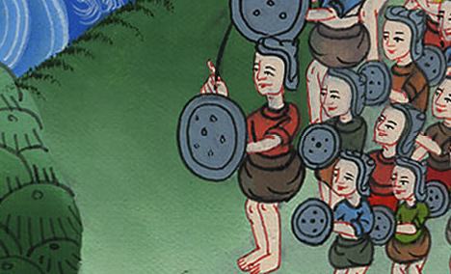
1 Samuel 17:39

Slide 27
40He took his staff in his hand, and chose for himself five smooth stones out of the brook, and put them in the pouch of his shepherd’s bag which he had. His sling was in his hand; and he came near to the Philistine.

Slide 28
1 Samuel 17:40

Slide 29
41The Philistine walked and came near to David; and the man who bore the shield went before him.

Slide 30
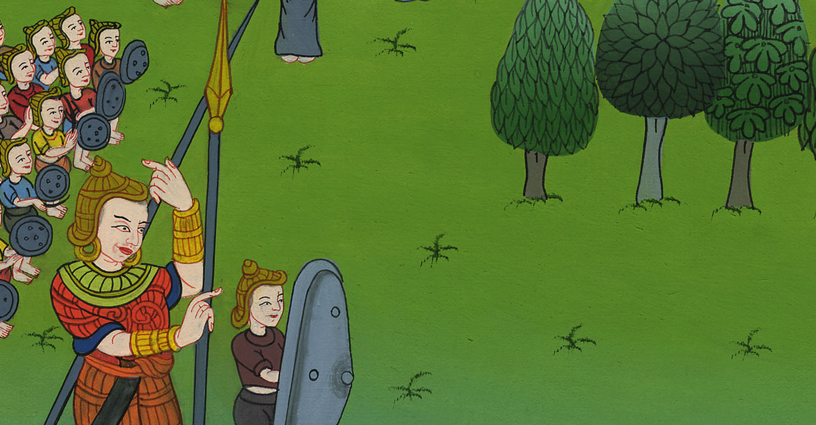
1 Samuel 17:41

Slide 31
42When the Philistine looked around and saw David, he disdained him; for he was but a youth, and ruddy, and had a good looking face.

Slide 32
1 Samuel 17:42

Slide 33
43The Philistine said to David, “Am I a dog, that you come to me with sticks?” The Philistine cursed David by his gods.

Slide 34
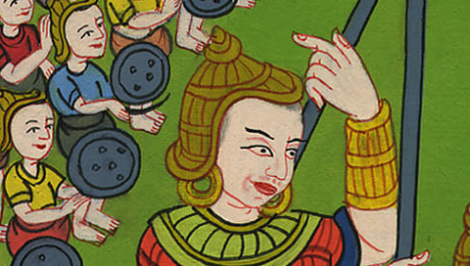
1 Samuel 17:43

Slide 35
45Then David said to the Philistine, “You come to me with a sword, with a spear, and with a javelin; but I come to you in the name of Yahweh of Armies, the God of the armies of Israel, whom you have defied.

Slide 36
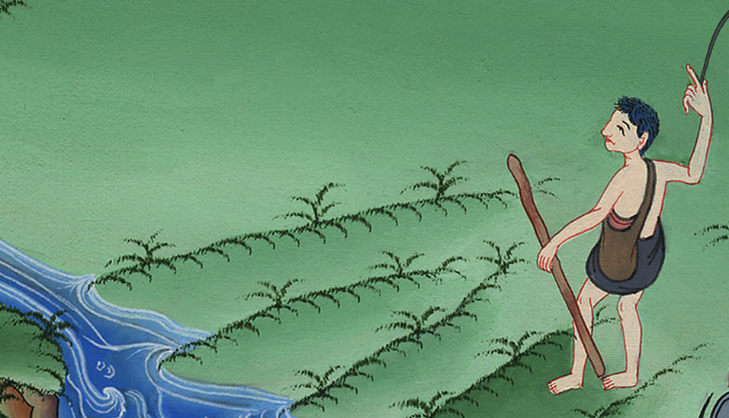
1 Samuel 17:45

Slide 37
46Today, Yahweh will deliver you into my hand. I will strike you and take your head from off you. I will give the dead bodies of the army of the Philistines today to the birds of the sky and to the wild animals of the earth, that all the earth may know that there is a God in Israel,

Slide 38
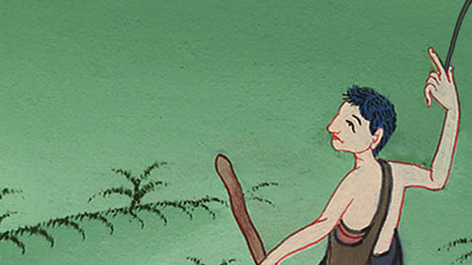
1 Samuel 17:46

Slide 39
48When the Philistine arose, and walked and came near to meet David, David hurried and ran toward the army to meet the Philistine.

Slide 40
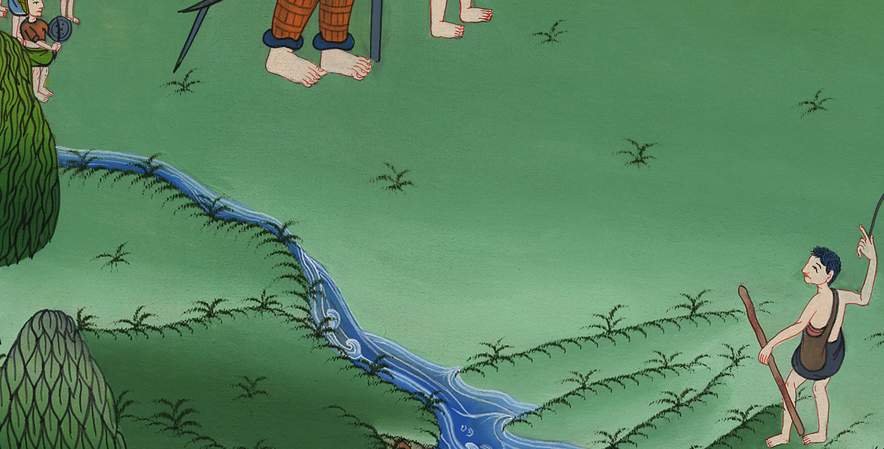
1 Samuel 17:48

Slide 41
49David put his hand in his bag, took a stone and slung it, and struck the Philistine in his forehead. The stone sank into his forehead, and he fell on his face to the earth.

Slide 42
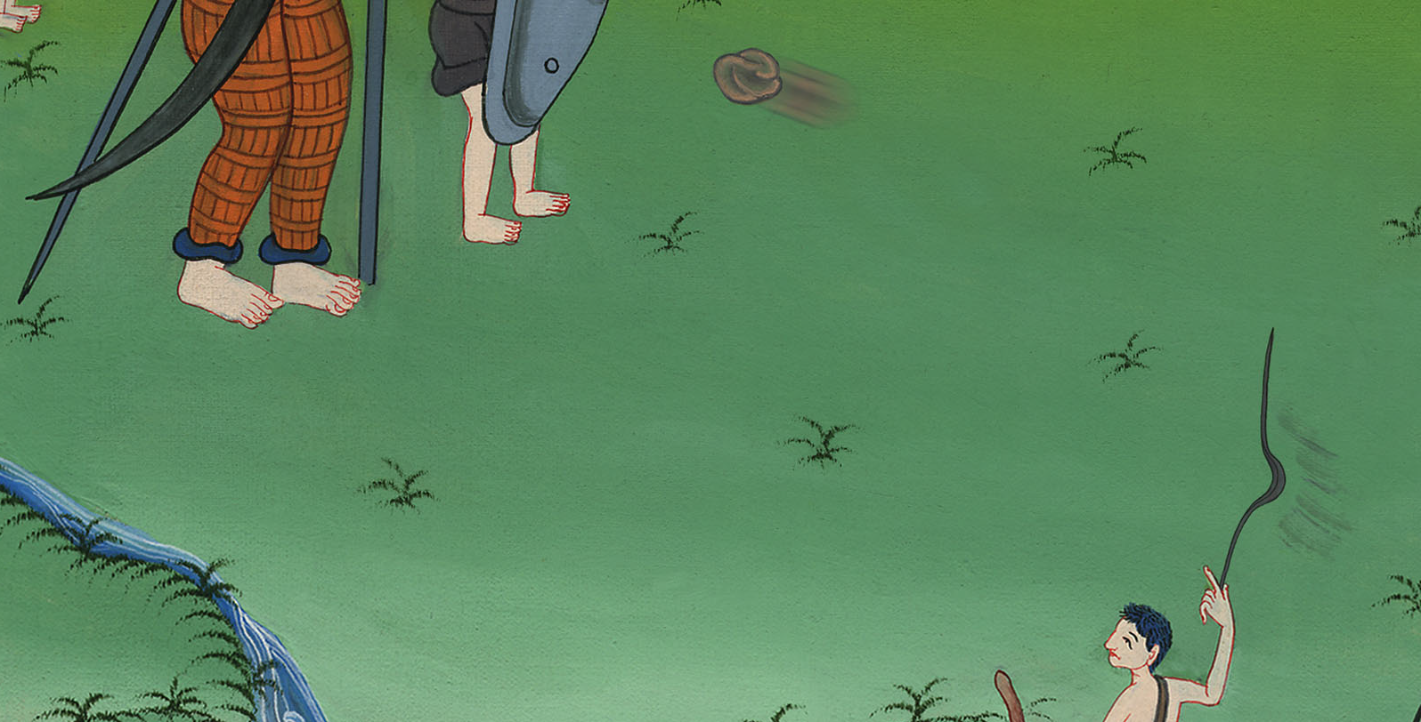
1 Samuel 17:49

Slide 43
50So David prevailed over the Philistine with a sling and with a stone, and struck the Philistine and killed him; but there was no sword in David’s hand.

Slide 44
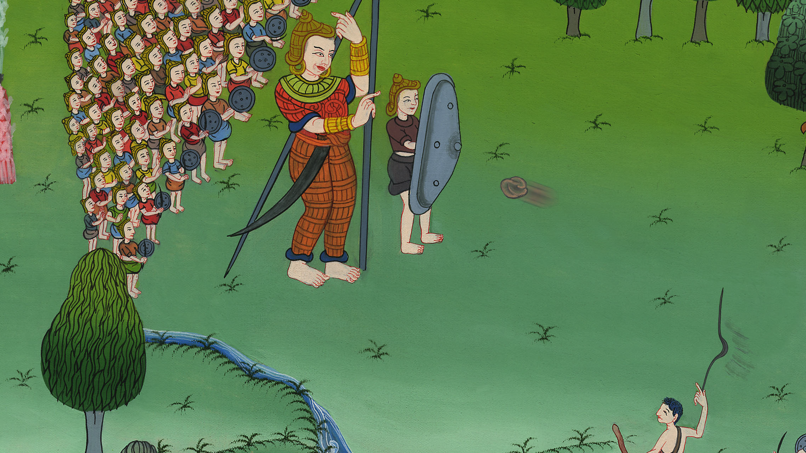
1 Samuel 17:50

