Slide 1
17-4
This work is licensed under a Creative Commons Attribution-Sharealike 4.0 International License.
Please add this statement to all the videos you create.
English Bible quotes are from the World English Bible US, which is in the public domain.
Notes:
Ch
17 Saul and David
1. David plays before the king - 1 Samuel 16:14-23 (Left Top)
2. Goliath challenges the Israelites 1 Sam 17 (Center)
3. David defeats Goliath 1 Sam 17
4. David’s popularity & Saul’s jealousy - 1 Sam 18:5-16,29-30 (Center Top)
5. David's marries Saul’s daughter - 1 Sam 18:17-28 (Right Top)
6. Saul throws a spear at David - 1 Sam 19:8-10 (Right Center)
7. Michal helps David escape - 1 Sam 19:11-17 (Right Bottom)
8. David's escape to Ramah -1 Sam 19:18-24 (Center Bottom)
9. Saul tries to kill Jonathan -1 Sam 18:1-4; 19:1-7; 20:1-34 (Left Bottom)
10. Jonathan warns David - 1 Sam 20:35-42 (Left Center)

Slide 2
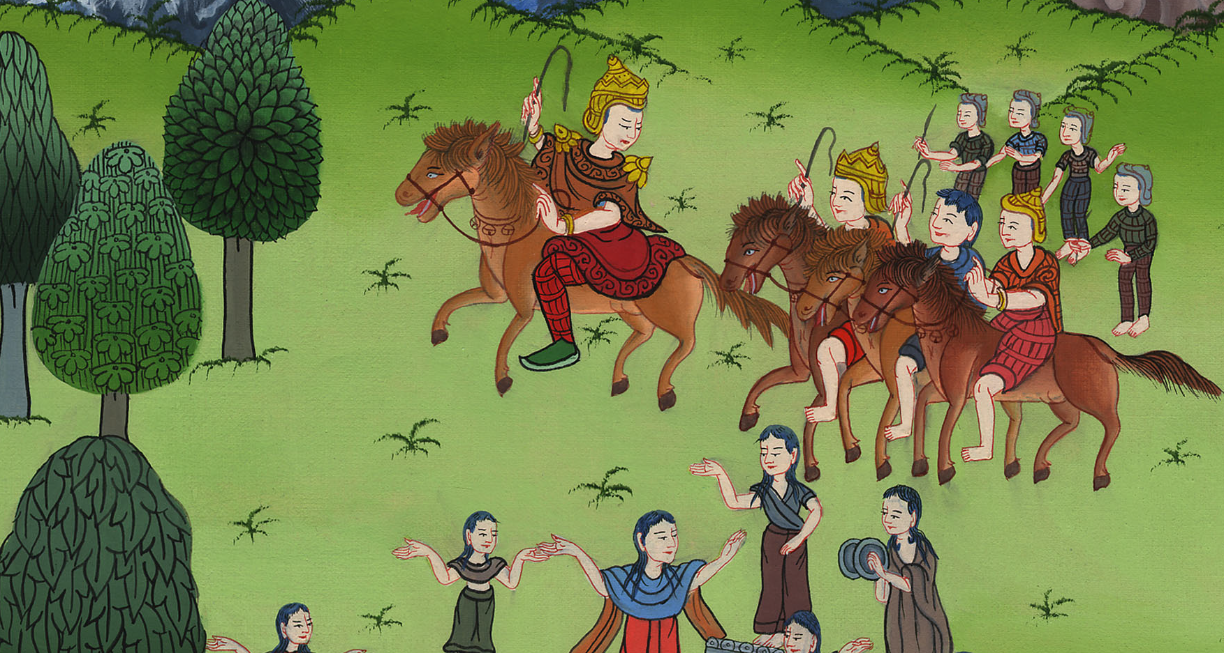
David’s popularity & Saul’s jealousy –
1 Samuel 18:5-16, 29-30

Slide 3
4. David’s popularity & Saul’s jealousy - 1 Samuel 18:5-16,29-30 (Center Top)

Slide 4
David’s popularity & Saul’s jealousy –
1 Samuel 18:5-16, 29-30

Slide 5
1Samuel18:5David went out wherever Saul sent him, and behaved himself wisely; and Saul set him over the men of war. It was good in the sight of all the people, and also in the sight of Saul’s servants.

Slide 6
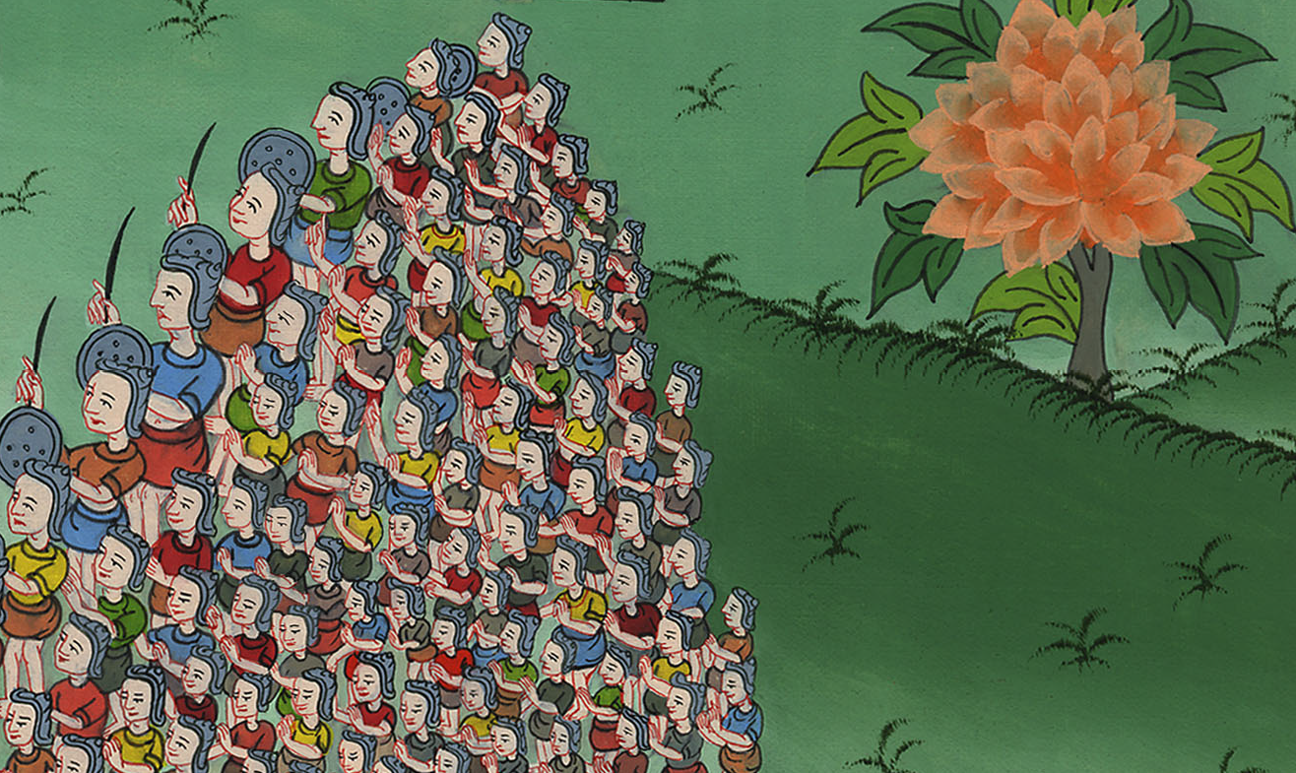
1 Samuel ། 18:5

Slide 7
6As they came, when David returned from the slaughter of the Philistine, the women came out of all the cities of Israel, singing and dancing, to meet King Saul with tambourines, with joy, and with instruments of music.

Slide 8
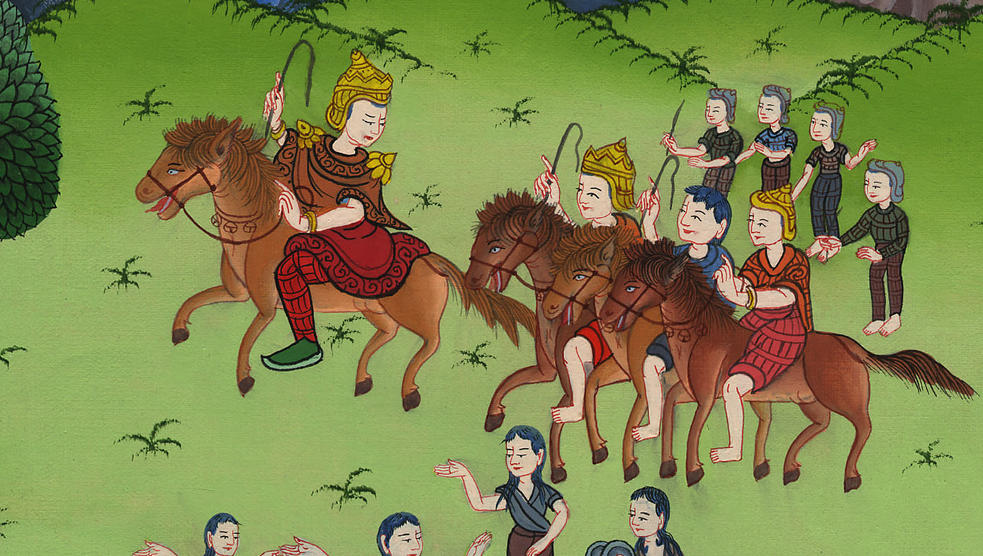
1 Samuel 18:6

Slide 9
7The women sang to one another as they played, and said,
“Saul has slain his thousands,
and David his ten thousands.”

Slide 10
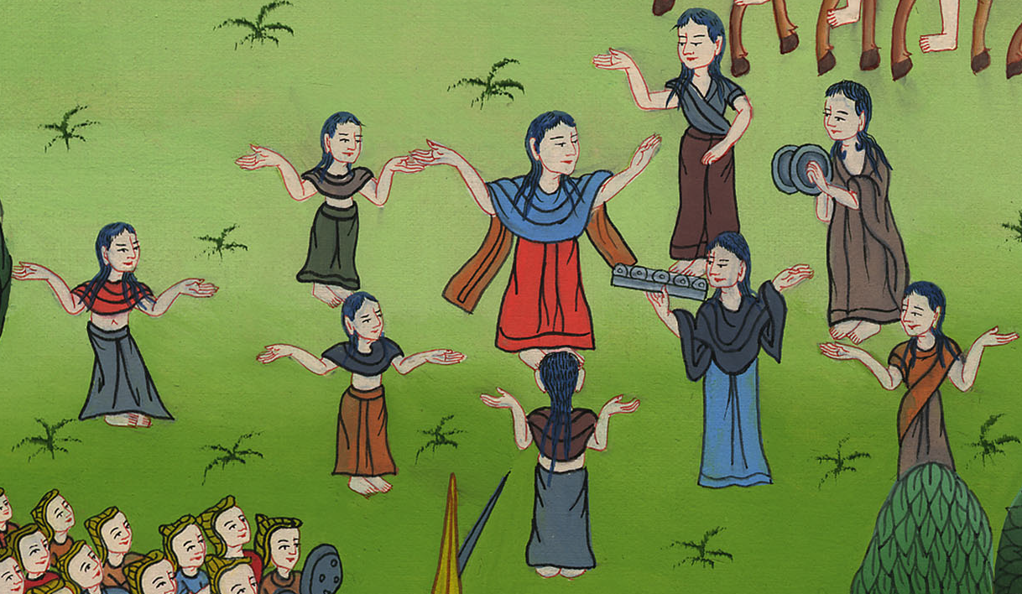
1 Samuel 18:7

Slide 11
8Saul was very angry, and this saying displeased him. He said, “They have credited David with ten thousands, and they have only credited me with thousands. What can he have more but the kingdom?”

Slide 12
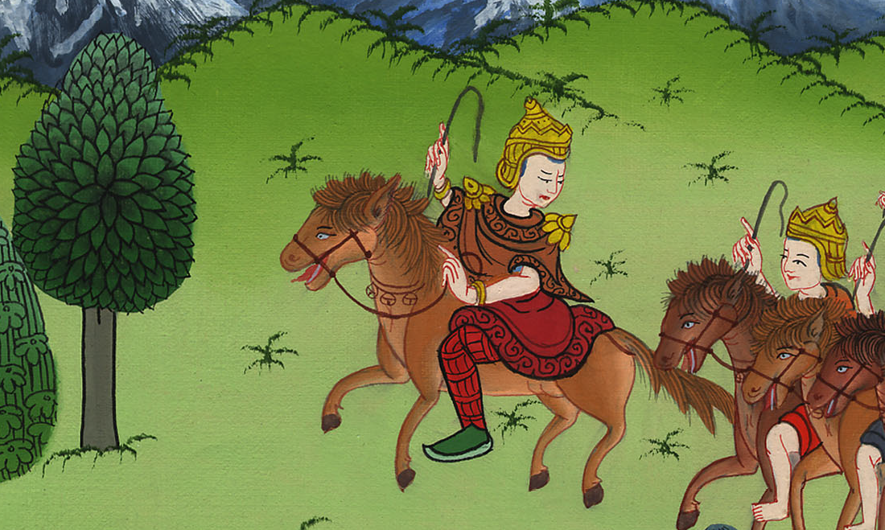
1 Samuel 18:8

Slide 13
12Saul was afraid of David, because Yahweh was with him, and had departed from Saul.

Slide 14
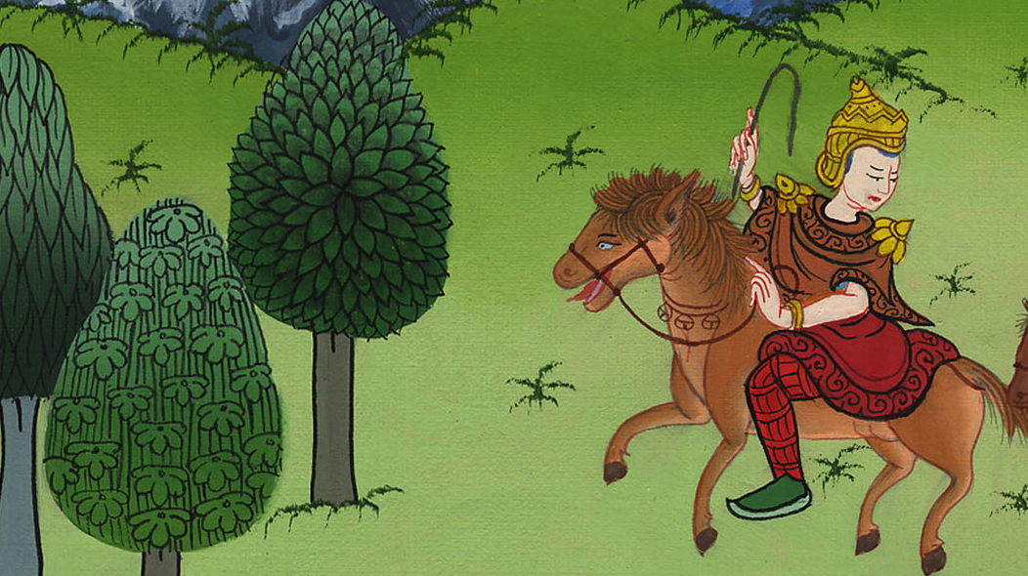
1 Samuel 18:12

Slide 15
13Therefore Saul removed him from his presence, and made him his captain over a thousand; and he went out and came in before the people.

Slide 16
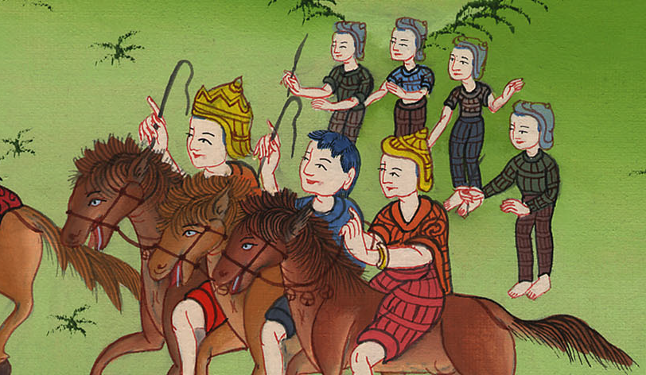
1 Samuel 18:13

Slide 17
14David behaved himself wisely in all his ways; and Yahweh was with him.

Slide 18
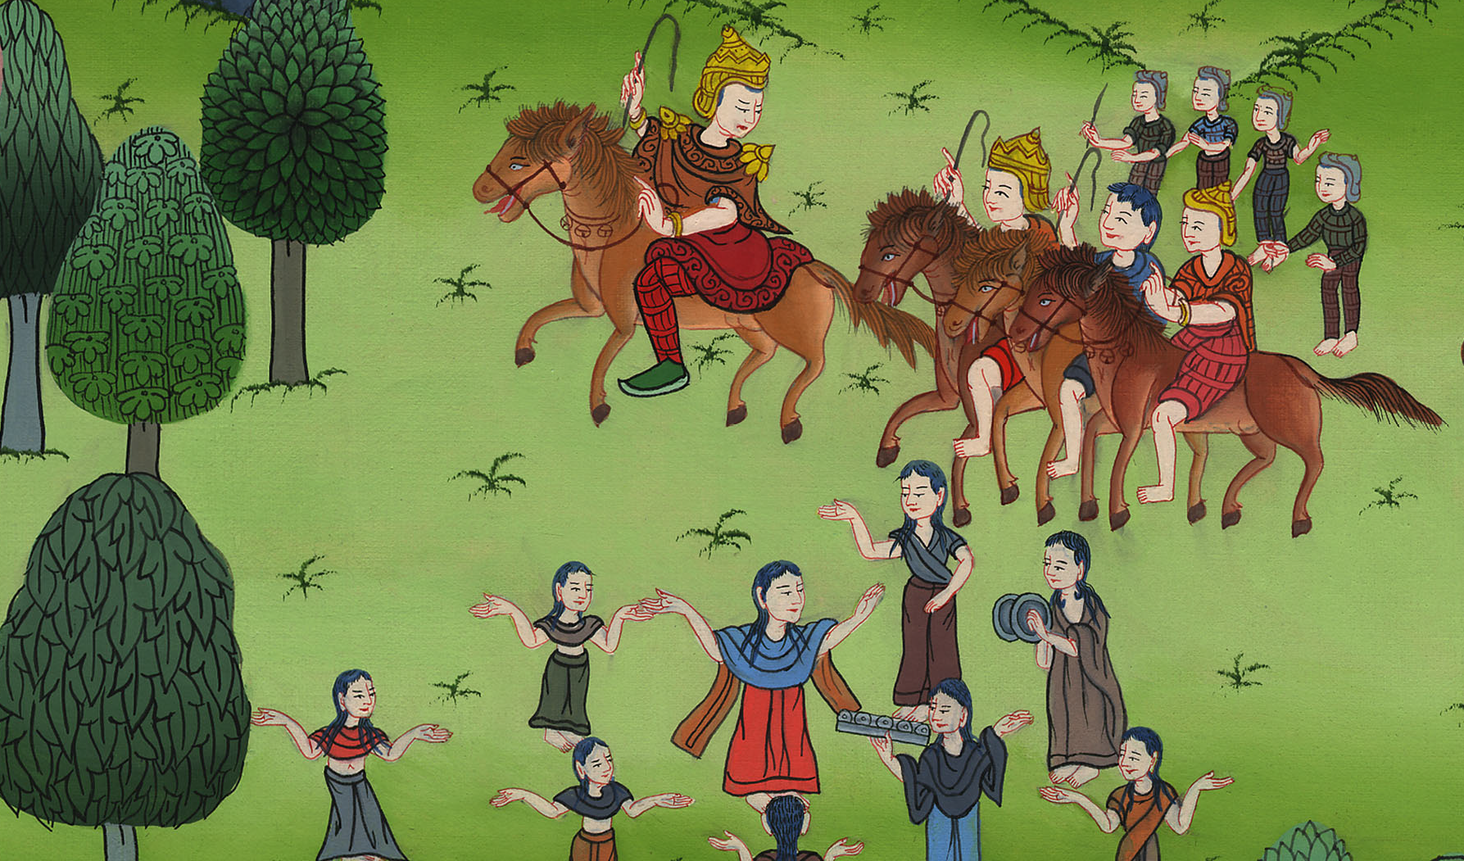
1 Samuel 18:14

Slide 19
29Saul was even more afraid of David; and Saul was David’s enemy continually.

Slide 20
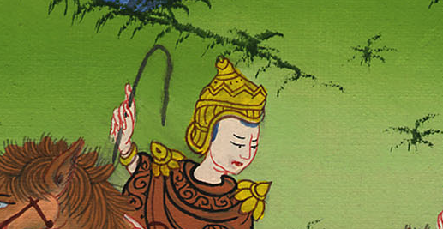
1 Samuel 18:29

Slide 21
30Then the princes of the Philistines went out; and as often as they went out, David behaved himself more wisely than all the servants of Saul, so that his name was highly esteemed.

Slide 22
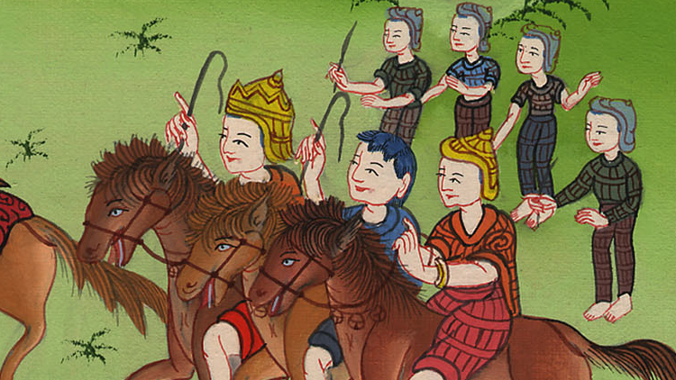
1 Samuel 18:30

