Slide 1
17-6
This work is licensed under a Creative Commons Attribution-Sharealike 4.0 International License.
Please add this statement to all the videos you create.
English Bible quotes are from the World English Bible US, which is in the public domain.
Notes:
ch

Slide 2
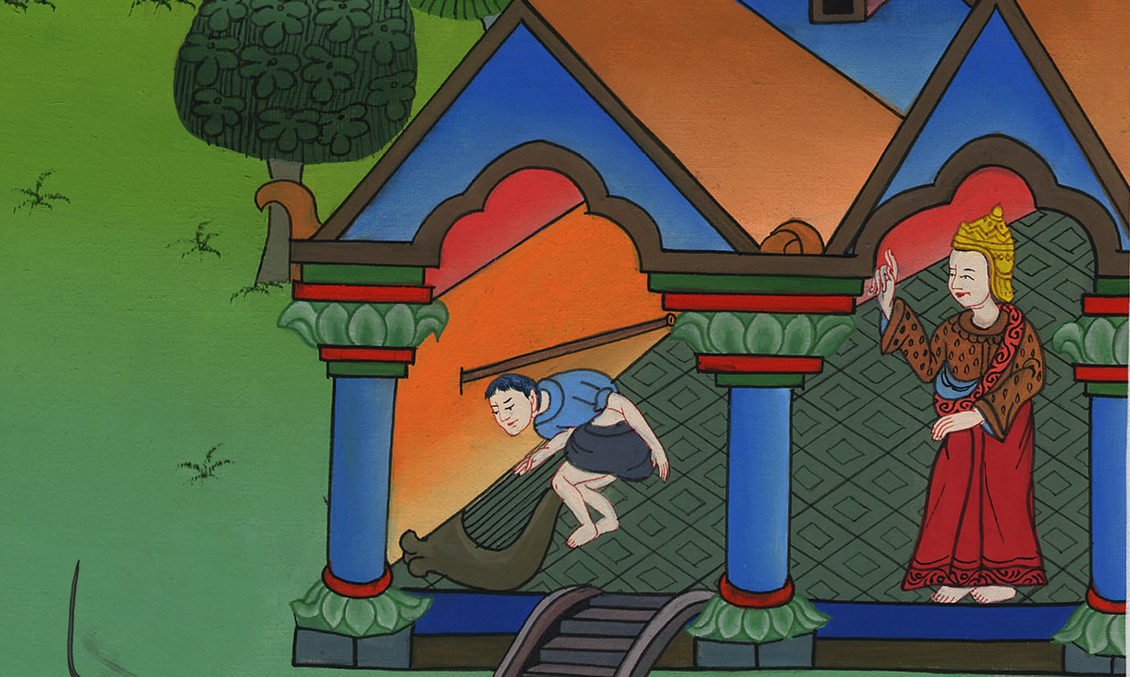
Saul throws a spear at David –
1 Samuel 19:8-17

Slide 3
6. Saul throws a spear at David - 1 Samuel 19:8-17 (Right Center)
Notes:
17 Saul and David
1. David plays before the king - 1 Samuel 16:14-23 (Left Top)
2. David and Goliath - 1 Sam 17 (Center)
3. David’s popularity & Saul’s jealousy - 1 Sam 18:5-16,29-30 (Center Top)
4. David's marries Saul’s daughter - 1 Sam 18:17-28 (Right Top)
5. Saul throws a spear at David - 1 Sam 19:8-10 (Right Center)
6.
7. David's escape to Ramah -1 Sam 19:18-24 (Center Bottom)
8. Saul tries to kill Jonathan -1 Sam 18:1-4; 19:1-7; 20:1-34 (Left Bottom)
9. Jonathan warns David - 1 Sam 20:35-42 (Left Center)

Slide 4
Saul throws a spear at David –
1 Samuel 19:8-17

Slide 5
1Samuel19:8There was war again. David went out and fought with the Philistines, and killed them with a great slaughter; and they fled before him.

Slide 6
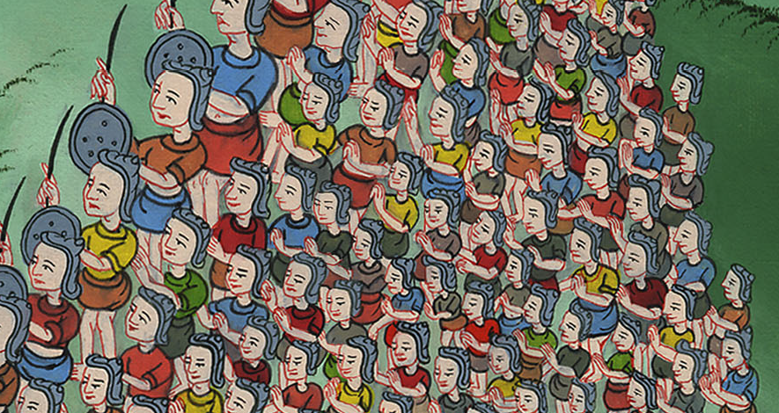
1 Samuel 19:8

Slide 7
9An evil spirit from Yahweh was on Saul as he sat in his house with his spear in his hand; and David was playing music with his hand.

Slide 8
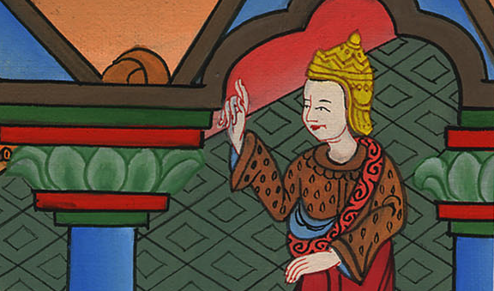
1 Samuel 19:9

Slide 9
10Saul sought to pin David to the wall with the spear, but he slipped away out of Saul’s presence; and he stuck the spear into the wall. David fled and escaped that night.

Slide 10
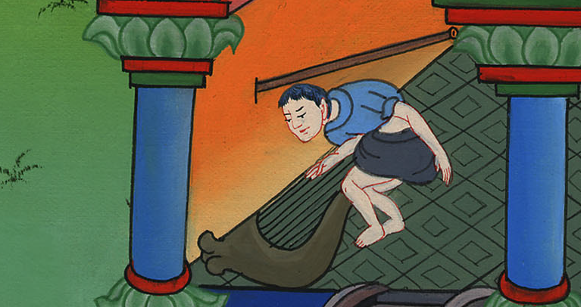
1 Samuel 19:10

Slide 11
11Saul sent messengers to David’s house to watch him and to kill him in the morning. Michal, David’s wife, told him, saying, “If you don’t save your life tonight, tomorrow you will be killed.”

Slide 12
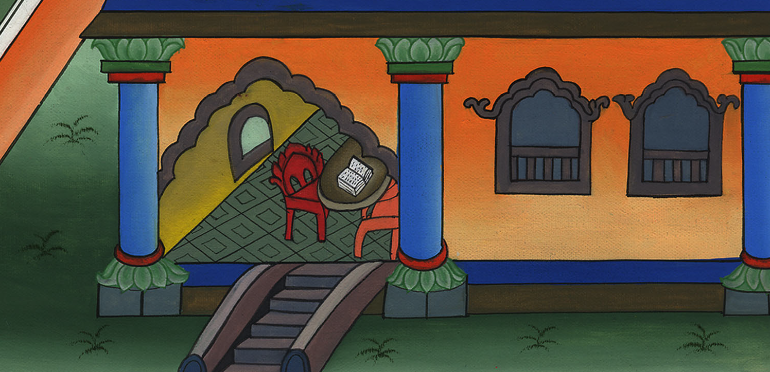
1 Samuel 19:11

Slide 13
12So Michal let David down through the window. He went away, fled, and escaped.

Slide 14
1 Samuel 19:12

Slide 15
13Michal took the teraphim (statue of a god) and laid it in the bed, and put a pillow of goats’ hair at its head and covered it with clothes.

Slide 16
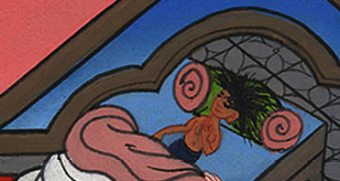
1 Samuel 19:13

Slide 17
14When Saul sent messengers to take David, she said, “He is sick.”

Slide 18
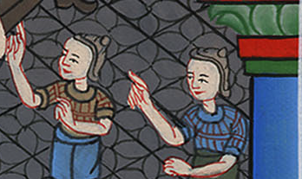
1 Samuel 19:14

Slide 19
15Saul sent the messengers to see David, saying, “Bring him up to me in the bed, that I may kill him.”

Slide 20
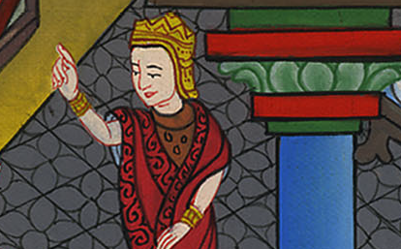
1 Samuel 19:15

Slide 21
16When the messengers came in, behold, the teraphim was in the bed, with the pillow of goats’ hair at its head.

Slide 22
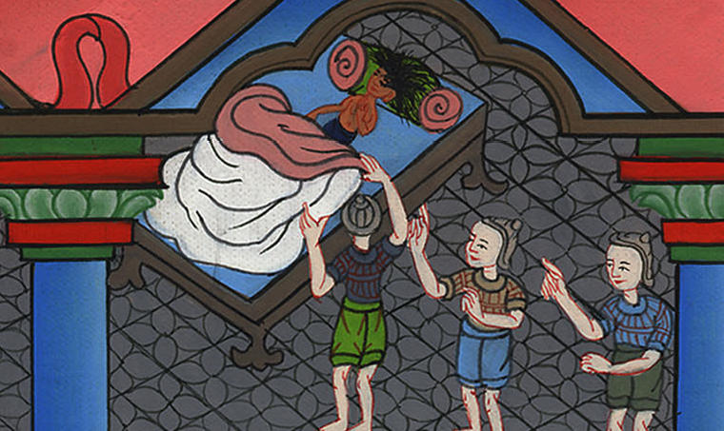
1 Samuel 19:16

Slide 23
17Saul said to Michal, “Why have you deceived me like this and let my enemy go, so that he has escaped?”
Michal answered Saul, “He said to me, ‘Let me go! Why should I kill you?’”

Slide 24
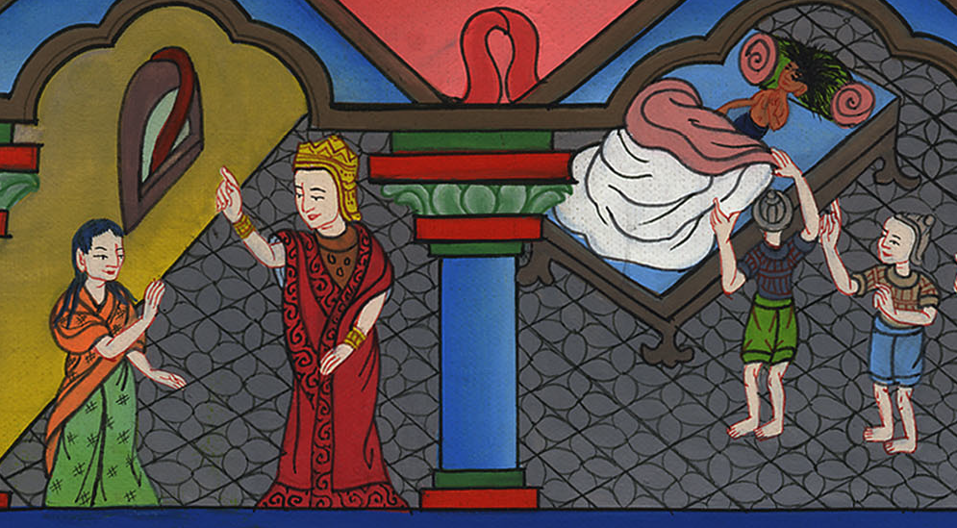
1 Samuel 19:17

