Slide 1
17-7
This work is licensed under a Creative Commons Attribution-Sharealike 4.0 International License.
Please add this statement to all the videos you create.
English Bible quotes are from the World English Bible US, which is in the public domain.
Notes:
Ch
17 Saul and David
1. David plays before the king - 1 Samuel 16:14-23 (Left Top)
2. David and Goliath - 1 Sam 17 (Center)
3. David’s popularity & Saul’s jealousy - 1 Sam 18:5-16,29-30 (Center Top)
4. David's marries Saul’s daughter - 1 Sam 18:17-28 (Right Top)
5. Saul throws a spear at David - 1 Sam 19:8-10 (Right Center)
6.
7. David's escape to Ramah -1 Sam 19:18-24 (Center Bottom)
8. Saul tries to kill Jonathan -1 Sam 18:1-4; 19:1-7; 20:1-34 (Left Bottom)
9. Jonathan warns David - 1 Sam 20:35-42 (Left Center)

Slide 2
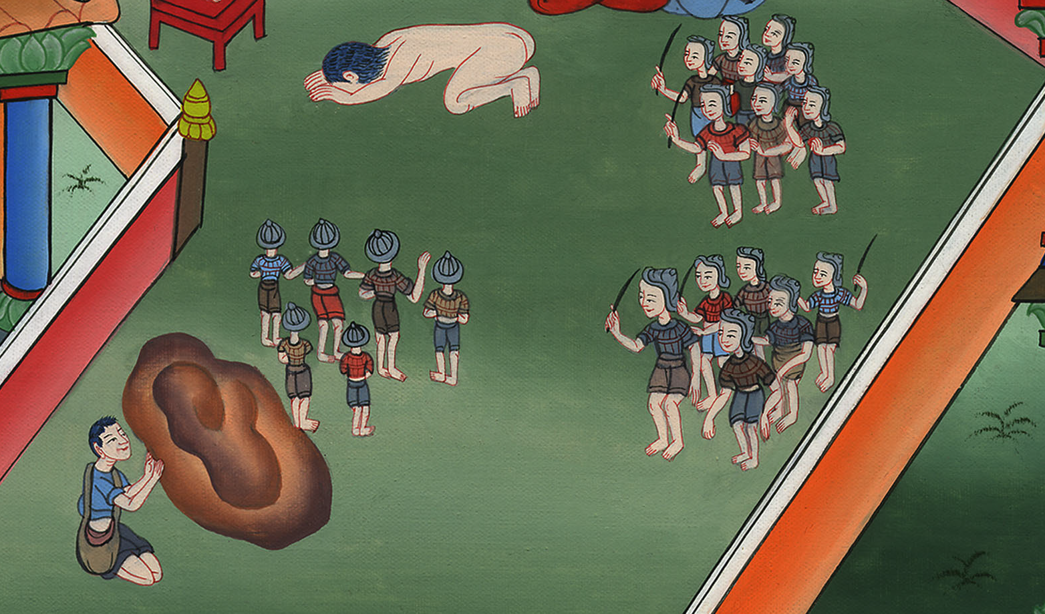
David's escape to Ramah –
1 Samuel 19:18-24

Slide 3
7. David's escape to Ramah -1 Samuel 19:18-24 (Center Bottom)

Slide 4
David's escape to Ramah –
1 Samuel 19:18-24

Slide 5
1Samuel19:18Now David fled and escaped, and came to Samuel at Ramah, and told him all that Saul had done to him. He and Samuel went and lived in Naioth.

Slide 6
1 Samuel 19:18

Slide 7
19Saul was told, saying, “Behold, David is at Naioth in Ramah.”
20Saul sent messengers to seize David;

Slide 8
1 Samuel 19:19

Slide 9
and when they saw the company of the prophets prophesying, and Samuel standing as head over them, God’s Spirit came on Saul’s messengers, and they also prophesied.

Slide 10
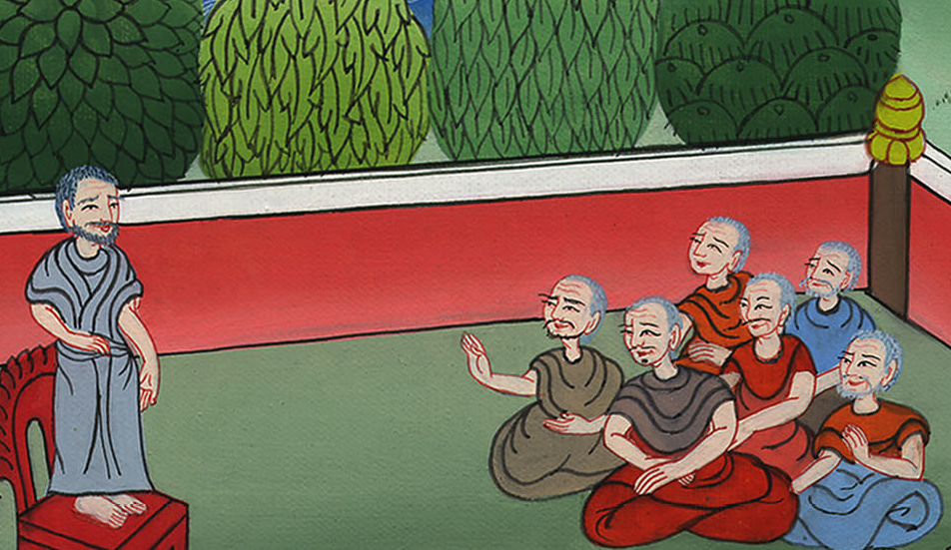
1 Samuel 19:19

Slide 11
21When Saul was told, he sent other messengers, and they also prophesied. Saul sent messengers again the third time, and they also prophesied.

Slide 12
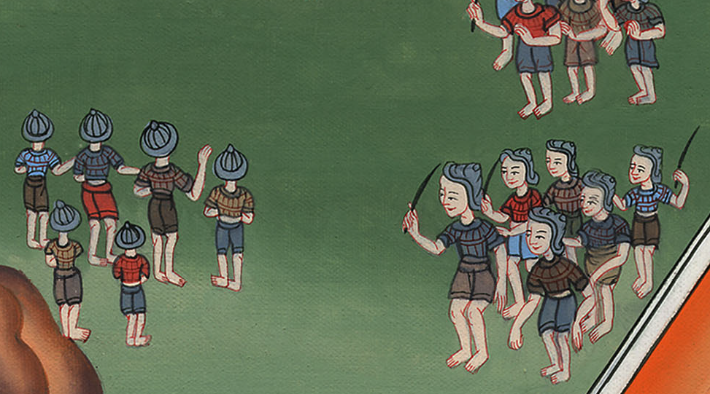
1 Samuel 19:21

Slide 13
22Then he also went to Ramah, and came to the great well that is in Secu: and he asked, “Where are Samuel and David?”
One said, “Behold, they are at Naioth in Ramah.”

Slide 14
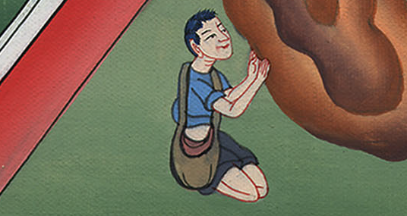
1 Samuel 19:22

Slide 15
23He went there to Naioth in Ramah. Then God’s Spirit came on him also, and he went on, and prophesied, until he came to Naioth in Ramah.

Slide 16
1 Samuel 19:23

Slide 17
24He also stripped off his clothes. He also prophesied before Samuel and lay down naked all that day and all that night. Therefore they say, “Is Saul also among the prophets?”

Slide 18
1 Samuel 19:24

