Slide 1
17-8
This work is licensed under a Creative Commons Attribution-Sharealike 4.0 International License.
Please add this statement to all the videos you create.
English Bible quotes are from the World English Bible US, which is in the public domain.
Notes:
Ch
17 Saul and David
1. David plays before the king - 1 Samuel 16:14-23 (Left Top)
2. David and Goliath - 1 Sam 17 (Center)
3. David’s popularity & Saul’s jealousy - 1 Sam 18:5-16,29-30 (Center Top)
4. David's marries Saul’s daughter - 1 Sam 18:17-28 (Right Top)
5. Saul throws a spear at David - 1 Sam 19:8-10 (Right Center)
6.
7. David's escape to Ramah -1 Sam 19:18-24 (Center Bottom)
8. Saul tries to kill Jonathan -1 Sam 18:1-4; 19:1-7; 20:1-34 (Left Bottom)
9. Jonathan warns David - 1 Sam 20:35-42 (Left Center)

Slide 2
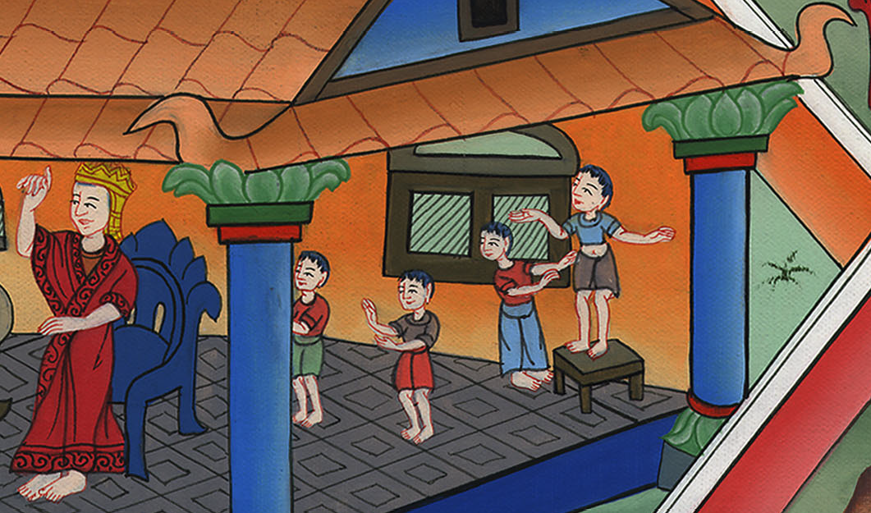
David and Jonathan –
1 Samuel 18:1-4; 19:1-7; 20:1-34

Slide 3
8. David and Jonathan -1 Samuel 18:1-4; 19:1-7; 20:1-34 (Left Bottom)

Slide 4
David and Jonathan –
1 Samuel 18:1-4; 19:1-7; 20:1-34

Slide 5
Saul had a son named Jonathan.18:1… Jonathan and David became close friends. …

Slide 6
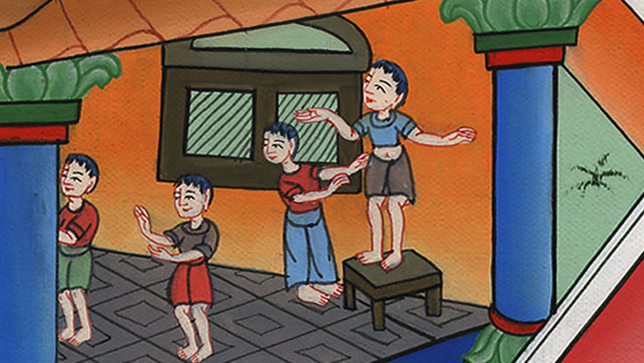
1 Samuel 18:1

Slide 7
1Saul spoke to Jonathan his son and to all his servants, that they should kill David. But Jonathan, Saul’s son, greatly delighted in David.

Slide 8
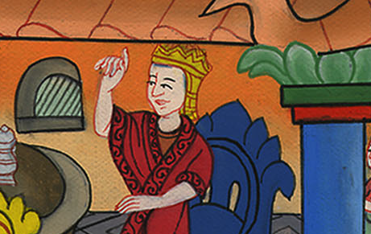
1 Samuel 19:1

Slide 9
1David fled from Naioth in Ramah, and came and said to Jonathan, “What have I done? What is my iniquity? What is my sin before your father, that he seeks my life?”

Slide 10
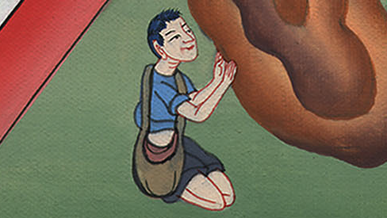
1 Samuel 20:1

Slide 11
4Then Jonathan said to David, “Whatever your soul desires, I will even do it for you.”

Slide 12
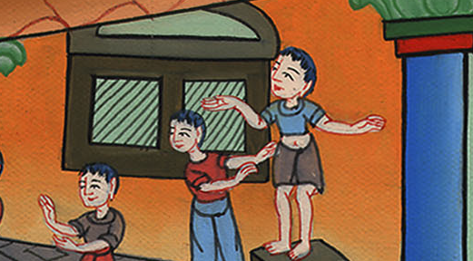
1 Samuel 20:4

Slide 13
5David said to Jonathan, “Behold, tomorrow is the new moon, and I should not fail to dine with the king; but let me go, that I may hide myself in the field to the third day at evening.

Slide 14
1 Samuel 20:5

Slide 15
12Jonathan said to David, “By Yahweh, the God of Israel, when I have sounded out my father about this time tomorrow, or the third day, behold, if there is good toward David, won’t I then send to you and disclose it to you?

Slide 16
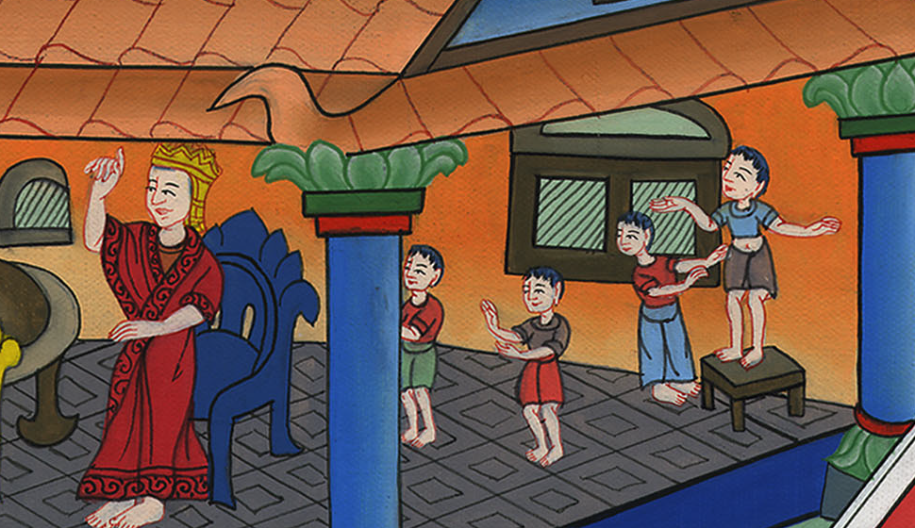
1 Samuel 20:12

Slide 17
20I will shoot three arrows on its side, as though I shot at a mark. 21Behold, I will send the boy, saying, ‘Go, find the arrows!’

Slide 18
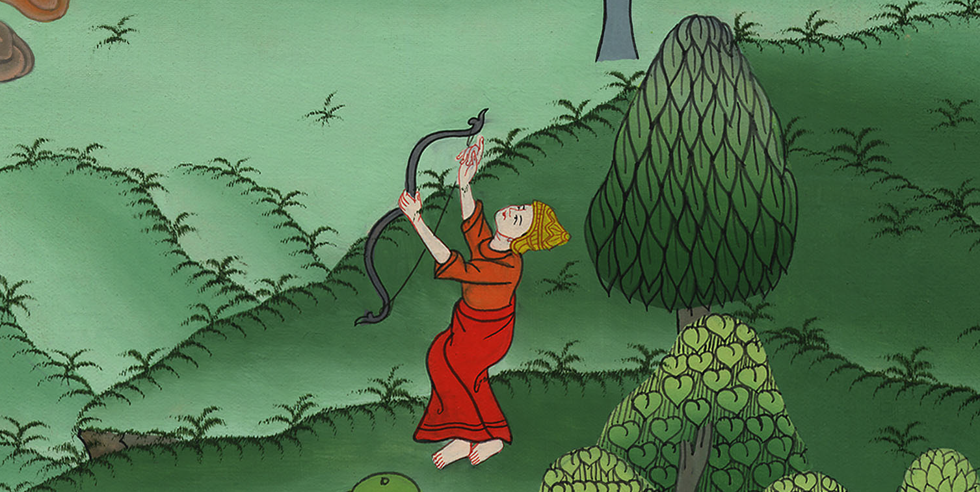
1 Samuel 20:20

Slide 19
…21 If I tell the boy, ‘Behold, the arrows are on this side of you. Take them;’ then come, for there is peace to you and no danger, as Yahweh lives.

Slide 20
1 Samuel 20:21

Slide 21
22But if I say this to the boy, ‘Behold, the arrows are beyond you,’ then go your way, for Yahweh has sent you away.

Slide 22
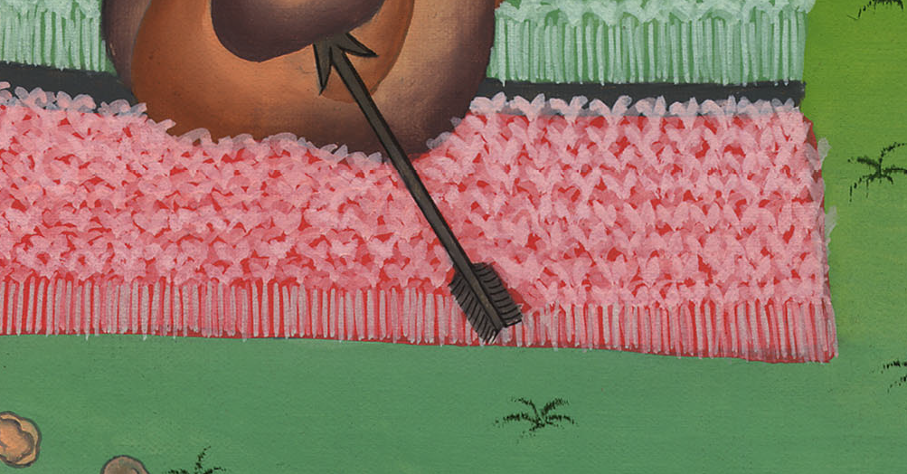
1 Samuel 20:22

