Slide 1
17-9
This work is licensed under a Creative Commons Attribution-Sharealike 4.0 International License.
Please add this statement to all the videos you create.
English Bible quotes are from the World English Bible US, which is in the public domain.
Notes:
ch

Slide 2
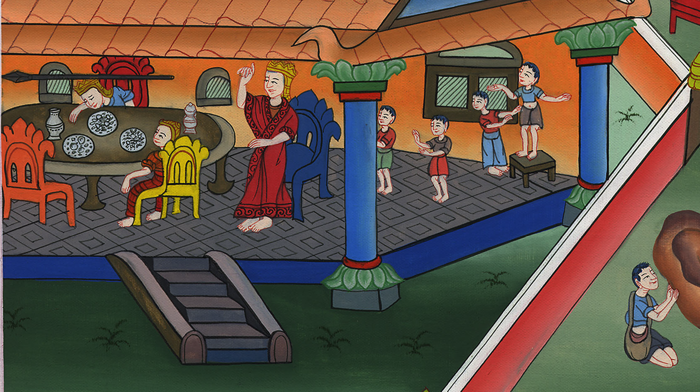
Jonathan warns David –
1 Samuel 20:24-42

Slide 3
9. Jonathan warns David - 1 Samuel 20:24-42 (Left Center)

Slide 4
Jonathan warns David –
1 Samuel 20:24-42

Slide 5
1Samuel20:24So David hid himself in the field. When the new moon had come, the king sat himself down to eat food.

Slide 6
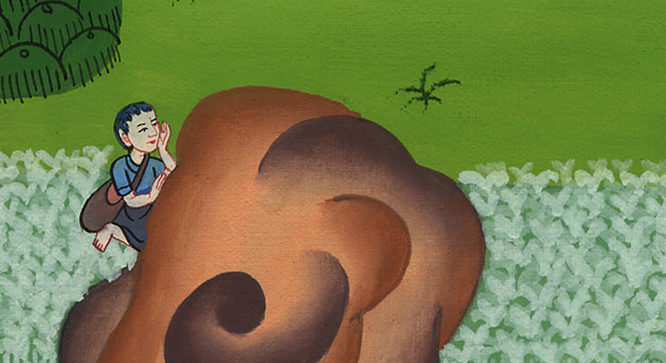
1 Samuel 20:24

Slide 7
27On the next day after the new moon, the second day, David’s place was empty. Saul said to Jonathan his son, “Why didn’t the son of Jesse come to eat, either yesterday, or today?”

Slide 8
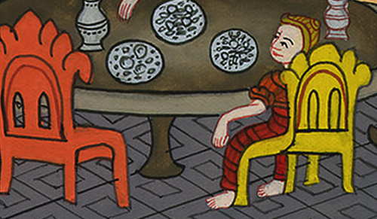
1 Samuel 20:27

Slide 9
28Jonathan answered Saul, “David earnestly asked permission of me to go to Bethlehem. (To make an offering with his family)

Slide 10
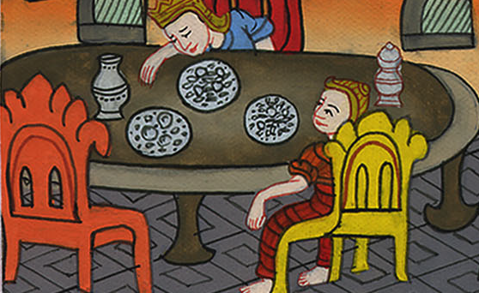
1 Samuel 20:28

Slide 11
30Then Saul’s anger burned against Jonathan, and he said to him, “You son of a perverse rebellious woman, don’t I know that you have chosen the son of Jesse to your own shame, and to the shame of your mother’s nakedness?

Slide 12
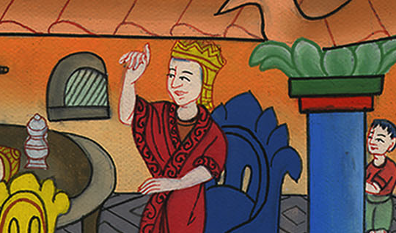
1 Samuel 20:30

Slide 13
31For as long as the son of Jesse lives on the earth, you will not be established, nor will your kingdom. Therefore now send and bring him to me, for he shall surely die!”

Slide 14
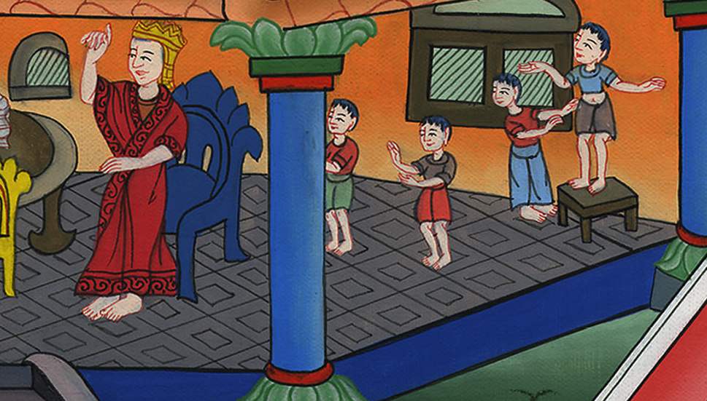
1 Samuel 20:31

Slide 15
32Jonathan answered Saul his father, and said to him, “Why should he be put to death? What has he done?”

Slide 16
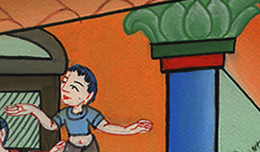
1 Samuel 20:32

Slide 17
33Saul cast his spear at him to strike him. By this Jonathan knew that his father was determined to put David to death.

Slide 18
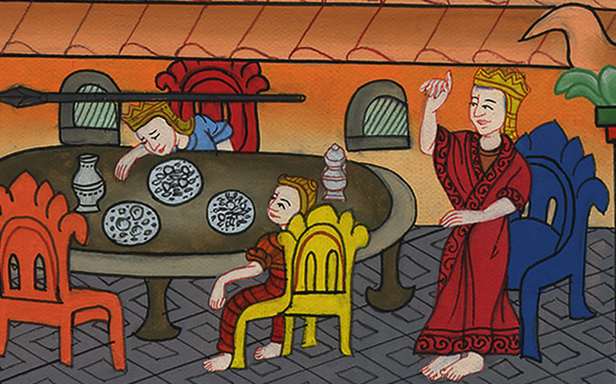
1 Samuel 20:33

Slide 19
34So Jonathan arose from the table in fierce anger, and ate no food the second day of the month; for he was grieved for David, because his father had treated him shamefully.

Slide 20
1 Samuel 20:34

Slide 21
35In the morning, Jonathan went out into the field at the time appointed with David, and a little boy with him.

Slide 22
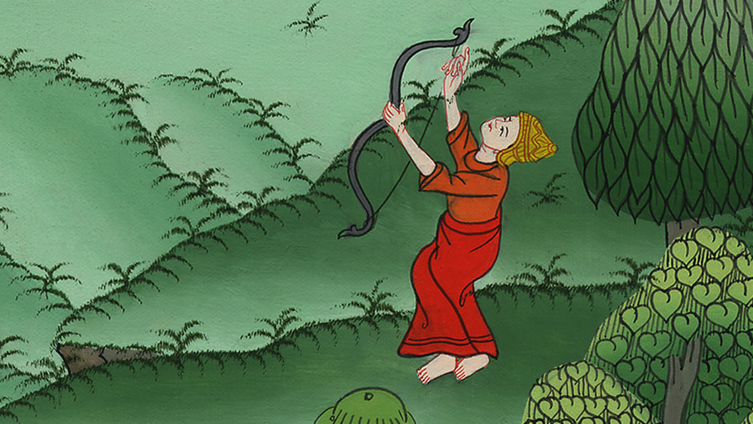
1 Samuel 20:35

Slide 23
36He said to his boy, “Run, find now the arrows which I shoot.” As the boy ran, he shot an arrow beyond him.

Slide 24
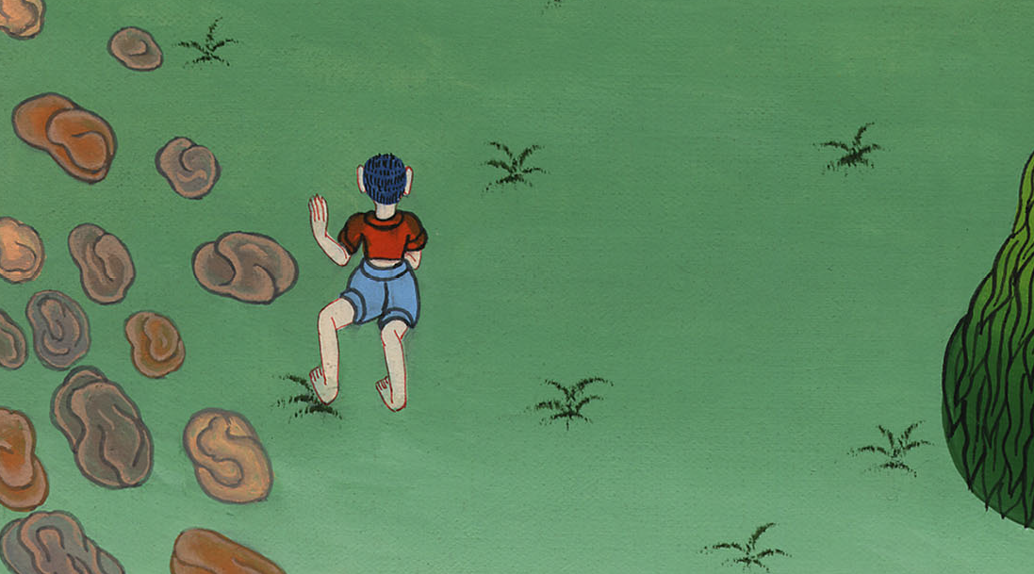
1 Samuel 20:36

Slide 25
37When the boy had come to the place of the arrow which Jonathan had shot, Jonathan cried after the boy, and said, “Isn’t the arrow beyond you?”

Slide 26
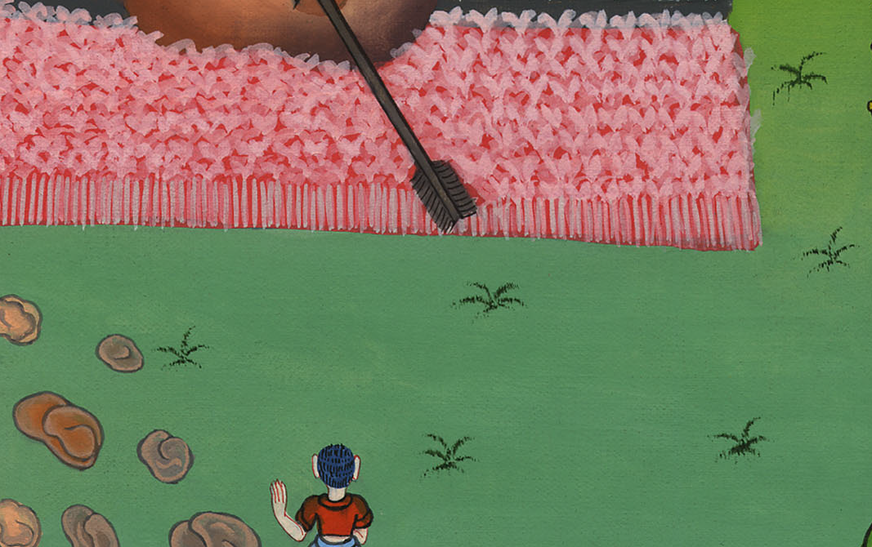
1 Samuel 20:37

Slide 27
38Jonathan cried after the boy, “Go fast! Hurry! Don’t delay!” Jonathan’s boy gathered up the arrows, and came to his master.

Slide 28
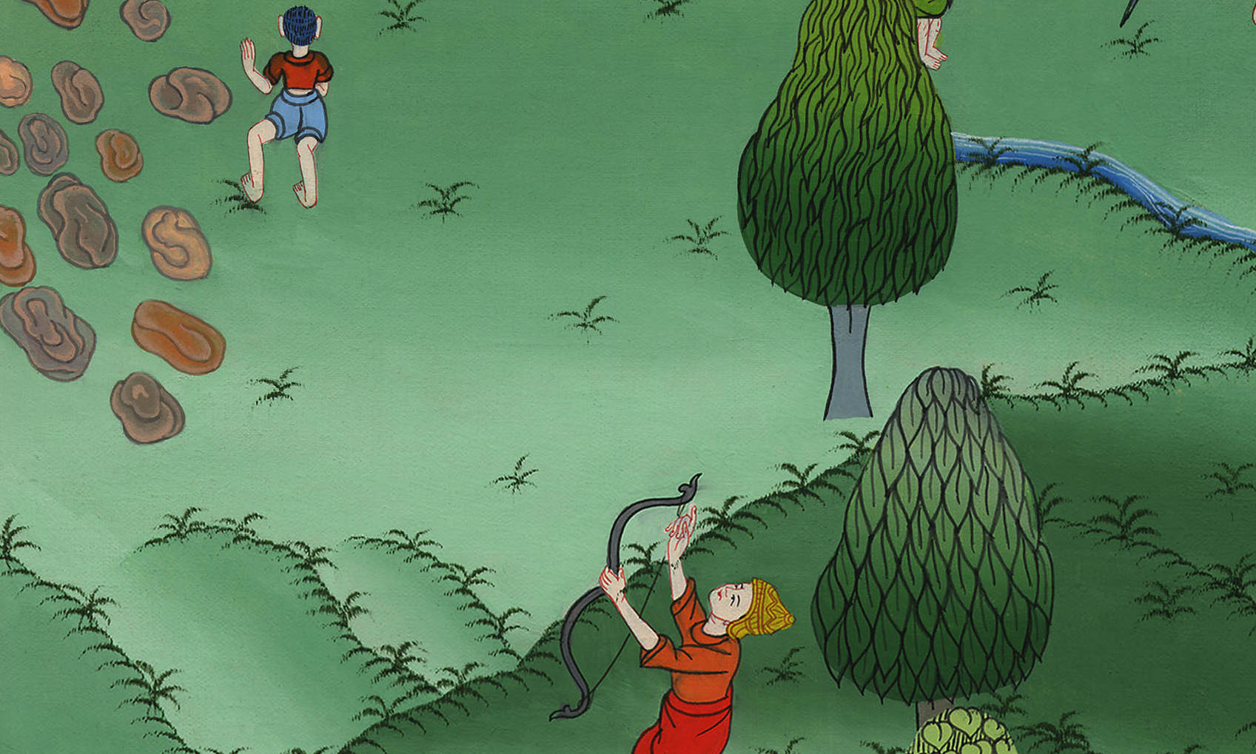
1 Samuel 20:38

Slide 29
39But the boy didn’t know anything. Only Jonathan and David knew the matter. 40Jonathan gave his weapons to his boy, and said to him, “Go, carry them to the city.”

Slide 30
1 Samuel 20:39

Slide 31
41As soon as the boy was gone, David arose out of the south, and fell on his face to the ground, and bowed himself three times. They kissed one another and wept with one another, and David wept the most.

Slide 32
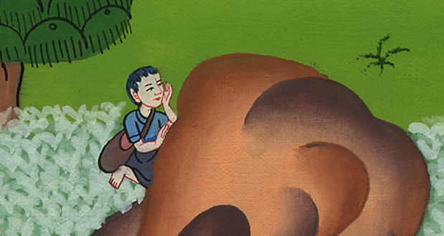
1 Samuel 20:41

Slide 33
42Jonathan said to David, “Go in peace, because we have both sworn in Yahweh’s name, saying, ‘Yahweh is between me and you, …

Slide 34
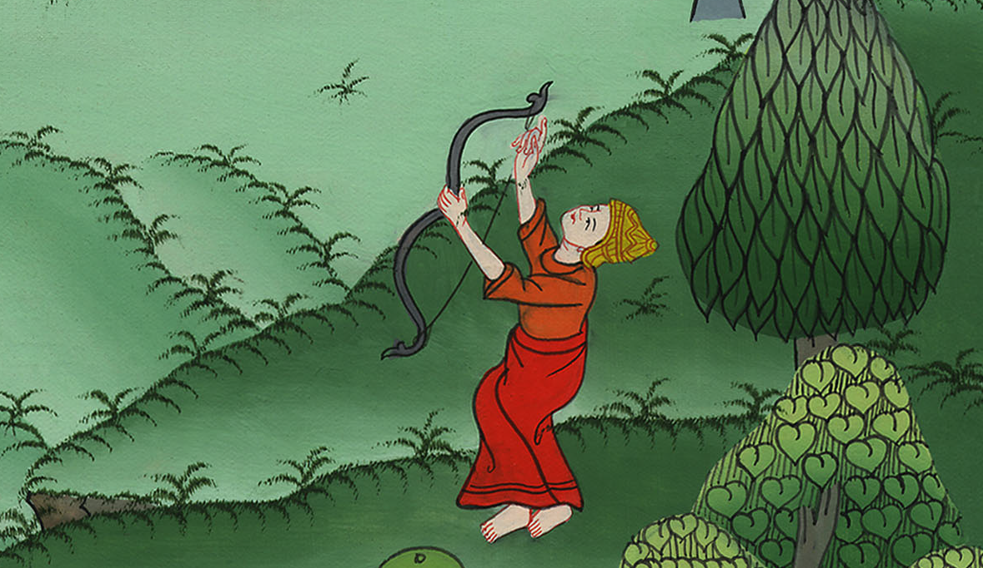
1 Samuel 20:42

Slide 35
… and between my offspring and your offspring, forever.’” He arose and departed; and Jonathan went into the city.

Slide 36
1 Samuel 20:42

