Slide 1
18-1
This work is licensed under a Creative Commons Attribution-Sharealike 4.0 International License.
Please add this statement to all the videos you create.
English Bible quotes are from the World English Bible US, which is in the public domain.
Notes:
18 Saul and David – Part 2
1. David at Nob and Saul’s vengeance - 1 Sam 21 – 22 ( Left Top)
2. The Rock of Escape -1 Sam 23 (Right Top)
3. David spares Saul’s life -1 Sam 24 (Right Center)
4. David spares Saul’s life again -1 Sam 26 (Right Bottom)
5. Saul and the witch of Endor -1 Sam 28:3-25 (Left Bottom)
6. David returns and finds that Ziklag has been raded -1 Sam 29-30 (Left Center)
7. David morns for Saul and Jonathan – 1 Sam 31, 2 Sam 1 (Center)

Slide 2
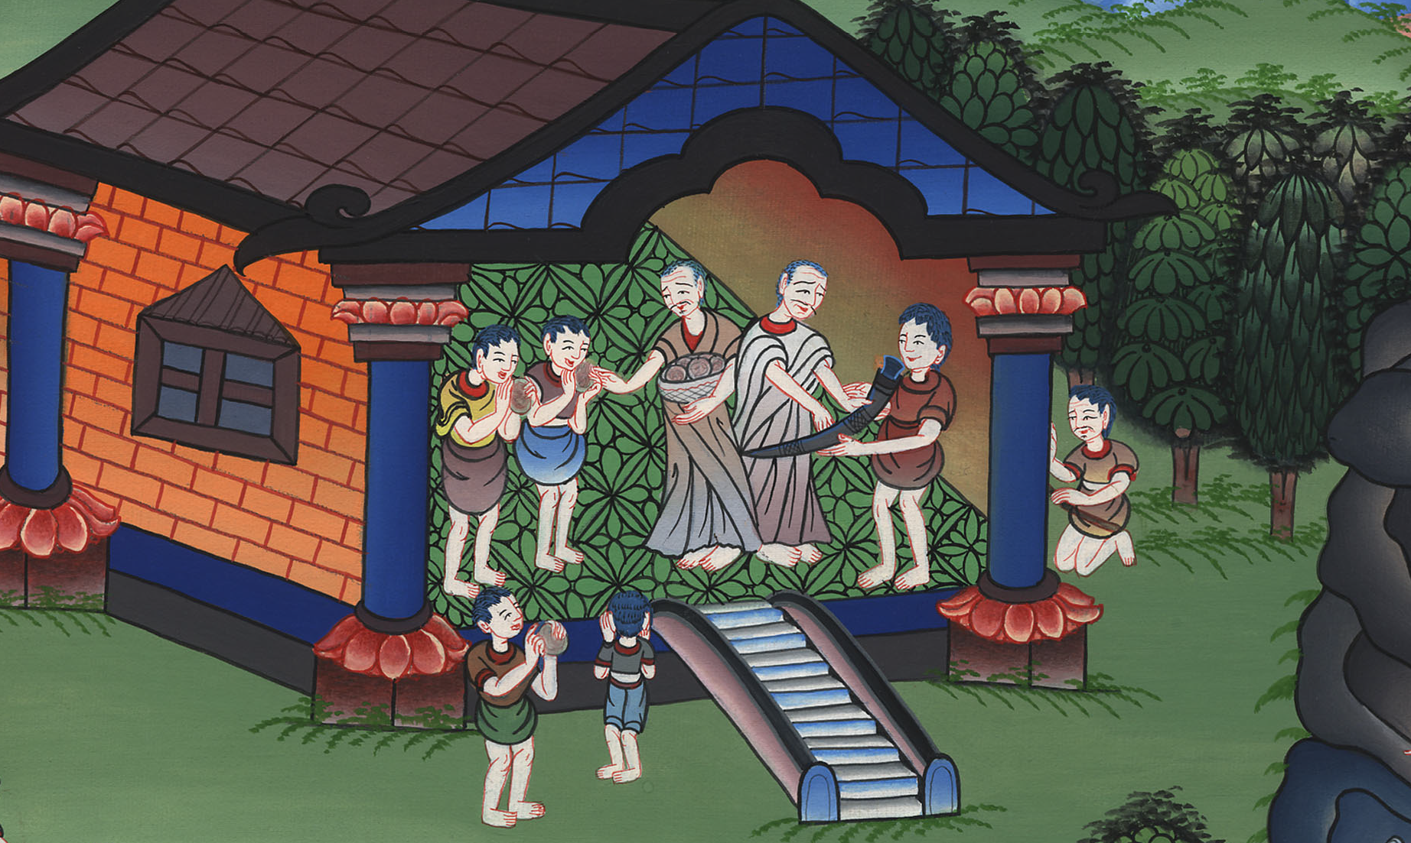
David at Nob and Saul’s vengeance - 1 Samuel 21 – 22

Slide 3
1. David at Nob and Saul’s vengeance - 1 Samuel 21 – 22 ( Left Top)

Slide 4
David at Nob and Saul’s vengeance - 1 Samuel 21 – 22

Slide 5
1Samuel21:1Then David came to Nob to Ahimelech the priest. (Because they were hungry, David asked the priest:)
3Now therefore what is under your hand? Please give me five loaves of bread in my hand, or whatever is available.”

Slide 6
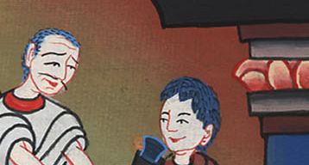
1 Samuel 21:1,3

Slide 7
4The priest answered David, and said, “I have no common bread, but there is holy bread; if only the young men have kept themselves from women.”

Slide 8
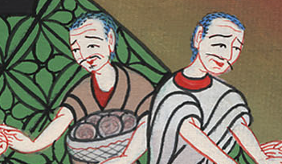
1 Samuel 21:1,4

Slide 9
5David answered the priest, and said to him, “Truly, women have been kept from us as usual these three days. When I came out, the vessels of the young men were holy, though it was only a common journey. How much more then today shall their vessels be holy?”

Slide 10
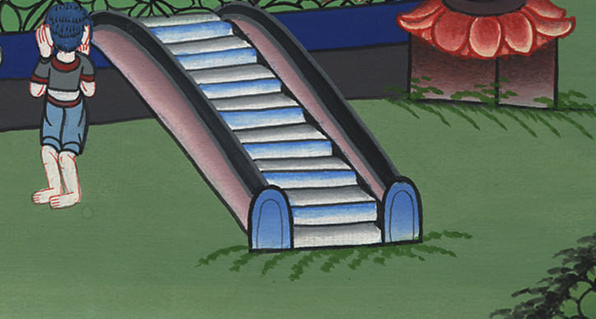
1 Samuel 21:1,5

Slide 11
6So the priest gave him holy bread; for there was no bread there but the show bread that was taken from before Yahweh, to be replaced with hot bread in the day when it was taken away.

Slide 12
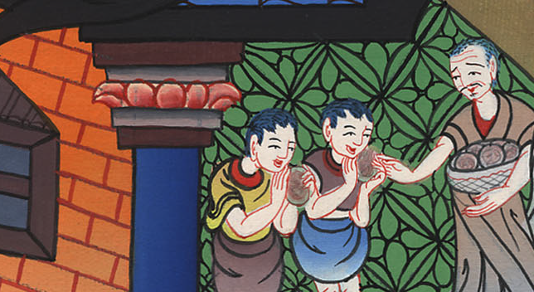
1 Samuel 21:1,6

Slide 13
7Now a certain man of the servants of Saul was there that day, detained before Yahweh; and his name was Doeg the Edomite, the best of the herdsmen who belonged to Saul.

Slide 14
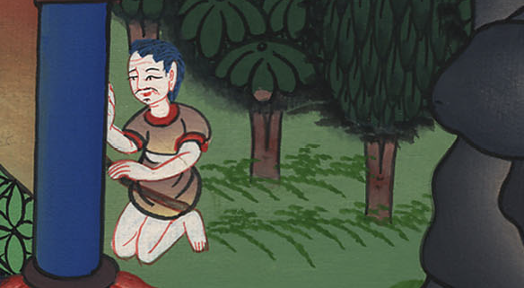
1 Samuel 21:1,7

Slide 15
8David said to Ahimelech, “Isn’t there here under your hand spear or sword? …

Slide 16
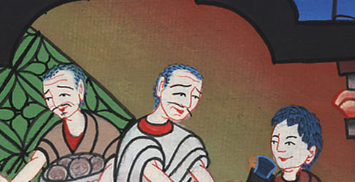
1 Samuel 21:1,8

Slide 17
9The priest said, “Behold, the sword of Goliath the Philistine, whom you killed in the valley of Elah, is here wrapped in a cloth behind the ephod. If you would like to take that, take it, for there is no other except that here.”
David said, “There is none like that. Give it to me.”

Slide 18
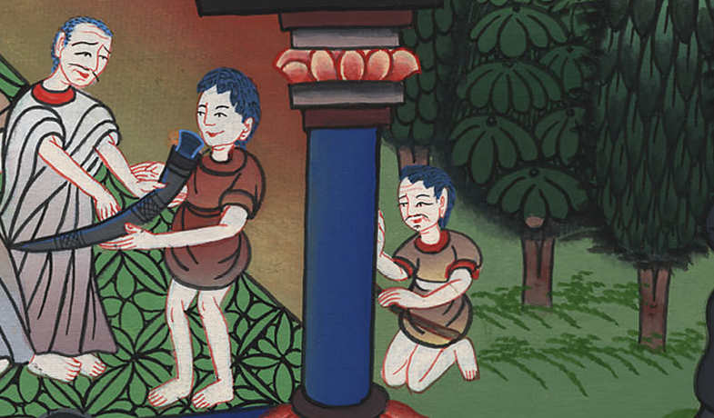
1 Samuel 21:1,9

Slide 19
22:1David therefore departed from there and escaped to Adullam’s cave. When his brothers and all his father’s house heard it, they went down there to him.

Slide 20
1 Samuel 22:1

Slide 21
2Everyone who was in distress, everyone who was in debt, and everyone who was discontented gathered themselves to him; and he became captain over them. There were with him about four hundred men.

Slide 22
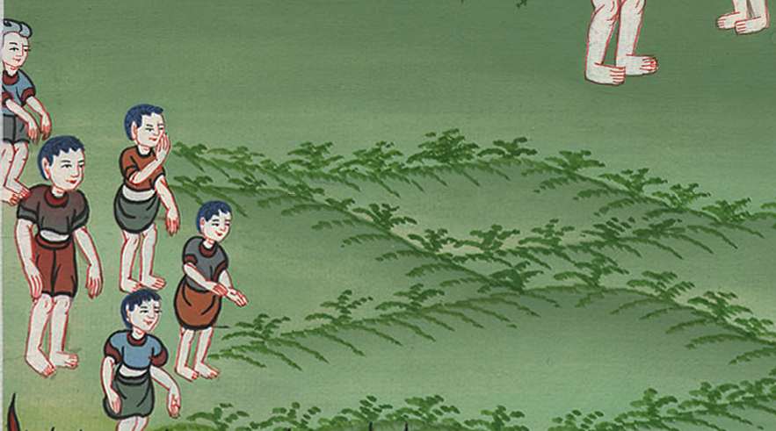
1 Samuel 22:2

Slide 23
9Then Doeg the Edomite, who stood by the servants of Saul, answered and said, “I saw the son of Jesse coming to Nob, to Ahimelech the son of Ahitub. 10He inquired of Yahweh for him, gave him food, and gave him the sword of Goliath the Philistine.”

Slide 24
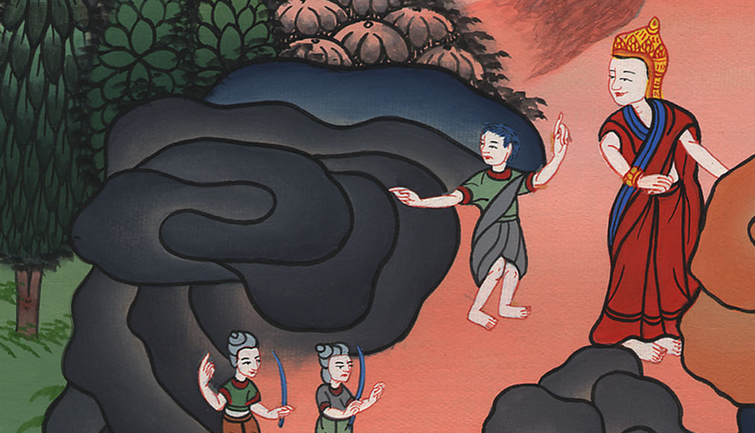
1 Samuel 22:9

Slide 25
17The king said to the guard who stood about him, “Turn and kill the priests of Yahweh, because their hand also is with David, and because they knew that he fled and didn’t disclose it to me.” But the servants of the king wouldn’t put out their hand to fall on the priests of Yahweh.

Slide 26
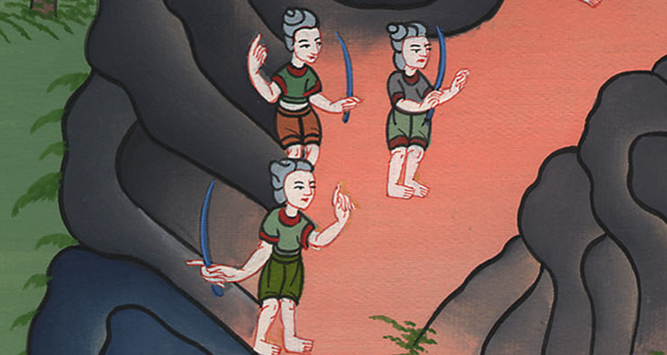
1 Samuel 22:17

Slide 27
18The king said to Doeg, “Turn and attack the priests!”
Doeg the Edomite turned, and he attacked the priests, and he killed on that day eighty-five people who wore a linen ephod.

Slide 28
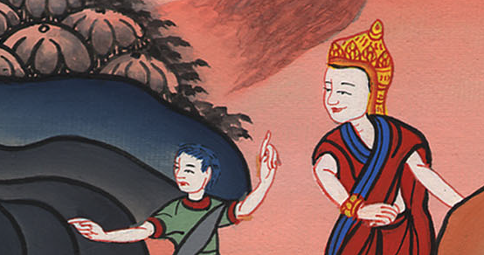
1 Samuel 22:18

Slide 29
20One of the sons of Ahimelech the son of Ahitub, named Abiathar, escaped and fled after David. 21Abiathar told David that Saul had slain Yahweh’s priests.

Slide 30
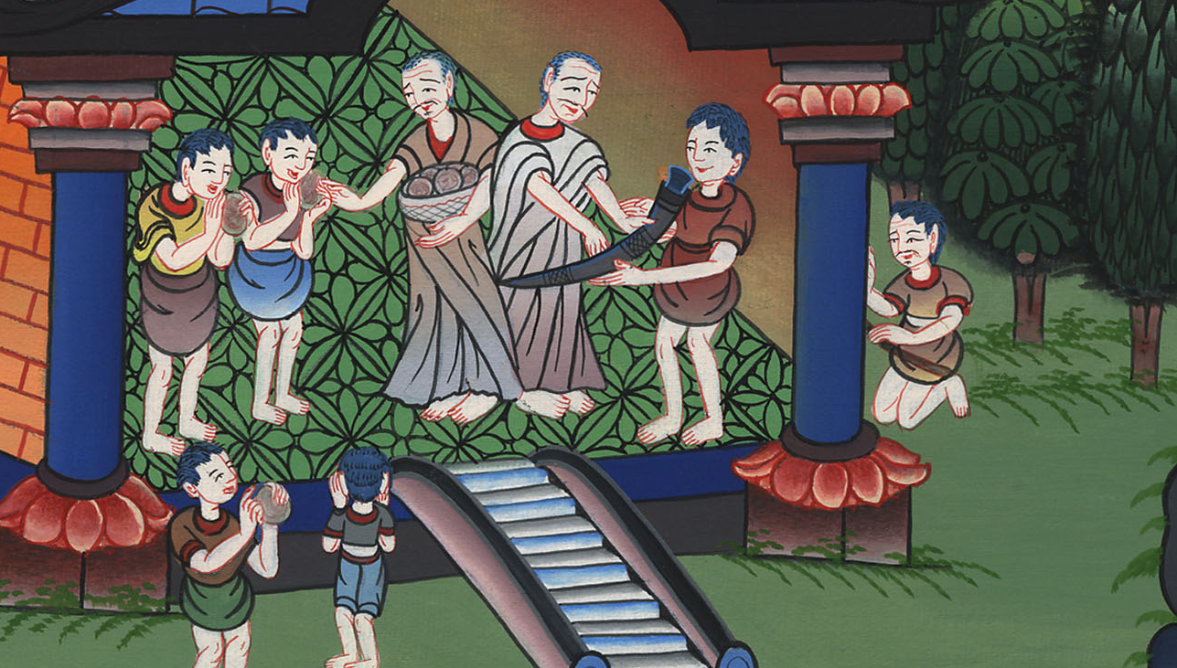
1 Samuel 22:20

