Slide 1
18-2
This work is licensed under a Creative Commons Attribution-Sharealike 4.0 International License.
Please add this statement to all the videos you create.
English Bible quotes are from the World English Bible US, which is in the public domain.
Notes:
18 Saul and David – Part 2
1. David at Nob and Saul’s vengeance - 1 Sam 21 – 22 ( Left Top)
2. The Rock of Escape -1 Sam 23 (Right Top)
3. David spares Saul’s life -1 Sam 24 (Right Center)
4. David spares Saul’s life again -1 Sam 26 (Right Bottom)
5. Saul and the witch of Endor -1 Sam 28:3-25 (Left Bottom)
6. David returns and finds that Ziklag has been raded -1 Sam 29-30 (Left Center)
7. David morns for Saul and Jonathan – 1 Sam 31, 2 Sam 1 (Center)

Slide 2
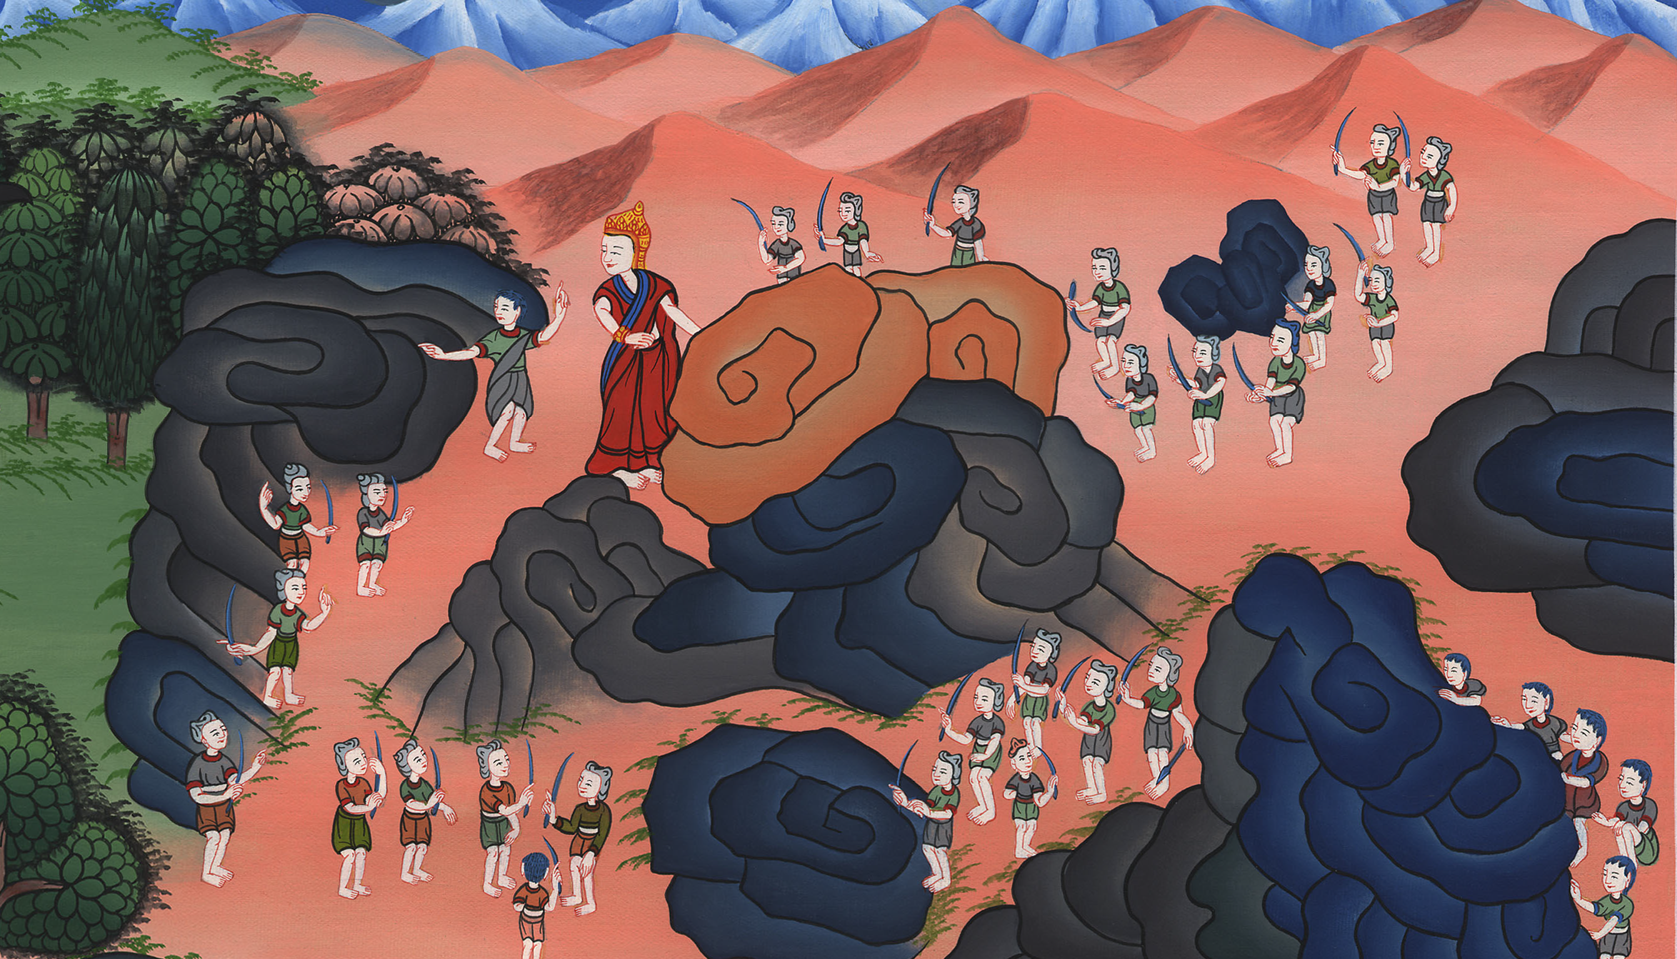
The Rock of Escape –
1 Samuel 23

Slide 3
2. The Rock of Escape -1 Samuel 23 (Right Top)

Slide 4
The Rock of Escape –
1 Samuel 23

Slide 5
David and his 600 men attacked the Philistines while hiding from Saul. They kept moving from place to place.

Slide 6
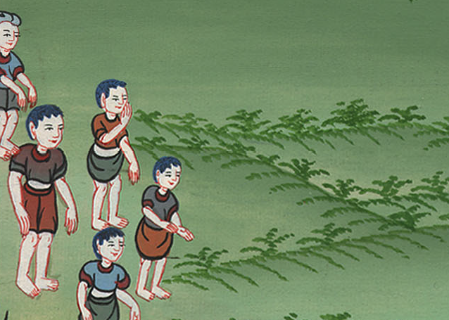

Slide 7
1Samuel23:14David stayed in the wilderness in the strongholds, and remained in the hill country in the wilderness of Ziph. Saul sought him every day, but God didn’t deliver him into his hand.

Slide 8
1 Samuel 23:14

Slide 9
15David saw that Saul had come out to seek his life. David was in the wilderness of Ziph in the woods.

Slide 10
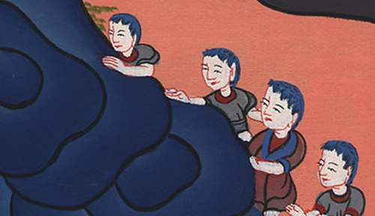
1 Samuel 23:15

Slide 11
16Jonathan, Saul’s son, arose and went to David into the woods, and strengthened his hand in God.

Slide 12
1 Samuel 23:16

Slide 13
17He said to him, “Don’t be afraid, for the hand of Saul my father won’t find you; and you will be king over Israel, and I will be next to you; and Saul my father knows that also.”

Slide 14
1 Samuel 23:17

Slide 15
25Saul and his men went to seek him. When David was told, he went down to the rock, and stayed in the wilderness of Maon. When Saul heard that, he pursued David in the wilderness of Maon.

Slide 16
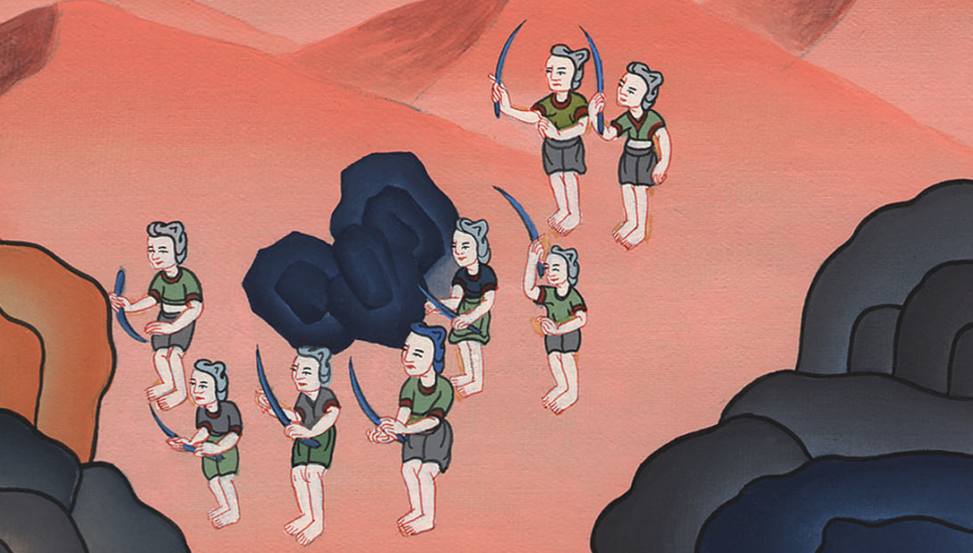
1 Samuel 23:25

Slide 17
26Saul went on this side of the mountain, and David and his men on that side of the mountain; and David hurried to get away for fear of Saul, …

Slide 18
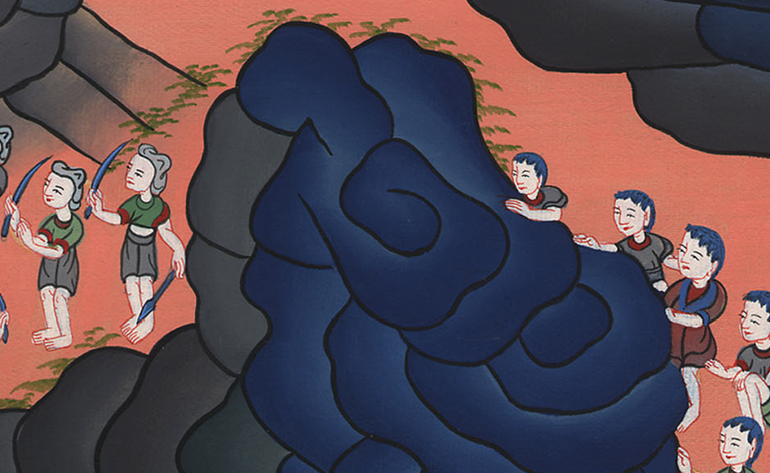
1 Samuel 23:26

Slide 19
Saul and his men surrounded David and his men to take them.

Slide 20
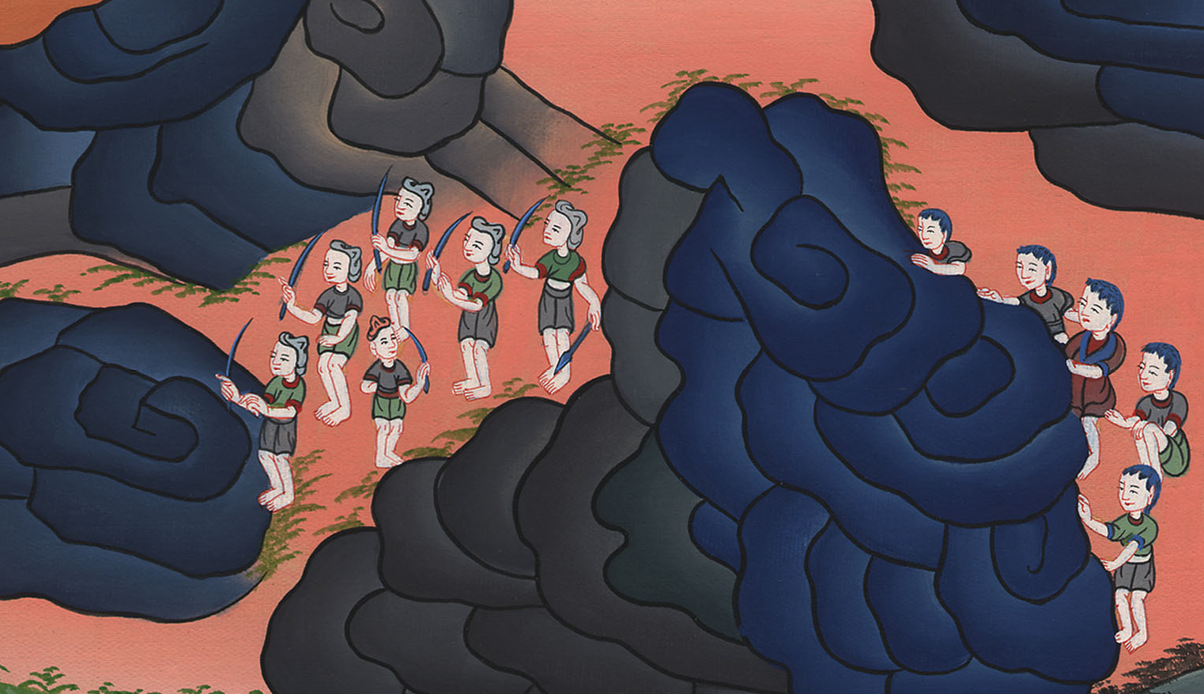
1 Samuel 23:26

Slide 21
27But a messenger came to Saul, saying, “Hurry and come, for the Philistines have made a raid on the land!”

Slide 22
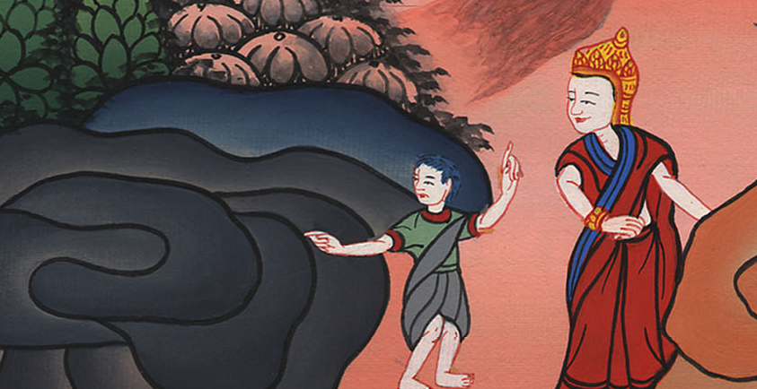
1 Samuel 23:27

Slide 23
28So Saul returned from pursuing David, and went against the Philistines. Therefore they called that place Sela Hammahlekoth.

Slide 24
1 Samuel 23:28

Slide 25
29David went up from there and lived in the strongholds of En Gedi.

Slide 26
1 Samuel 23:29

