Slide 1
18-3
This work is licensed under a Creative Commons Attribution-Sharealike 4.0 International License.
Please add this statement to all the videos you create.
English Bible quotes are from the World English Bible US, which is in the public domain.
Notes:
18 Saul and David – Part 2
1. David at Nob and Saul’s vengeance - 1 Sam 21 – 22 ( Left Top)
2. The Rock of Escape -1 Sam 23 (Right Top)
3. David spares Saul’s life -1 Sam 24 (Right Center)
4. David spares Saul’s life again -1 Sam 26 (Right Bottom)
5. Saul and the witch of Endor -1 Sam 28:3-25 (Left Bottom)
6. David returns and finds that Ziklag has been raded -1 Sam 29-30 (Left Center)
7. David morns for Saul and Jonathan – 1 Sam 31, 2 Sam 1 (Center)

Slide 2
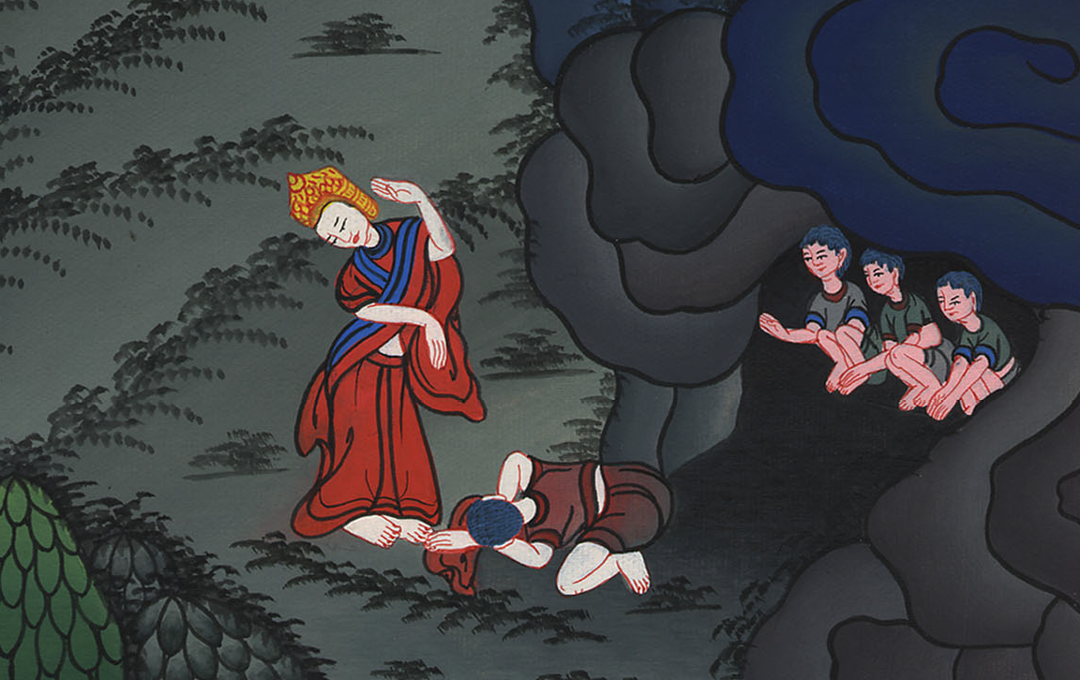
David spares Saul’s life -1 Samuel 24

Slide 3
3. David spares Saul’s life -1 Samuel 24 (Right Center)

Slide 4
David spares Saul’s life –
1 Samuel 24

Slide 5
1Samuel24:1When Saul had returned from following the Philistines, he was told, “Behold, David is in the wilderness of En Gedi.”

Slide 6
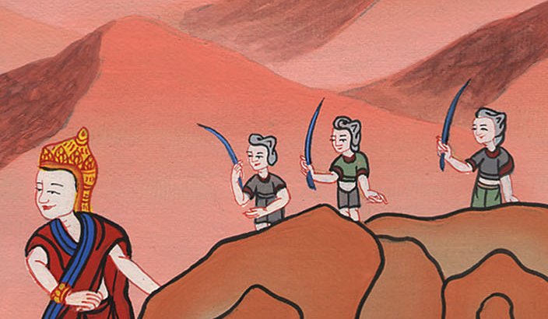
1 Samuel 24:1

Slide 7
2Then Saul took three thousand chosen men out of all Israel, and went to seek David and his men on the rocks of the wild goats.

Slide 8
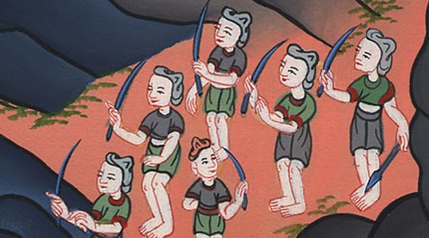
1 Samuel 24:2

Slide 9
3He came to the sheep pens by the way, where there was a cave; and Saul went in to relieve himself. Now David and his men were staying in the innermost parts of the cave.

Slide 10
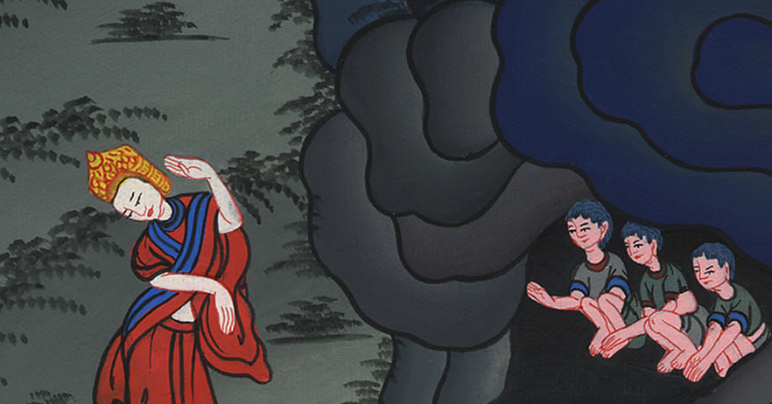
1 Samuel 24:3

Slide 11
4David’s men said to him, “Behold, the day of which Yahweh said to you, ‘Behold, I will deliver your enemy into your hand, and you shall do to him as it shall seem good to you.’”

Slide 12
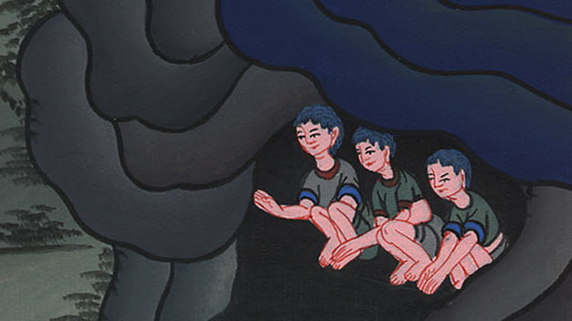
1 Samuel 24:4

Slide 13
…Then David arose and cut off the skirt of Saul’s robe secretly.

Slide 14
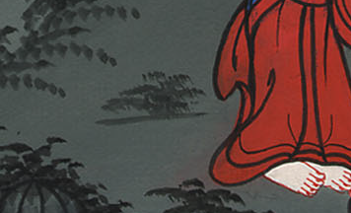
1 Samuel 24:4

Slide 15
5Afterward, David’s heart struck him because he had cut off Saul’s skirt. 6He said to his men, “Yahweh forbid that I should do this thing to my lord, Yahweh’s anointed, to stretch out my hand against him, since he is Yahweh’s anointed.”

Slide 16
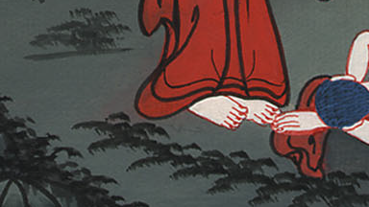
1 Samuel 24:5,6

Slide 17
7So David checked his men with these words, and didn’t allow them to rise against Saul. Saul rose up out of the cave, and went on his way.

Slide 18
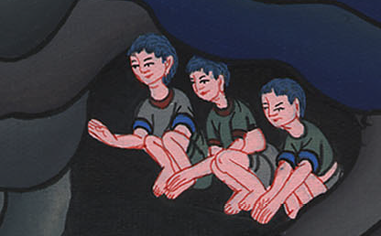
1 Samuel 24:7

Slide 19
8David also arose afterward, and went out of the cave and cried after Saul, saying, “My lord the king!”
When Saul looked behind him, David bowed with his face to the earth, and showed respect.

Slide 20
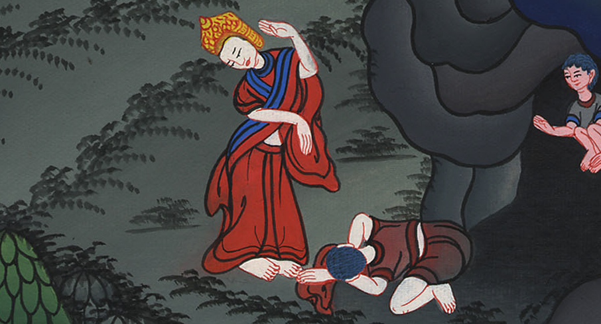
1 Samuel 24:8

Slide 21
9David said to Saul, “Why do you listen to men’s words, saying, ‘Behold, David seeks to harm you?’

Slide 22
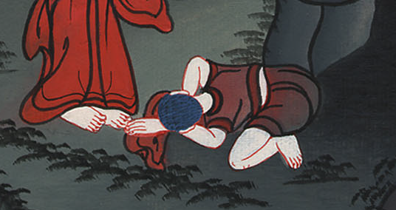
1 Samuel 24:9

Slide 23
10Behold, today your eyes have seen how Yahweh had delivered you today into my hand in the cave. Some urged me to kill you, but I spared you. I said, ‘I will not stretch out my hand against my lord, for he is Yahweh’s anointed.’

Slide 24
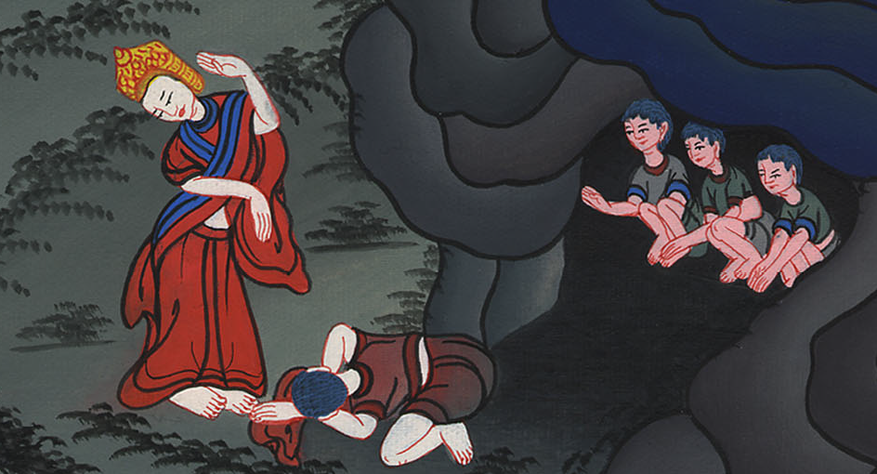
1 Samuel 24:10

Slide 25
11Moreover, my father, behold, yes, see the skirt of your robe in my hand; for in that I cut off the skirt of your robe and didn’t kill you, know and see that there is neither evil nor disobedience in my hand. I have not sinned against you, though you hunt for my life to take it.

Slide 26
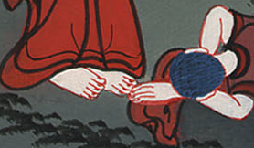
1 Samuel 24:11

Slide 27
12May Yahweh judge between me and you, and may Yahweh avenge me of you; but my hand will not be on you.

Slide 28
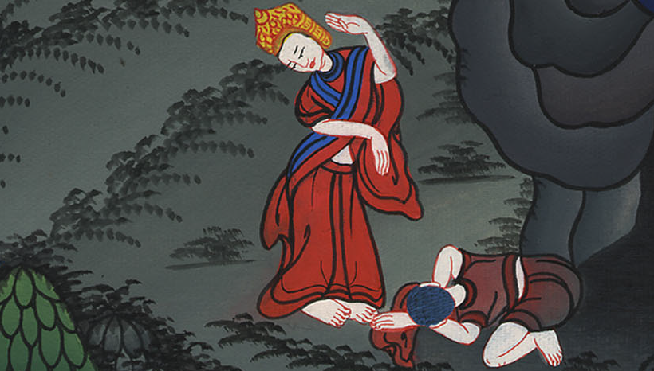
1 Samuel 24:12

Slide 29
13As the proverb of the ancients says, ‘Out of the wicked comes wickedness;’ but my hand will not be on you.

Slide 30
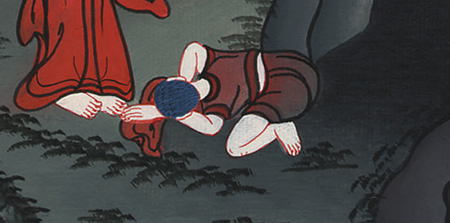
1 Samuel 24:13

Slide 31
16It came to pass, when David had finished speaking these words to Saul, that Saul said, “Is that your voice, my son David?” Saul lifted up his voice and wept.

Slide 32
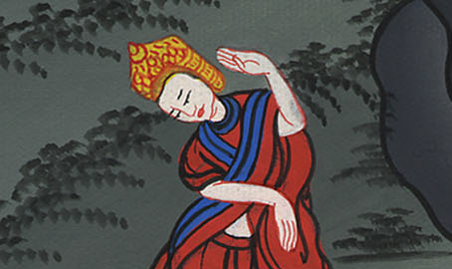
1 Samuel 24:16

Slide 33
17He said to David, “You are more righteous than I; for you have done good to me, whereas I have done evil to you.

Slide 34
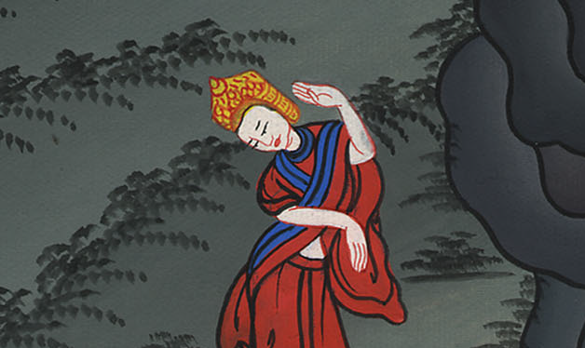
1 Samuel 24:17

Slide 35
20Now, behold, I know that you will surely be king, and that the kingdom of Israel will be established in your hand.

Slide 36
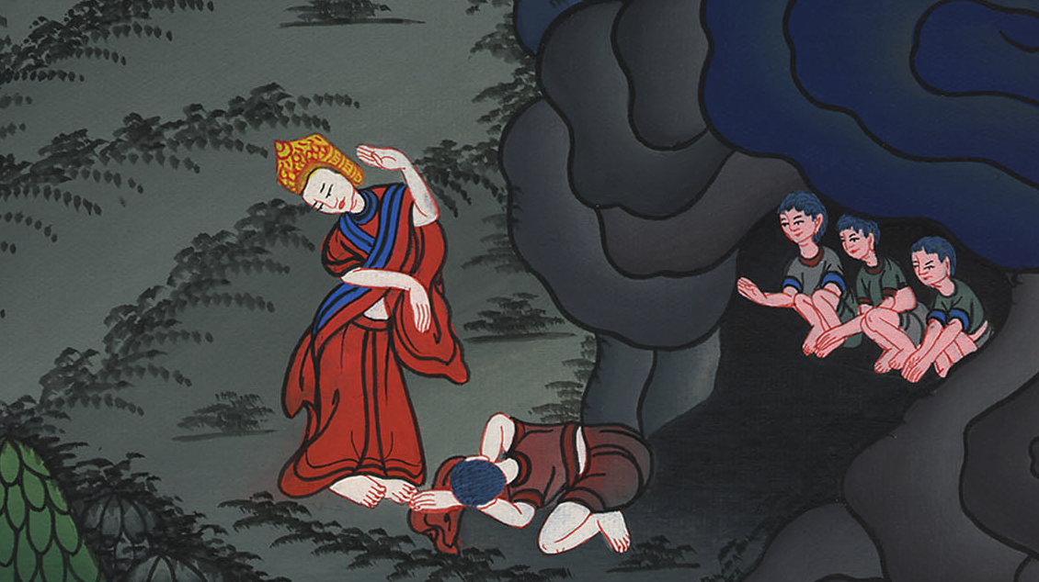
1 Samuel 24:20

