Slide 1
18-4
This work is licensed under a Creative Commons Attribution-Sharealike 4.0 International License.
Please add this statement to all the videos you create.
English Bible quotes are from the World English Bible US, which is in the public domain.
Notes:
Ch
18 Saul and David – Part 2
1. David at Nob and Saul’s vengeance - 1 Sam 21 – 22 ( Left Top)
2. The Rock of Escape -1 Sam 23 (Right Top)
3. David spares Saul’s life -1 Sam 24 (Right Center)
4. David spares Saul’s life again -1 Sam 26 (Right Bottom)
5. Saul and the witch of Endor -1 Sam 28:3-25 (Left Bottom)
6. David returns and finds that Ziklag has been raded -1 Sam 29-30 (Left Center)
7. David morns for Saul and Jonathan – 1 Sam 31, 2 Sam 1 (Center)

Slide 2
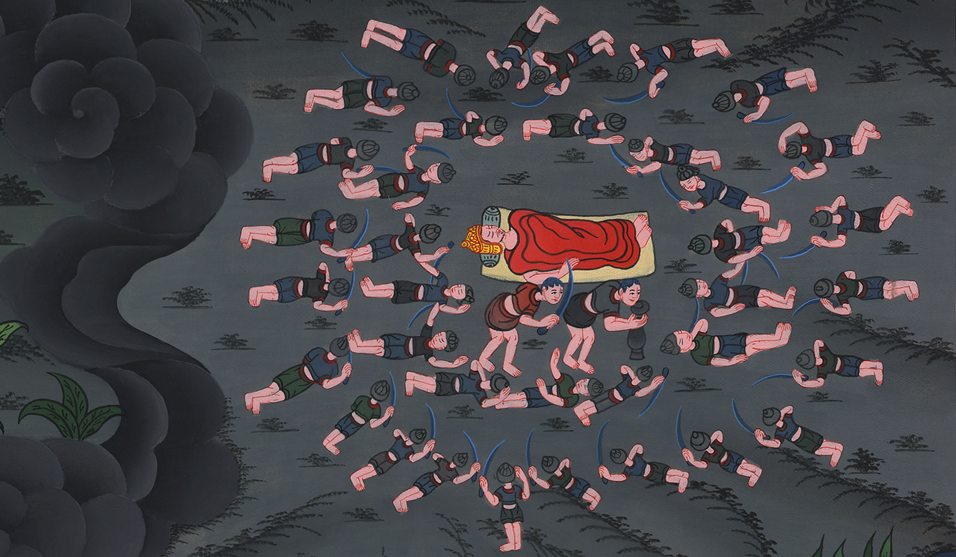
David spares Saul’s life again –
1 Samuel 26

Slide 3
David spares Saul’s life again -1 Samuel 26

Slide 4
David spares Saul’s life again –
1 Samuel 26

Slide 5
(Even though David had spared Saul’s life, Saul still wanted to kill him). 1Samuel26:1The Ziphites came to Saul to Gibeah, saying, “Doesn’t David hide himself in the hill of Hachilah, which is before the desert?”

Slide 6
1 Samuel 26:1

Slide 7
2Then Saul arose and went down to the wilderness of Ziph, having three thousand chosen men of Israel with him, to seek David in the wilderness of Ziph.

Slide 8
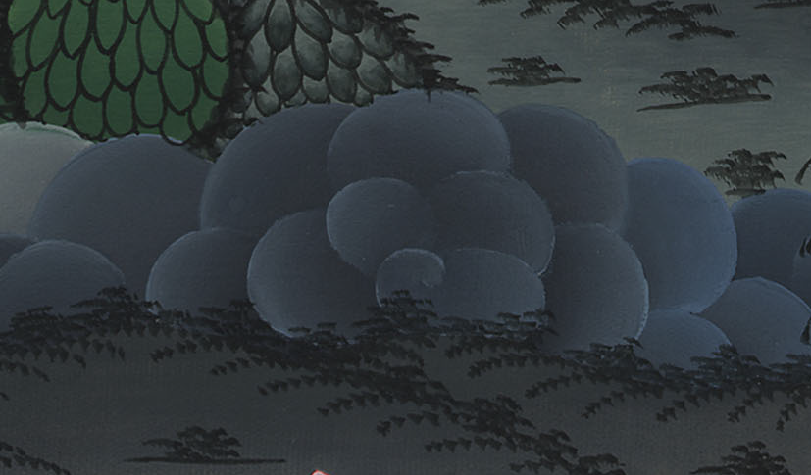
1 Samuel 26:2

Slide 9
3Saul encamped in the hill of Hachilah, which is before the desert, by the way. But David stayed in the wilderness, and he saw that Saul came after him into the wilderness.

Slide 10
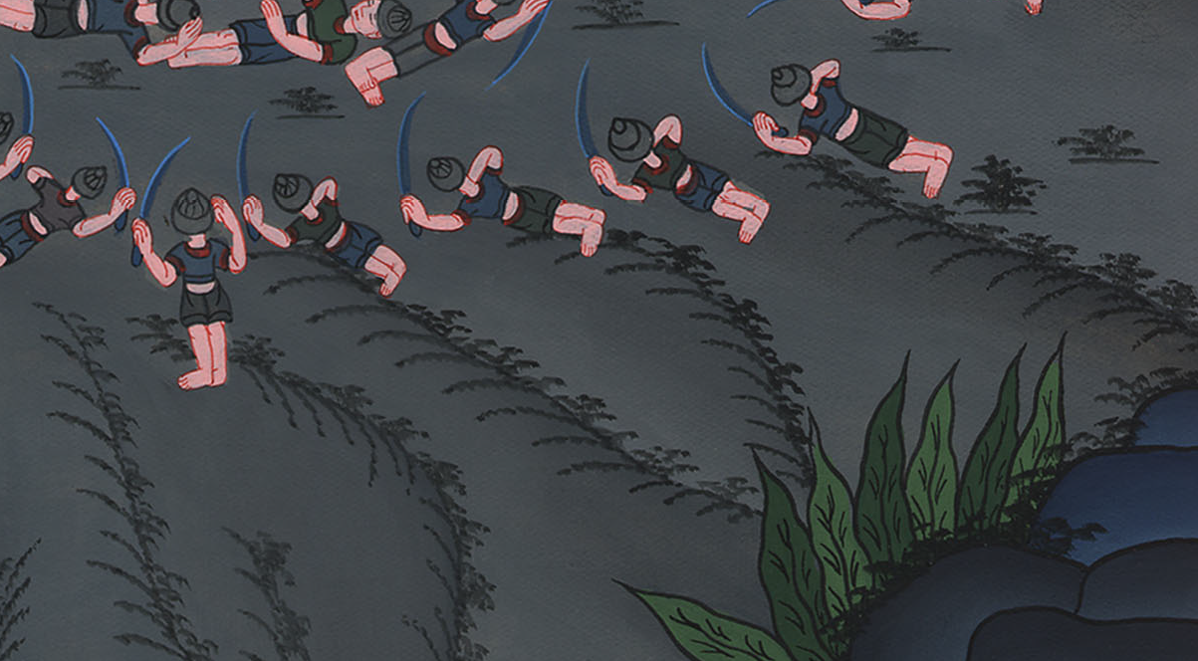
1 Samuel 26:3

Slide 11
5Then David arose and came to the place where Saul had encamped; and David saw the place where Saul lay, with Abner the son of Ner, the captain of his army. Saul lay within the place of the wagons, and the people were encamped around him.

Slide 12
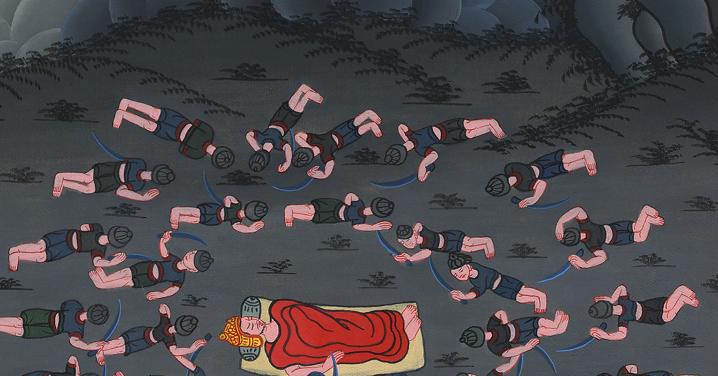
1 Samuel 26:5

Slide 13
7So David and Abishai came to the people by night: and, behold, Saul lay sleeping within the place of the wagons, with his spear stuck in the ground at his head; and Abner and the people lay around him.

Slide 14
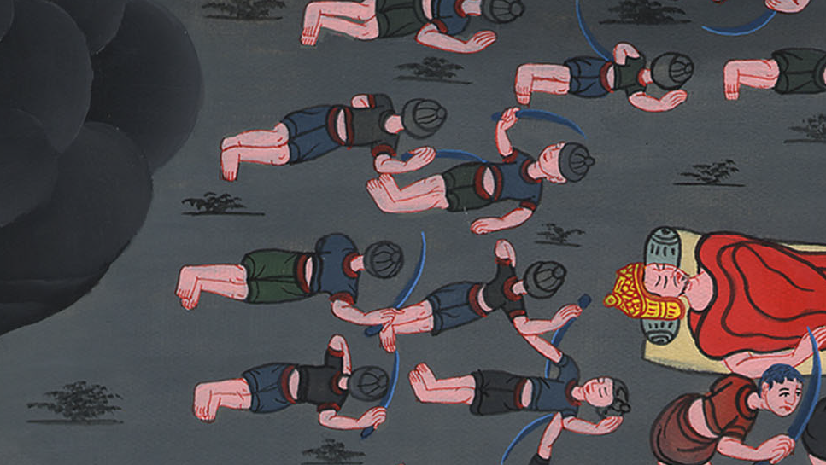
1 Samuel 26:7

Slide 15
8Then Abishai said to David, “God has delivered up your enemy into your hand today. Now therefore please let me strike him with the spear to the earth at one stroke, and I will not strike him the second time.”

Slide 16
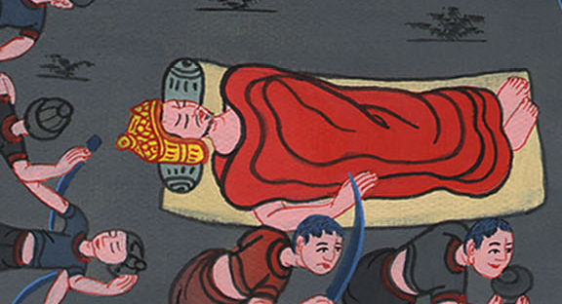
1 Samuel 26:8

Slide 17
9David said to Abishai, “Don’t destroy him, for who can stretch out his hand against Yahweh’s anointed, and be guiltless?”

Slide 18
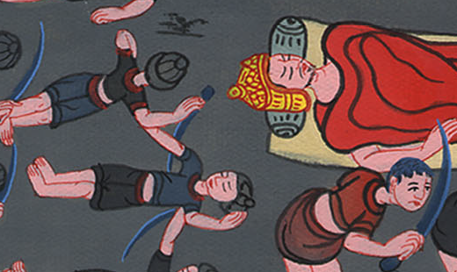
1 Samuel 26:9

Slide 19
11Yahweh forbid that I should stretch out my hand against Yahweh’s anointed; but now please take the spear that is at his head and the jar of water, and let’s go.”

Slide 20
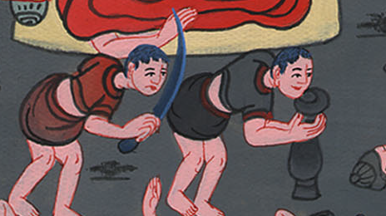
1 Samuel 26:11

Slide 21
12So David took the spear and the jar of water from Saul’s head, and they went away. No man saw it, or knew it, nor did any awake; for they were all asleep, because a deep sleep from Yahweh had fallen on them.

Slide 22
1 Samuel 26:12

Slide 23
So David again spared Saul’s life

Slide 24
So David spared Sauls life again

