Slide 1
18-5
This work is licensed under a Creative Commons Attribution-Sharealike 4.0 International License.
Please add this statement to all the videos you create.
English Bible quotes are from the World English Bible US, which is in the public domain.
Notes:
cH
18 Saul and David – Part 2
1. David at Nob and Saul’s vengeance - 1 Sam 21 – 22 ( Left Top)
2. The Rock of Escape -1 Sam 23 (Right Top)
3. David spares Saul’s life -1 Sam 24 (Right Center)
4. David spares Saul’s life again -1 Sam 26 (Right Bottom)
5. Saul and the witch of Endor -1 Sam 28:3-25 (Left Bottom)
6. David returns and finds that Ziklag has been raded -1 Sam 29-30 (Left Center)
7. David morns for Saul and Jonathan – 1 Sam 31, 2 Sam 1 (Center)

Slide 2
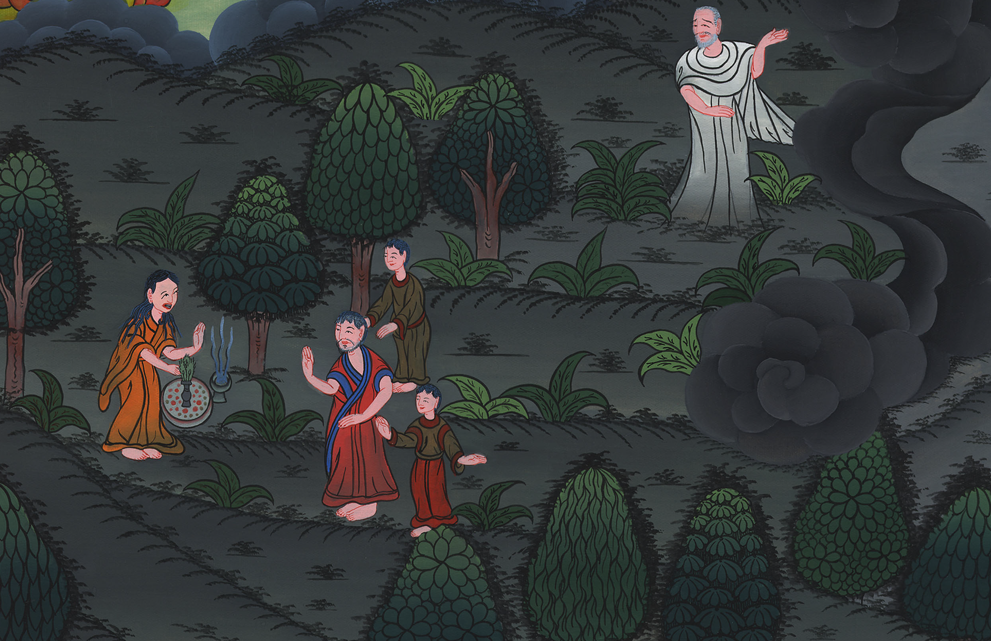
Saul and the witch of Endor –
1 Samuel 28:3

Slide 3
Saul and the witch of Endor -1 Samuel 28:3 -25

Slide 4
Saul and the witch of Endor –
1 Samuel 28:3

Slide 5
1Samuel28:3Now Samuel was dead, and all Israel had mourned for him and buried him in Ramah, even in his own city. Saul had sent away those who had familiar spirits and the wizards out of the land.

Slide 6
1 Samuel 28:3

Slide 7
4The Philistines gathered themselves together, and came and encamped in Shunem; and Saul gathered all Israel together, and they encamped in Gilboa.

Slide 8
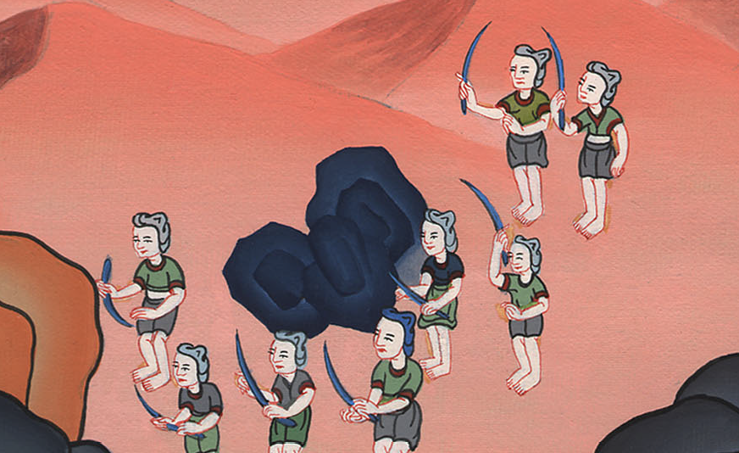
1 Samuel 28:4

Slide 9
5When Saul saw the army of the Philistines, he was afraid, and his heart trembled greatly.

Slide 10
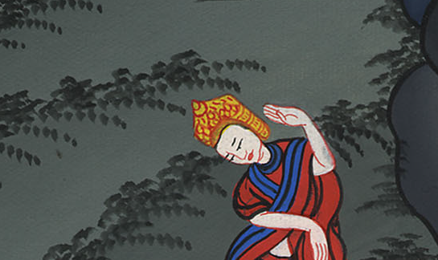
1 Samuel 28:5

Slide 11
6When Saul inquired of Yahweh, Yahweh didn’t answer him by dreams, by Urim, or by prophets.

Slide 12
1 Samuel 28:6

Slide 13
7Then Saul said to his servants, “Seek for me a woman who has a familiar spirit, that I may go to her and inquire of her.”
His servants said to him, “Behold, there is a woman who has a familiar spirit at Endor.”

Slide 14
1 Samuel 28:7

Slide 15
8Saul disguised himself and put on other clothing, and went, he and two men with him, and they came to the woman by night. Then he said, “Please consult for me by the familiar spirit, and bring me up whomever I shall name to you.”

Slide 16
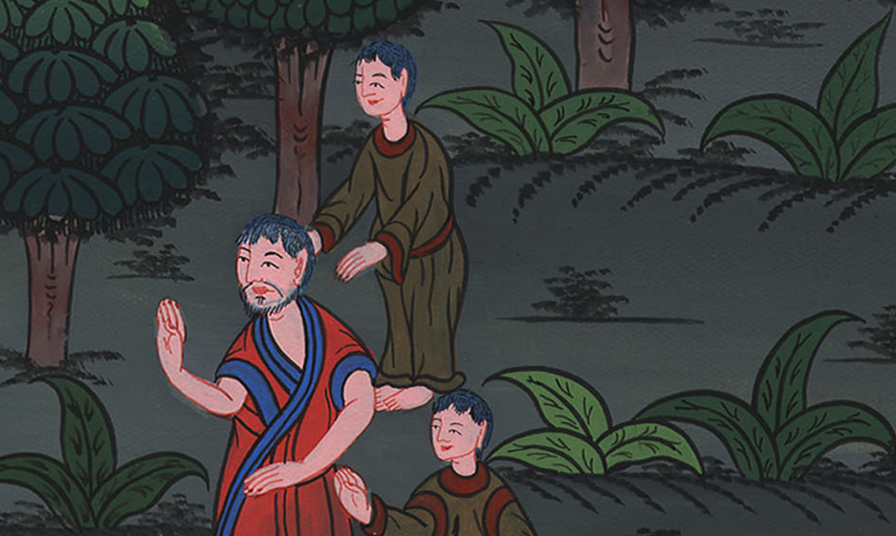
1 Samuel 28:8

Slide 17
11Then the woman said, “Whom shall I bring up to you?”
He said, “Bring Samuel up for me.”

Slide 18
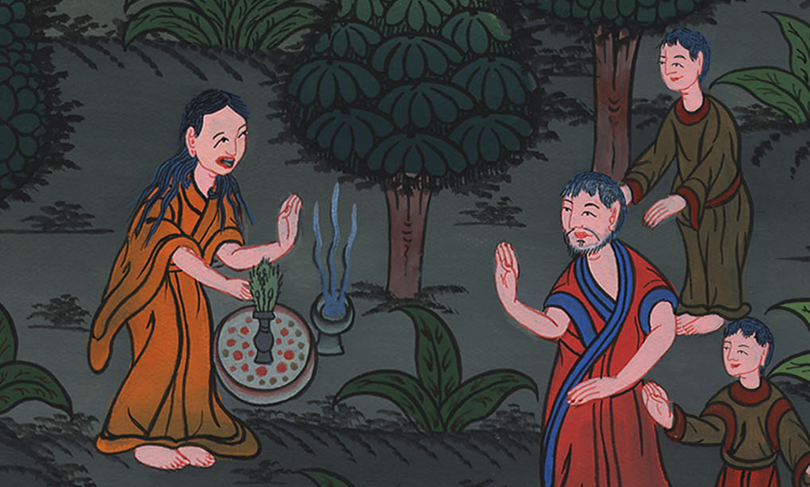
1 Samuel 28:11

Slide 19
12When the woman saw Samuel, she cried with a loud voice; and the woman spoke to Saul, saying, “Why have you deceived me? For you are Saul!”

Slide 20
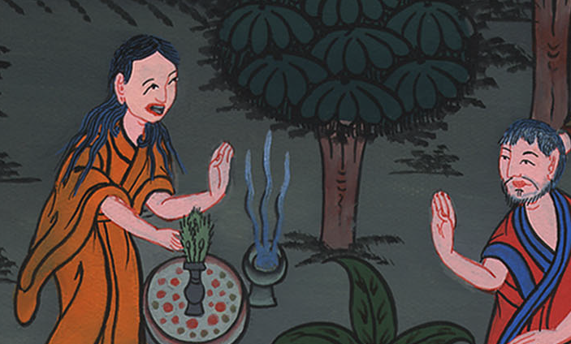
1 Samuel 28:12

Slide 21
13The king said to her, “Don’t be afraid! What do you see?”
The woman said to Saul, “I see a god coming up out of the earth.”

Slide 22
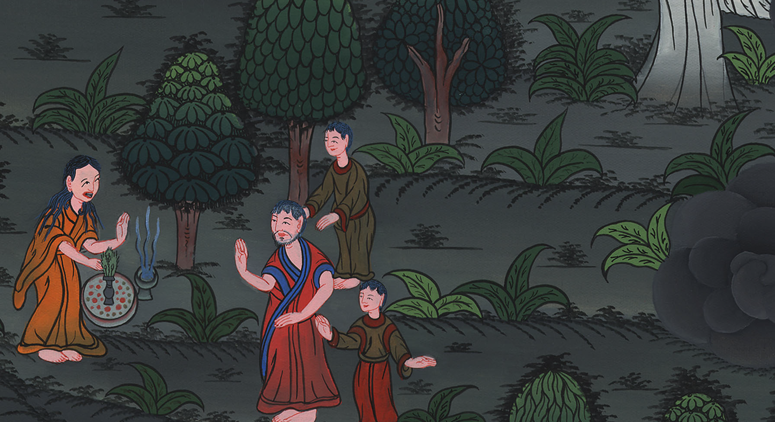
1 Samuel 28:13

Slide 23
14He said to her, “What does he look like?”
She said, “An old man comes up. He is covered with a robe.” Saul perceived that it was Samuel, and he bowed with his face to the ground, and showed respect.

Slide 24
1 Samuel 28:14

Slide 25
15Samuel said to Saul, “Why have you disturbed me, to bring me up?”

Slide 26
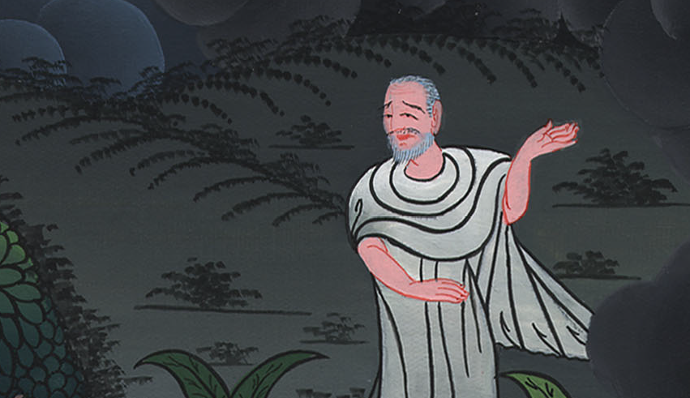
1 Samuel 28:15

Slide 27
Saul answered, “I am very distressed; for the Philistines make war against me, and God has departed from me, and answers me no more, by prophets, or by dreams. Therefore I have called you, that you may make known to me what I shall do.”

Slide 28
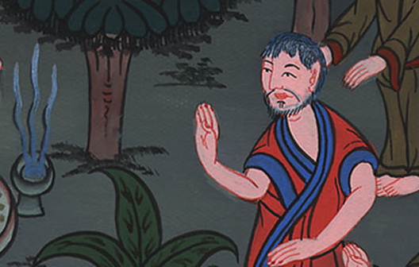
1 Samuel 28:15

Slide 29
16Samuel said, “Why then do you ask me, since Yahweh has departed from you and has become your adversary?

Slide 30
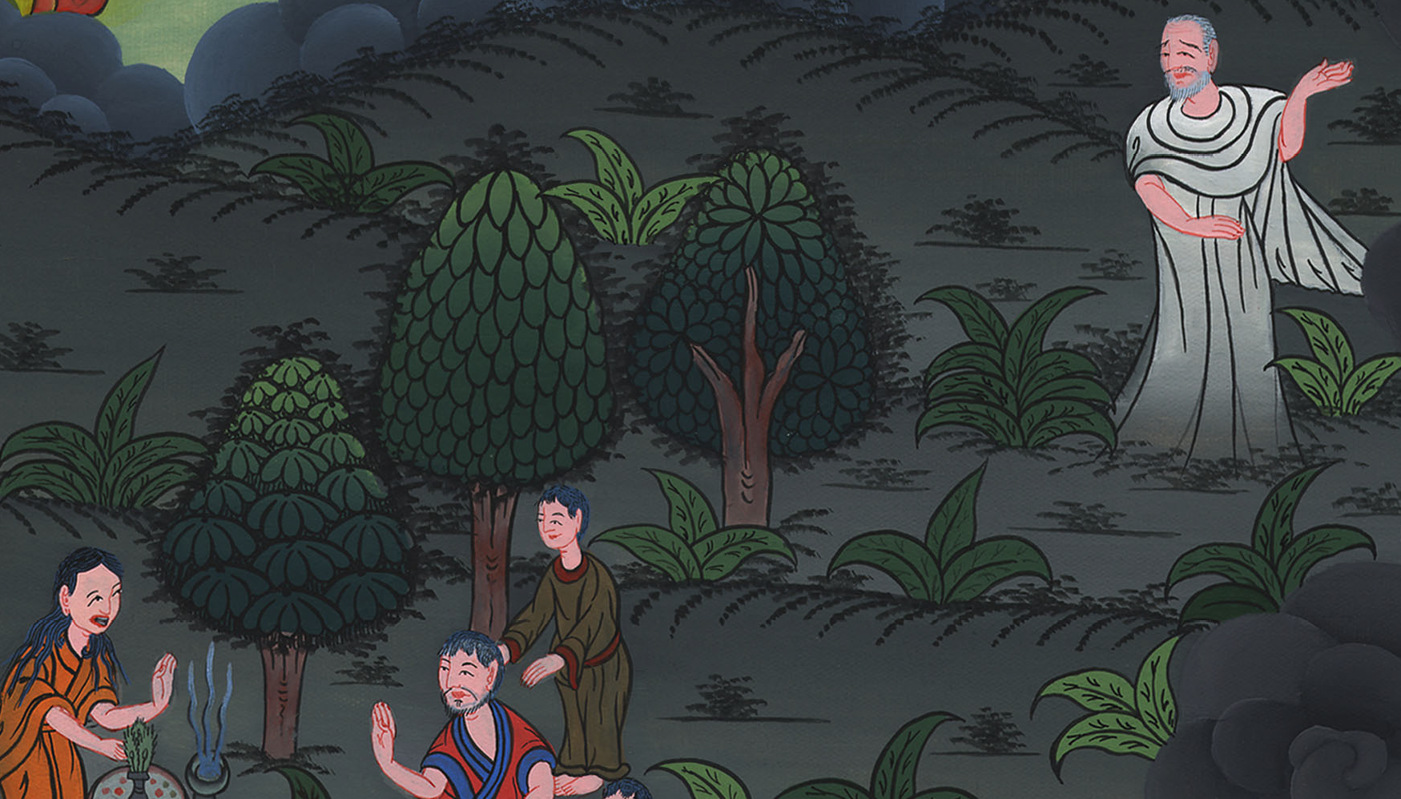
1 Samuel 28:16

Slide 31
17Yahweh has done to you as he spoke by me. Yahweh has torn the kingdom out of your hand and given it to your neighbor, even to David.

Slide 32
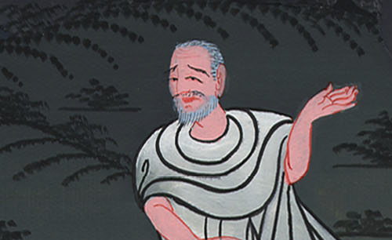
1 Samuel 28:17

Slide 33
18Because you didn’t obey Yahweh’s voice, and didn’t execute his fierce wrath on Amalek, therefore Yahweh has done this thing to you today.

Slide 34
1 Samuel 28:18

Slide 35
19Moreover Yahweh will deliver Israel also with you into the hand of the Philistines; and tomorrow you and your sons will be with me. Yahweh will deliver the army of Israel also into the hand of the Philistines.”

Slide 36
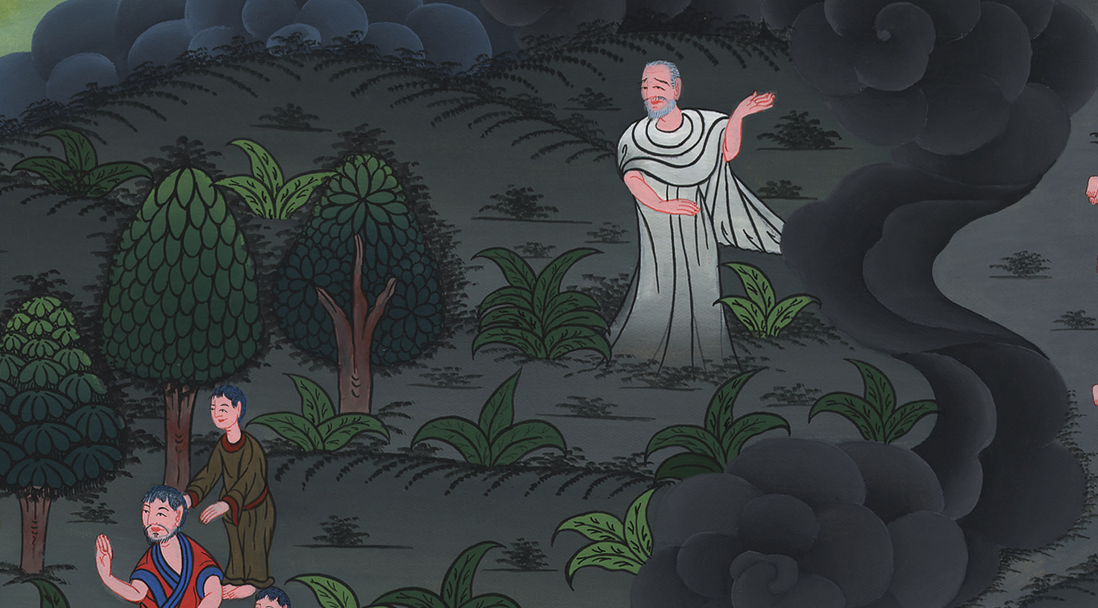
1 Samuel 28:19

