Slide 1
18-6
This work is licensed under a Creative Commons Attribution-Sharealike 4.0 International License.
Please add this statement to all the videos you create.
English Bible quotes are from the World English Bible US, which is in the public domain.
Notes:
Ch
18 Saul and David – Part 2
1. David at Nob and Saul’s vengeance - 1 Sam 21 – 22 ( Left Top)
2. The Rock of Escape -1 Sam 23 (Right Top)
3. David spares Saul’s life -1 Sam 24 (Right Center)
4. David spares Saul’s life again -1 Sam 26 (Right Bottom)
5. Saul and the witch of Endor -1 Sam 28:3-25 (Left Bottom)
6. David returns and finds that Ziklag has been raded -1 Sam 29-30 (Left Center)
7. David morns for Saul and Jonathan – 1 Sam 31, 2 Sam 1 (Center)

Slide 2
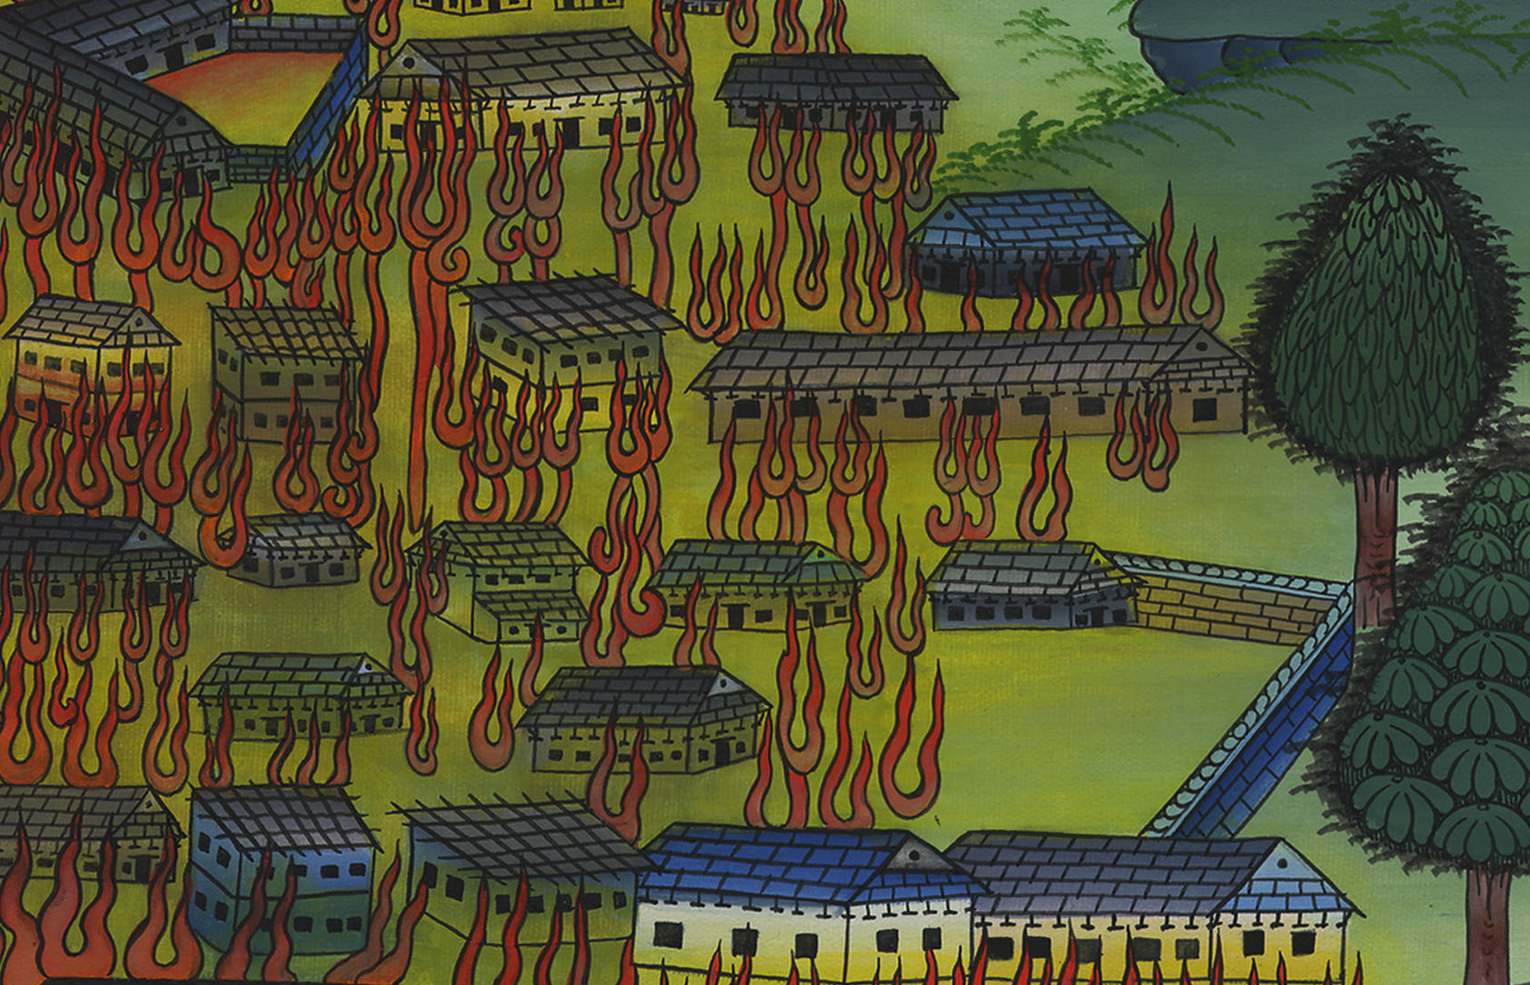
David returns and finds that Ziklag has been raided –
1 Samuel 30

Slide 3
6. David returns and finds that Ziklag has been raided -1 Samuel 30 (Left Center)

Slide 4
David returns and finds that Ziklag has been raided –
1 Samuel 30

Slide 5
1 Samuel30:1When David and his men had come to Ziklag (David’s home) on the third day, the Amalekites had made a raid on the South and on Ziklag, and had struck Ziklag and burned it with fire,

Slide 6
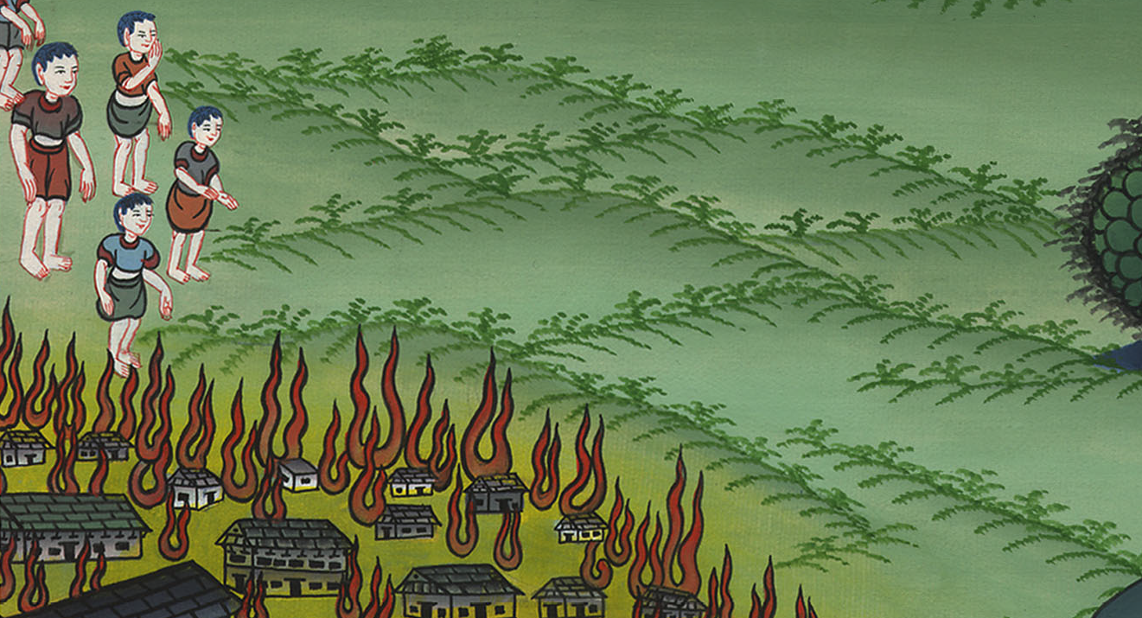
1 Samuel 30:1

Slide 7
2and had taken captive the women and all who were in it, both small and great. They didn’t kill any, but carried them off and went their way.

Slide 8
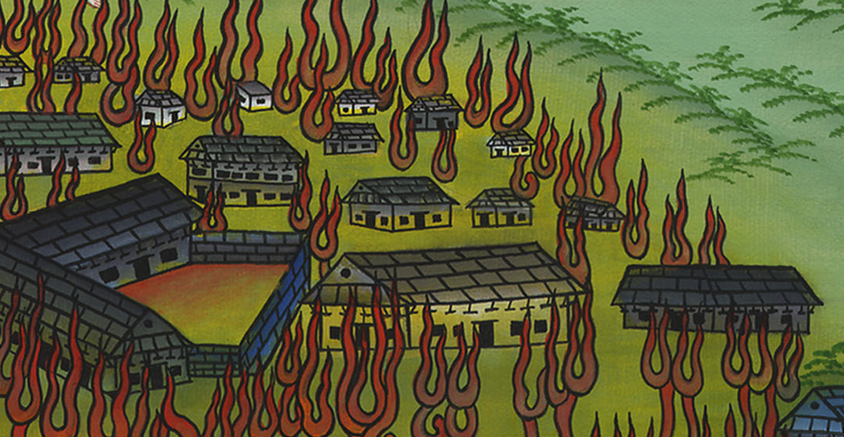
1 Samuel 30:2

Slide 9
3When David and his men came to the city, behold, it was burned with fire; and their wives, their sons, and their daughters were taken captive.

Slide 10
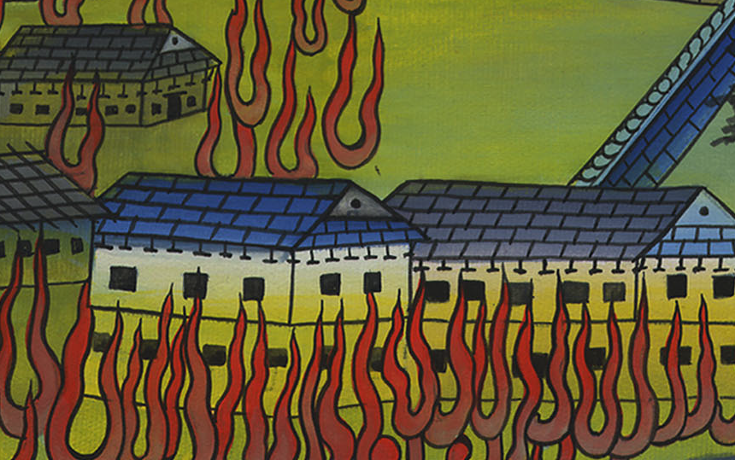
1 Samuel 30:3

Slide 11
4Then David and the people who were with him lifted up their voice and wept until they had no more power to weep. 5David’s two wives were taken captive, Ahinoam the Jezreelitess, and Abigail the wife of Nabal the Carmelite.

Slide 12
1 Samuel 30:4,5

Slide 13
6David was greatly distressed, for the people spoke of stoning him, because the souls of all the people were grieved, every man for his sons and for his daughters; but David strengthened himself in Yahweh his God.

Slide 14
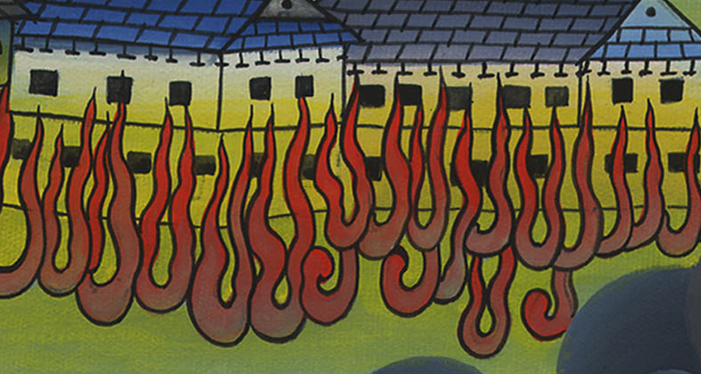
1 Samuel 30:6

Slide 15
8David inquired of Yahweh, saying, “If I pursue after this troop, will I overtake them?”
He answered him, “Pursue, for you will surely overtake them, and will without fail recover all.”

Slide 16
1 Samuel 30:8

Slide 17
(They met a man who led them to where the Amalekites were.) 16When he had brought him down, behold, they were spread around over all the ground, eating, drinking, and dancing, because of all the great plunder that they had taken out of the land of the Philistines, and out of the land of Judah.

Slide 18
1 Samuel 30:16

Slide 19
18David recovered all that the Amalekites had taken, and David rescued his two wives.

Slide 20
1 Samuel 30:18

Slide 21
19There was nothing lacking to them, neither small nor great, neither sons nor daughters, neither plunder, nor anything that they had taken. David brought them all back.

Slide 22
1 Samuel 30:19

